Slide 1
Consortium for Global Health, Biodiversity, and Therapeutics Innovation:
A South-to-South and South-to-North Collaboration
San Jose, Costa Rica
Verónica Vargas Ph.D.
August 20, 2024

Slide 2
Percentage of drugs naturally derived and inspired:
From all newly FDA-approved drugs 1981-2019
All drugs ~ 2000
Cancer drugs ~ 206
Newman and Cragg, 2020
Notes:
Natural products have long demonstrated their therapeutic value. Here, we have two graphs, the first one being all drugs approved by the FDA over the past four decades; approximately 50% of drugs are synthetic or semi-synthetic inspired by nature (dark blue) or are natural —both from marine and terrestrial sources. For cancer drugs, it is even higher; about half are naturally inspired, and 14 are natural. So despite progress in drug synthesis methods, the complexity of many NPs, continues to make them challenging to replicate, leading to their continued use in natural forms (light blue).

Slide 3
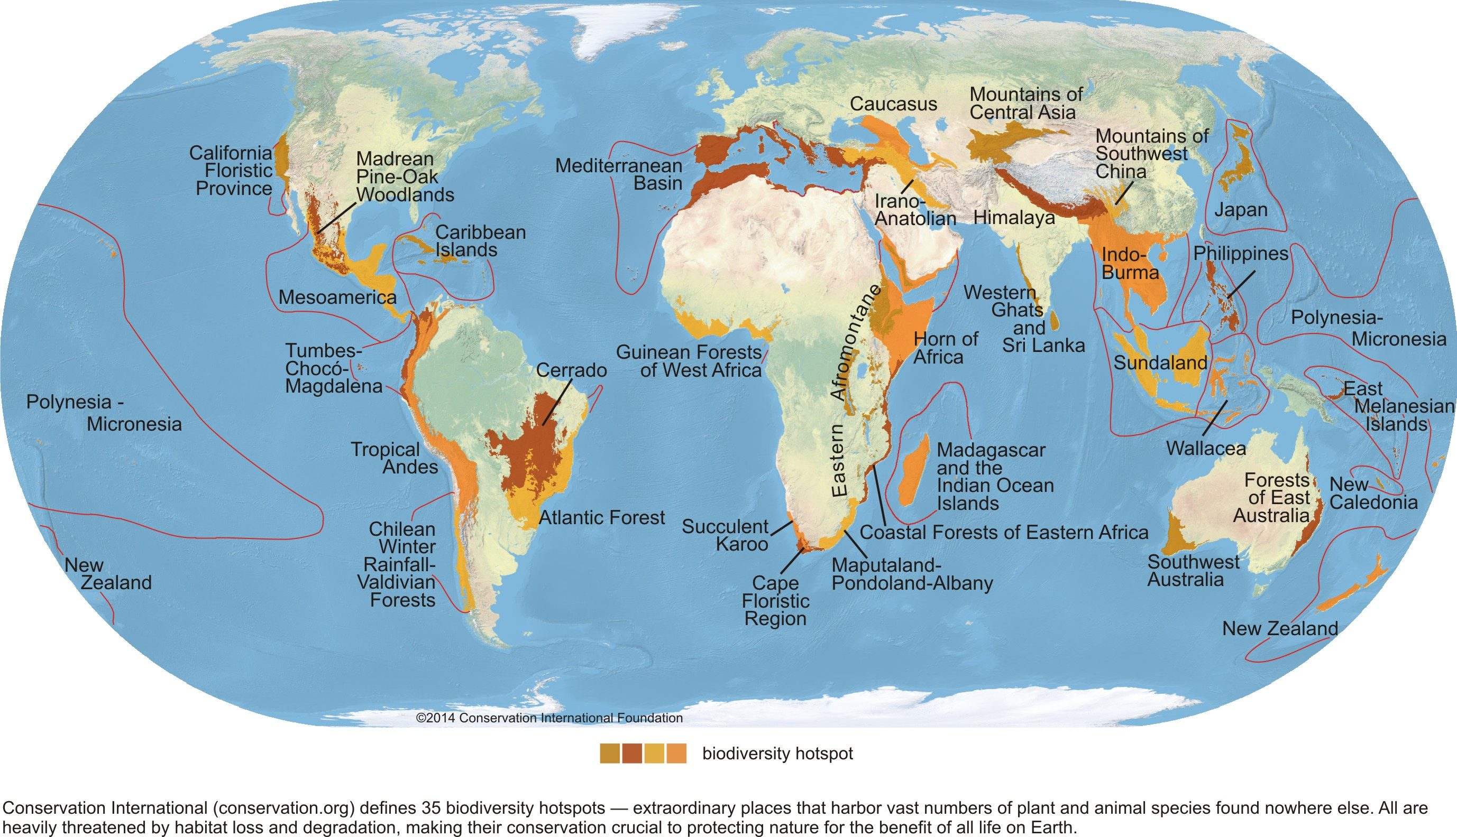
Global Biodiversity Hotspots
Notes:
Latin America is one of the most biodiverse regions in the world, including plants, fungi, and animals. According to the United Nations Environment Program, around sixty percent of global terrestrial life, including water and marine species, can be found in Latin America and the Caribbean.
Central and South America hold around seven biodiverse hotspots—at least 1500 species per 10,000 km²— species not found elsewhere on Earth and in danger. These are the Chocó-Costa Rica region, the tropical Andes, and the Chilean Valdivian Forest.
There are approximately 350,000 known species of plants worldwide, and many of these remain unexplored chemically. The same is true for fungi, of which 2.2 million and 3.8 million estimated, 90% remain unknown, holding potential for future discoveries.

Slide 4
Biodiversity and global health
Plant and fungal-derived drugs are essential for global health, i.e., WHO essential medicine list
Traditional and complementary botanical medicines are often the primary or complementary for health care
More research on the safety and effectiveness of botanicals
Compiling the evidence is challenging
Biodiversity still holds the key to addressing global health challenges, i.e., infectious diseases, cancers, Alzheimer’s disease, and antibiotic resistance
It has the potential to develop new treatments and improve traditional medicine.
Notes:
Plant and fungal-derived drugs are essential for global health. For example, the WHO’s List of Essential Medicines includes drugs inspired by nature, such as penicillin, artemether for malaria, and vincristine for cancer. Some of these drugs are rooted in traditional Chinese, Ayurvedic, and indigenous knowledge—for example, quinine from the Peruvian cinchona tree and Cat’s Claw from the Amazon rainforest.
About 80% of the global population uses herbs in their health care. WHO advocates for more research into their safety and effectiveness. Our challenge is systematically compiling hundreds of papers from journals and university dissertations using strong methods.
Biodiversity's potential for addressing global health challenges is immense when combined with new technological advancements such as DNA sequencing, molecular techniques, and AI.

Slide 5
Natural non-synthetic medicines in R&D in LAC (as of April 2023)
Source: Vargas and Darrow, 2023
Notes:
Over 26 R&D projects, with about half in the preclinical phase and only around five already in the market involving products from Brazil and Cuba. Brazil’s lead is attributed to its size, vast biodiversity, and substantial investment in research and development. Costa Rica, Colombia, and Chile follow

Slide 6

Our Consortium: Pilot for testing extracts of plants, algae, and fungi for antiviral activity against COVID-19
  Rega Institute at Leuven University, Belgium
  Salk Institute for Biological Studies, University of California.
  Universidad Nacional de la Patagonia San Juan Bosco, Argentina
  INDICASAT, Panama
Notes:
Our project was born during the pandemic. With the support of the Radcliffe Institute from Harvard, we hosted two virtual seminars and in 2022, we launched a pilot project with the sponsorship of the Harvard Herbaria with Prof Don Pfister, searching for antivirals against COVID-19 in collaboration with the Rega Institute at the University of Leuven in Belgium, the Salk Institute, the Argentinian Minister of Science, the National Patagonian University-San Juan Bosco in Argentina, and INDICASAT in Panama.
Our partners from California and Argentina prepared 200 extracts from plants, algae, and fungi, which were tested for antiviral activity against COVID-19. We got four hits, marking an Aha moment of our project.

Slide 7
Objectives of the Consortium:
R&D of new drugs and natural products from the Americas’ unique biodiversity
Basic research of plant-based medicine for natural product development
Applied research of natural product-based drug discovery for neglected diseases, Alzheimer’s, cancer, and COVID-19
Upgrade in traditional medicine, botanicals, and nutraceutical
Notes:
We engage in scientific diplomacy, supporting collaboration among scientists, scholars, laboratories, policymakers, practitioners, and entrepreneurs. Our goal is to translate scientific discoveries into therapeutics that reach people promptly and equitably.
We support R&D in three interconnected areas: basic research, applied research targeting specific diseases, and upgrades in traditional medicine. Today, Prof. Ryan Nett from Harvard University
This morning, we will have several presentations on applied R&D targeting specific diseases, such as neglected tropical diseases, cancer, and dementia. Other presentations will touch on research-accelerating tools such as a large bank of extracts, improving ID through sequencing, and using computational tools.
Latin American and Caribbean universities are leading the way in researching natural products for medicinal properties. Their work involves R&D on native medicinal plants, psychedelics, and local marine organisms. After lunch, we have several presentations from LAC researchers.
In the past, we collaborated with the Rega Institute from the University of Leuven in Belgium on COVID-19. Soon, we plan to collaborate with the Fundacion Medina and the US National Cancer Institute.

Slide 8
Developing Natural Medicinal Products with Conservation in Mind
Overharvesting wild trees, plants, and fungi for medicinal use can lead to species decline and even extinction, especially in biodiverse hotspots.
In vitro cultivation for industrial production: To promote sustainability in vitro growing techniques for the industrial production and commercialization of natural drugs, e.g., Botanical Solutions.
Education and infrastructure building: The public sector can contribute by building infrastructure like herbaria, supporting sustainable medicinal gardens, and data systems for identifying and naming plant species.
Notes:
Overharvesting wild trees, plants, and fungi for medicinal purposes can lead to species decline and even extinction, particularly in fragile biodiverse hotspots. One example is paclitaxel, a drug widely used for breast cancer treatment. It was initially derived from the bark of the Pacific yew tree, and it led to harvesting thousands of trees, leading to a 30% decline over time. As a result, the Pacific yew tree is now classified as Near Threatened. To promote sustainability, in vitro cultivation techniques can be employed for the industrial production and commercialization of natural drugs, today, Botanical Solutions company serve as an example
Educating and building infrastructure like herbaria, medicinal gardens, and databases naming plant species. The Kew Royal Garden scientists have identified "dark spots" in our biodiversity knowledge, particularly in the Andean region; these “dark spots" regions lack information about their biodiversity. We want to collaborate with the Royal Botanic Gardens, Kew, to address these knowledge gaps and support research and conservation.

Slide 9
Biodiversity Domains and Intellectual Property Challenges
Medicinal plants and medicinal fungi associated with the Nagoya Protocol and Convention on Biological Diversity and traditional knowledge (bilateral)
Marine organisms are associated with national sovereignty challenges, alongside easier sequencing (DSI), and use of global databases, complicates Benefit Sharing negotiations and creates competing international regimes (multilateral)
Notes:
Terrestrial and marine resources follow distinct intellectual property regimes. While terrestrial biological resources fall under national sovereignty, as agreed in the 1992 Convention on Biological Diversity, the legal status of marine resources is less clear-cut.
The CBD, the Nagoya Protocol, and associated benefit-sharing agreements rule the access to terrestrial genetic resources. These resources, plants, and animals can not be patented as they are products of nature rather than human invention. Equally, ancestral knowledge, like traditional medicinal plants, can not be patent due to its roots in community tradition and, therefore, lacks legal novelty, as agreed in the recent diplomatic conference on genetic resources held by the World Intellectual Property Org.
Usually, IP discussions focus on physical samples. But, advancements in genetic sequencing led to a surge in digital bio data. Sharing genetic information across borders has become easier, but ensuring equitable benefit-sharing, especially for marine resources, rimeins a complex challenge.
As the digital age transforms biological research, reconciling the need for open scientific collaboration with the principle of fair benefit-sharing for physical and digital resources is a critical issue for policymakers and researchers.

Slide 10
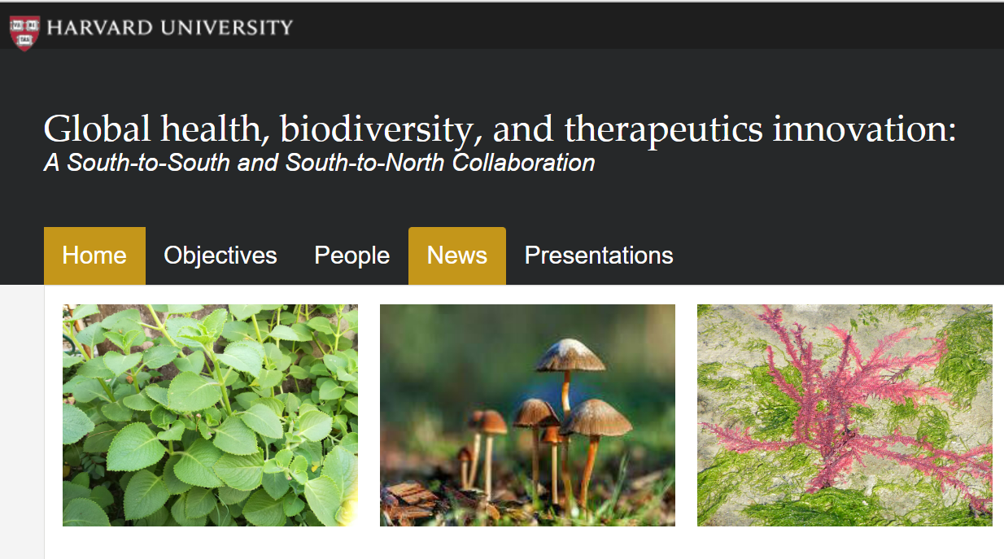
Our website

