Slide 1
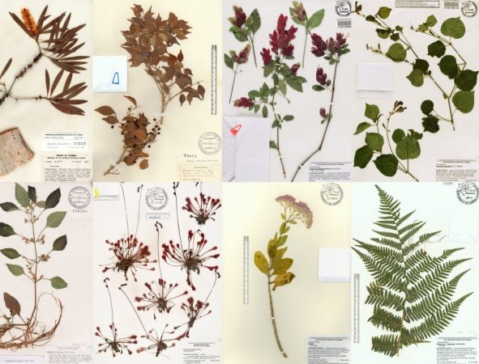

Novel Approaches to Identifying Natural Products for Treating Age-related Neurodegenerative Diseases
Pamela Maher
Cellular Neurobiology

Slide 2
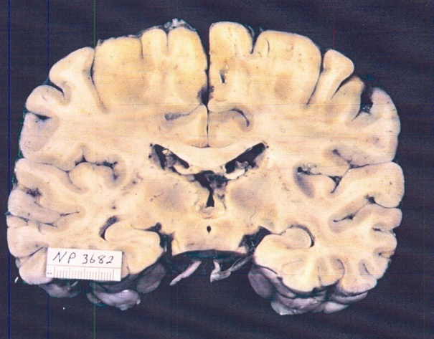
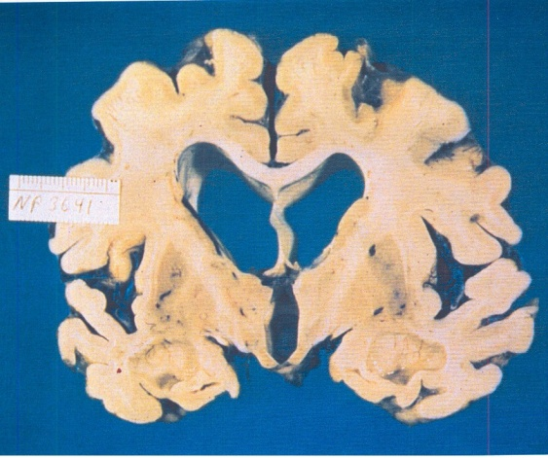
The Problem
How do you identify new drug candidates for AD?
Healthy
AD
Leading cause of dementia. >6.7 million people in US. Expected to rise to >13.8 million by 2060
Characterized by extensive synaptic loss and nerve cell death leading to brain atrophy
Clinical hallmarks of the disease are loss of memory and executive function
There are no treatments to slow or stop the deterioration of nerve cells in AD
Current therapies only transiently improve cognitive function or effects are not clinically significant (aducanamab)

Slide 3
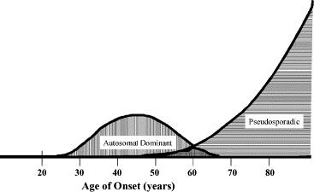
Age Distribution of Familial and Sporadic AD
Old Age is the Greatest Risk Factor for AD
Major Drug Target
~1-3% of AD cases
Sporadic
Autosomal Dominant (FAD)
Age of Onset (years)
Swerdlow, Neurobiol. Aging 28: 1465, 2007

Slide 4
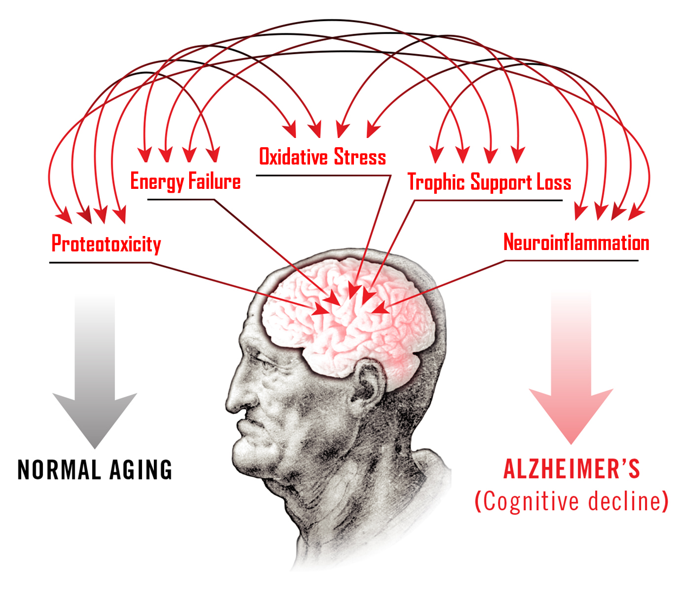
Aging and Alzheimer’s Disease
Complexity of Old Age-Associated Neurodegeneration
Hypothesis: Prevention of these changes can slow down or block AD development and/or progression
Bellantuono, I. Nature 554, 293, 2018; Prior et al. ACS Chem. Neurosci. 5, 5032014

Slide 5
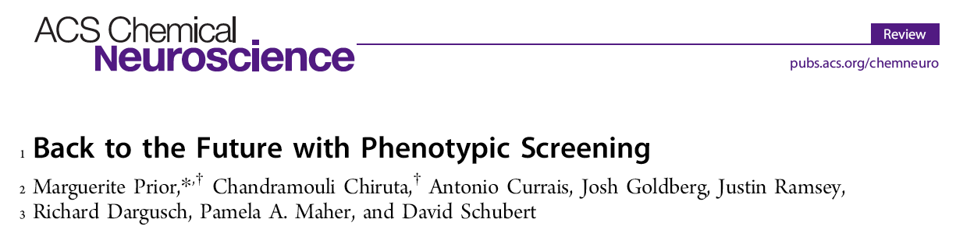
Our Approach
Developed set of novel cell culture-based assays that mimic the pathophysiological changes in the brain associated with aging and exacerbated in AD.
Cure the disease first and understand the mechanism later
Versus Pharmaceutical Industry approach that focuses on preselected molecular targets → not successful for AD.

Slide 6
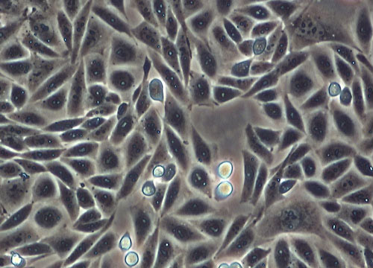
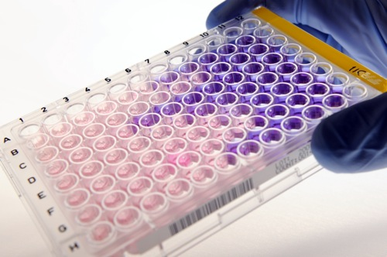
Our Phenotypic Screens
Primary assay:
Oxytosis/ferroptosis (HT22 cells)
Secondary assays:
Reductions in energy metabolism (HT22 cells)
Amyloid toxicity (MC65 cells)
Anti-inflammatory activity (BV2 cells)
Neurotrophic activity (PC12 cells & primary neurons)
Goal: Drug candidates that show efficacy in all assays

Slide 7
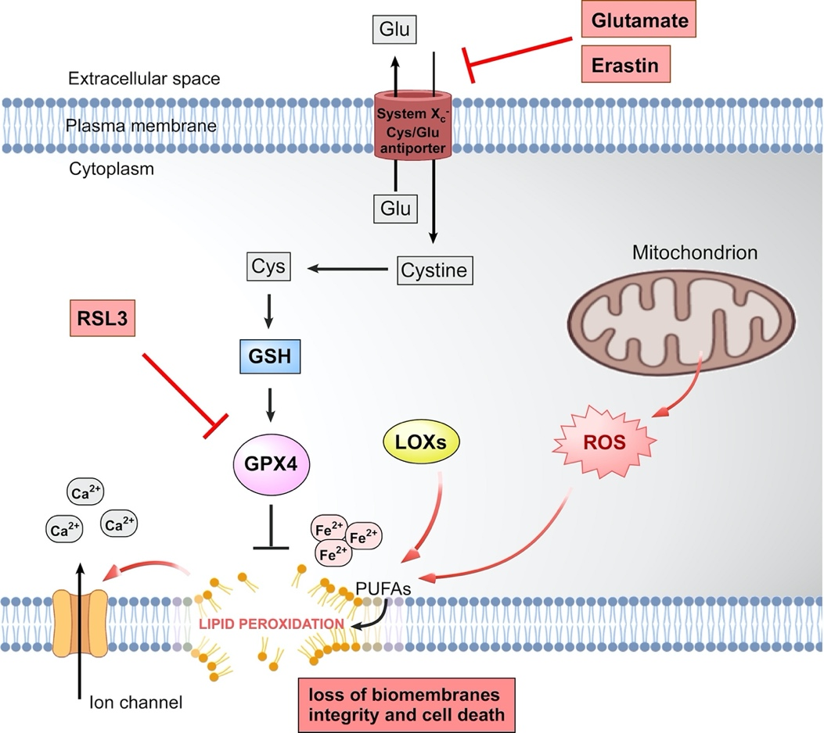
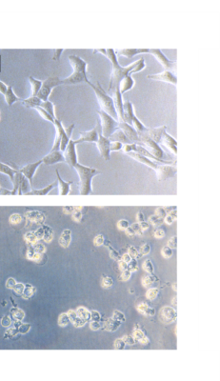
Cell Death Pathway in Oxytosis/Ferroptosis
HT22 Cells (mouse hippocampal neurons)
ct
+ glu
SOCE

Slide 8
Key Features of the Oxytosis/Ferroptosis Pathway Mimic Pathological Changes Associated with Aging & AD
Implicated in AD, PD, HD, FTD, ALS, stroke, traumatic brain injury
In cell culture activation of this pathway results in death but in vivo activation leads to chronic toxicity

Slide 9
Plant-Derived Natural Products as Lead Compounds
Arguments For
Structural backbones of many drugs ( at least 25% of FDA-approved drugs are plant based)
Ethnopharmacological data
Rich chemical diversity (>200,000 unique compounds)
Oxytosis/ferroptosis occurs in plants where it is activated by various biotic and abiotic stresses!
Arguments Against
Low bioavailability
Non-specific inhibitors
Cannot be effectively modified
Many are antioxidants, all failed in the clinic
Not true or easily addressed
If you are going to use phenotypic screening assays for the discovery of novel compounds for the treatment of AD, what do you start with?

Slide 10

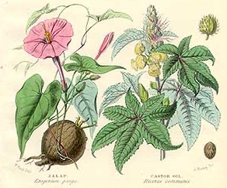
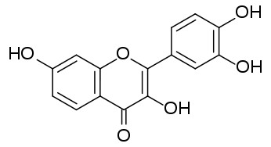
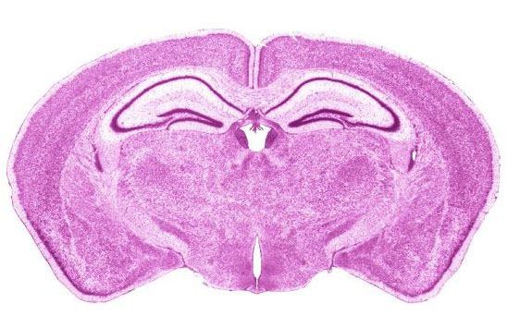
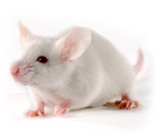
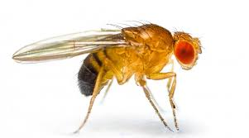
Workflow
Natural compounds/extracts
Cell-based phenotypic screening assays
Chemical optimization for CNS drugs
Neuroprotective compounds
Testing in animal models
Efficacy and mechanism of action
1
3
2
New drug candidates for treating AD
Improved understanding of the disease
Identification of novel therapeutic targets

Slide 11
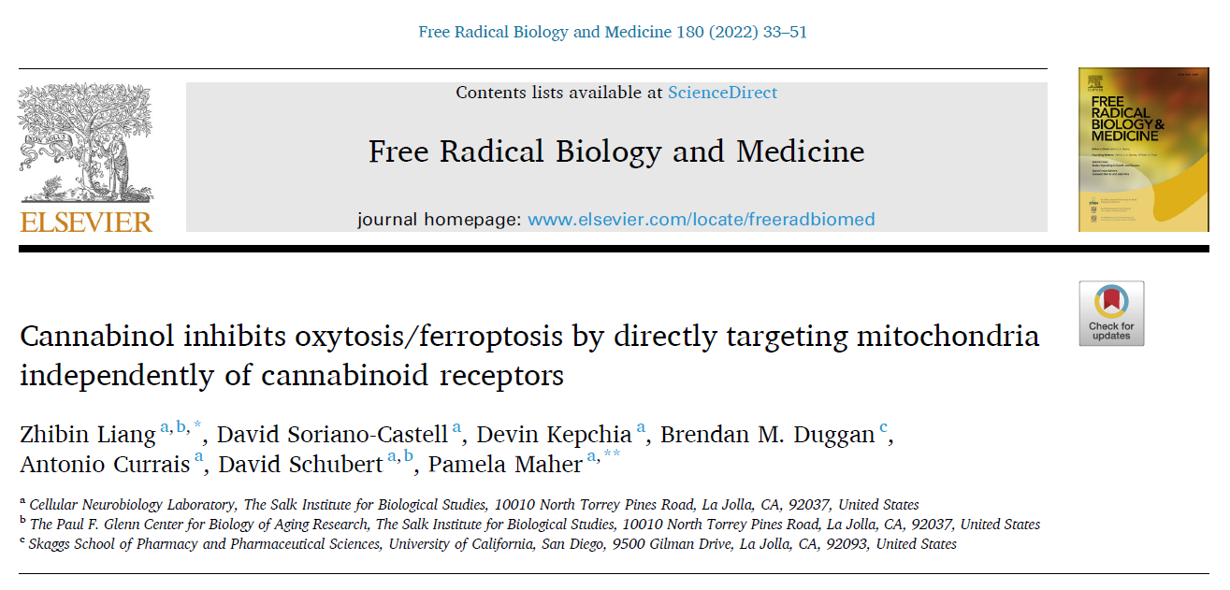
Project 1

Slide 12
Biological Activities of Selected Phytocannabinoids
Natural cannabinoids (non-psychoactive) | Oxytosis (Glutamate) EC₅₀ (µM) | Ferroptosis (RSL3) EC₅₀ (µM)
Cannabinol (CBN) | 0.7 | 0.20
Cannabidiol (CBD) | 0.6 | 0.50
Cannabichromene | 1.9 | 1
Cannabivarin | 3 | 1.3
Cannabigerorcin | 4.9 | 1
Cannabidibutol | 1 | 0.9
Cannabigerovarin | 2.9 | 0.73
Cannabicyclol (CBL) | 0.5 | 0.45
Cannabigerovarinic acid | >10 | >10
Cannabigerolic acid | >10 | >10
Cannabigerorcinic acid | >10 | >10
Cannabidivarinic acid | >10 | >10
Cannabidiol dimethyl ether | >10 | 9.5
Cannabielsoin | 10 | 2
Cannabinol monomethyl ether | >10 | >10
Cannabidiolic acid methyl ester | >10 | >10
Cannabidiolic acid | >10 | >10
Cannabicitran | >10 | >10
Cannabichromeorcin | 2.3 | <1
Schubert D, Kepchia D, Liang Z, Dargusch R, Goldberg J, Maher P. Mol. Neurobiol. 2019

Slide 13
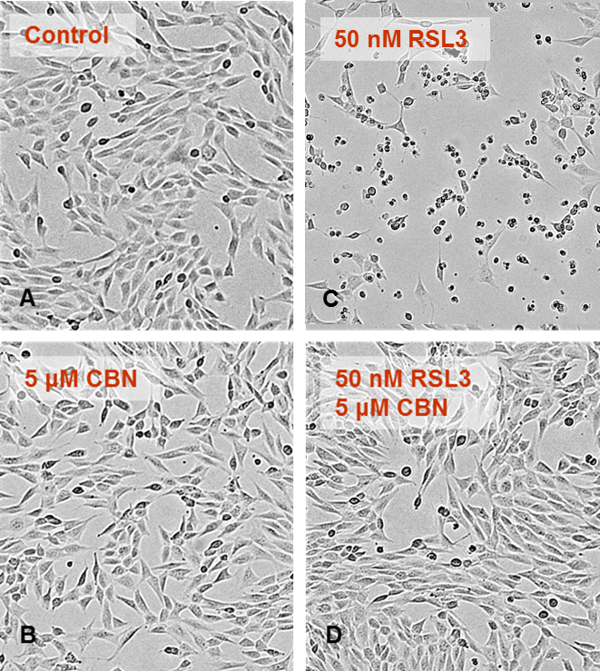
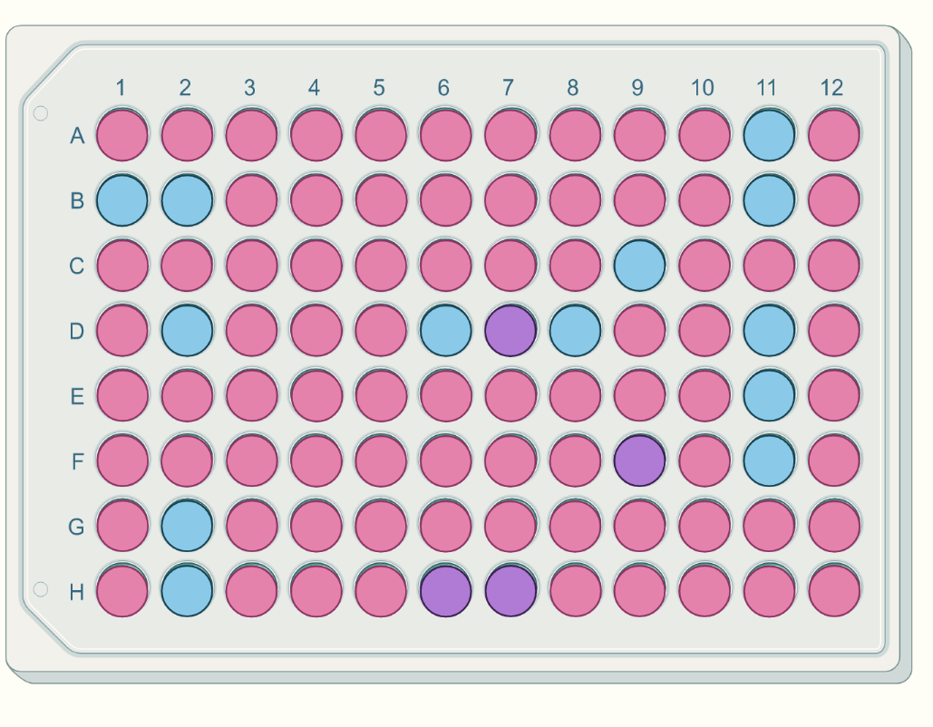
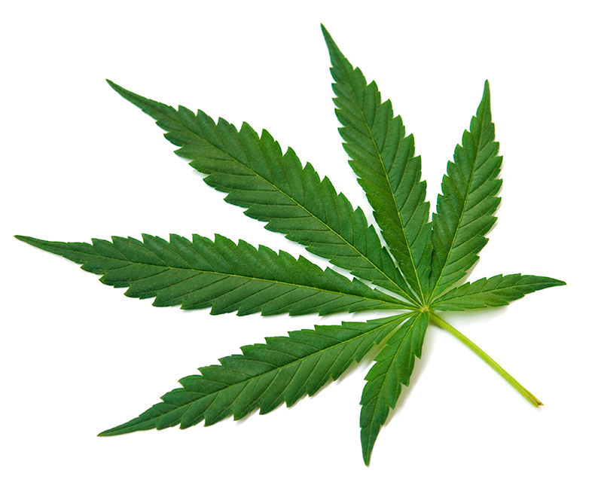
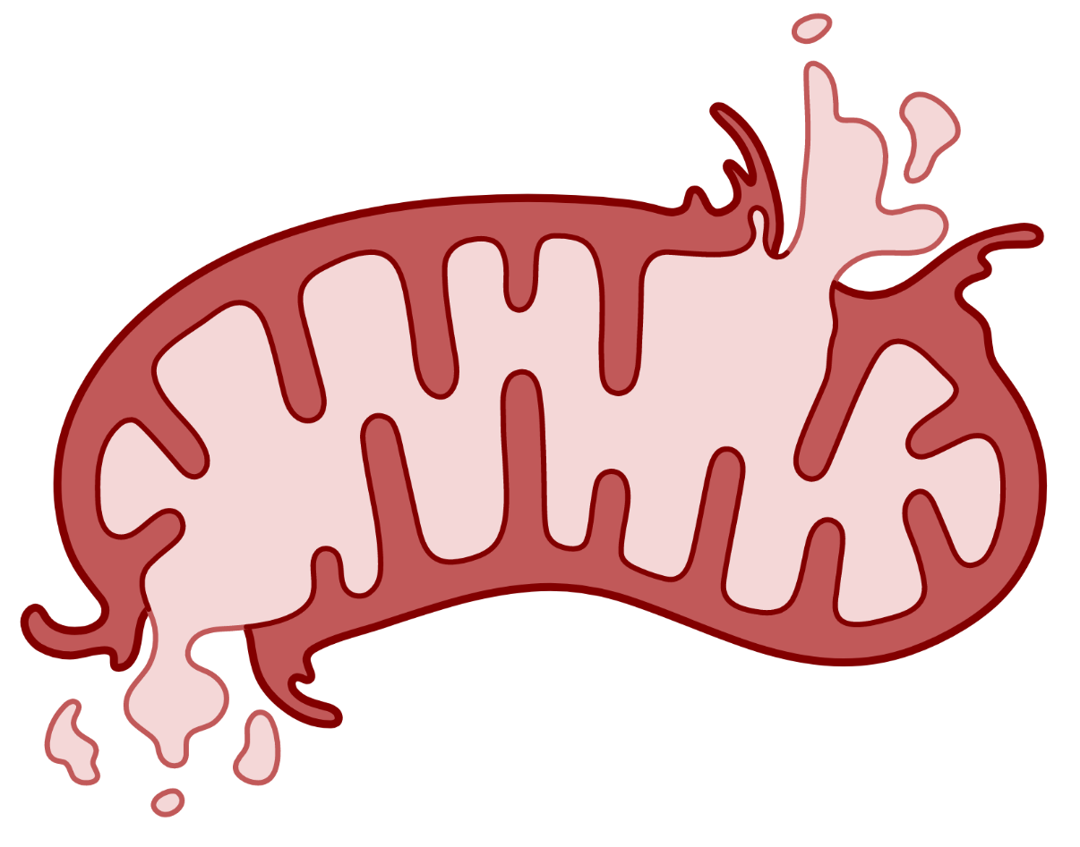
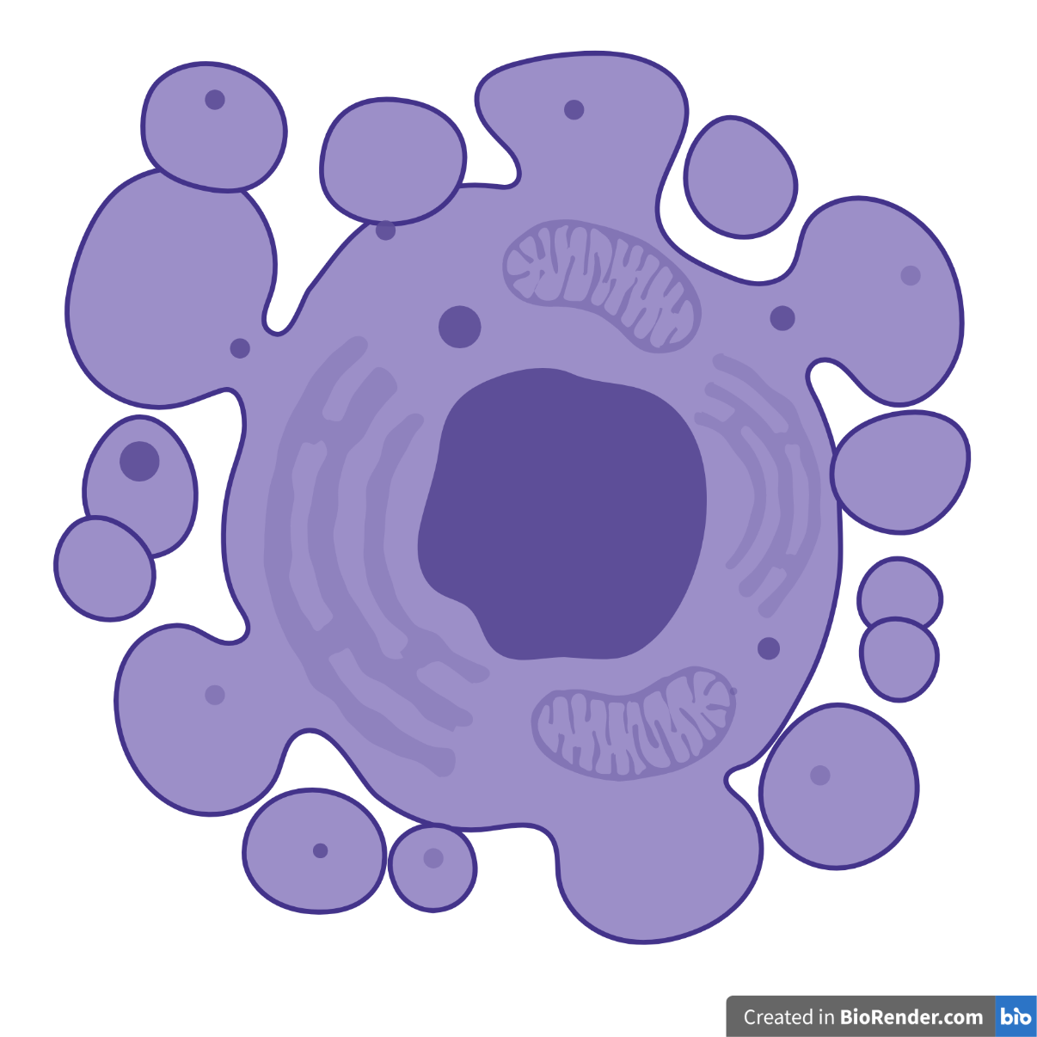
The Cannabinoid CBN Shows Potent Neuroprotection
RSL3: inducer of oxytosis/ferroptosis
Schubert D et al, Molecular Neurobiology, 2019
Liang Z et al, Free Radical Biology & Medicine, 2022

Slide 14
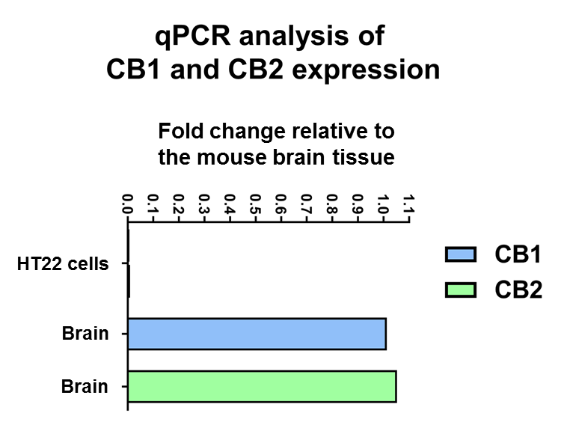
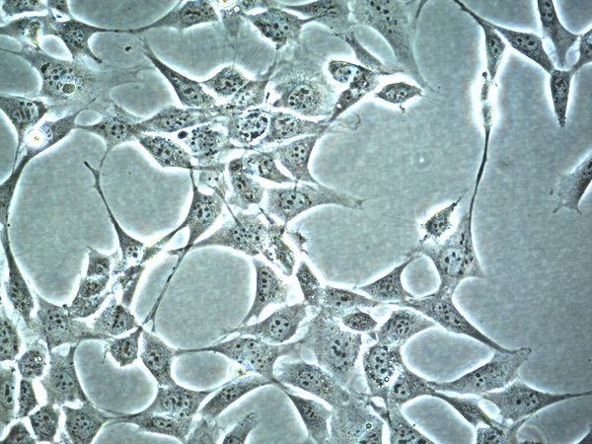
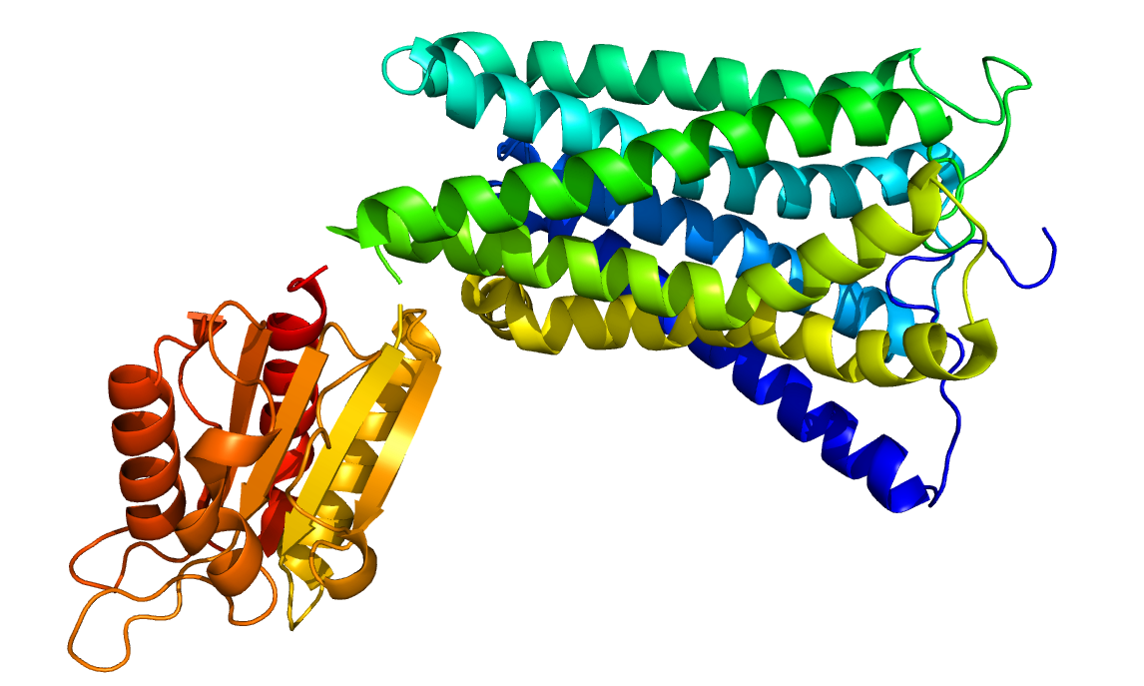
Neuroprotection by CBN is Independent of Cannabinoid (CB1/CB2) Receptors
Cannabinoid receptor-deficient cell line (HT22 neuronal cells)
qRT-PCR analysis of
Not detected
Mouse HT22 hippocampal neuronal cells
Cannabinoid receptors (CB1 & CB2)

Slide 15
CBN Inhibits Oxidative Stress & Lipid Peroxidation

Slide 16
CBN is Not an Antioxidant

Slide 17
CBN Prevents Negative Impact of RSL3 on Multiple Mitochondrial Functions

Slide 18
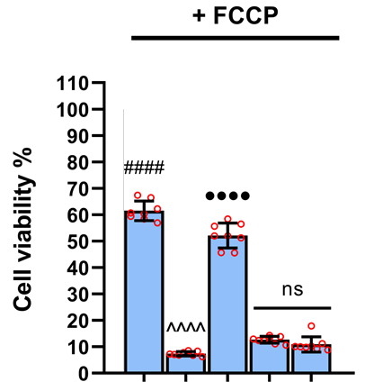
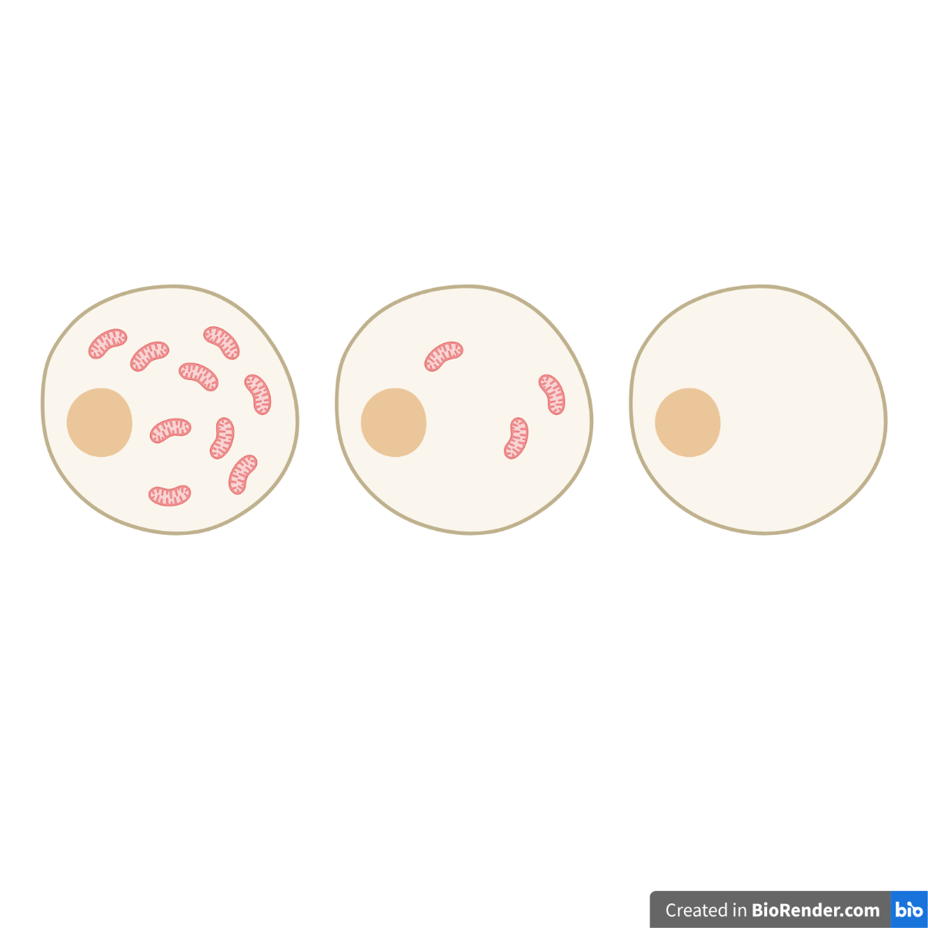
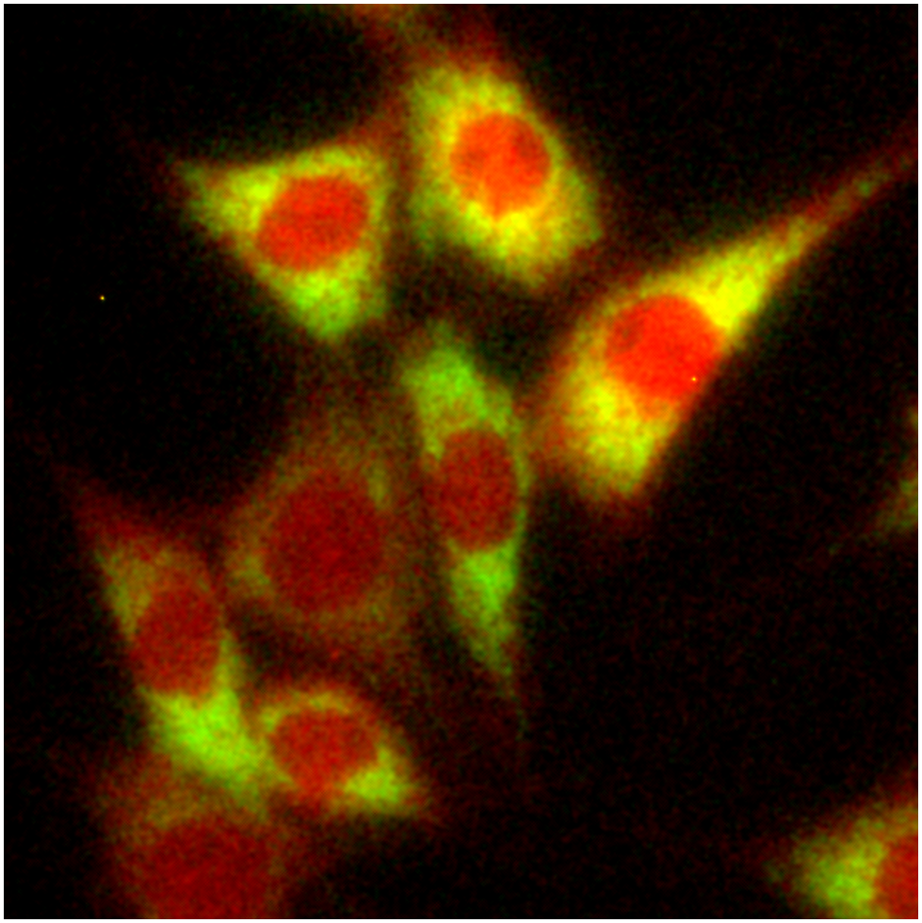
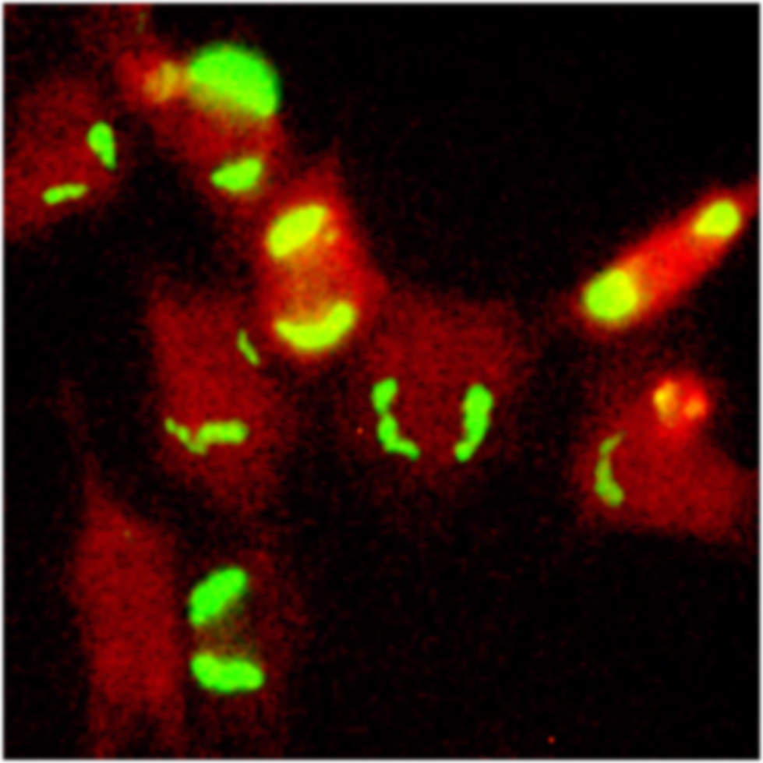
CBN Depends on Mitochondria for Neuroprotection
Inducible, mitochondrially-depleted HT22 cells
Parkin OE
FCCP
Induced mitophagy
Mitochondrial clearance
HT22 mt-GFP/mCherry-Parkin cells
- FCCP
+ FCCP
Vehicle
RSL3
Ferrostatin
MitoQ
CBN
- | - | - | - | -
- | + | + | + | +
- | - | + | - | -
- | - | - | + | -
- | - | - | - | +
Vehicle
RSL3
Ferrostatin
MitoQ
CBN
- | - | - | - | -
- | + | + | + | +
- | - | + | - | -
- | - | - | + | -
- | - | - | - | +
Green: GFP-Mitochondria
Red: mCherry-Parkin
Known inhibitors of oxytosis/ferroptosis:
Ferrostatin (mitochondrially independent MOA), MitoQ (mitochondrially targeted MOA)
Correia-Melo C et al, Nature Protocols, 2017

Slide 19
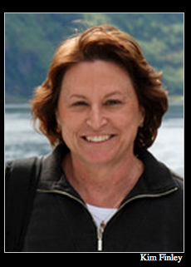
CBN Increases Lifespan in Adult Flies
Hypothesis: Compounds that inhibit the changes that occur in the aging brain can also increase lifespan (geroneuroprotectors)
+ 22.4% ***
in collaboration with Kim Finley, SDSU

Slide 20
Project 2
Strategy for Repurposing Drugs for Treating Aging and Dementia
ReFrame Library
Drug repurposing library from Calibr
Contains nearly all small molecules that have reached clinical development or undergone significant preclinical profiling
Therefore, theoretically all compounds have optimized safety and pharmacokinetics

Slide 21
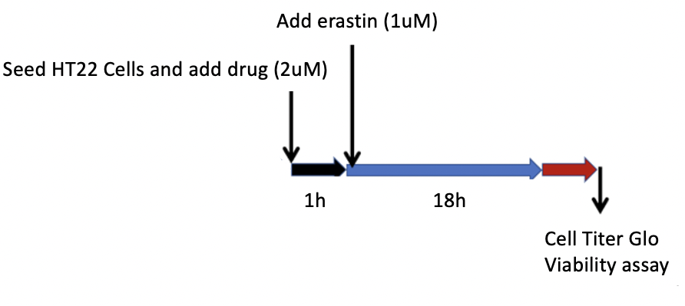
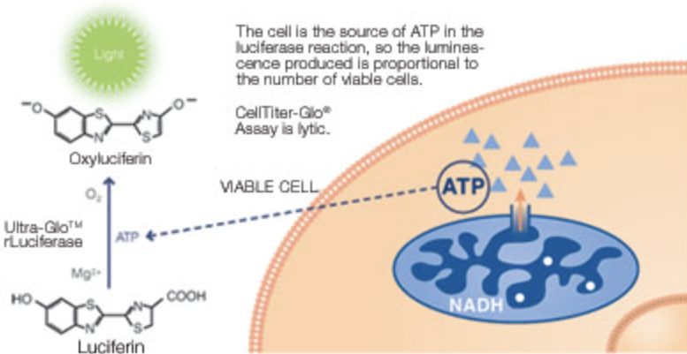
Calibr ReFrame Library Screen
13,613 small molecules were tested for protection against oxytotic death in HT22 cells
Oxytotic insult | Number of Cells | Format
Erastin (1uM) | 625 | 1,536 well plates
Source: Promega
Notes:
The ReFrame library is composed of small molecules that reached clinical development or had undergone significant pre-clinical profiling

Slide 22
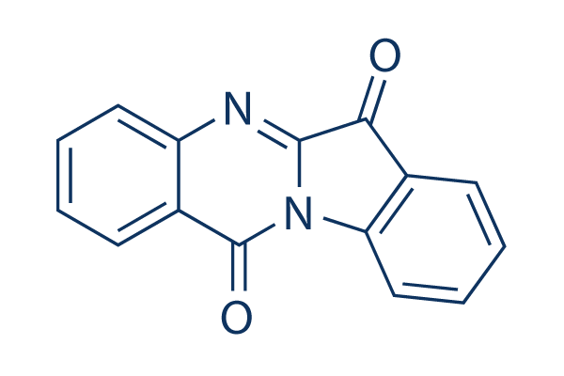
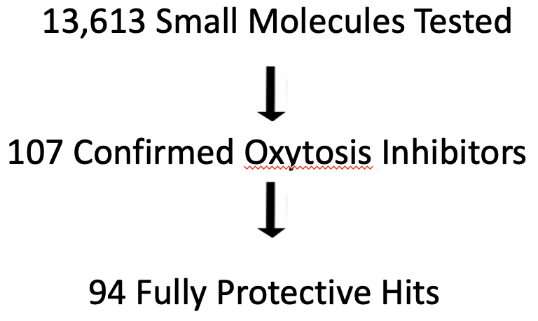
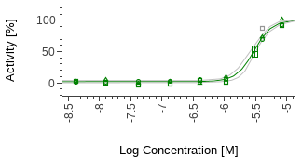
ReFrame Oxytosis Screen Results
Tryptanthrin

Slide 23
What is tryptanthrin?
Alkaloid from Isatis tinctoria L. (woad)
  Plant has a long history of use as medicinal herb and dye in Europe
  Related Isatis indigotica from China is used in TCM
Also found in fungi, cold water marine bacteria and multiple higher plants
Inhibits 5LOX and COX2 activity
Also has anti-bacterial, anti-fungal and anti-protozoal activity
Previous studies indicate high oral absorption and excellent BBB penetration

Slide 24
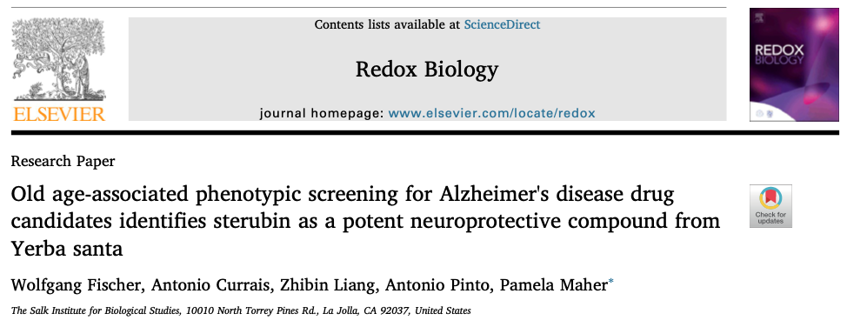



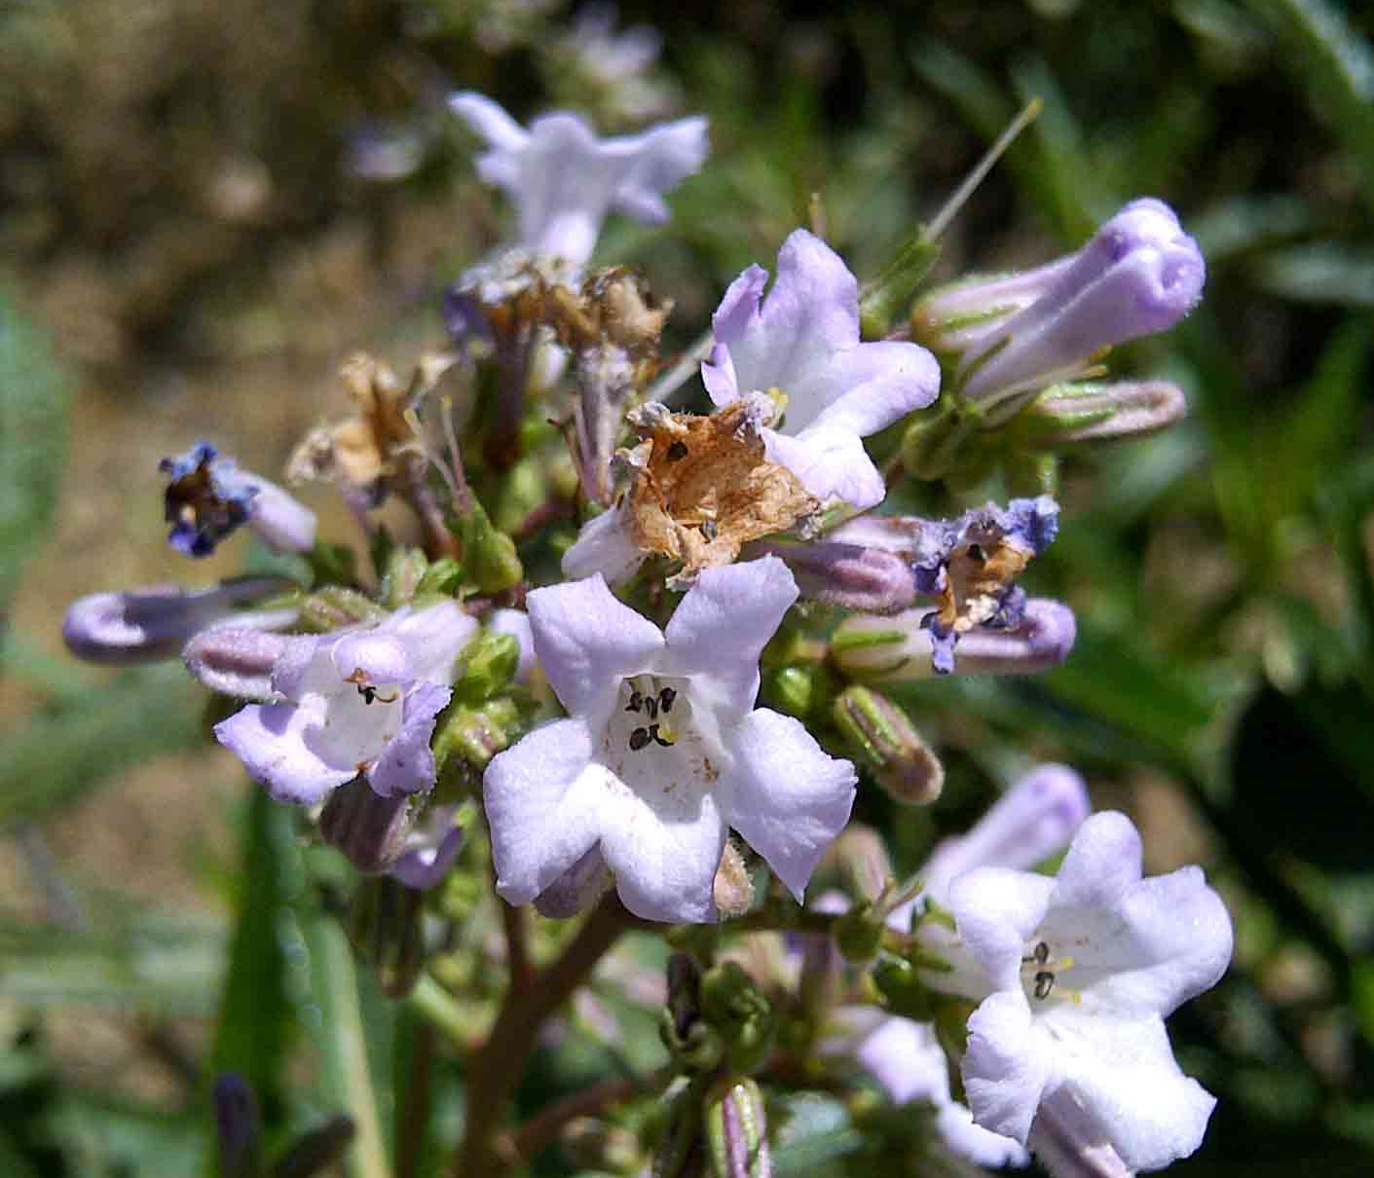
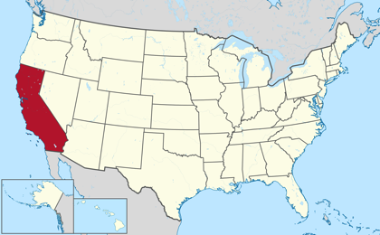
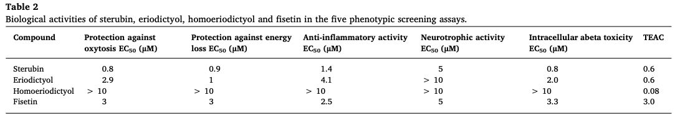
Project 3
Yerba Santa
Used to treat an array of illnesses, some directly associated with aging, including rheumatism, headaches, inflammation and respiratory complications such as asthma, cough, and lung infections (Moerman, 2009).
Library of plant extracts with medicinal relevance
Phenotypic screening
(>350 plants)
Eriodictyon californicum – Yerba Santa

Slide 25
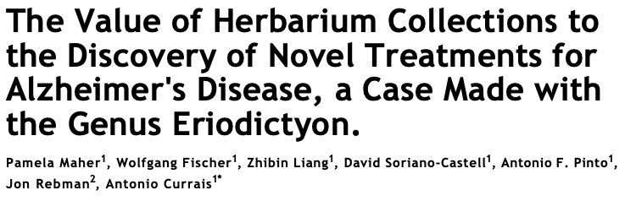


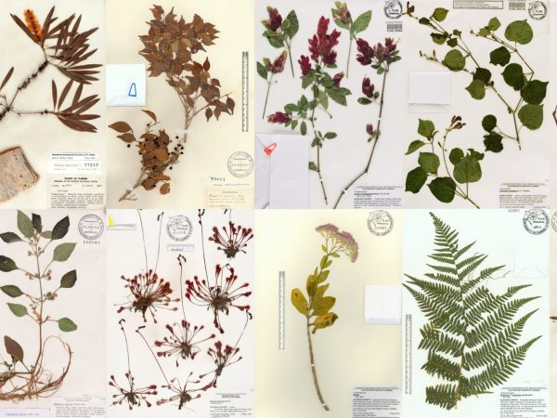

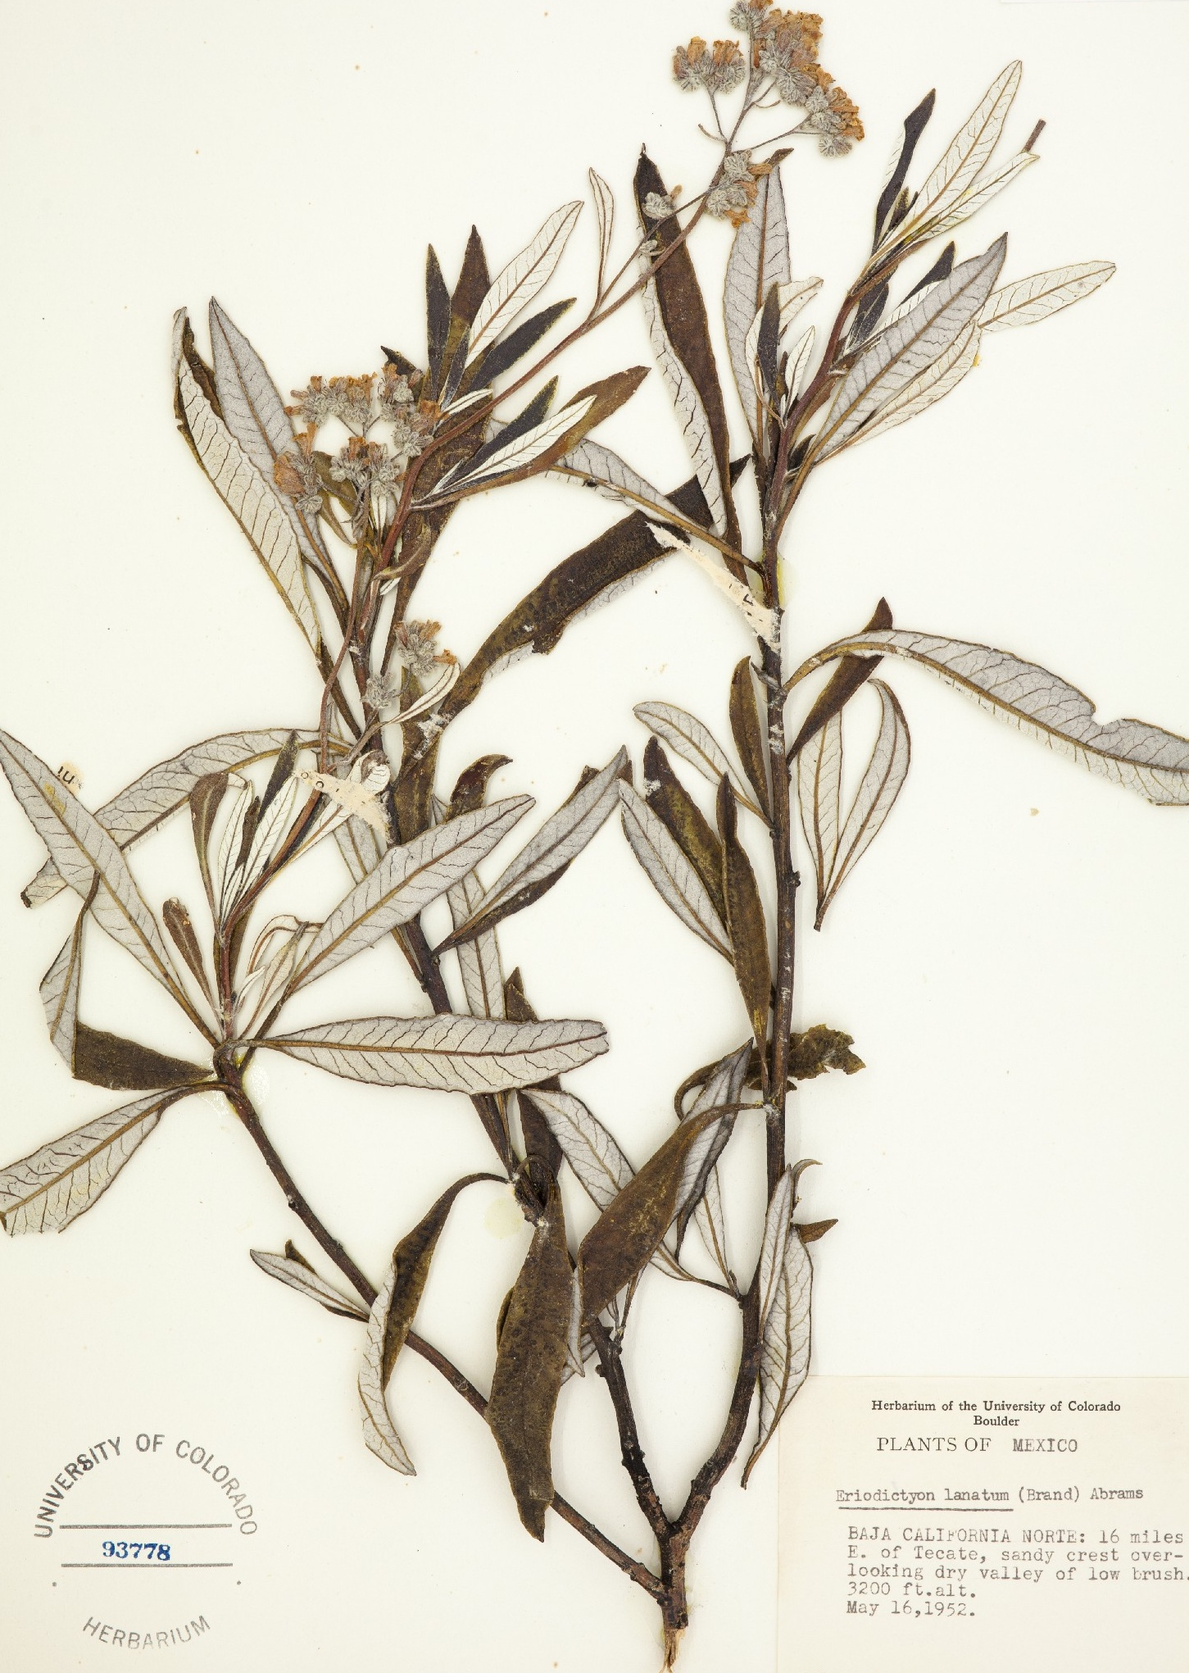
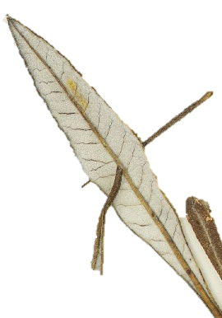
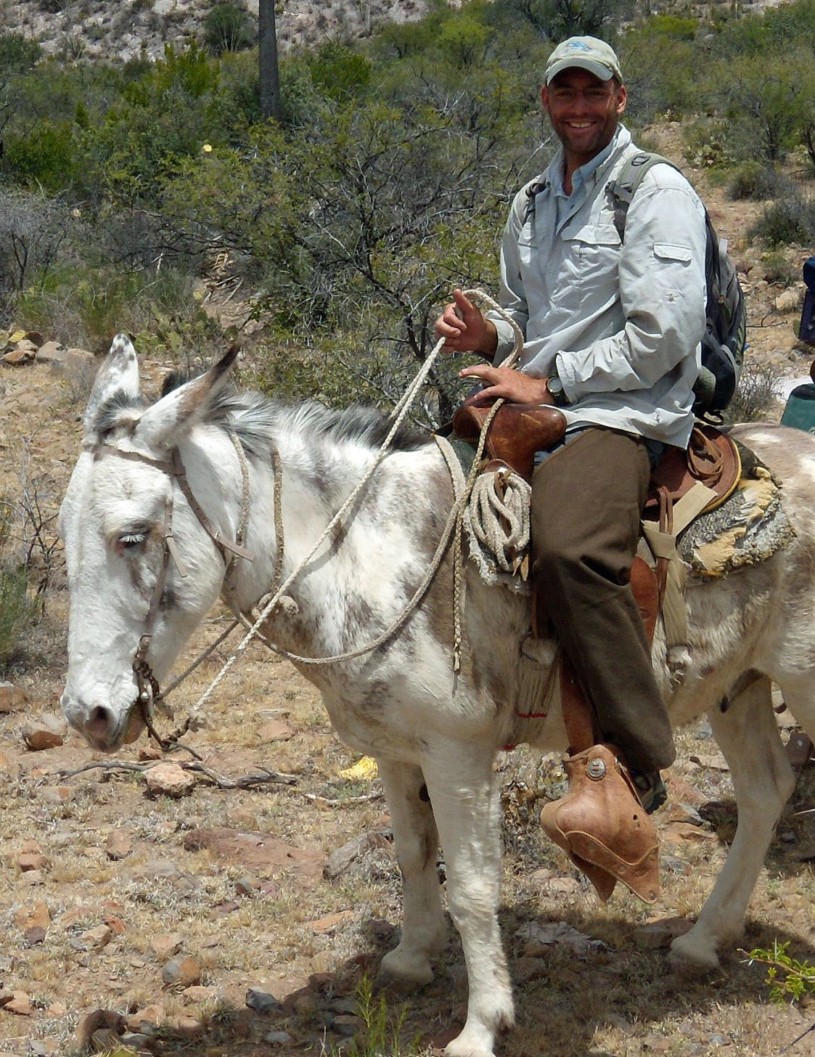
Project 4
2020 Mar 10;11:208
The herbarium at the San Diego Natural History Museum
~ 275,000 specimens native and naturalized plants of the southwestern US and northwestern Mexico.
One leaf extraction
Phenotypic screening
100-800 mg
Jon Rebman

Slide 26
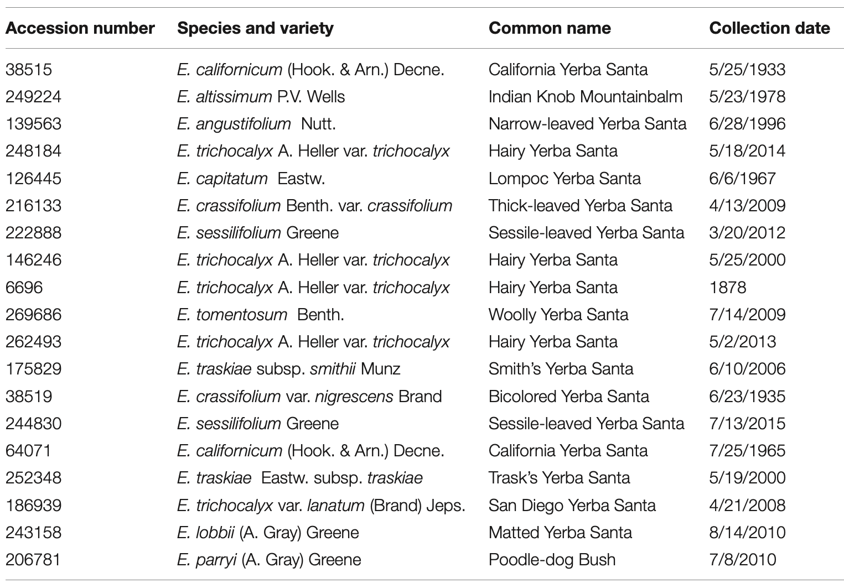
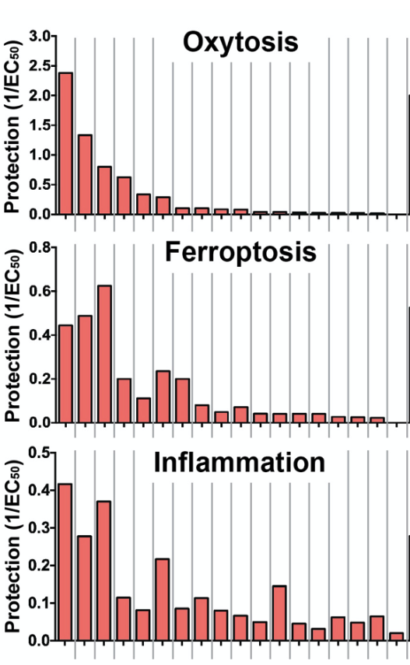
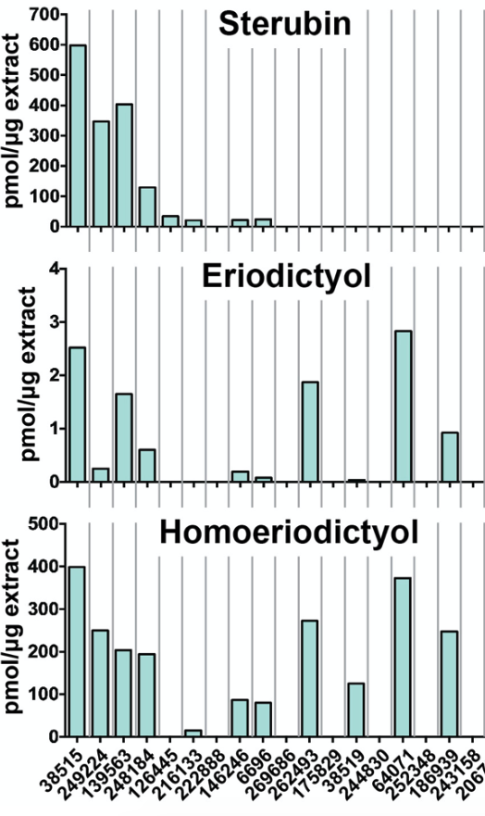
19 specimens of 10 species
+
-
+
Oxytosis
Ferroptosis
-
Phenotypic screening
. Sterubin correlates with neuroprotection and anti-inflammatory action -> active compound!
. Different species produce sterubin -> yerba santa

Slide 27
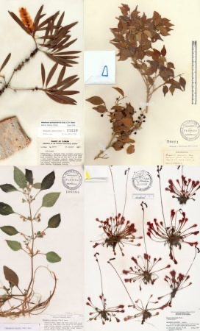
Herbaria for drug discovery:
Innovative approach.
Rich source of potential therapeutics (275,000 at SDNHM).
Minimally invasive (1-3 leaves, 100-800 mg).
Old specimens are not a problem (1878, 1933).

Slide 28
Workflow
Natural compounds/extracts
Cell-based phenotypic screening assays
Chemical optimization for CNS drugs
Neuroprotective compounds
Testing in animal models
Efficacy and mechanism of action
1
3
2
New drug candidates for treating AD
Improved understanding of the disease
Identification of novel therapeutic targets

Slide 29
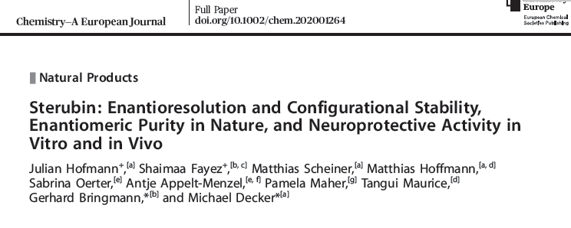
Project 5
26:7299, 2020

Slide 30
ICV Model of AD
Oligomerized Aβ₂₅₋₃₅ injected ICV on day 1
Sterubin (0.3, 1 and 3 mg/kg) injected IP on days 1-7
On day 8 spatial working memory evaluated in the Y maze
On days 9-10, learning and long-term memory evaluated in step-through passive avoidance test

Slide 31
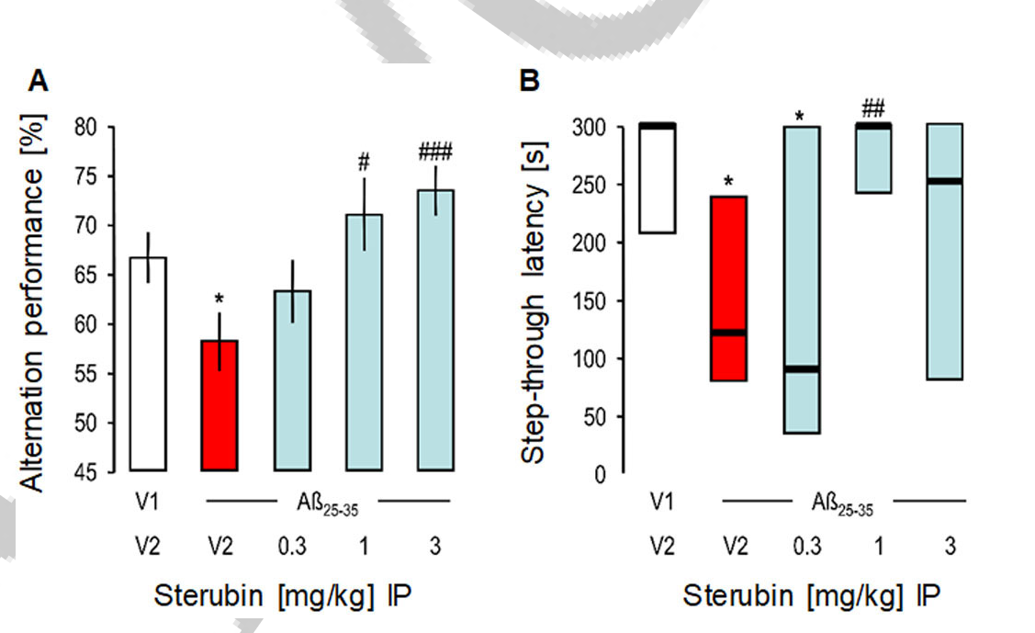
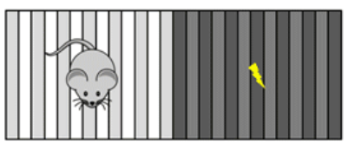

Sterubin Maintains Short- & Long-Memory in ICV Model of AD
N = 12=15/group

Slide 32
Summary
Growing evidence indicates that chronic activation of the oxytosis/ferroptosis pathway plays an important role in age-related neurodegenerative diseases
Plants are an excellent source of neuroprotective compounds that act by inhibiting the oxytosis/ferroptosis pathway
Using our cell based phenotypic screening assays we have identified several plant-derived natural products that have potential for treating age-related neurodegenerative diseases

Slide 33

Acknowledgements
Cellular Neurobiology (Salk)
Antonio Currais
David Soriano Castell
Ben Liang
Taketo Taguchi
Nawab Dar
Wolfgang Fischer
Joshua Goldberg
Richard Dargusch
Gamze Ates
Chandra Chiruta
David Schubert
Jon Rebman
SDSU
Kim Finley
Scripps
Michael Petrascheck
  Funding
NIH, Glenn Foundation, Burns Foundation, Bundy Foundation, Thome Foundation, Shiley Foundation.

