Slide 1
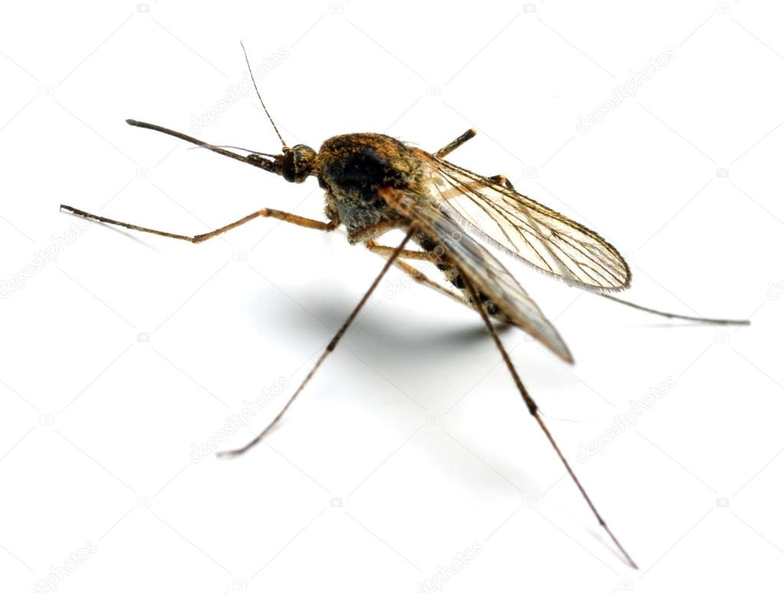


Building molecular barcoding capacity in Guyana
Global Health, Biodiversity, and Therapeutics
June 9th, 2023
Daniel Neafsey
Associate Professor, Dept. of Immunology & Infectious Diseases, HSPH
Associate Director, Genomic Center for Infectious Disease, Broad Institute

Slide 2
Premise:
Creating local DNA sequencing capacity is important.
Applications of DNA sequencing for public health and general biodiversity inventories can mutually reinforce sequencing capacity establishment.

Slide 3
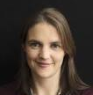
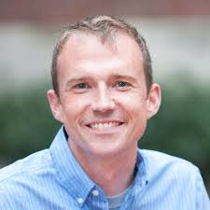
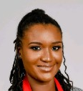
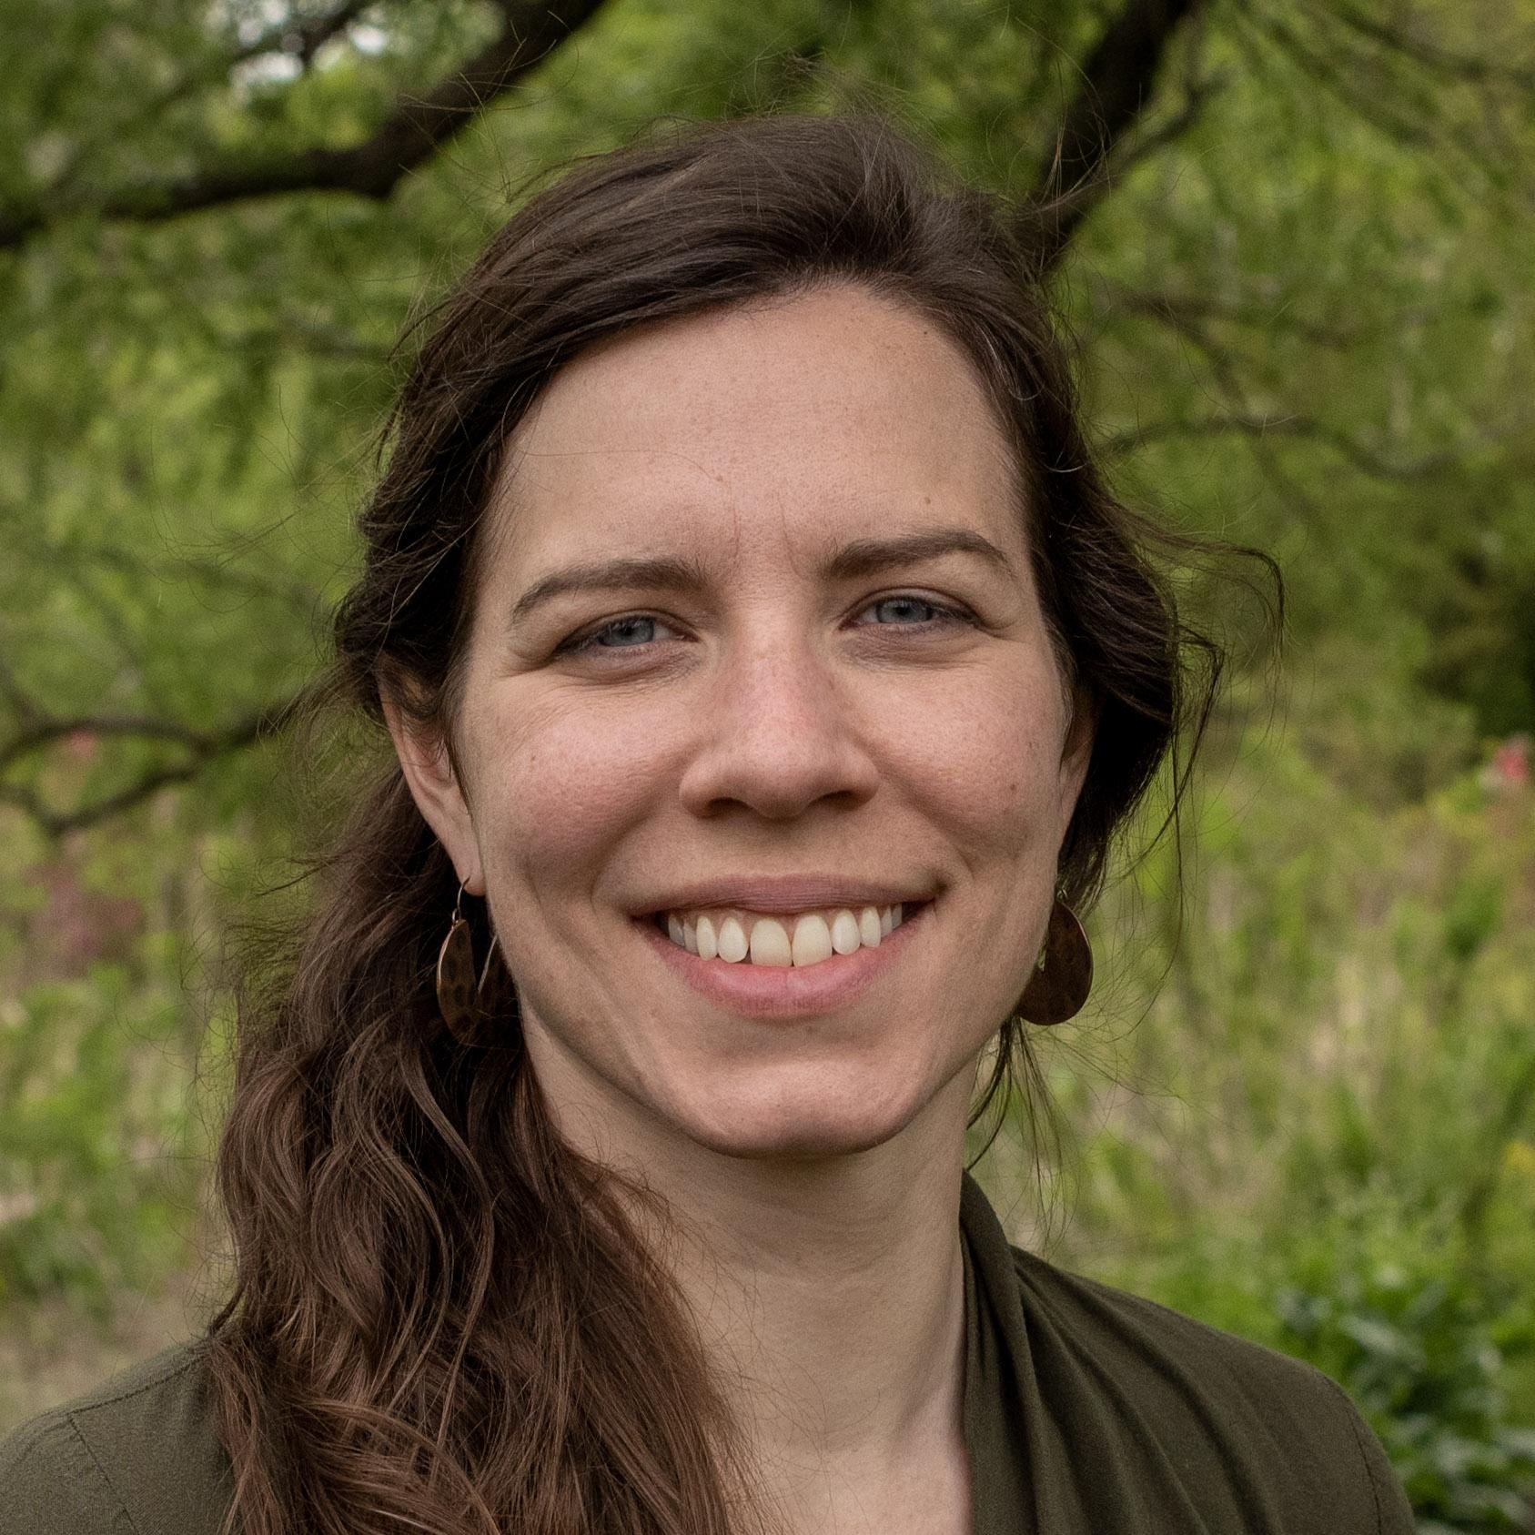
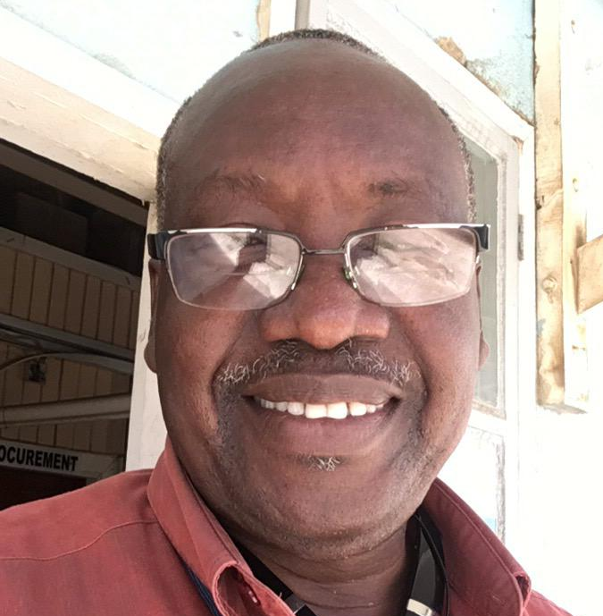


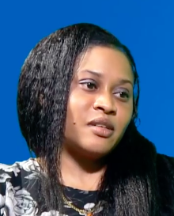
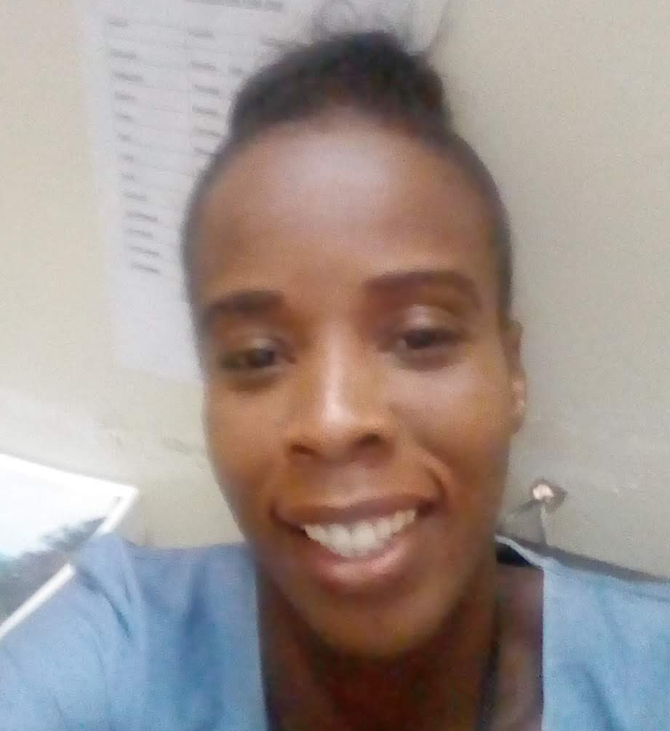
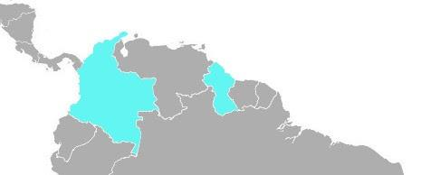




Malaria molecular surveillance in South America (2019-2023)
Dr. Caroline Buckee
Professor, Dept. of Epidemiology, HSPH
Dr. Dan Neafsey
Associate Professor, Dept. of Immunology & Infectious Diseases, HSPH
Dr. Reza Niles-Robin
Director of Vector Control Services,
Guyana MoH
Annie Laws
Gates Project Sr. Manager, HSPH and Broad Institute
Trevor Thomas
Project manager,
Guyana MoH
Mohini Sooklall
Biologist,
Guyana MoH
Dr. Kashana James
National Malaria Focal Point
Guyana MoH
Collette Clementson
Data Manager,
Guyana MoH

Slide 4
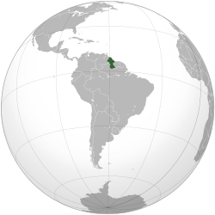

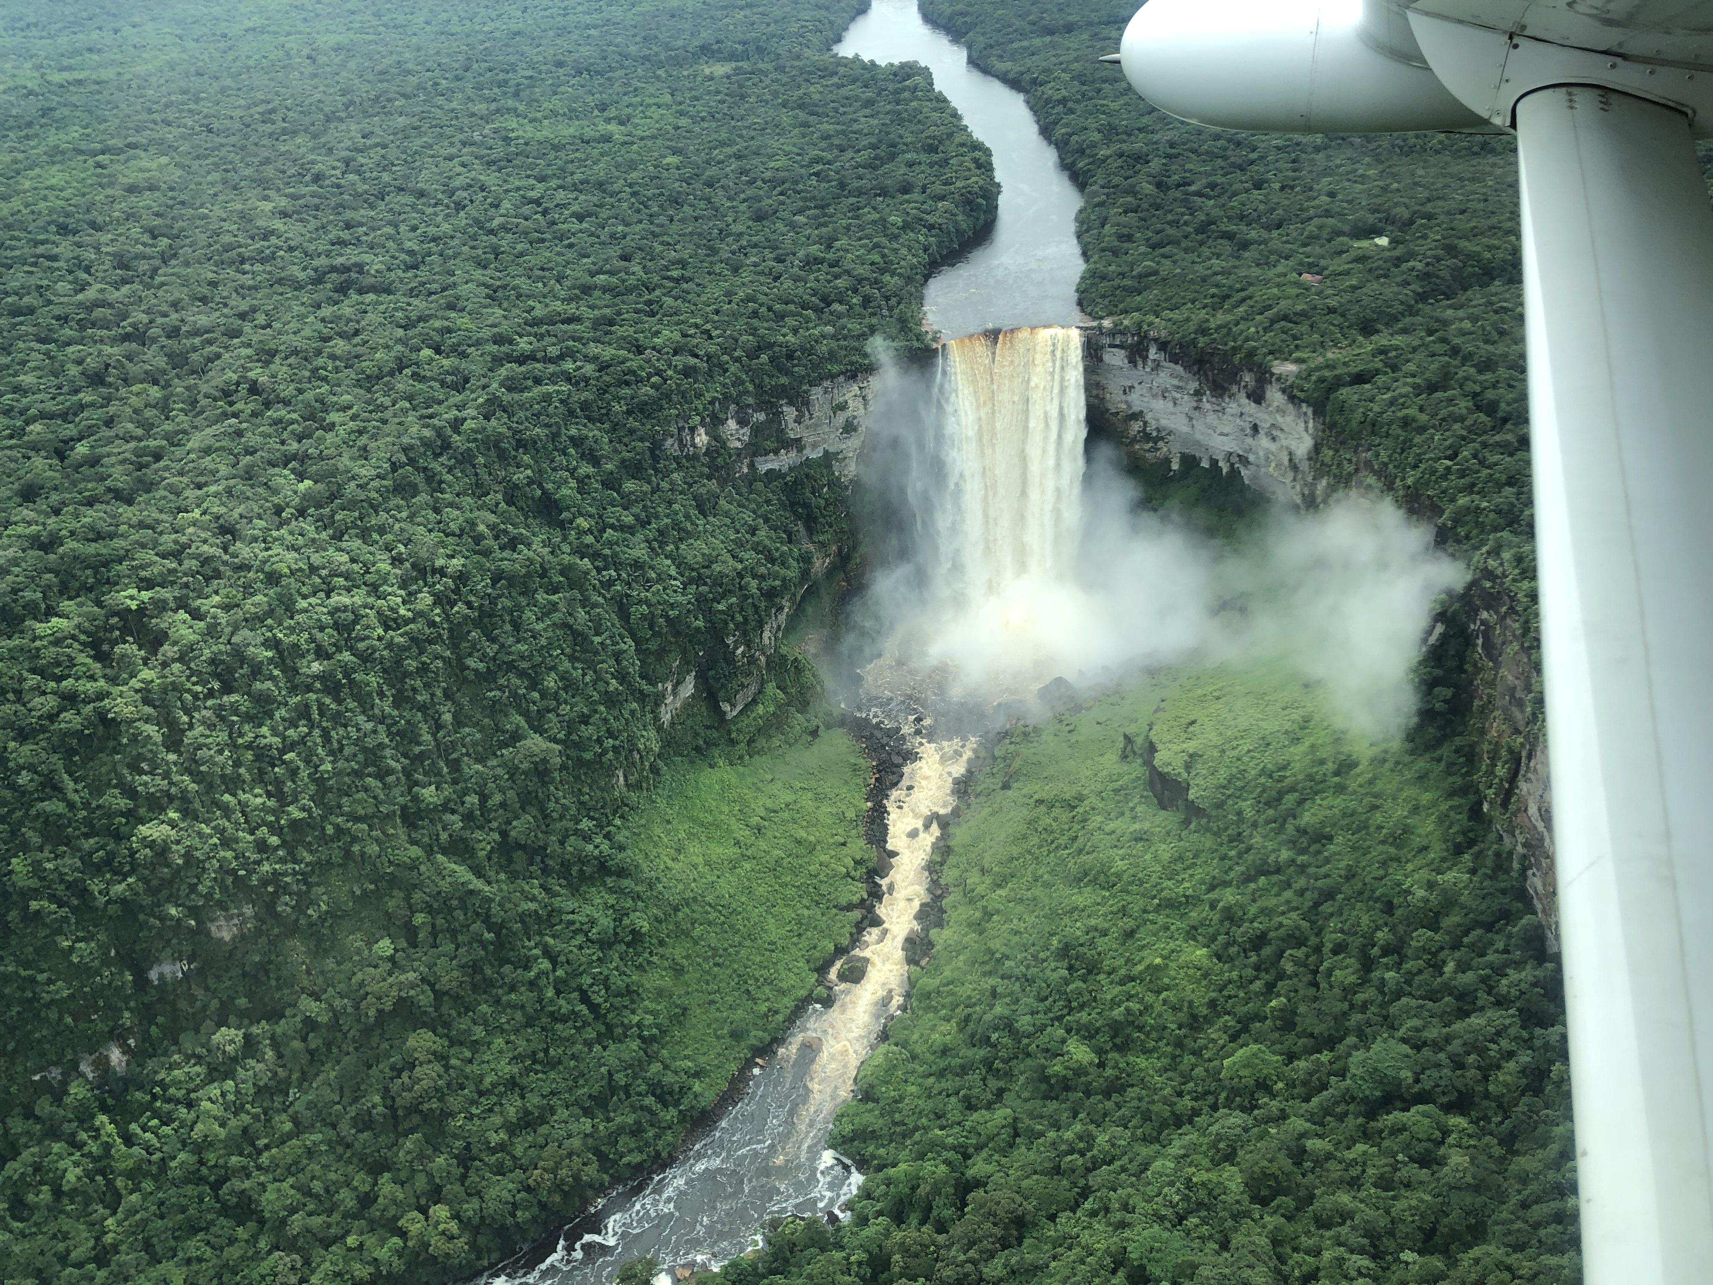
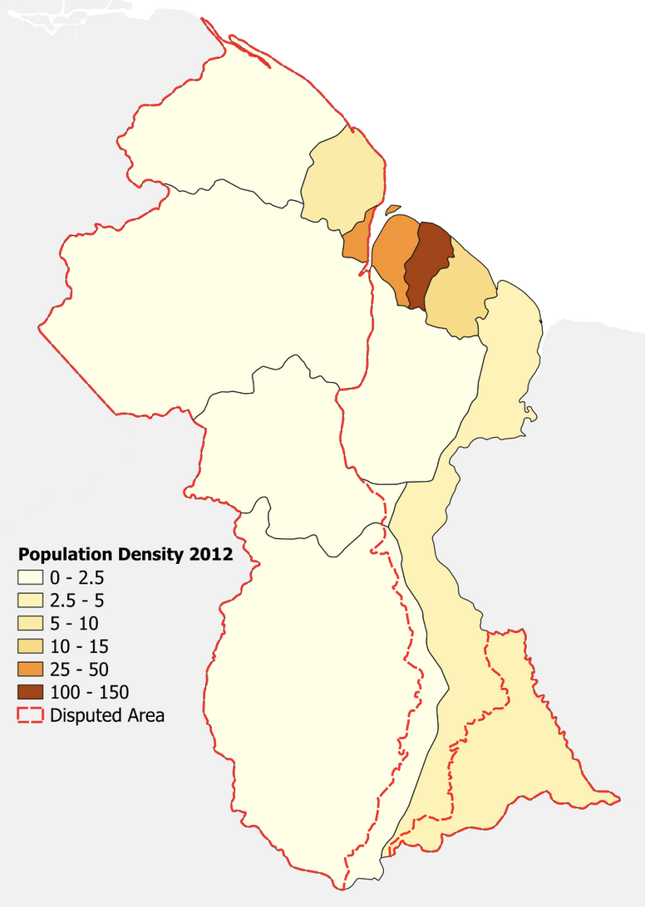
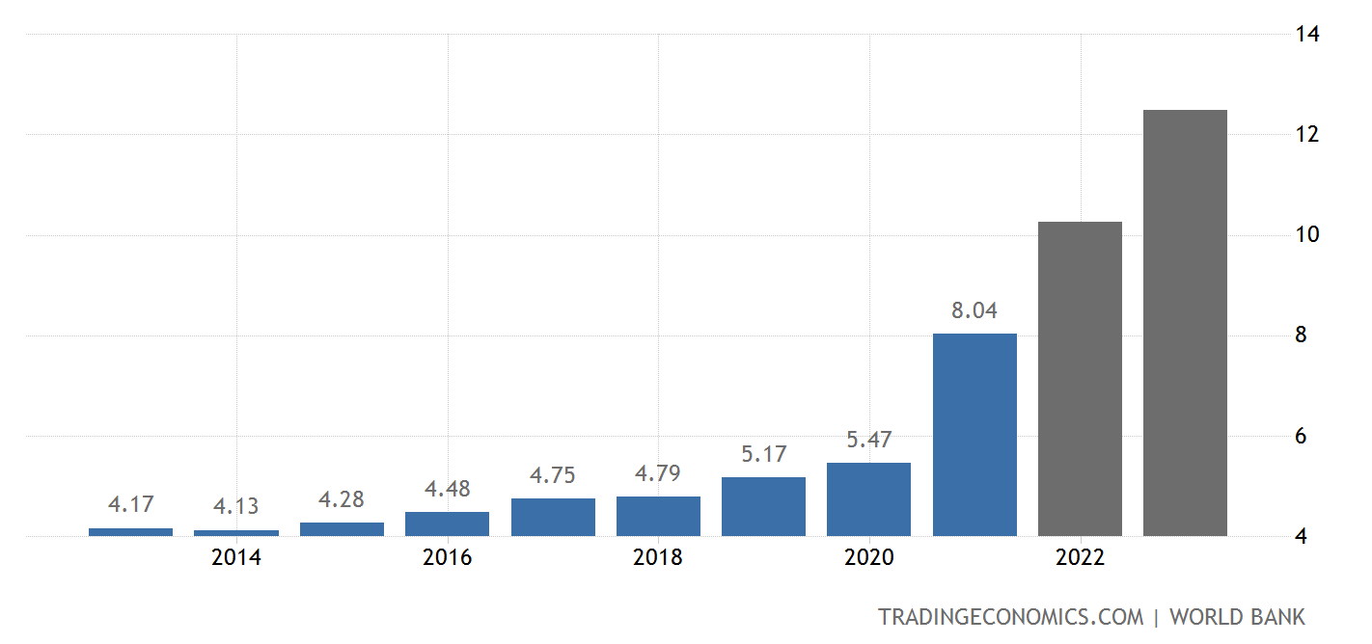
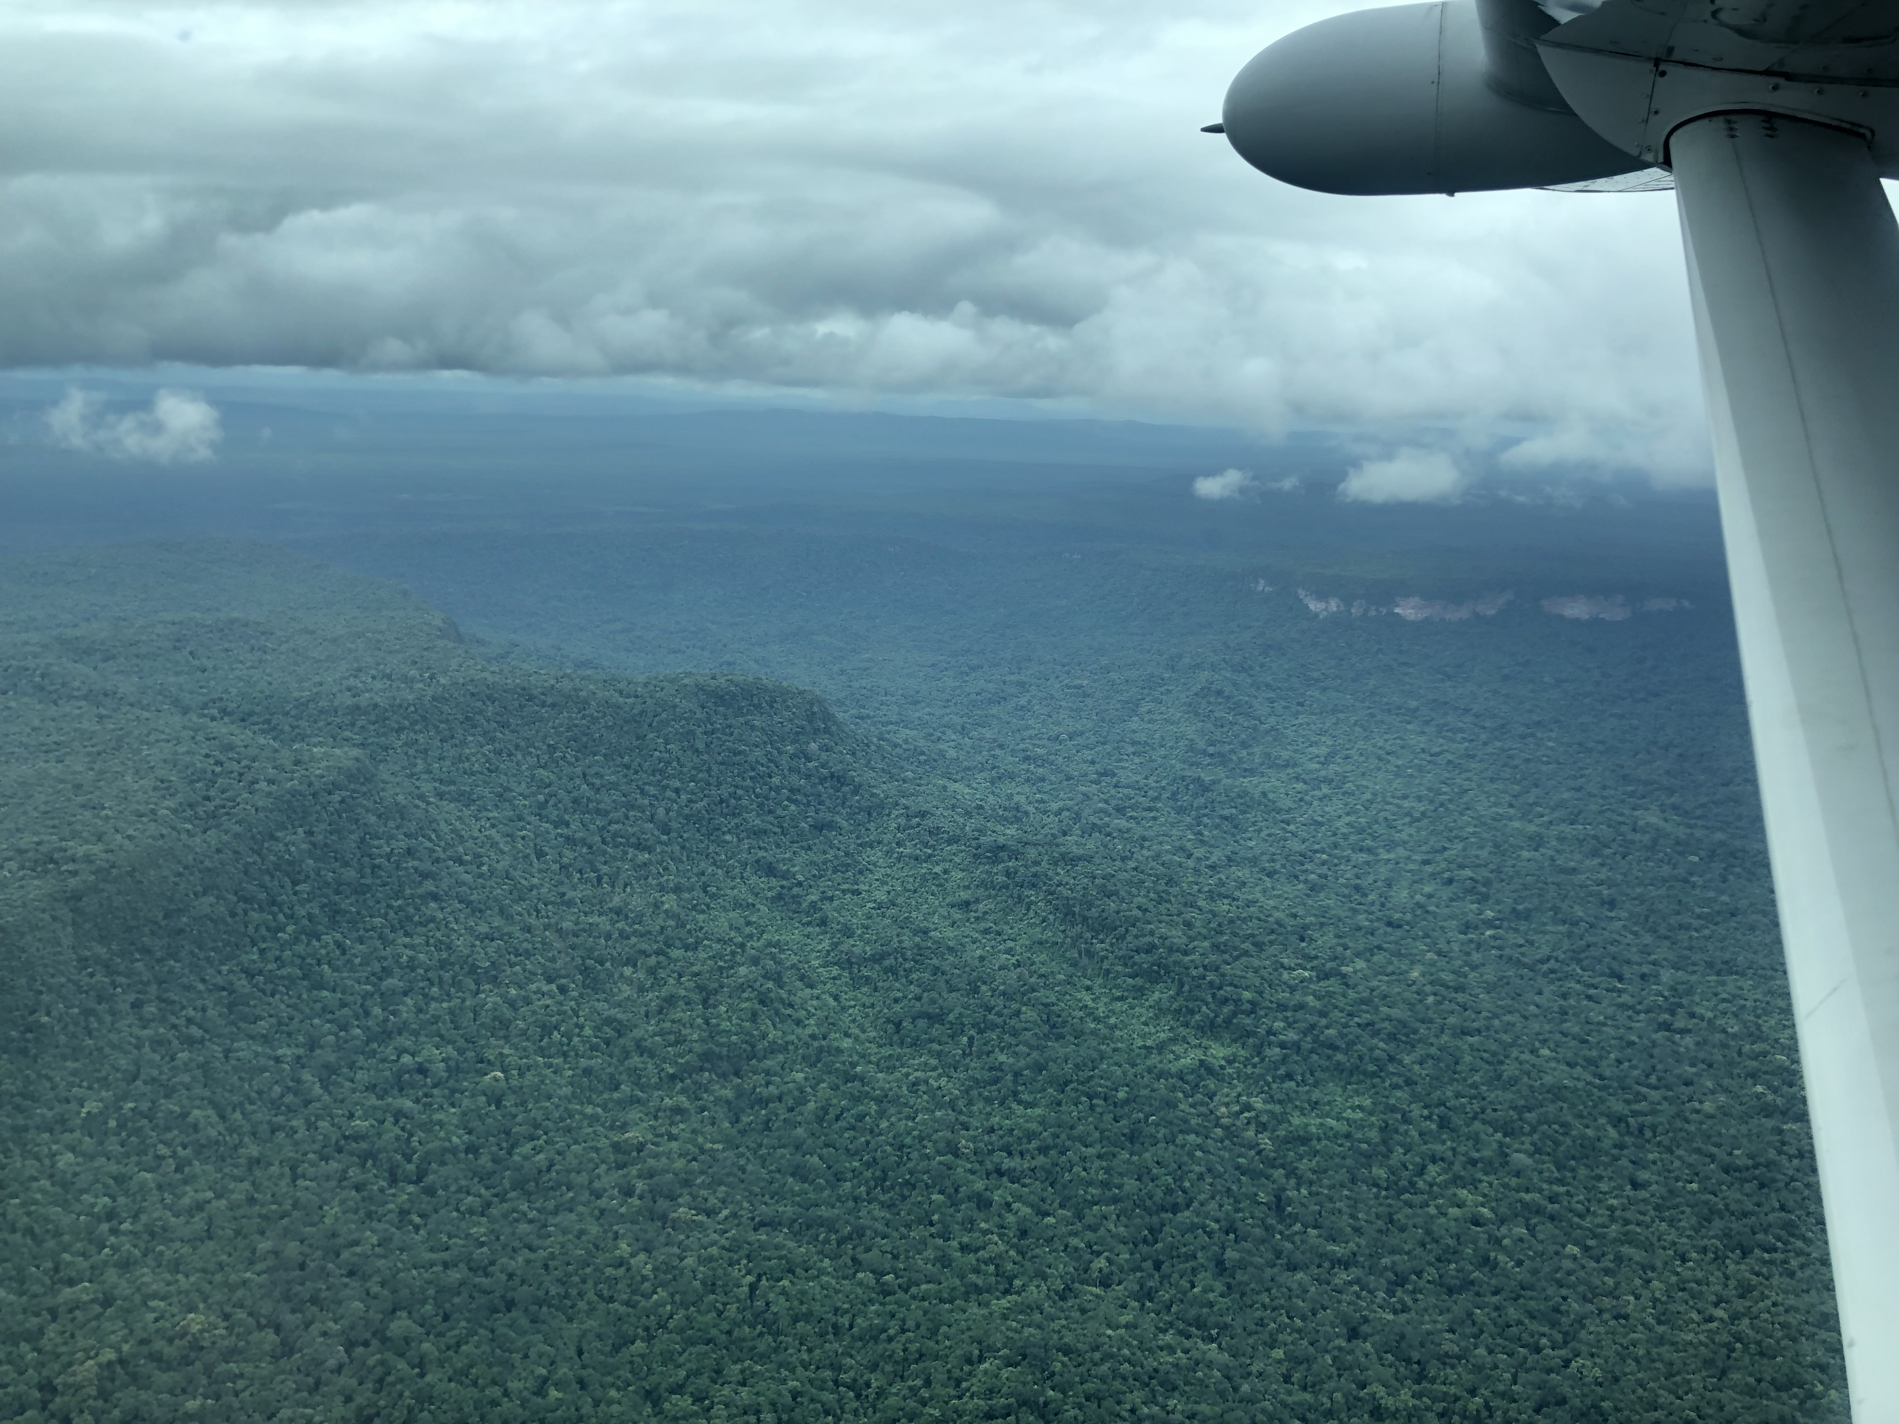
Guyana
Population: 795K
Enormous biodiversity
41% of population below the poverty line (2017)
Steep GDP growth in recent years due to oil
Population density
GDP

Slide 5
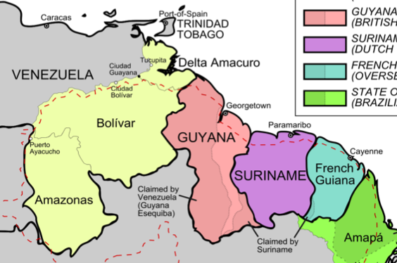
Malaria elimination in Guyana is possible
40K
20K
Annual Malaria Cases
Guyana
0
Suriname
2002
2004
2006
2008
2010
2012
2014
2016
Improved prevention (free bed nets, education)
Case management (earlier switch to more effective drugs)
Surveillance
Hiwat et al. 2018, Malaria Journal; Guyana MOPH

Slide 6
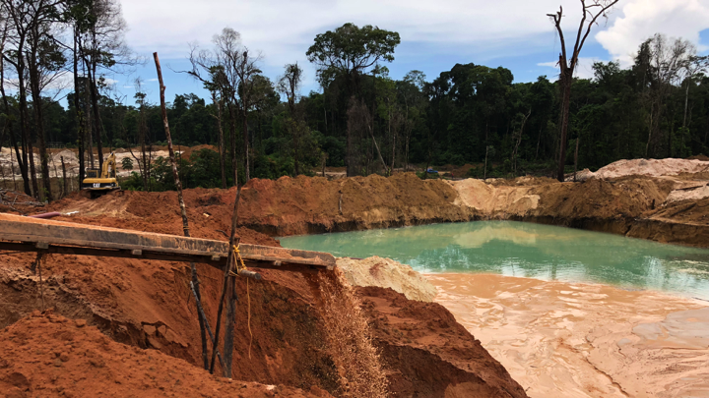
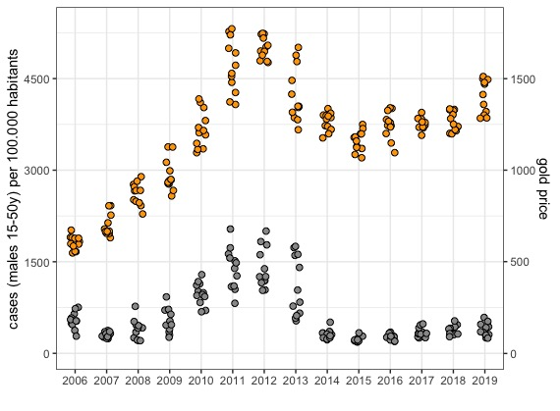
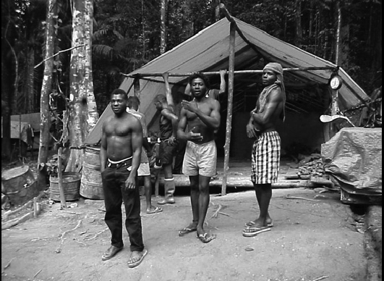
Malaria transmission and gold mining
Gold price
Landscape alteration favors the primary malaria vector mosquito in Guyana (Anopheles darlingi)
Case rate in Guyana
Malaria cases
Miners are highly mobile and many sleep in camps without mosquito protection
Pablo Martinez & Caroline Buckee (HSPH)

Slide 7

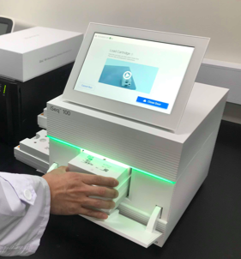

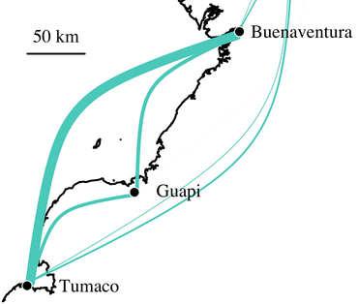




Malaria molecular surveillance
Sample collection
Amplicon sequencing
Data Analysis:
Local or
Resistance
time
In the cloud
Population connectivity
Vector ID
Vector bionomics

Slide 8
Whole Genome Sequencing (WGS) costs have fallen dramatically over time
Anopheles: ~$250 USD

Slide 9
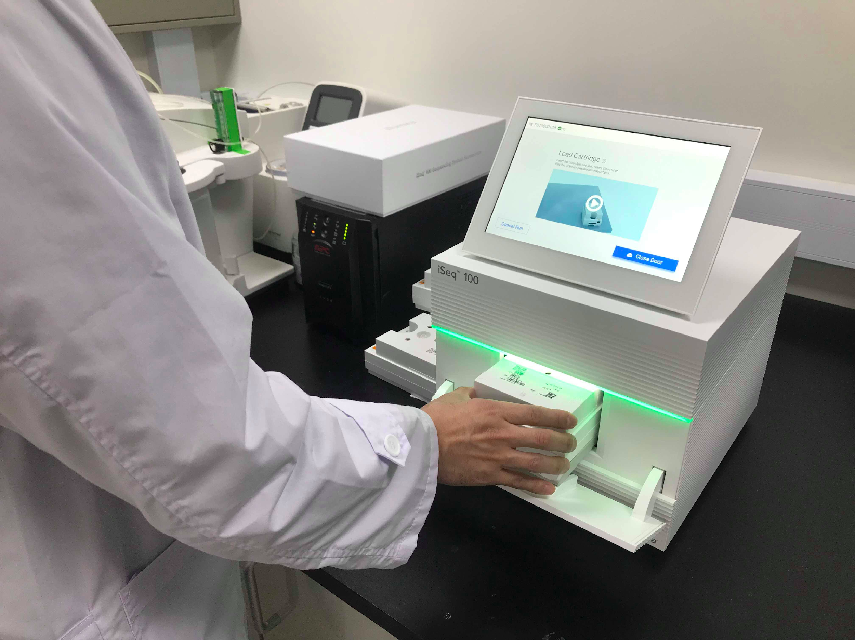
Illumina amplicon sequencing (AmpSeq)
Using PCR to focus sequencing coverage on genes of interest, we can sequence parasite or vector samples for just a few dollars per sample, on a relatively inexpensive instrument
Illumina iSeq
$20K USD
Illumina HiSeq
$900K USD

Slide 10

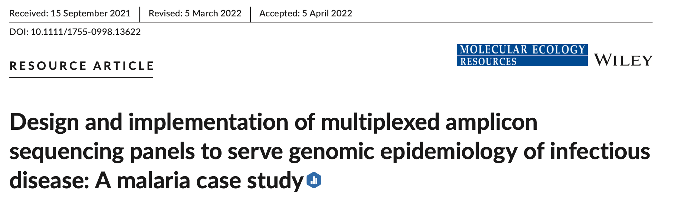
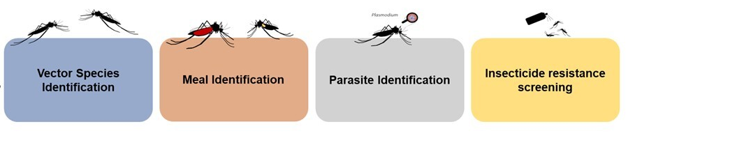
DNA barcoding assays for malaria
AMPLseq-”A Multiplex of Plasmodium Loci’-seq
128 amplicons in one tube
Drug resistance markers
Geographic markers
Polymoprhic antigens
Vector Species ID
Blood/Nectar Meal ID
Parasite Detection
Insecticide Resistance
ITS2
COX-I
Cyt-b
16S
18S
VGSC
ACE1
BARCODING AMPLICONS

Slide 11
What have we learned?
A resistance mutation to the first-line drug artemisinin has disappeared since 2017
Resistance is emerging to unofficial drug combinations used by self-medicating miners
Multiple Anopheles vector species are present, not just Anopheles darlingi
Mosquitoes frequently blood feed on domestic animals, and nectar feed from trees
~30% of Culex mosquitoes may be resistant to pyrethroid insecticides
Creating durable capacity for molecular genetics takes time and effort!

Slide 12
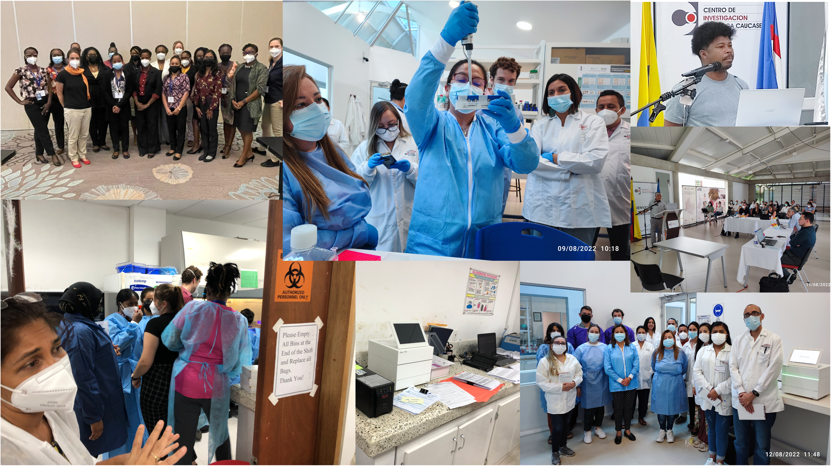

Slide 13
Challenges
Reagent supply chains: high cost and long delays
Personnel turnover and training
Data interpretation and reporting

Slide 14
How to sustain sequencing capacity?
Reinforcement from DNA-based applications across different diseases
Reinforcement from applications outside public health
Investment in versatile data generation platforms and protocols can advance all causes

Slide 15



Acknowledgements
Neafsey Group (HSPH and Broad)
Angela Early
Emily LaVerriere
Philipp Schwabl
Raquel Lima-Cordón
Paulo Manrique
Cheyenne Knox
Sabrina Gobran
Zack Johnson
Ruchit Panchal
Katrina Kelley
Jacob Tennessen
Mathieu VanHove
Annie Laws
Jason Mohabir
Jorge Amaya-Romero
Melodi Anahtar
HSPH
Caroline Buckee
Guyana Ministry of Public Health Mohini Sooklall
Reza Niles
Trevor Thomas
Instituto Nacional de Salud (Col)
Angela Guerra
CARPHA
Horace Cox
Universidad Nacional de Colombia
Martha Quiñones
Vladimir Corredor
Caucaseco
Socrates Herrera

