Slide 1
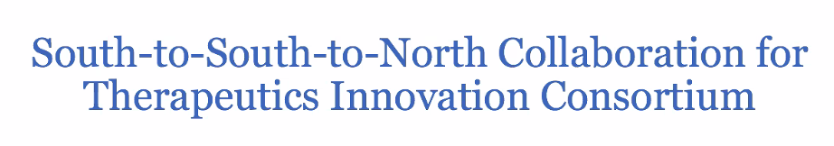

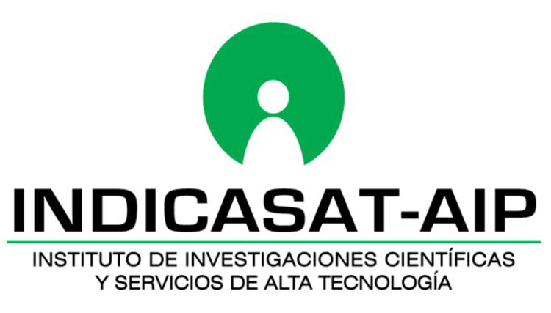
Latest advances on the INDICASAT Panama project:
Natural product development without borders
Carmenza Spadafora, PhD
2023

Slide 2
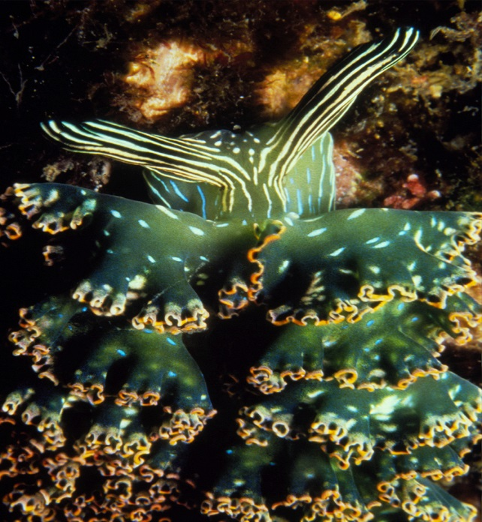
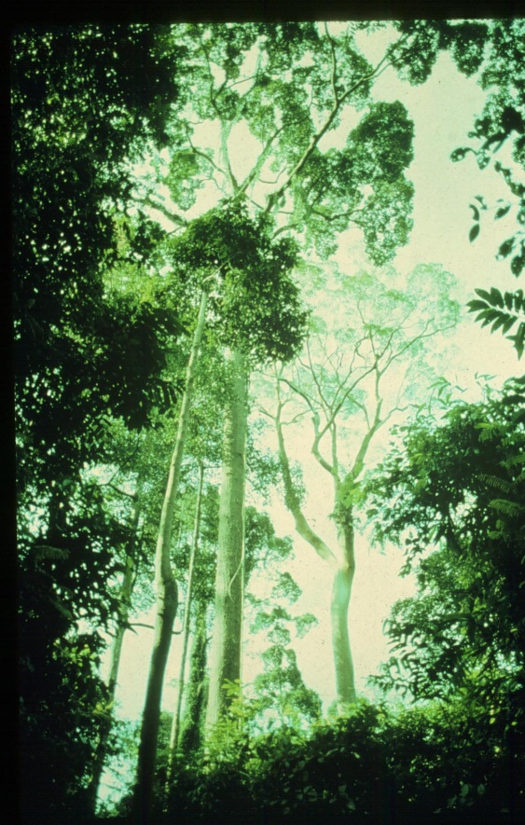
For >20 yrs, including today, 30-50% of new pharmaceutical drugs come from natural products
Phylis Coley

Slide 3
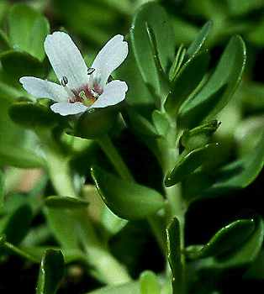
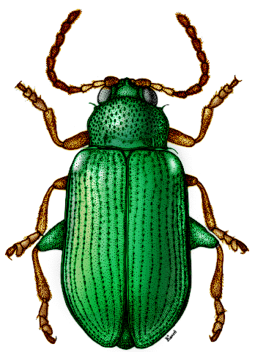
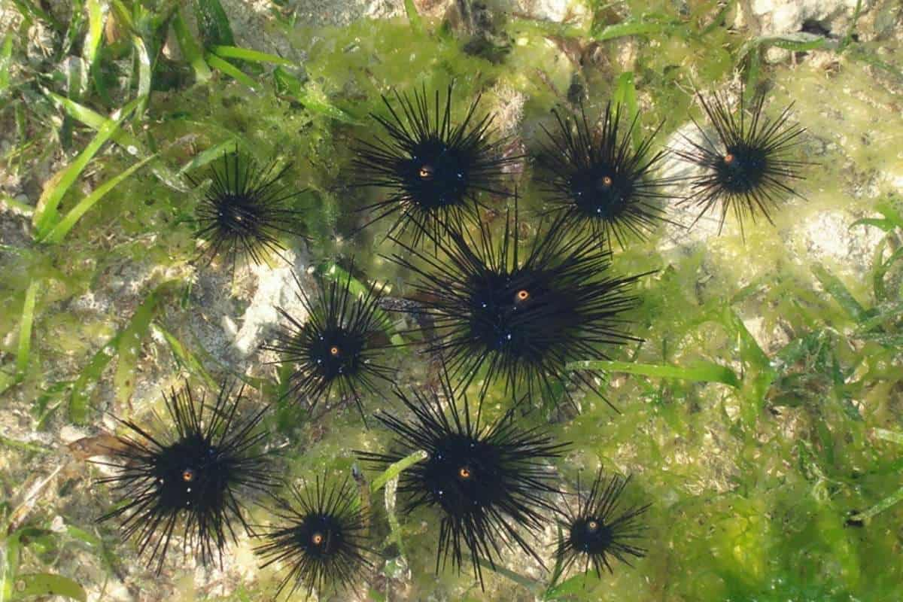
Chemical Arms Race
Predators evolve detox mechanisms
Species evolve novel defenses
(Co-evolution)
novel chemical defenses and high diversity of defenses
Phylis Coley

Slide 4
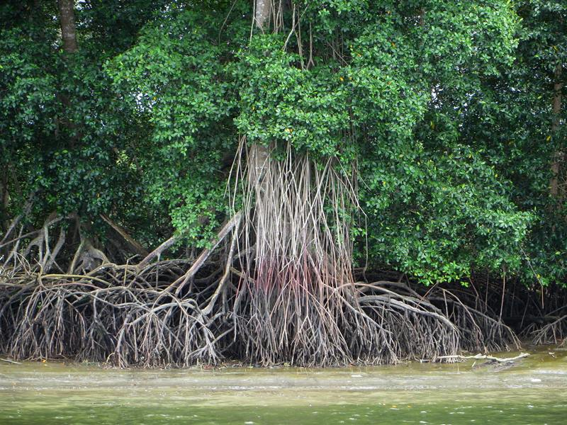
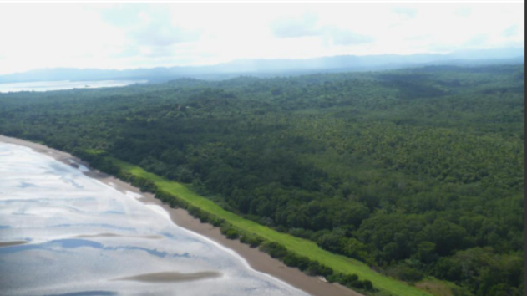
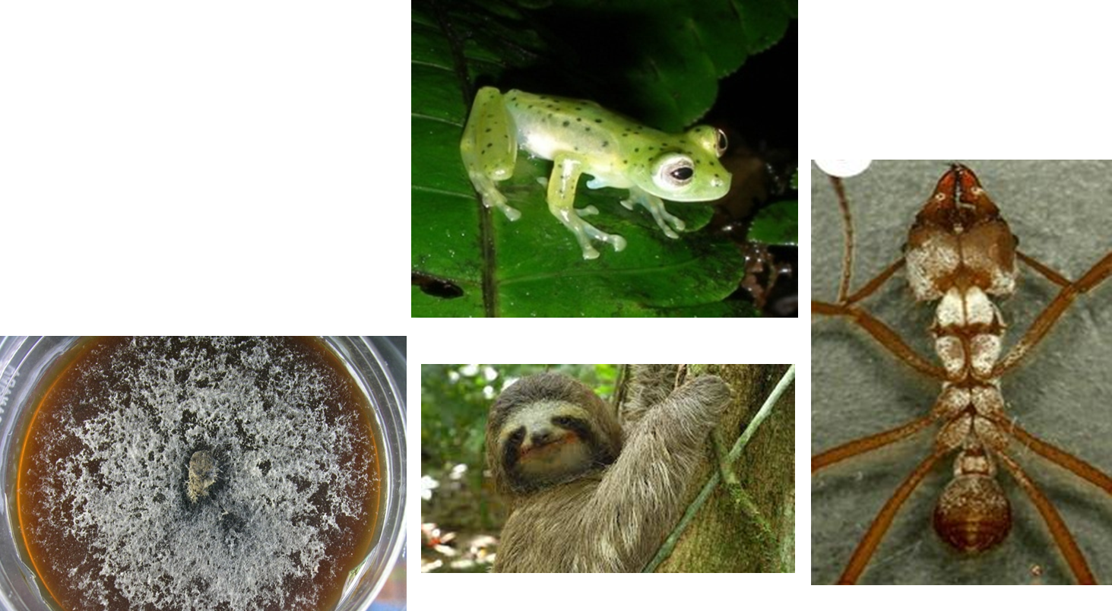
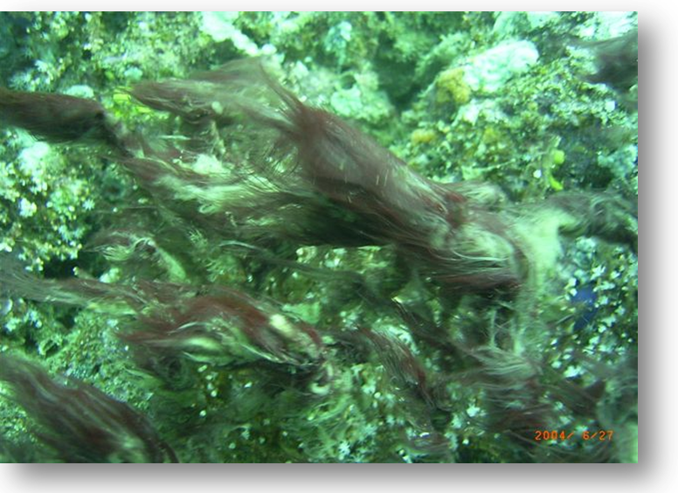
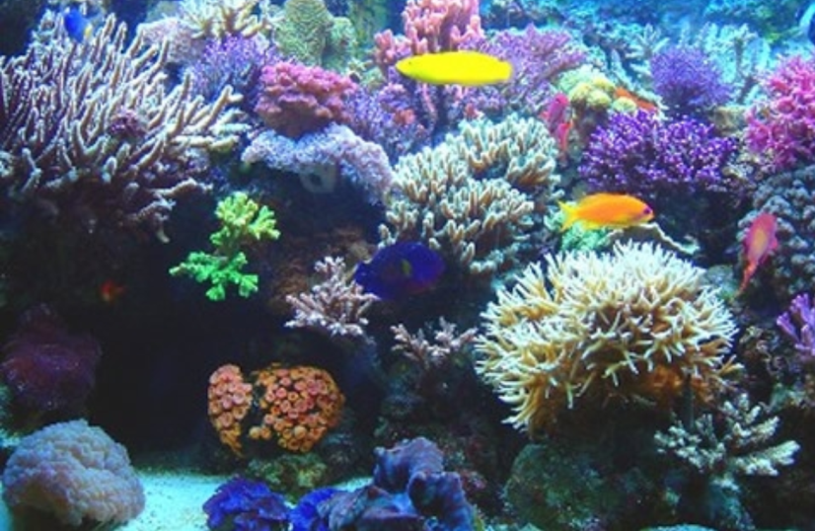
RICH BIODIVERSITY -
MANY SOURCES
However….

Slide 5
A Dilemma or a Conandrum?
Many companies have reduced or abandoned their interest in natural products, because of the hurdles in accessing genetic resources. Yet it is estimated that fewer than 1% of known plants in the world have been fully analyzed for their pharmacological activity.
It is an unfortunate fact that the major reason for the decline in the investigation of nature resources as potential medicines and consumer products has been the very international treaty that was intended to encourage it, namely the Convention on Biological Diversity (CBD).
Alan Hesketh

Slide 6
An exemplary country with different opportunities
The road to the Implementation of the Nagoya Protocol and ABS of Panama

Slide 7
CBD SIGNATURE 1992
RATIFICATION 1995

Slide 8
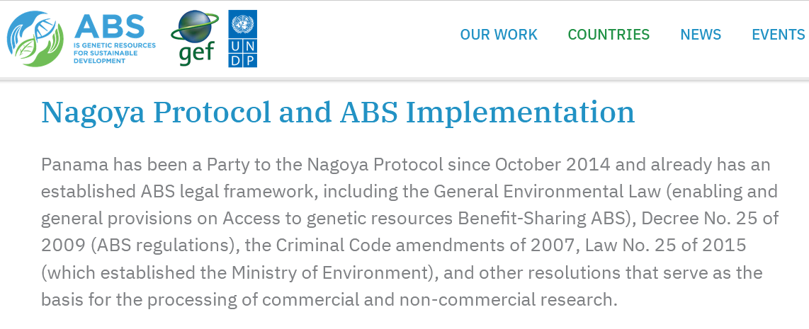
Nagoya Protocol signed in 2011 and ratified in 2012

Slide 9
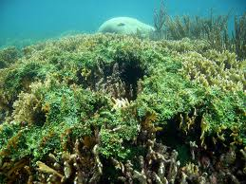
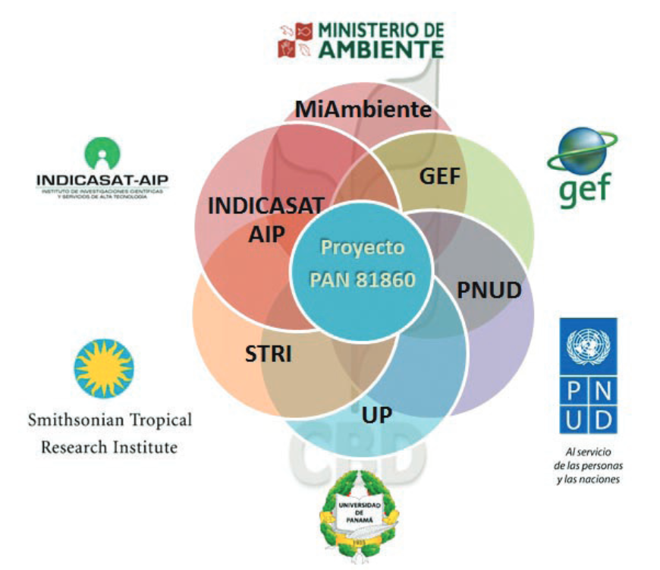
Proyecto 81860
Promotion of the Nagoya Protocol
Dic 2014

Slide 10
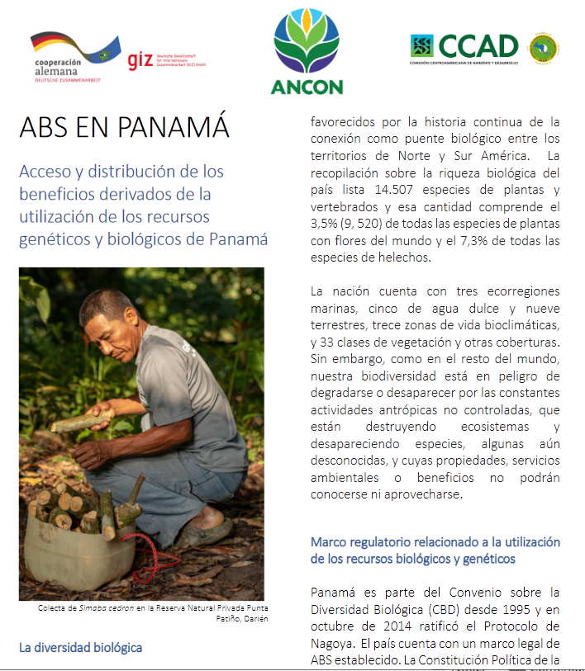
Explanatory Pamphlet on ABS and how to carry out the process in Panama

Slide 11
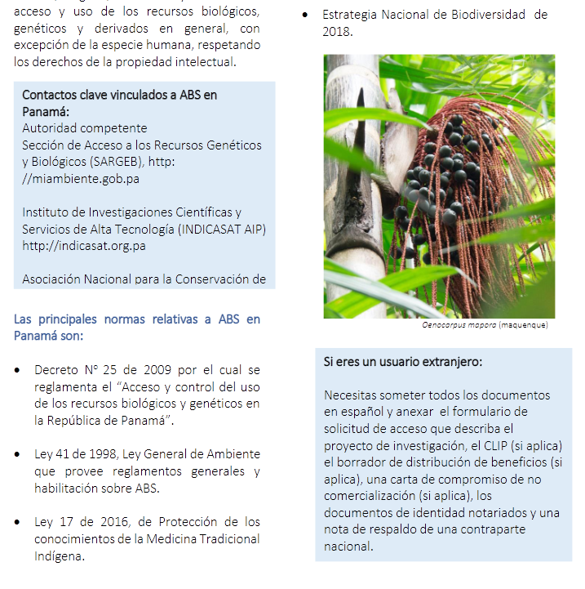

Slide 12
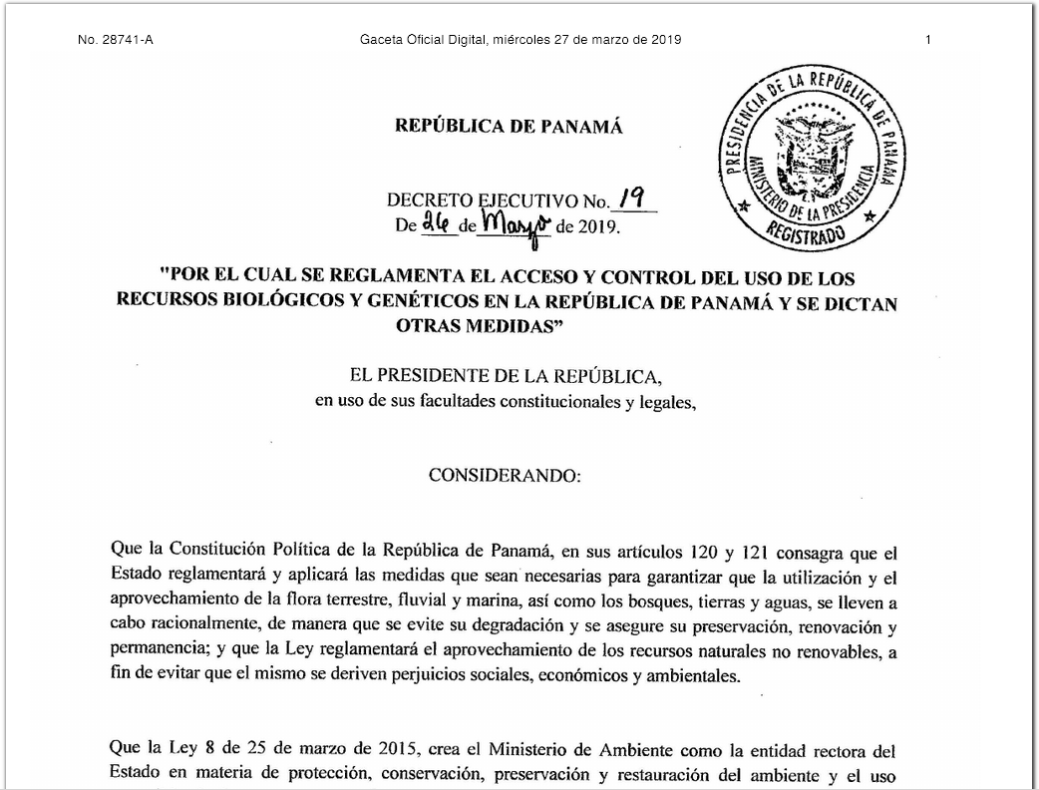

Slide 13
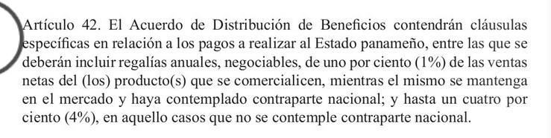

Slide 14
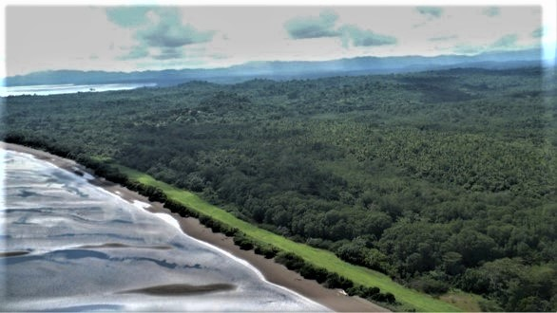
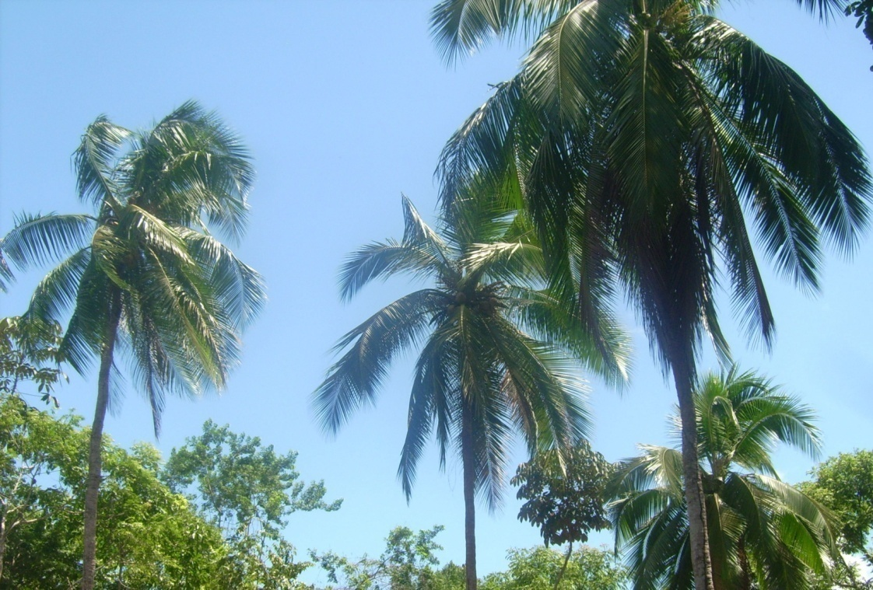
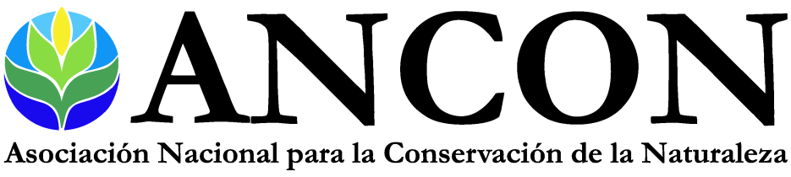
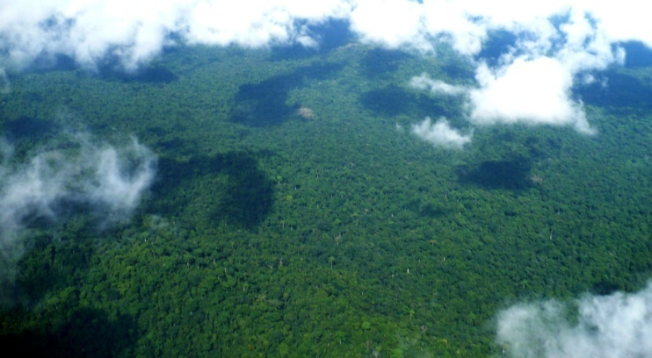
BIOCOMMERCE INTERESTS
German Agency of Cooperation
(GIZ)
Funding for basic research, workshops & commercial partners

Slide 15
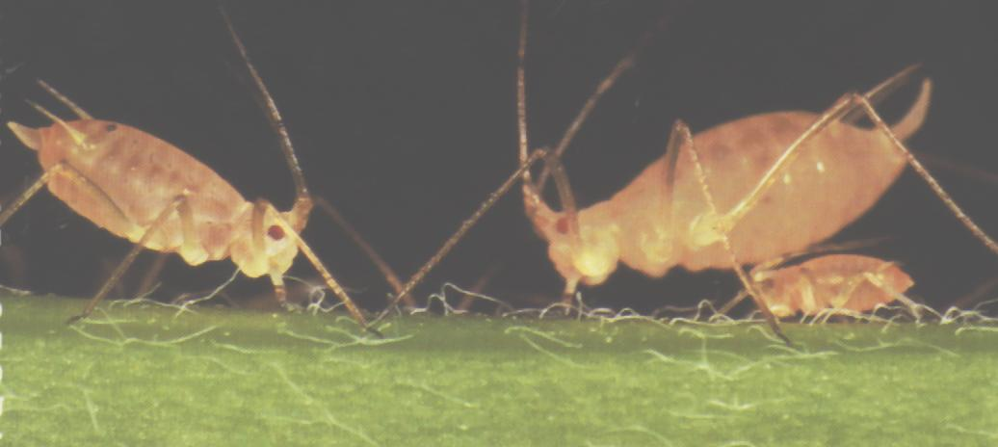
Bioassays in Panama
Major disease targets:
Cancer (lung, breast, CNS Cancer)
Spadafora Lab
Tropical disease targets:
Malaria
Trypanosomiasis
(Chagas’ disease)
Leishmaniasis
Antibiotic and antifungal
Agricultural pests
Angiotensin inhibitors (Hypertension)
Alzheimer’s Disease Plaque Formation
Glucose Production
Dengue
INDICASAT AIP

Slide 16




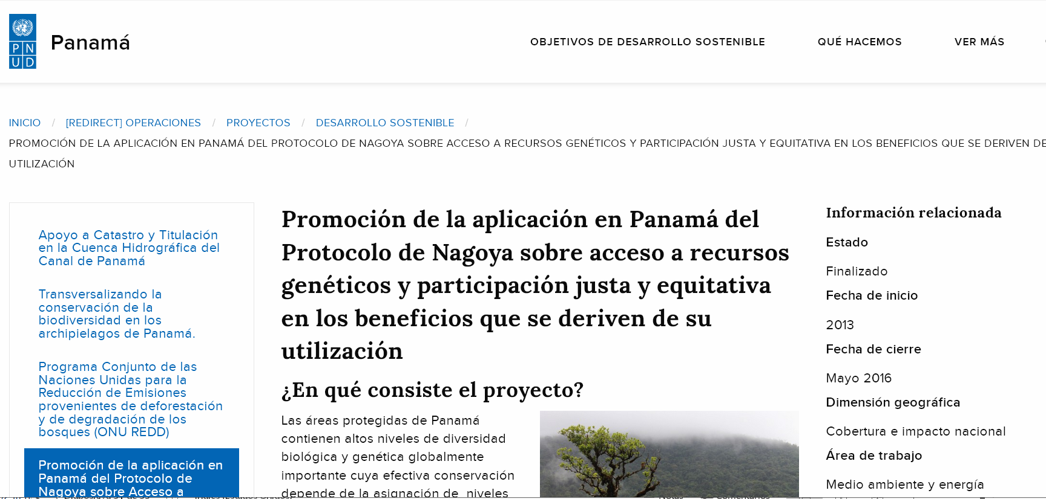

https://www.pa.undp.org/content/panama/es/home/operations/projects/environment_and_energy/aplicacion_protocolo_nagoya.html

Slide 17

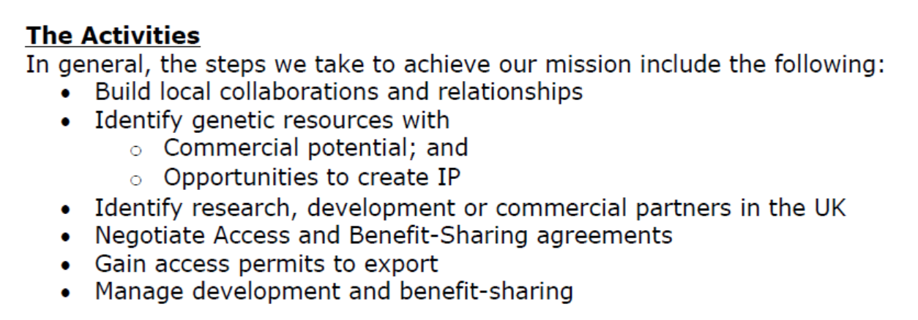

Slide 18
OXFORD Biotrans, UK
BioPharm Enterprises, UK
Costwold Perfumery Limited, UK
University College of London

Slide 19
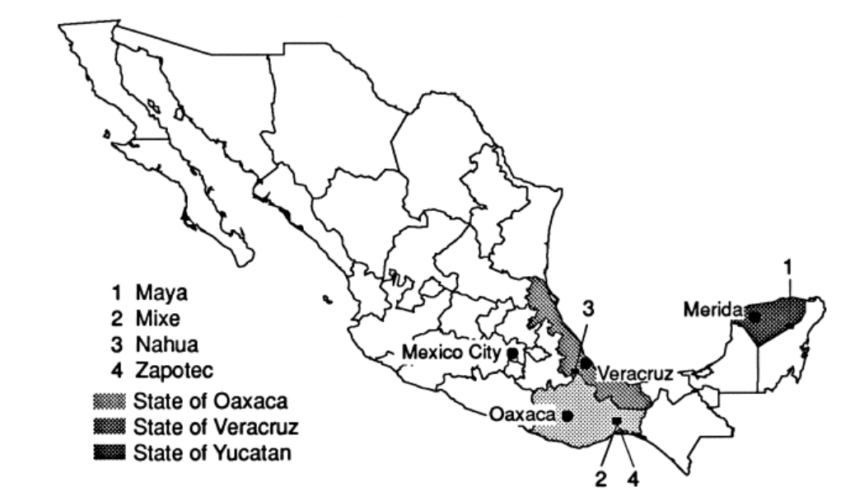
University College of London collaboration
Michael Heinrich et al, 1998

Slide 20
Mexican Indians, Maya, Nahua, Zapotec and Mixe
Important groups of indigenous healers
± specialists in home remedies
± midwives + + + +
± specialists in medicinal plants
± diverse types of ritual specialists
± bonesetters
± spiritists and/or spiritualists

Slide 21
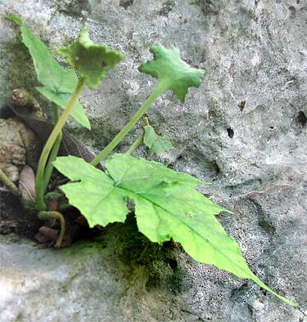
Dorstenia contrajerba
For the 19th century , Francisco Flores mentions: "boils were easily cured, in addition to diseases of the cornea". For the same years as Flores, the Mexican Society of Natural History describes it as alexitera, antimalarial, antipyretic, antipodagric, antiseptic, diuretic, for insteps, typhoid fever, sores, oxytocic, stimulant. Almost at the end of the century, the National Medical Institute reports it for gangrenous, anticrotalic, aperitif, carminative, stimulant, eupeptic, tonic angina and for smallpox and dermatosis.
https://es.wikipedia.org/wiki/Dorstenia_contrajerva

Slide 22
Dorstenia contrajerba
Asociated with mangroves and tropical forests of warm and semi-warm climates
The presence of alkaloids has been detected in leaves and stems.
https://es.wikipedia.org/wiki/Dorstenia_contrajerva

Slide 23
Alkaloids with therapeutic uses
10 of the 12 most important plant-derived
medicines are alkaloids
Codeine (anesthetic)
Morphine (anesthetic)
Digoxin (cardiovascular)
Vincristine (cancer)
Ephedrine (pulmonary)
Quinine (malaria)
(additional popular alkaloids: caffeine, nicotine, cocaine)
Phylis Coley

Slide 24
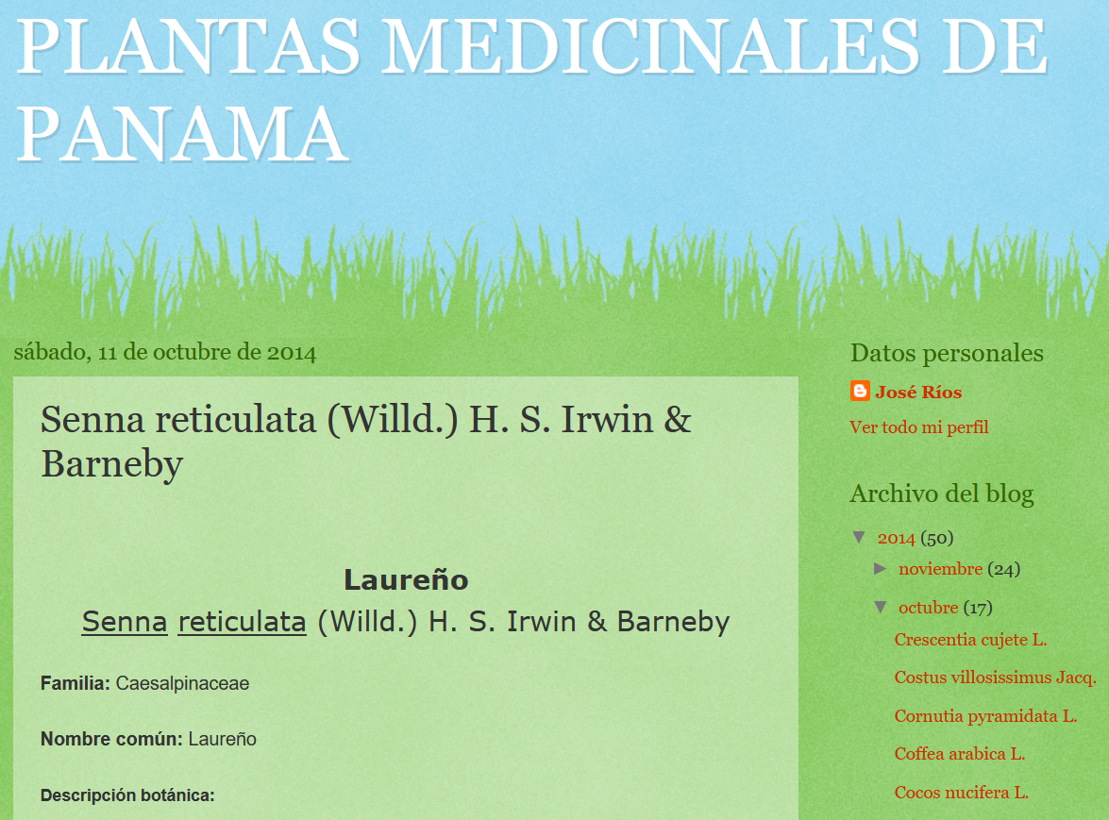
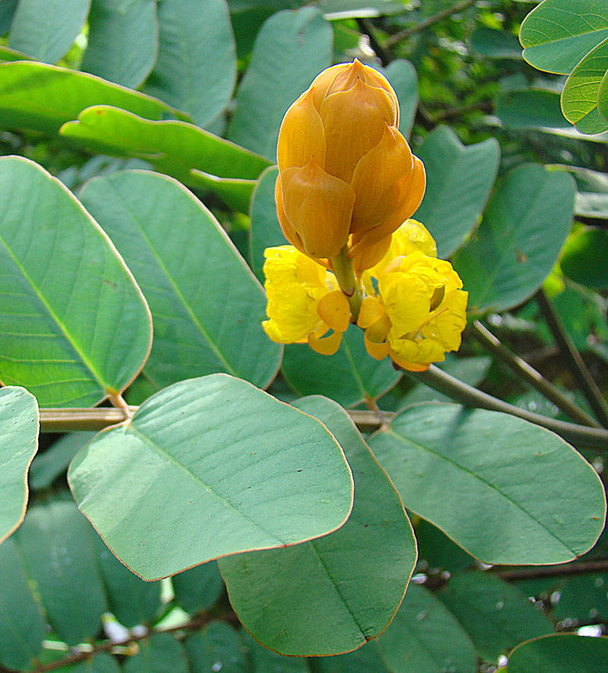
Senna reticulata
For liver and rheumatism
For pimples and skin infections
Other skin problems
Mexico to Brazil
https://es.wikipedia.org/wiki/Senna_reticulata#/media/Archivo:Senna_reticulata,_flower_of_the_Swamp_Senna_(9336852822).jpg

Slide 25
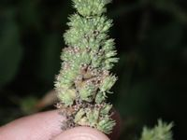
Mesosphaereum pectinatum
https://www.gbif.org/species/3889976

Slide 26
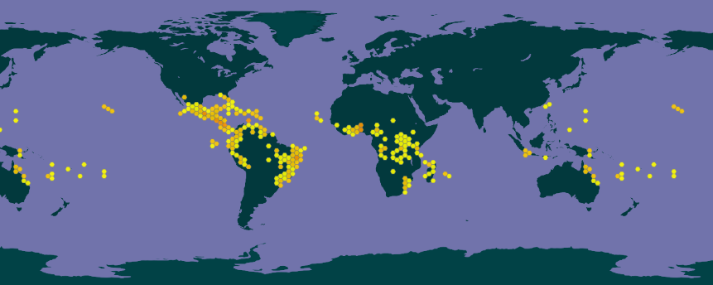
Mesosphaereum pectinatum
Originally from tropical America

Slide 27
Activities for the project
Stage 2 - Extraction
Each of the parts of the plant species will be extracted in solvents to provide extracts containing predominantly non-polar, medium polar and very polar compounds.
Stage 3 - Toxicity
Samples of the extracts will be subject to testing on cell lines for cytotoxicity. Optionally, testing will be carried out on skin cells including keratinocytes
Stage 4 - Activity
Each sample which shows lack of toxicity will be tested for antimicrobial activity.
Stage 5 - Formulation
Samples that show antibacterial activity will be formulated for medical use.
Stage 6 – Use of results
The result of the research is expected to provide a wound healing agent that has effective antibacterial activity as well as lack of skin toxicity and cytotoxicity.
The information gained from the research will be shared with the indigenous community that provided the plant samples, for use by local healers.

Slide 28
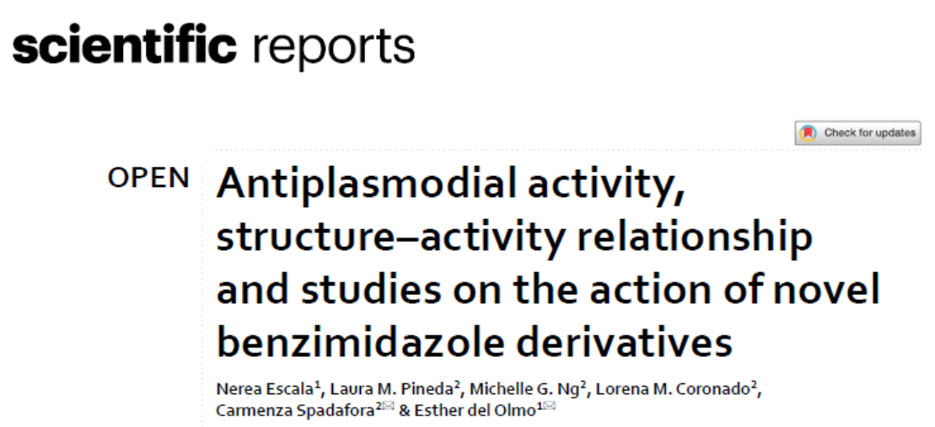
University of Salamanca
Natural products and synthetic compounds

Slide 29




Early contacts on new collaborations
Anwar Alduma
University of Khartoum
Sudan
Augusto Crespi and Tamara Rubilar
Instituto Patagónico del Mar
Argentina
??!!
??!!

Slide 30
Center of Biodiversity and Drug Discovery- INDICASAT AIP

Slide 31

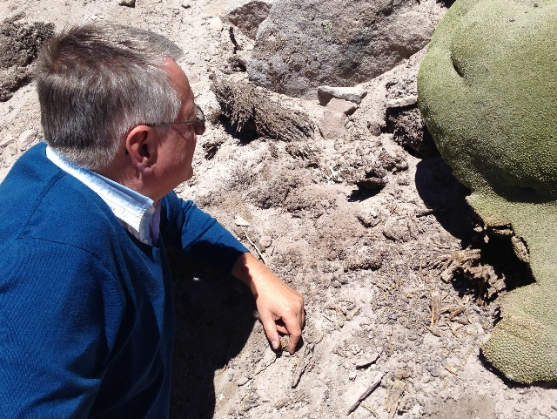

Michael Heinrich
University College of London
Dr Alan Hesketh
Indigena Biodiversity Ltd
Dr Francesca Scotti
University College of London

Slide 32
