Slide 1
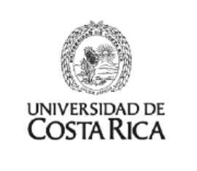

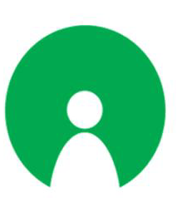
Validating the Bioactivity of Panama's 'Desbaratadora': In Vitro Approaches
Global Health, Biodiversity, and Therapeutics
Justicia seconda Vahl
Instituto de Investigaciones Científicas y Servicios de Alta Tecnología (INDICASAT AIP)
Aug 20, 2024

Slide 2
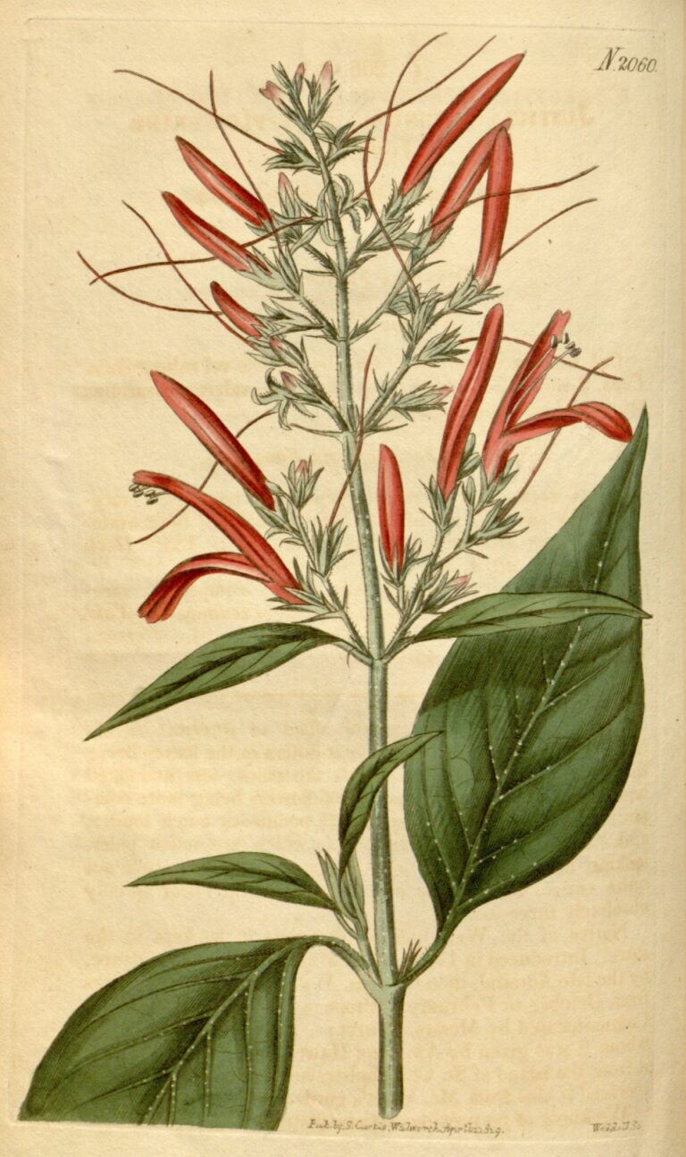
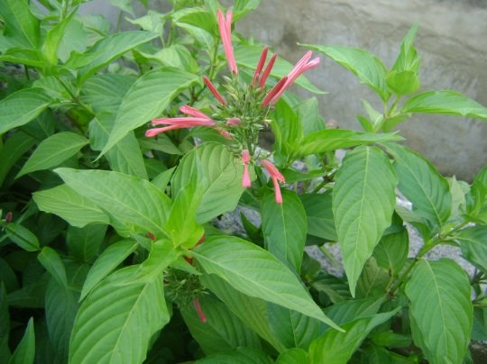
The four main regions of its distribution are Malaysia and Indonesia, Brazil, tropical Africa and Central America

Slide 3
Reino | Plantae
Filo | Traqueofita
Clase | Magnoliopsida
Orden | Lamiales
Family | Acanthaceae (346 Genus)
Genus | Justicia L (largest genus)
Especie | Justicia secunda Vahl
"la hoja de la vida” (the leaf of life), "Singamochilla", "Cascajera“ (gravel), “desbaratadora” (disruptor), "Insuline", "Sanguinaria“ (bloodroot), and "Curatodo“ (cure-all)

Slide 4
Its greatest use is in traditional medicine, which attributes to it the ability to treat problems such as
Fibroids in the uterus
Menstruation cramps
Colds
Fever
Malaria
Whooping cough
Anemia
Hipotension
Kidney stones
Antiinflamatory, antinociceptive, and antioxidant properties

Slide 5
ANTIOXIDANT, ANTI-INFLAMMATORY AND ANTINOCICEPTIVE ACTIVITIES OF METHANOLIC EXTRACT OF JUSTICIA SECUNDA VAHL LEAF.
Onoja, s., Ezeja, m., Omeh, y., & Onwukwe, b. 2017.. Alexandria Journal of Medicine, 53(1), 207- 213
IN VITRO EFFECTS OF ANTHOCYANIN EXTRACTS FROM JUSTICIA SECUNDA VAHL ON THE SOLUBILITY OF HAEMOGLOBIN S AND MEMBRANE STABILITY OF SICKLE ERYTHROCYTES
Mpiana, p., Ngbolua, k., Bokota, m., Kasonga, t., Atibu, e., Damien, tshibangu, d., & Mudogo, V. 2010.. Blood Transfusion, 8(4), 248-254
HYPOTENSIVE AND ANTIHYPERTENSIVE EFFECTS OF TOTAL AQUEOUS EXTRACT OF JUSTICIA SECUNDA VAHL M. (ACANTHACEAE) IN RABBITS.
Kouakou, j., Kouakou, l., & Adou, y. 2016. International Journal of Science and Research, 5(5), 1455- 1462.

Slide 6
ANÁLISIS DEL COMPORTAMIENTO DE LOS PARÁMETROS BIOQUÍMICOS EN PACIENTES DIABÉTICOS TIPO II, QUE CONSUMEN LA INFUSIÓN DE JUSTICIA SECUNDA (PLANTA DE INSULINA), COMO COADYUVANTE EN SU TERAPIA Y QUE INTEGRAN EL CLUB DE DIABÉTICOS DEL CANTÓN PALESTINA GUAYAS (TESIS DE LICENCIATURA).
García, b., & Patiño, c. 2015. Universidad de Guayaquil, Ecuador.

Slide 7
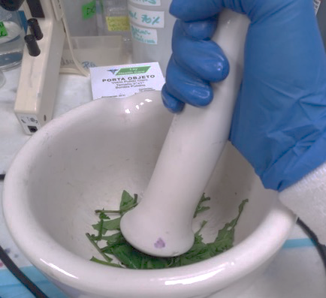
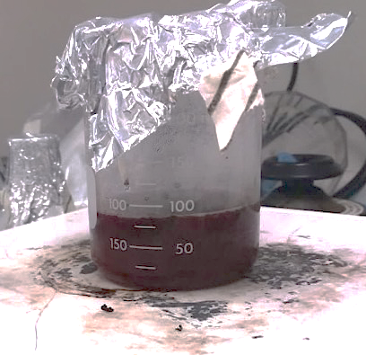
Washed, dried
RT 23 ^{O}C
3 min boiling
Stored at -20 ^{O}C

Slide 8
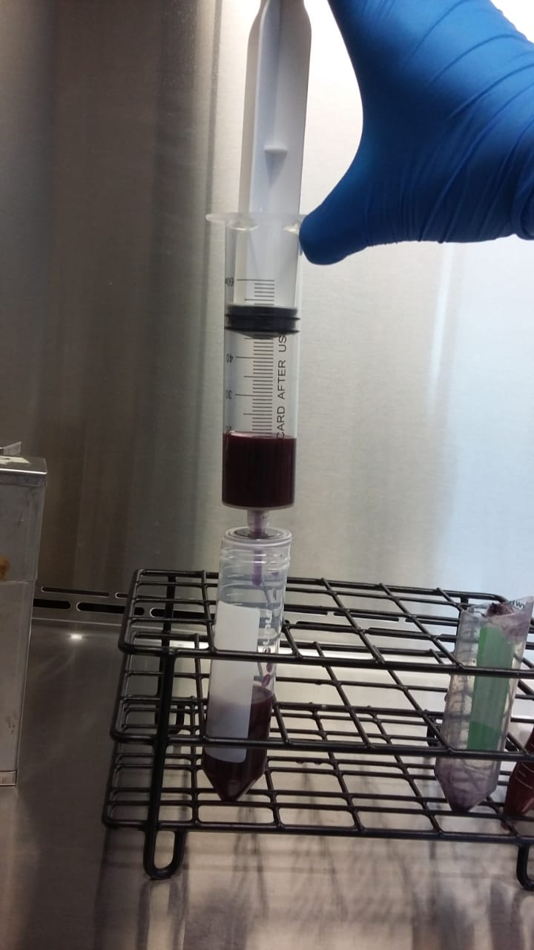
Filtration of the aqueous extract of Justicia secunda Vahl.
Whatman paper (3X)
0.2 µm acrodisc (1X)

Slide 9
(uL) | 2% | 2.5% | 3% | 3.5% | 4% | 4.5% | 5% | 6% | 8% | 10%
Samples | 4 | 5 | 6 | 7 | 8 | 9 | 10 | 12 | 16 | 20
RPMI | 196 | 195 | 194 | 193 | 192 | 191 | 190 | 188 | 184 | 180

Slide 10
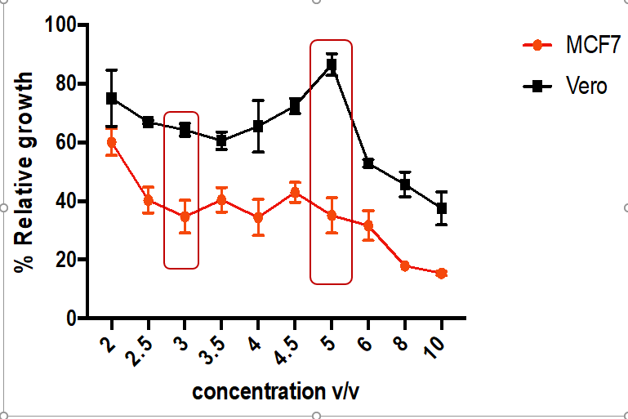
Cytotoxic effect of aqueous extract of Justicia secunda Vahl on MCF-7 and Vero cells using MTT. Results (mean ± SD) were calculated as the percentage of control values. Significant differences were obtained by one-way ANOVA followed by Bonferroni test.

Slide 11
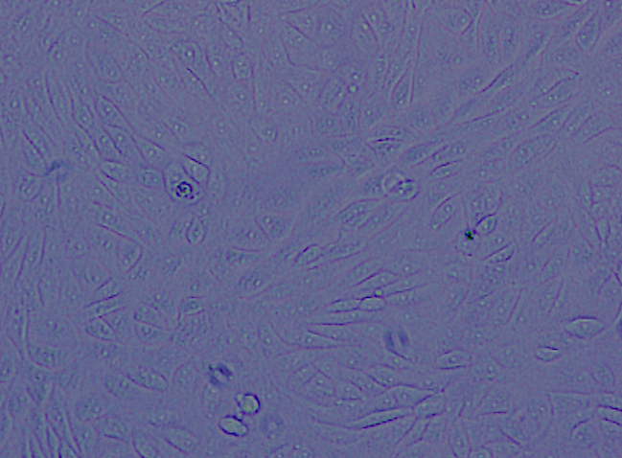
MCF-7 treated with the aqueous extract of Justicia secunda Vahl for 24 h. Left, negative control ~85% confluency. Right, cells treated with 5% of the extracts v/v ~45% confluency

Slide 12
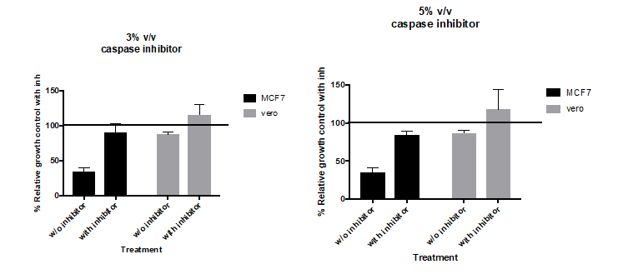
Effect of aqueous extract of Justicia seconda Vahl on caspase activity
****
****

Slide 13
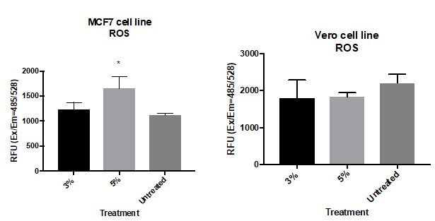
Effect of aqueous extract of Justicia secunda Vahl on the content of reactive oxygen species in MCF-7 and Vero cells

Slide 14
Effect of aqueous extract of Justicia secunda Vahl on mitochondrial membrane potential of MCF-7 and Vero cells

Slide 15
It´s an extract
TRADITIONAL KNOWLEDGE
NAGOYA PROTOCOL
MASS SPRECTOMETRY DATA
BIOINFORMATICS
PHARMA VALUE
Flavonoids, quinines, alkaloids, cumarines, glucosides, phenolic compounds in the hydroalcoholic extract, triterpenes, esteroids in the alcoholic extract, anthocianines and derivatives of luteoline

Slide 16
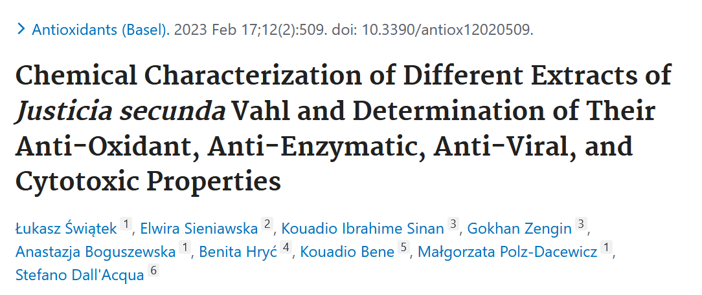

Slide 17
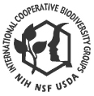
ICBG
International Cooperative Biodiversity Groups (ICBG) projects worldwide
Research focus on drug discovery, biodiversity conservation, and sustainable economic growth
Notes:
The over-arching goal of this work is to discover new lead compounds from Panamanian microorganisms for the treatment of cancer, CNS disorders, tropical diseases, and agricultural pests, employing a spectrum of innovative as well as traditional bioassays. This pursuit will be inextricably connected to the development of scientific training and capacity building in a biodiversity-rich yet economically-developing country, and will foster tangible results in biodiversity conservation and infrastructure development.

Slide 18









Background of ICBG-Panama
International Cooperative Biodiversity Groups
Drs. Tom Kursar and Phylis Coley 1998
Funded by NIH (administered by Fogarty International Center (Flora Katz)), NSF and USDA
15 years of successful performance
Notes:
Use ecological concepts to guide the collection and culture of endophytic fungi, cyanobacteria and other heterotrophic bacteria within the biodiversity-rich country of Panama.

Slide 19
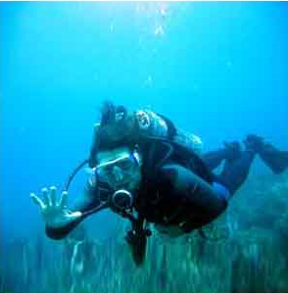
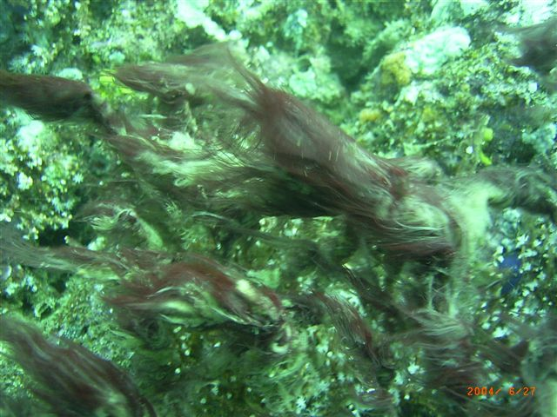
Coibamide A, a natural anticancer product from cianobacteria from Coiba island, Panama
Kerry McPhail (Oregon State University)

Slide 20
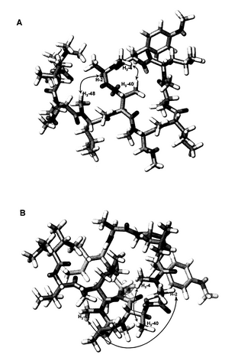
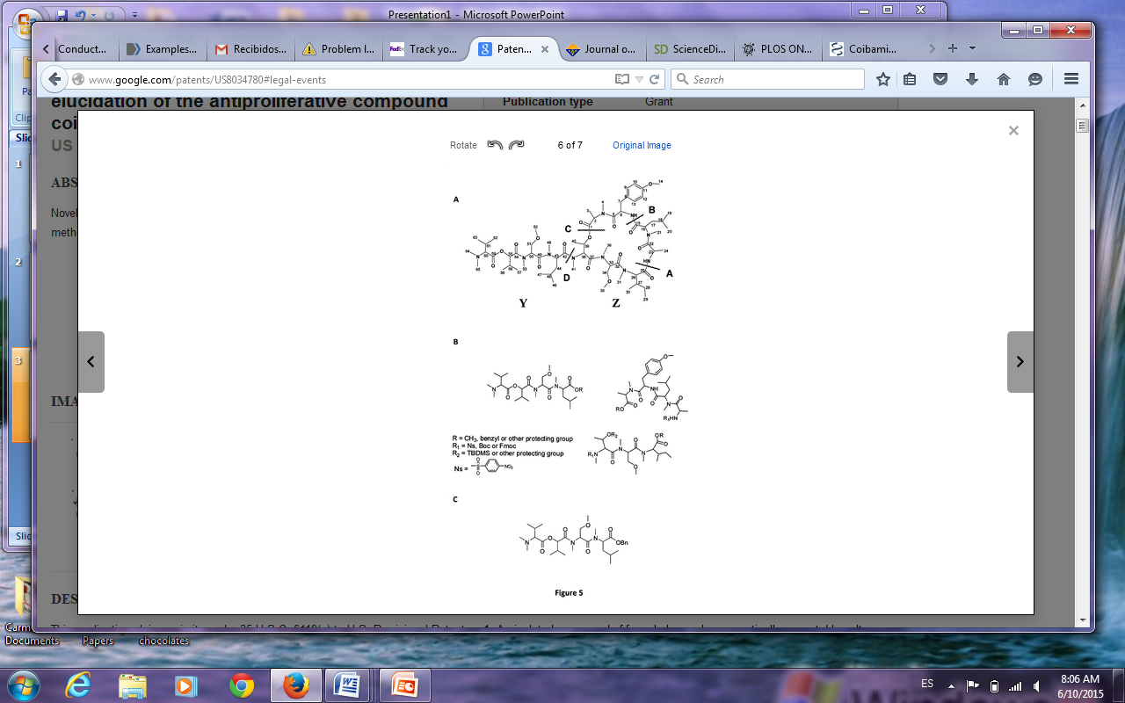
Coibamide A

Slide 21
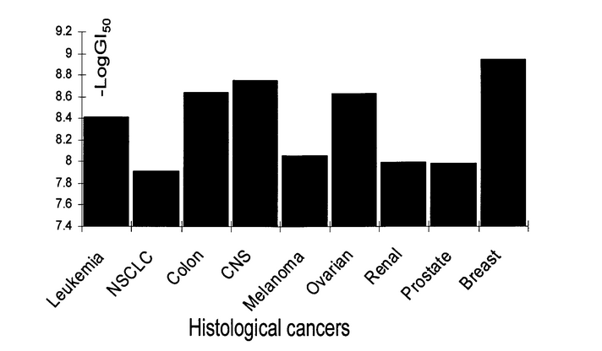

Slide 22
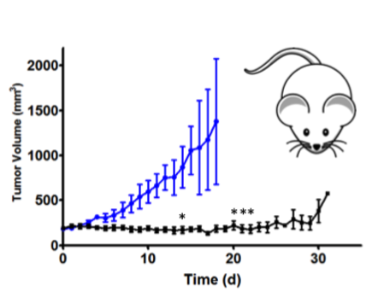

Slide 23
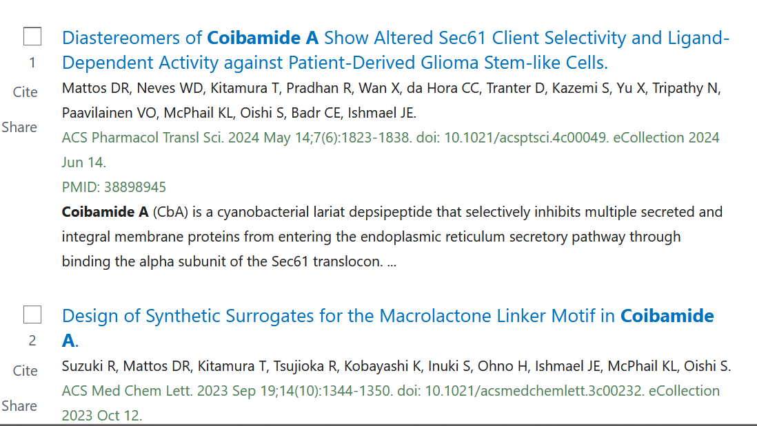

Slide 24
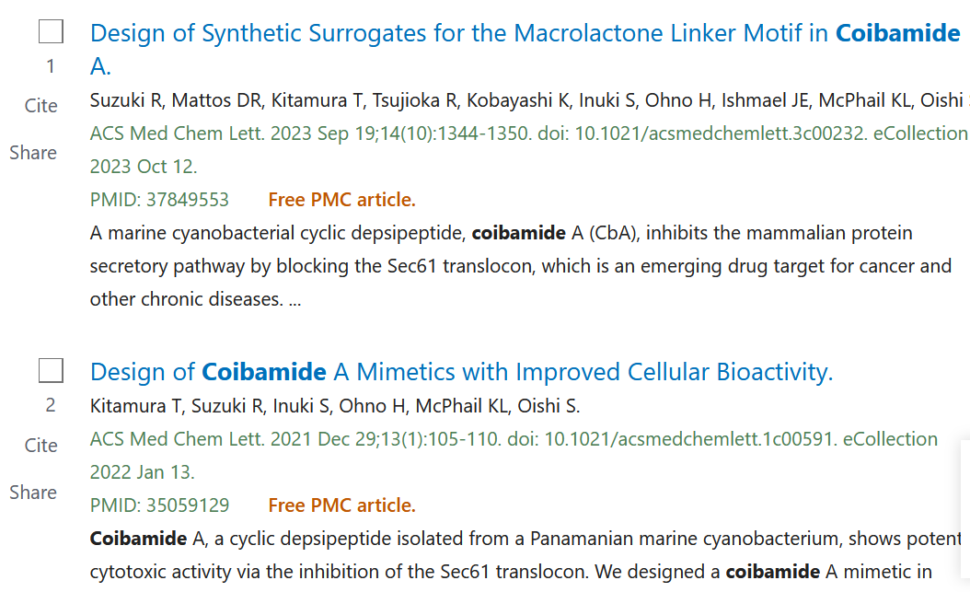

Slide 25
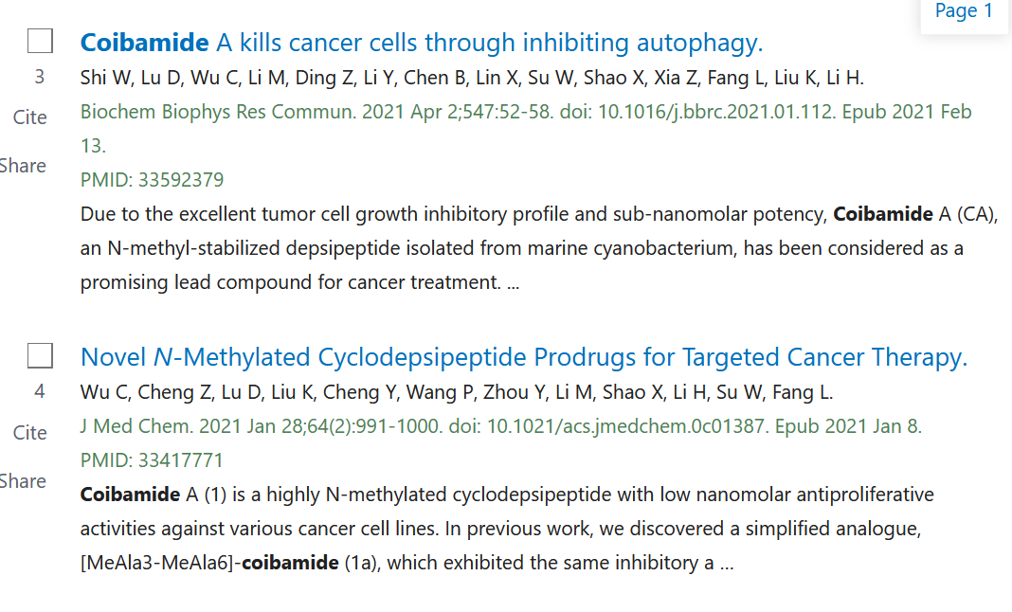

Slide 26


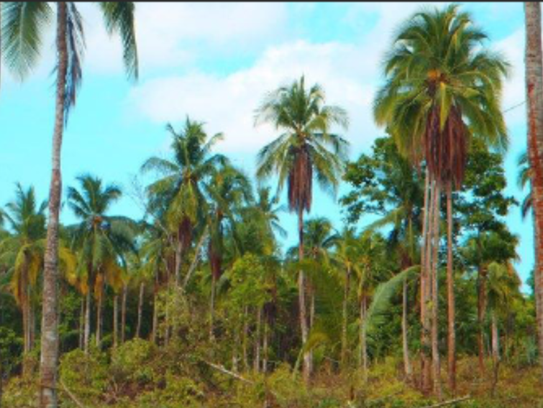


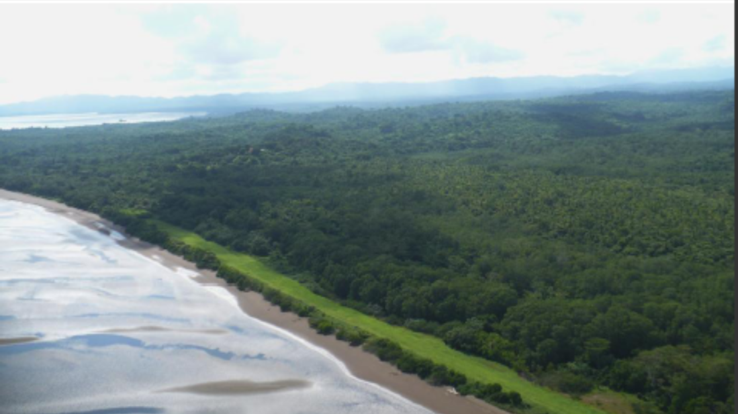
INDIGENA BIODIVERSITY Ltd

Slide 27
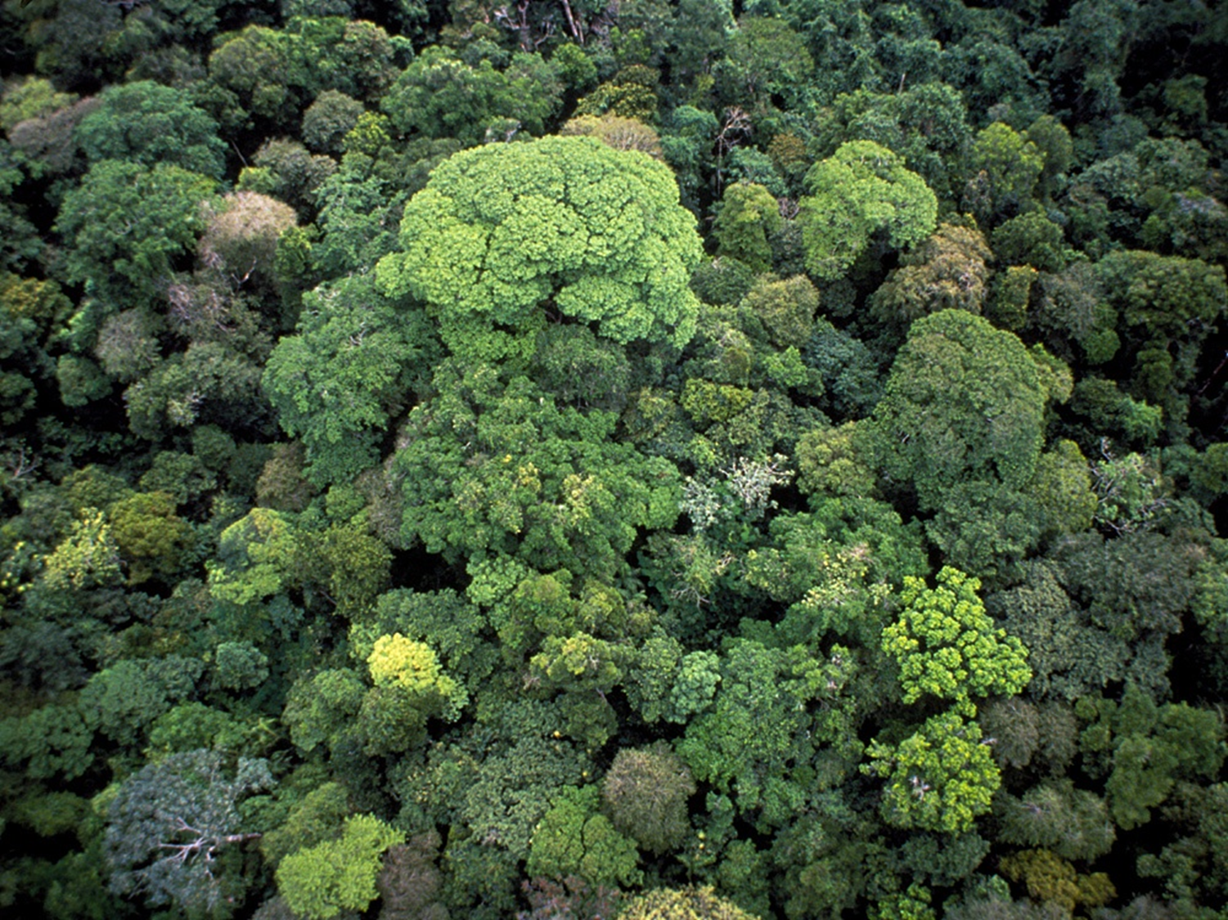

OXFORD BIOTRANS
COSTWOLD PERFUMERY
BIOPHARM ENTERPRISES LTD
UNIVERSITY COLLEGE LONDON
ALIANZAS PARA IMPULSAR LA BIOPROSPECCIÓN y EL DESCUBRIMIENTO DE DROGAS
Carmenza Spadafora, Ph.D.
Jyly 16th, 2020

Slide 28
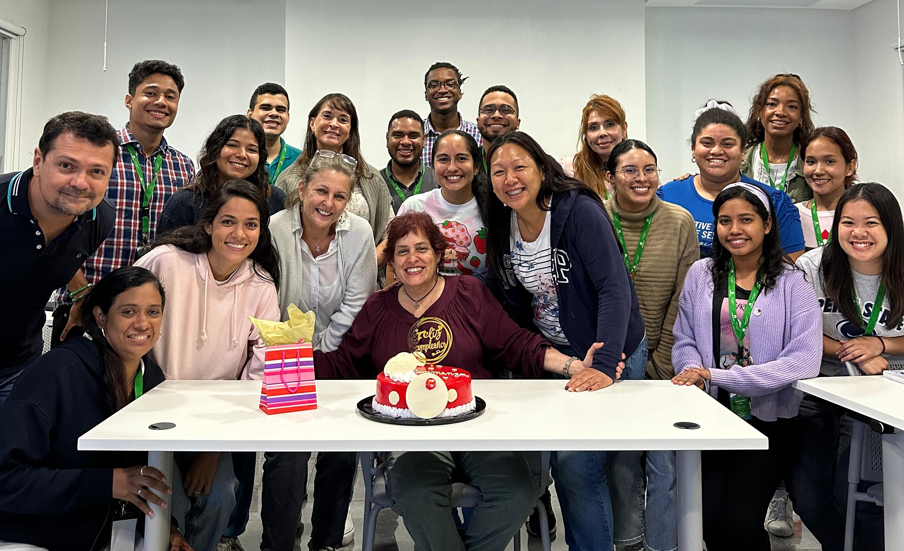
THANKS
Lorena Coronado, Ph.D
Sara Rosero, Ph.D. The Spadafora Lab
Doriana Dorta, BS
Michelle Ng, BS All the Spadafora Group at INDICASAT AIP
www.carmenzaspadafora.net
cspadafora@indicasat.org.pa

