Slide 1
Funding opportunities for natural products research from the Fogarty International Center, NIH
Global Health, Biodiversity, and Therapeutics Hybrid Seminar,
Harvard University Herbaria and University of Costa Rica
Costa Rica August 20, 2024
Flora Katz, Ph.D.
Director of Extramural Activities
Fogarty International Center

Slide 2

National Institutes of Health
$45 bil/year
Office of the
Director
National Institute
on Aging
National Institute
on Alcohol Abuse
and Alcoholism
National Institute
of Allergy and
Infectious Diseases
National Institute
of Arthritis and
Musculoskeletal
and Skin Diseases
National Cancer
Institute
National Institute
of Child Health
and Human
Development
National Institute on
Deafness and Other
Communication
Disorders
National Institute
of Dental and
Craniofacial
Research
National Institute
of Diabetes and
Digestive and
Kidney Diseases
National Institute
on Drug Abuse
National Institute
of Environmental
Health Sciences
National Eye
Institute
National Institute
of General
Medical Sciences
National Heart,
Lung, and Blood
Institute
National Human
Genome Research
Institute
National Institute
of Mental Health
National Institute
of Neurological
Disorders and
Stroke
National Institute
of Nursing Research
National Institute of
Biomedical Imaging
and Bioengineering
National Center
for Complementary
and Integrative
Health
National Center for
Accelerating
Translational
Science
National Library
of Medicine
National Center on
Minority Health and
Health Disparities
Fogarty
International
Center
Nat’l Center
for Research
Resources
Clinical Center
Center for
Information
Technology
Center for
Scientific Review
Notes:
Balkanized; CF

Slide 3

The Fogarty International Center (FIC): Mission
To address global health challenges through innovative & collaborative (US-foreign) programs for research & research training
Focus on building research capacity in low- and middle-income countries
To support & advance the NIH mission thru global partnerships
“Science for Global Health”
Rhode Island Congressman John E. Fogarty

Slide 4
Scope: Mix of broad and targeted programs
All applications solicited by NOFO (notice of funding opportunity)
Research | 66
mHealth (R21, R33) | 16
GEOHealth (U01) | 9
EEID (R01) | 5
HIV Stigma (R01, R21) | 15
HIV NCD (R21) | 10
DS-I Africa Hubs (U54) | 8
Brain Disorders (R21) | 3
Educational Development | 32
HEPI (R25) | 9
AFREHealth (R25) | 1
Bioethics (R25) | 22
Training | 164
GID (D43, U2R, D71) | 33
HIVRT (D43, D71, G11) | 61
NCD Lifespan (D43) | 33
LAUNCH (D43) | 7
Trauma & Injury (D43) | 8
GEOHealth (U2R) | 7
Bioinformatics (U2R) | 2
DS-I Africa (U2R) | 7
Bioethics (D43) | 6
Career Development | 76
K01 US Scientist | 22
K43 Foreign Scientist | 54

Slide 5
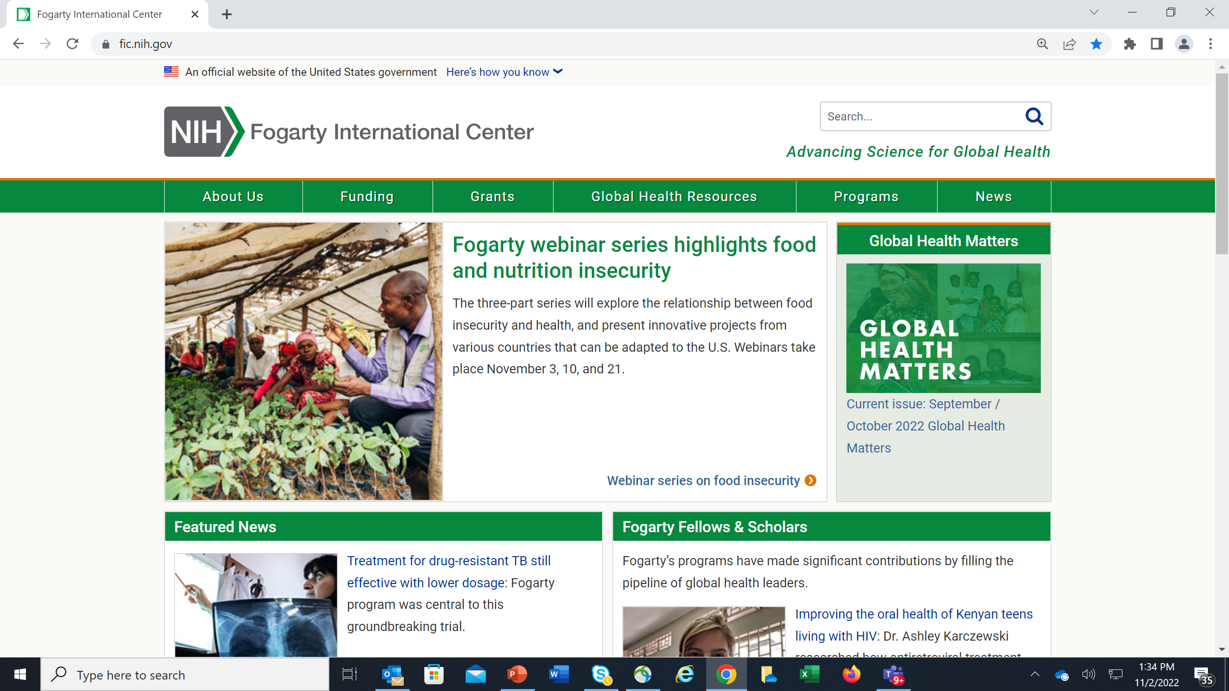

Slide 6
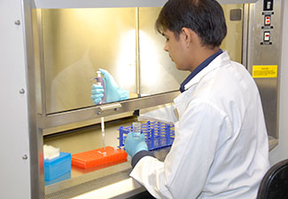
Fogarty Career Development Programs: building a robust global health workforce
Three- to Five-year fellowships for mentored global health research and career development
for U.S. advanced postdoctoral investigators
FIC International Research Scientist Development Award (IRSDA; K01)
PAR-21-104; K awards from other ICs at NIH
for LMIC junior faculty
Emerging Global Leader Award (K43)
  PAR-21-252 (Independent Clinical Trial Not Allowed)
  PAR-21-251 (Independent Clinical Trial Required)
K01
Photo courtesy of Aga Khan University
K43
Transition to Research Independence

Slide 7
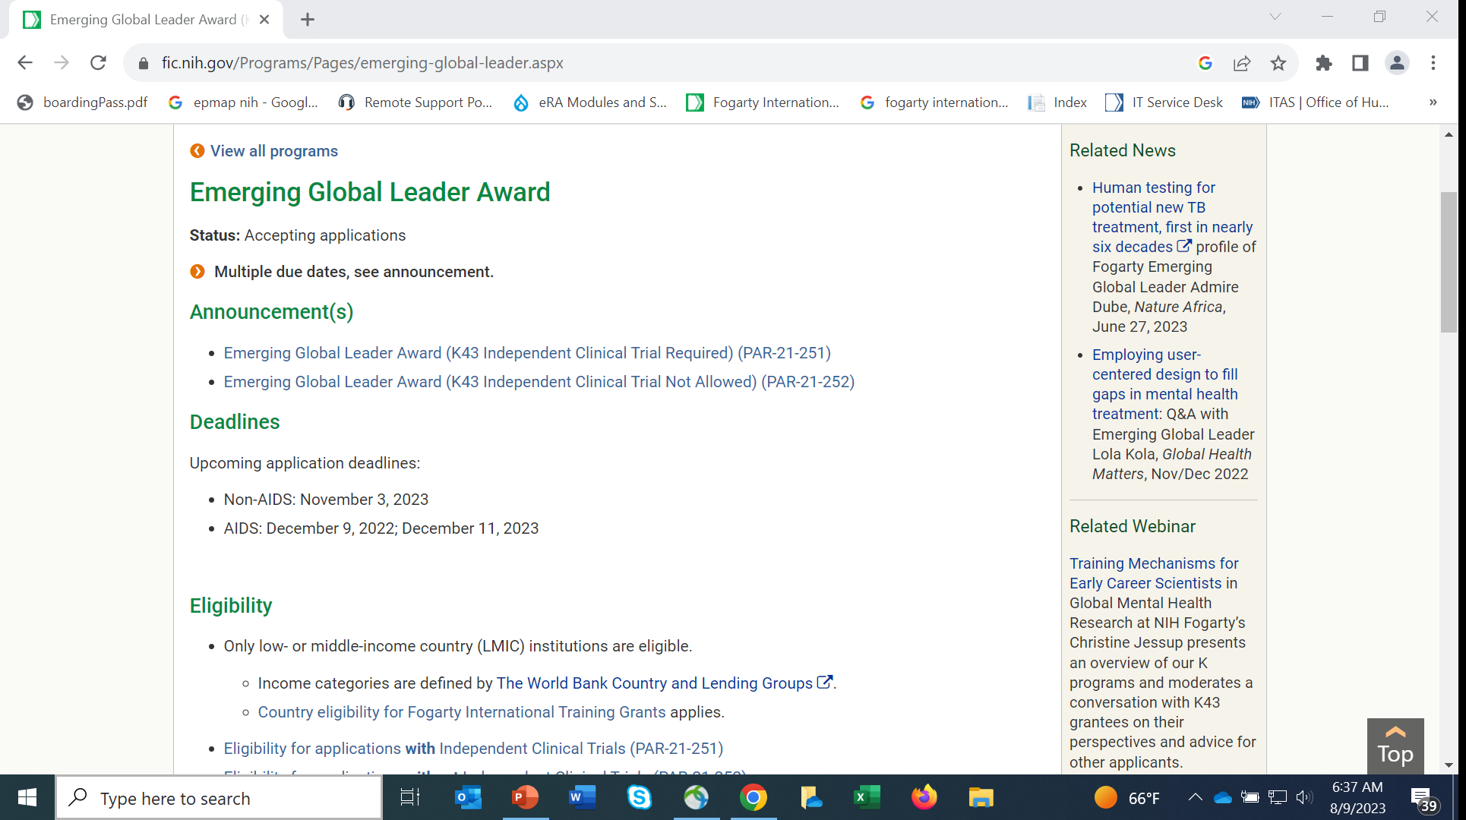

Slide 8
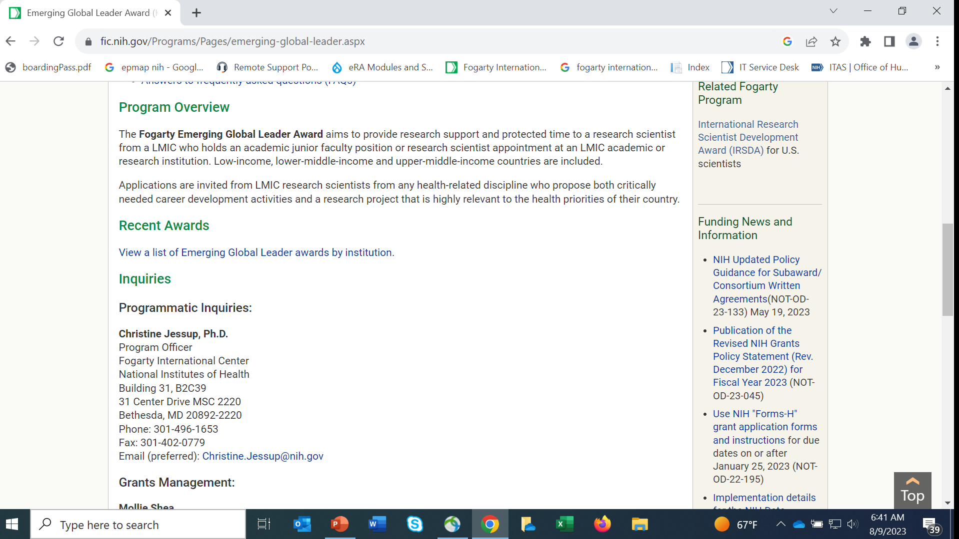

Slide 9
Program Features: K43 Emerging Global Leaders Award
LMIC Citizen (see exceptions in NOFO), LMIC Inst.
Provides 3-5 years of mentored research and career development in global health
Minimum 75% effort (min. 9 person-months)
Up to $75,000 salary, $30,000 research costs/year
Junior Faculty or Research Scientist position
Cannot have independent funding at R01 level
Must have both US and LMIC mentors
Majority of time/effort in home country
Scope: any area covered by NIH and highly relevant to collaborating LMIC
Partners: FIC, NCI, NHGRI, NHLBI, NIA,NIDCD, NIDCR, NIEHS, NIMH, NINDS, ORWH

Slide 10
Program Features: K01 Emerging Global Leaders Award
U.S. citizens, non-citizen nationals, or persons with U.S. permanent resident status
Provides 3-5 years of mentored research and career development in global health
Minimum 75% effort (min. 9 person-months)
Up to $100,000 salary, $40,000 research costs/year
Advanced Postdoctoral appointment or recent appointment as junior faculty
Cannot have independent R01-level funding
Must have both US and LMIC mentors
Majority of time/effort in LMIC (50% time over life of award)
Scope: any area covered by NIH and highly relevant to collaborating LMIC
Partners: FIC, NCI, NIDCD, NEI

Slide 11
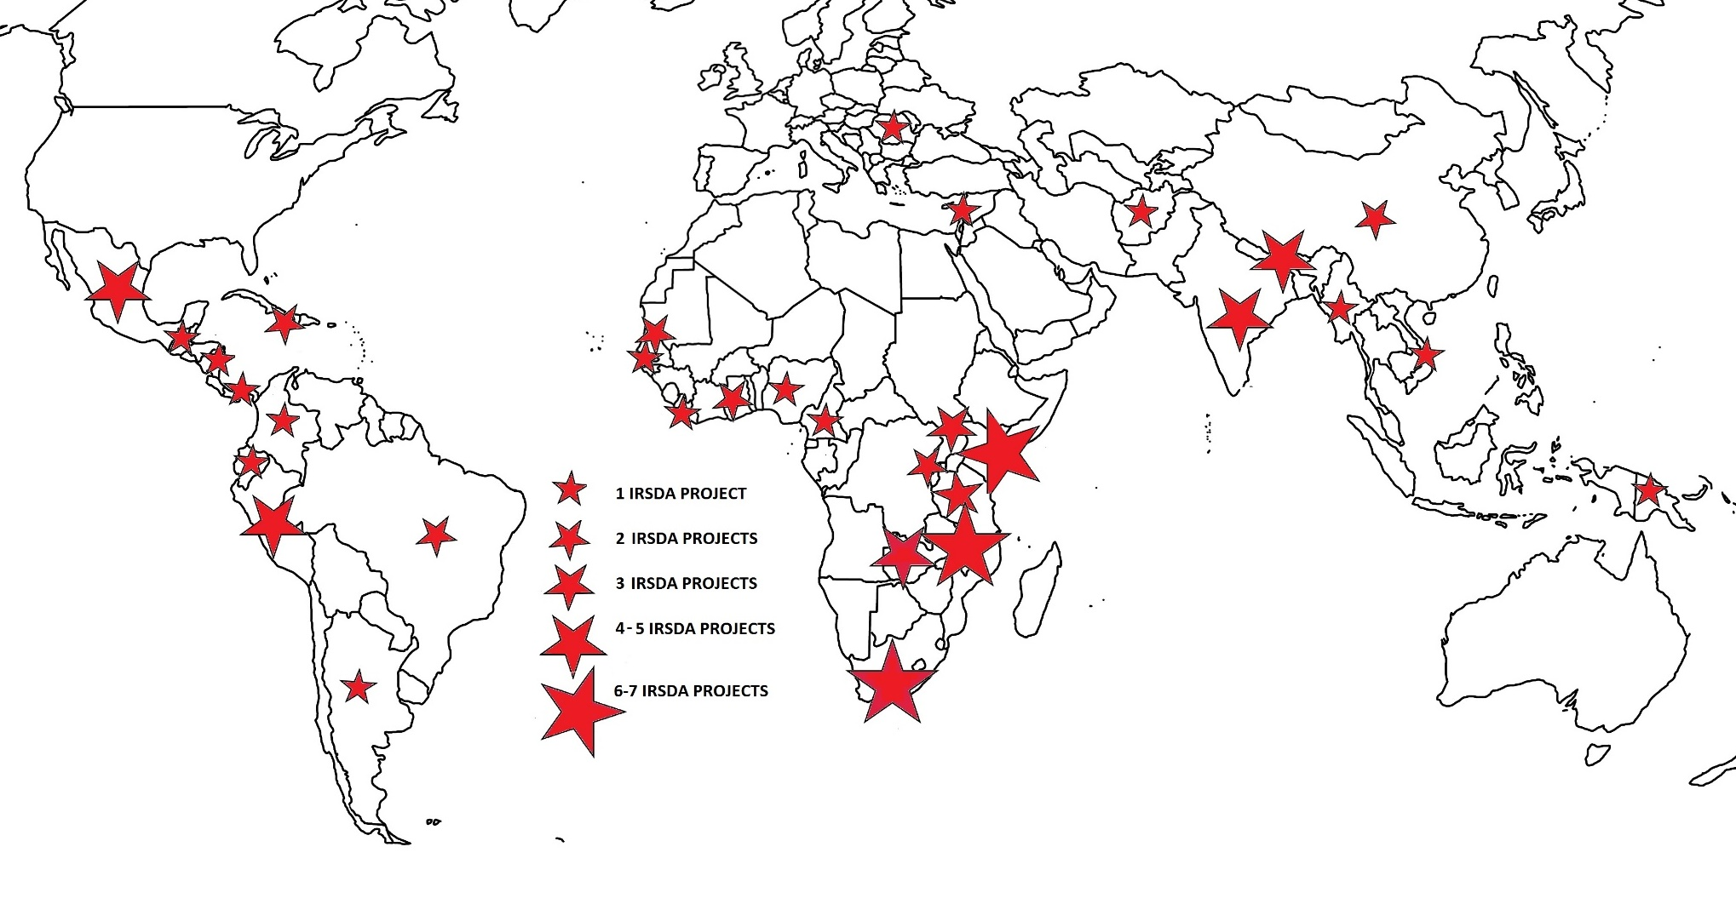
Fogarty K01 and K43 Awards
K01 International Research Scientist Development Awards (IRSDAs) – research sites
K43 Emerging Global Leader Awards
Awards
1
2
3
4-5
6+

Slide 12
Research Training Programs: 5-year awards at $250-350K/year
Compete annually
  Global Infectious Diseases Training Program (D43)
  HIV Research Training Program (D43)
  Non-communicable Diseases and Disorders across the Lifespan (D43)
  If interested, contact the Program Officer listed on webpage re responsiveness

Slide 13
Common Features of a Training Program
Provide training for LMIC scientists; help build institutional capacity
Can include degree, non-degree, post-doctoral, short- and long-term training, distance and in-person; clinical, biomedical, BSS: no prescriptive format
Usually as collaboration between an LMIC and a US university, but US partner not required and either can be the contact institution
Some training may occur in the US, but research project must be in LMIC
May require an active research award as basis for training
Co-funding from many other NIH ICs

Slide 14
Relevant Research Programs
Brain Disorders across the Lifespan (R01/R21)
R01 is standard NIH grant (3-5 years)
R21 is a smaller exploratory 2-year award that does not require preliminary data and may produce the data needed to apply for a larger R01
Deadlines
Non-AIDS: November 15, 2024
AIDS: December 9, 2024
Nine ICO partners
The National Center for Complementary and Integrative Health (NCCIH) is interested in supporting basic, mechanistic and translational research on natural products and their therapeutic potential to treat nervous system disorders, in particular with relevance to pain management.
https://grants.nih.gov/grants/guide/notice-files/NOT-AT-24-001.html

Slide 15
International Research in Infectious Diseases (R01 Clinical Trial Not Allowed) from NIAID: RFA-AI-23-023
https://grants.nih.gov/grants/guide/rfa-files/RFA-AI-23-023.html
To support applications for high-priority, regionally relevant infectious diseases research in resource-constrained countries; LMIC applicants are particularly encouraged to apply, and only foreign applicants are eligible. Collaborative projects involving investigators from international sites and the U.S. are encouraged, however a U.S. partner is not required.
Studies may be proposed on any aspect of infectious diseases research (except clinical trials), including emerging and re-emerging infectious diseases.
Application budgets should not exceed $125,000 in direct costs per year, for a maximum project period of five years
Call the program officer to discuss if your proposal would be responsive
Next application due date: August 01, 2025
See also: HIV-associated Noncommunicable Diseases Research at Low- and Middle-Income Country Institutions (R21)
Mobile Health: Technology and Outcomes in Low and Middle Income Countries (mHealth) (R21/R33)

Slide 17
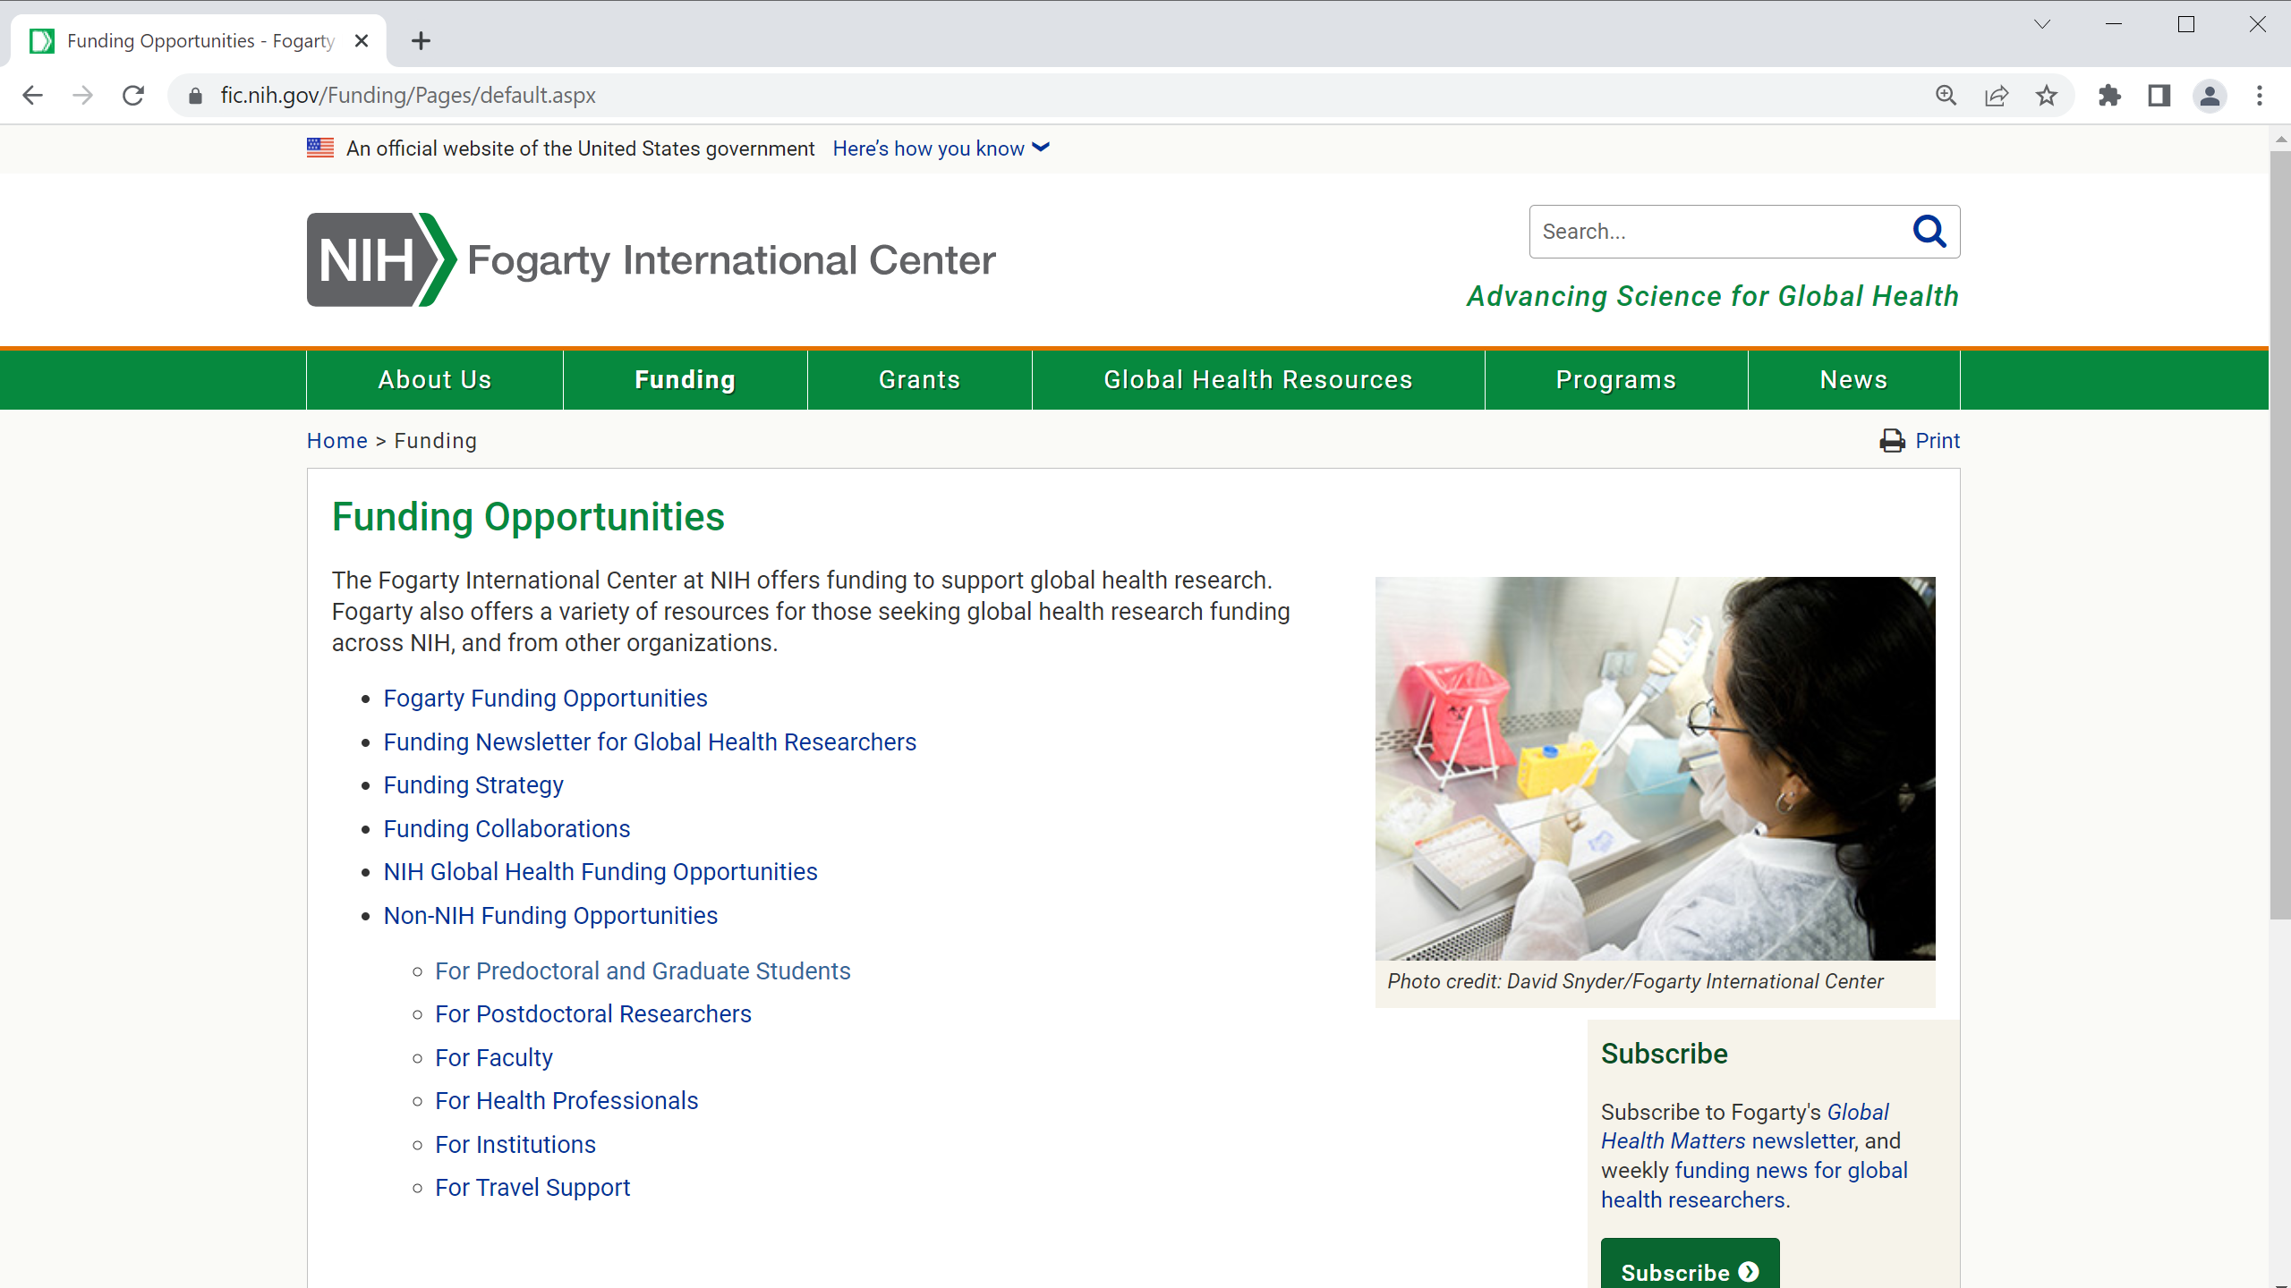

Slide 18








Connect with Fogarty
Website:
www.fic.nih.gov
Like our Facebook page: ​
@fogarty.nih
Watch us on YouTube:​
Fogarty International Center at NIH
Subscribe:
go.nih.gov/SubscribeFogarty
Follow us on X:
@Fogarty_NIH
Follow us on LinkedIn:​
Fogarty International Center at NIH

