Slide 1


Understanding and harnessing plant chemistry and metabolism
Ryan Nett
Assistant Professor, MCB
Harvard University

Slide 2
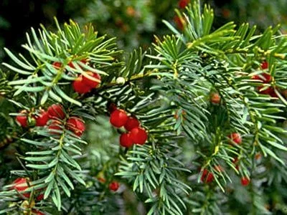
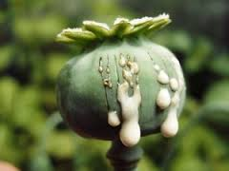
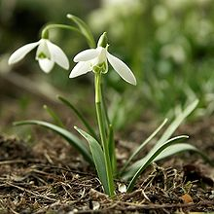
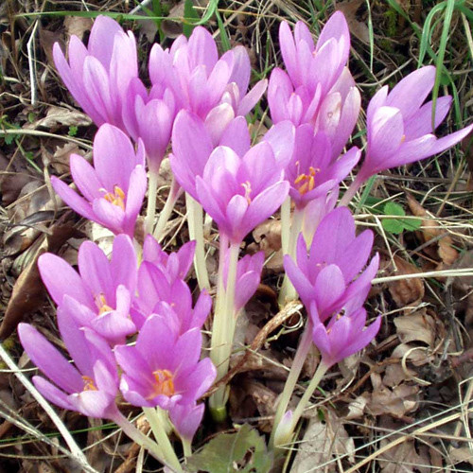
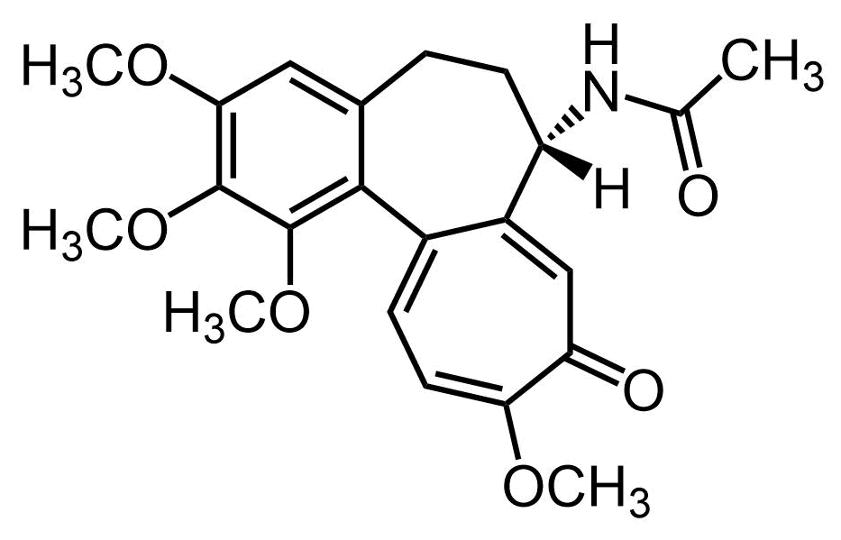
Plant chemistry yields diverse structures and functions
Pacific yew tree
opium poppy
Caucasian snowdrop
autumn crocus
paclitaxel
chemotherapeutic
morphine
analgesic
galantamine
dementia treatment
colchicine
anti-inflammation
Accessing these molecules at scale can be a challenge – how can we overcome this?
Notes:
Humans have used plants as medicine for thousands of years, and we now know that most of the beneficial activities are from the small molecules produced by plants. This isn’t just historically important – plant molecules are still relevant in medicine, and make up ~10% of WHO essential medicines. Across the plant kingdom, there is diversity not only in the function of these molecules, but also in the structural diversity – today I’m going to tell you about the work I’ve done on two structurally and functionally distinct alkaloids, huperzine A and colchicine.

Slide 3
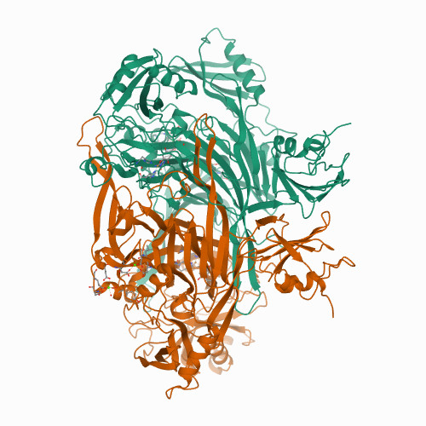
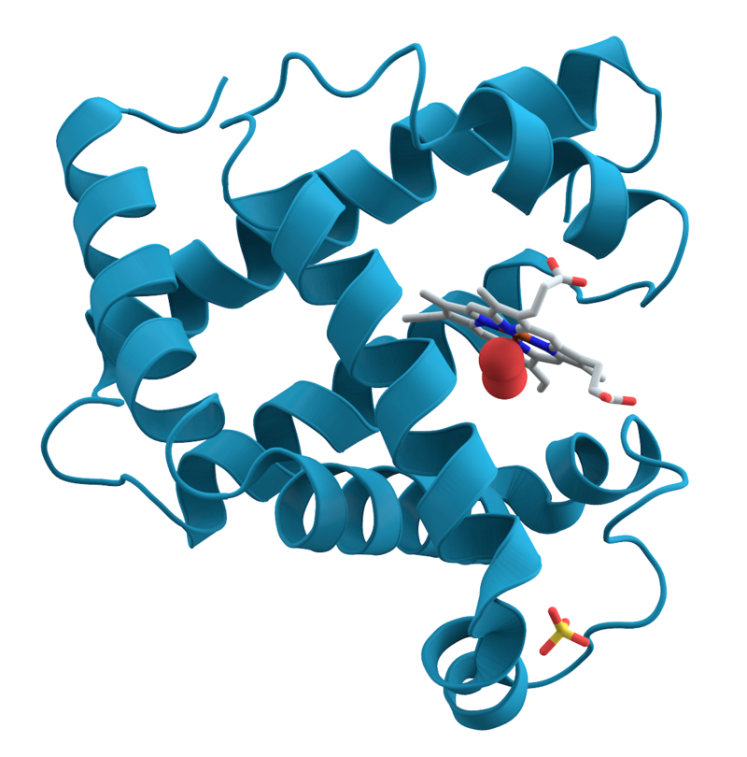

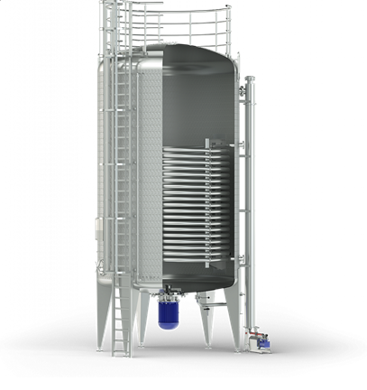
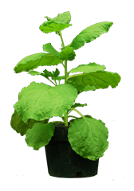
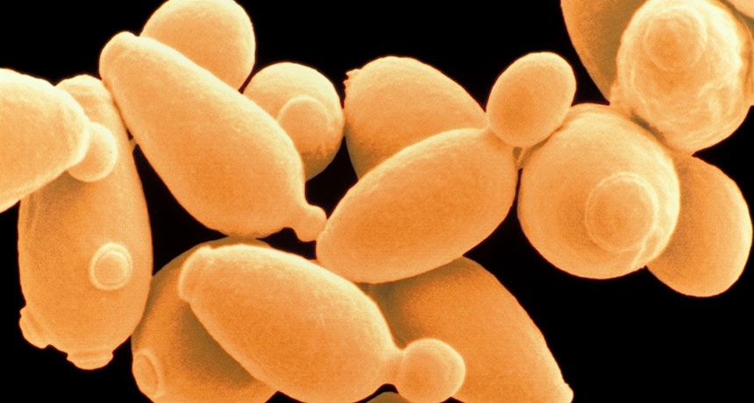
Unlocking plant biosynthesis to access bioactive molecules
Novel enzyme classes and catalytic reactions
primary metabolites
amino acids
isoprenoids
specialized natural products
acyl precursors
bioengineering
scaled production
modified plant metabolism
Notes:
If we can discover the biosynthetic genes, and thus enzymes, we can then make use of the primary metabolism of more tractable organisms like yeast or model plants. Furthermore, study of relatively unknown plant pathways is very likely to lead to the discovery of novel enzyme families, as well as new chemistry within established enzymes – this will expand our biocatalytic toolbox for accessing new-to-nature molecules and help us to better understand the breadth of enzyme catalysts in nature.

Slide 4
Unlocking plant biosynthesis to access bioactive molecules
primary metabolites
amino acids
isoprenoids
specialized natural products
acyl precursors
How do we find the genes for plant biosynthetic enzymes?
Notes:
This idea is all well and good – but how do we actually find these biosynthetic genes. As it turns out, this is difficult for several reasons.

Slide 5
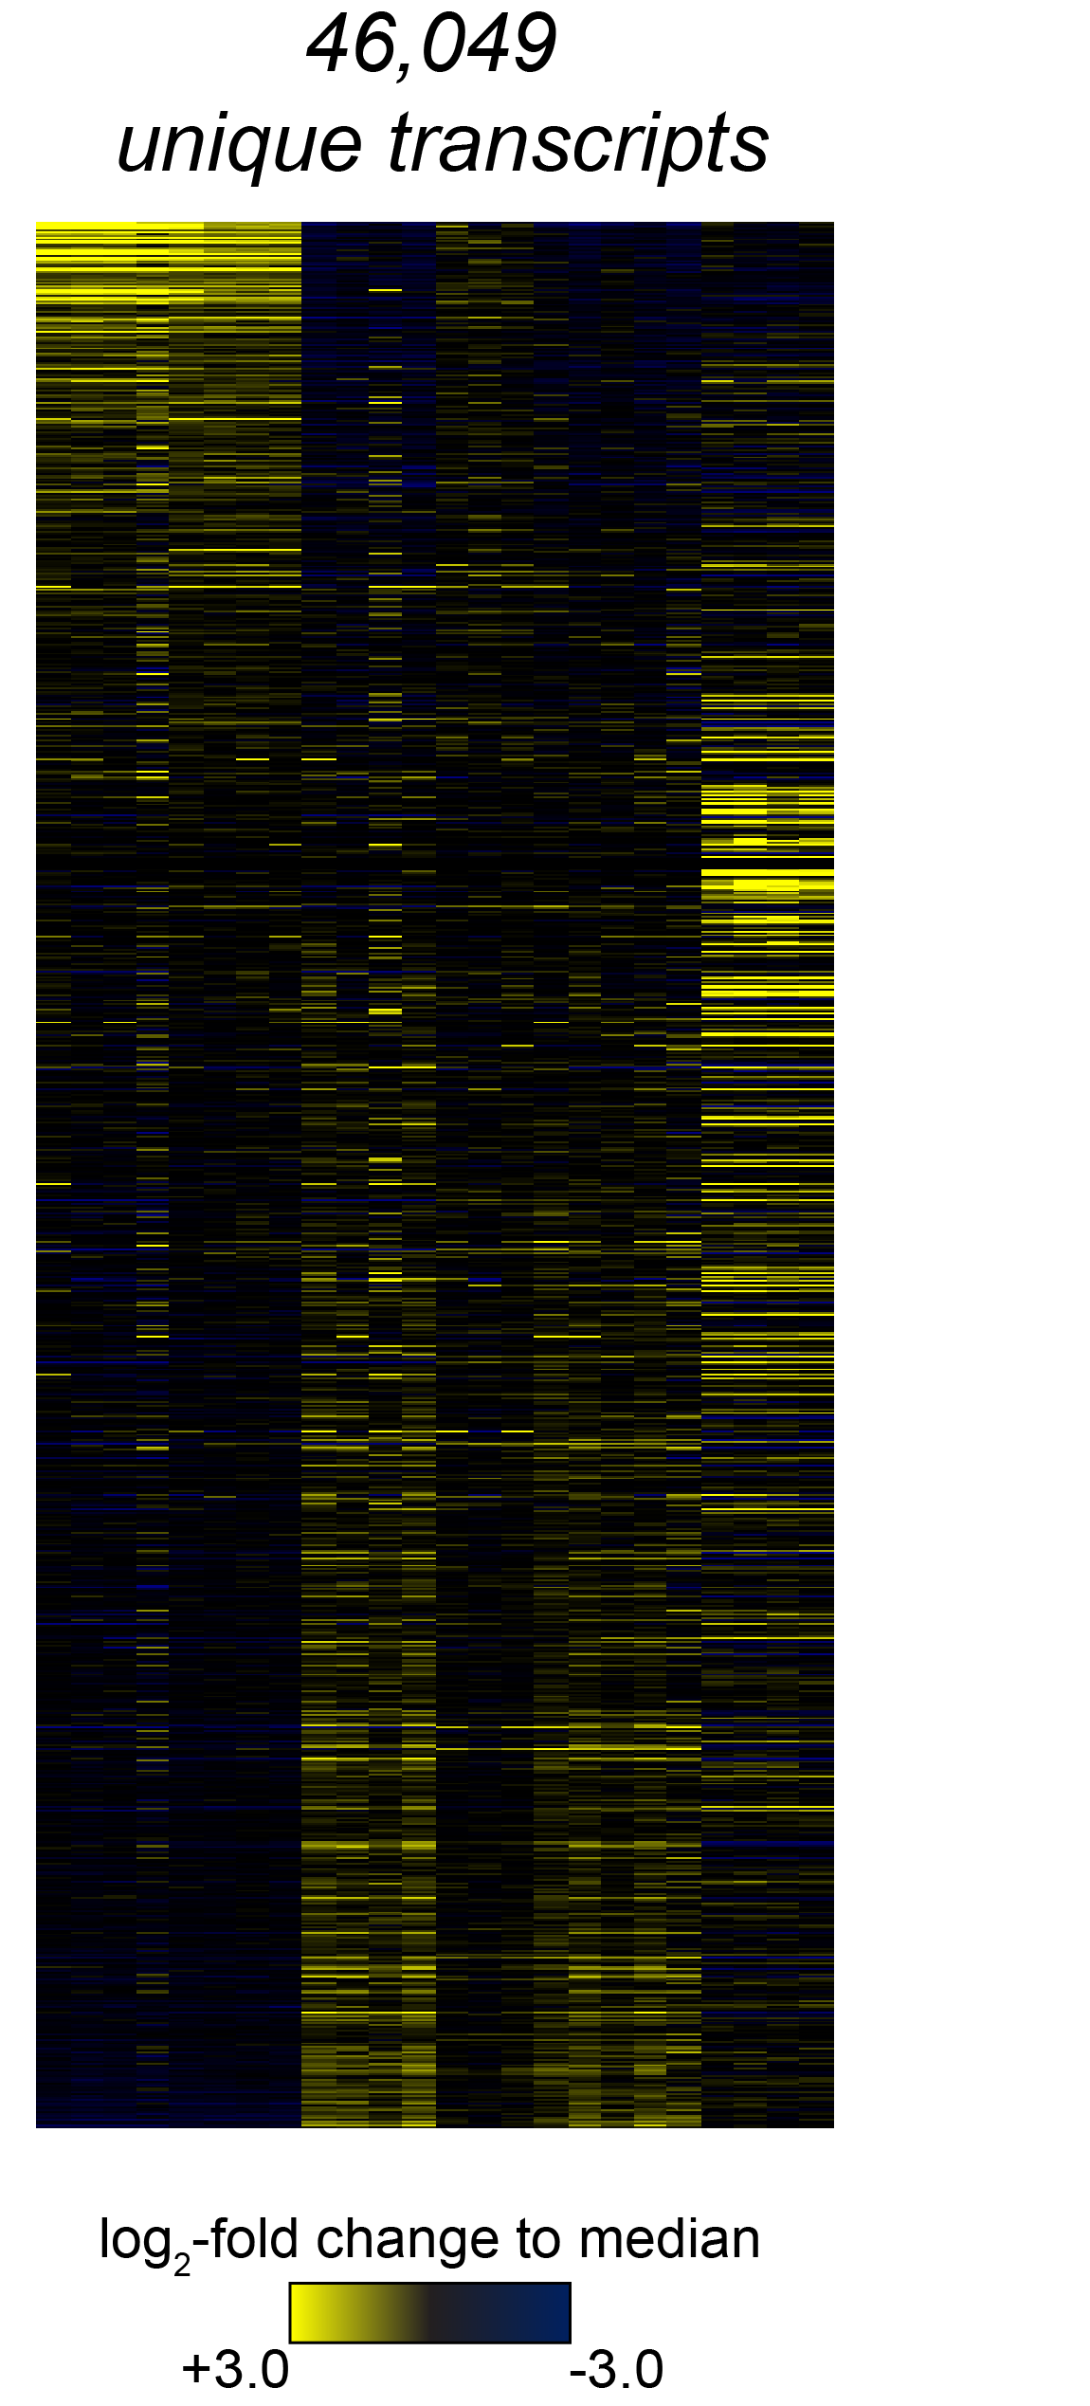
A strategy for studying plant specialized metabolism
Production of specialized metabolites is usually conditional
  Tissue specific
  Developmental stage
  Environmental stress
Metabolomic analysis - determines active sites of biosynthesis
Transcriptomic profiling - associates gene expression with biosynthesis
biosynthetic genes
RNA-seq
active site of biosynthesis
Notes:
With these challenges in mind, how can we try to understand biosynthesis and accelerate discovery. In the Sattely lab, we’ve relied upon the condition production of specialized metabolites. In theory, if a molecule is only made under a certain condition, then we would expect for the corresponding biosynthetic genes to have enriched expression in this condition. So first perform metabolomic analysis, then transcriptomic analysis to complement this. After this, we can perform co-expression analyses to look for sets of genes expressed in the right place with similar expression patterns,

Slide 6
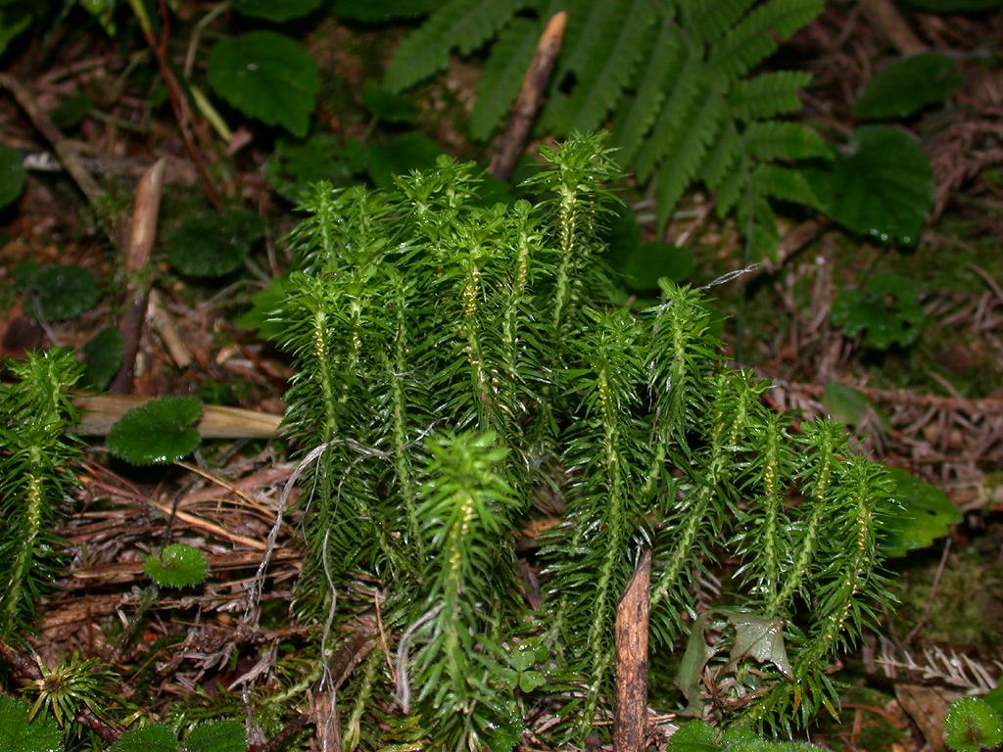
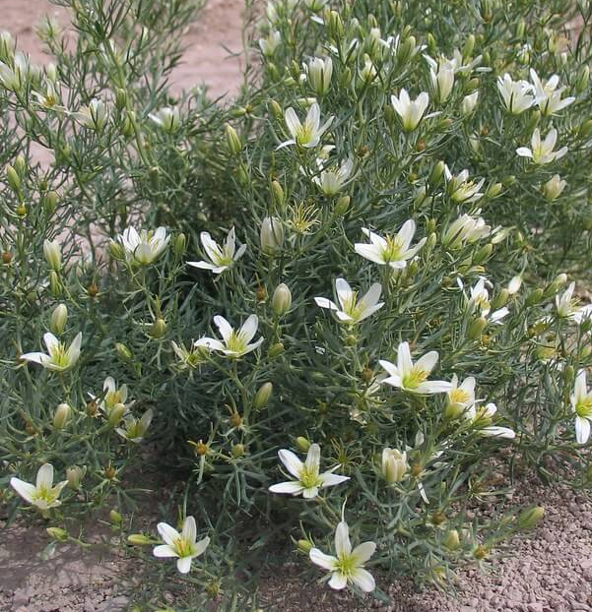
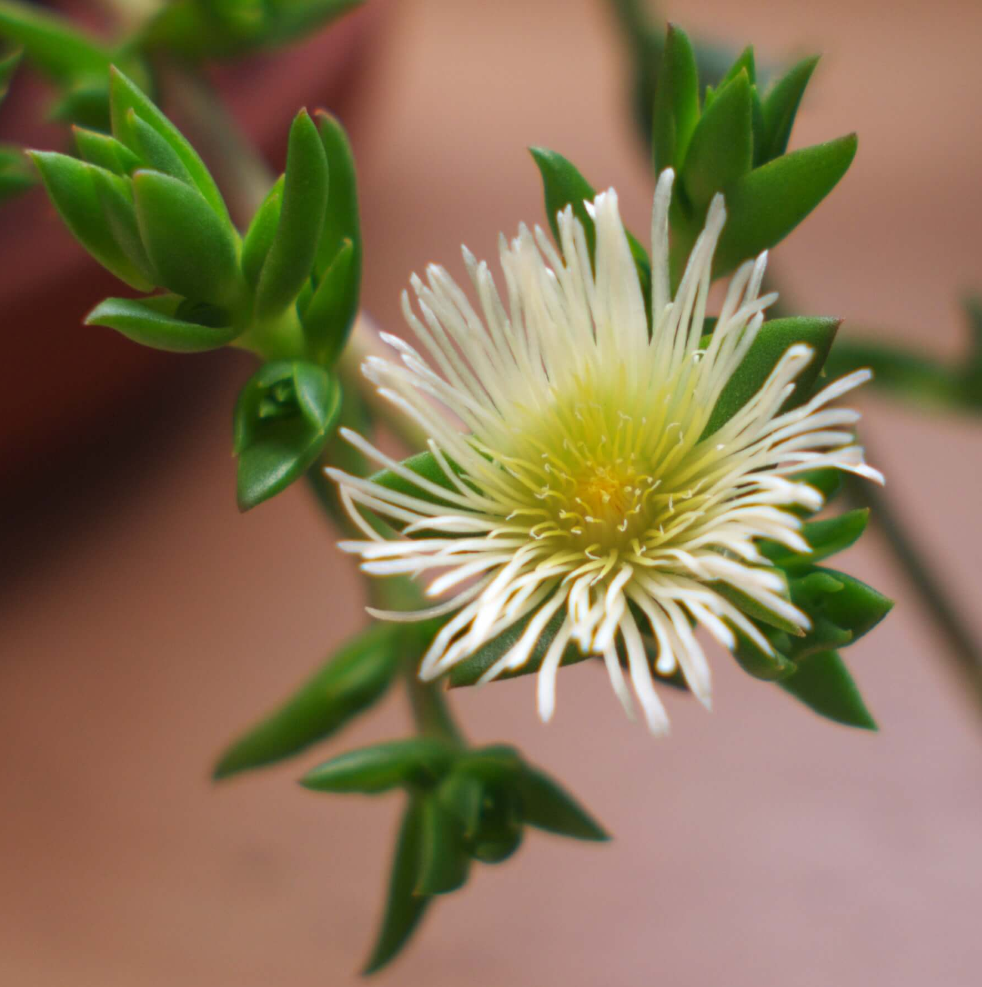
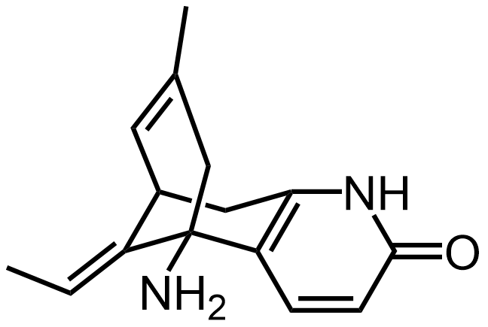
Targets for pathway discovery
clubmosses
autumn crocus
kanna
Syrian rue
harmine
anti-depressant
huperzine A
dementia treatment
colchicine
anti-inflammation
mesembrine
anti-depressant
Notes:
Now that I’ve laid out a general strategy for finding these genes, I want to talk about how I have applied them to two specific molecules. Huperzine A, a potential treatment for dementia, and colchicine, an FDA-approved treatment for inflammation. First, I’ll talk about huperzine A.

Slide 7
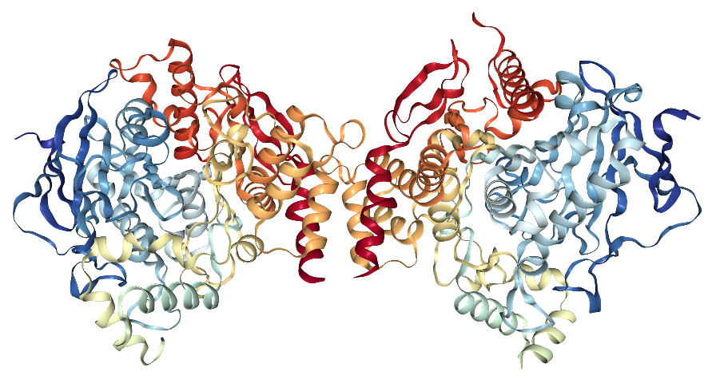
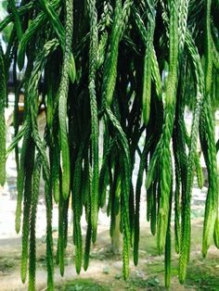
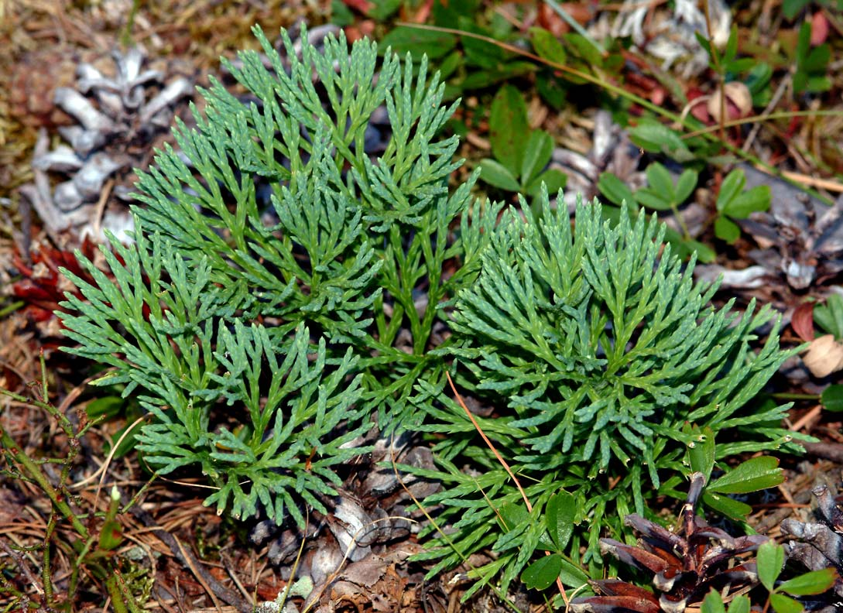
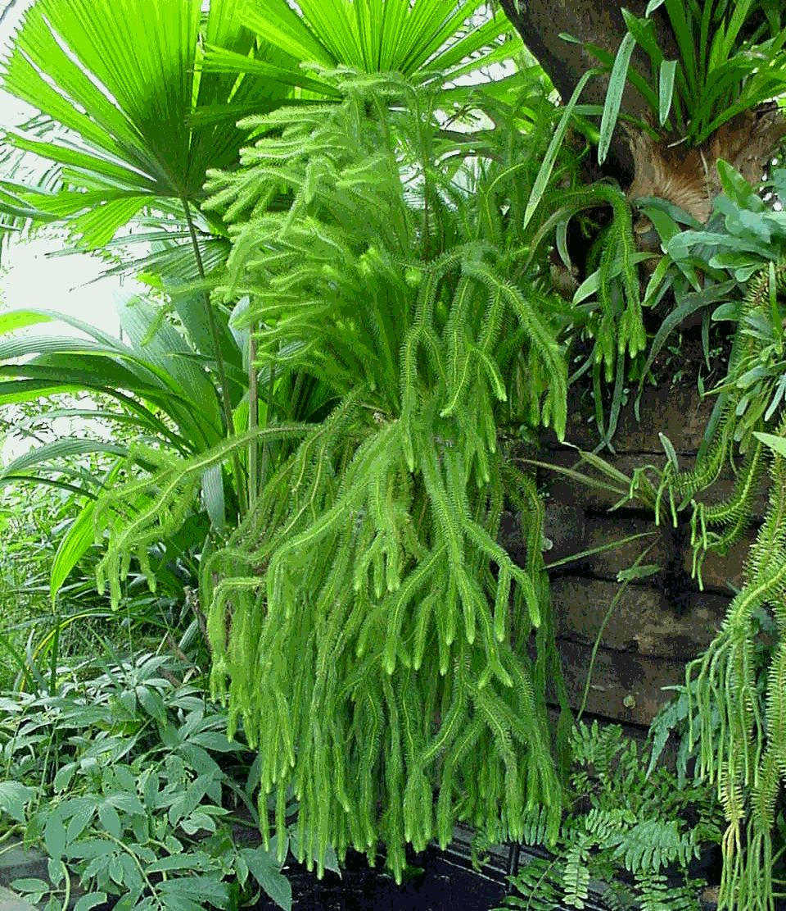
Huperzine A (HupA) – a model Lycopodium alkaloid
acetylcholine esterase (AChE)
Clinical trials
Alzheimer’s disease
dementia
traumatic brain injury
cocaine dependence
hearing loss
schizophrenia
epilepsy
“clubmosses” - Lycopodiaceae family
huperzine A
AChE inhibitor
clinicaltrials.gov
Ma et al. J. Ethnopharmacol. 2006.
Ma and Gang. Nat. Prod. Rep. 2004.
Notes:
A lead example is HupA, which is produced by club mosses. HupA is an AChE inhibitor, and has been explored as a treatment for neurological disease. Beyond pharmacology of this one molecule, there are hundreds of other Lycopodium alkaloids with unique structures, yet no information on biosynthetic genes. Great opportunity to study uncharted territory of plant metabolism.

Slide 8
Huperzine A (HupA) – a model Lycopodium alkaloid
>500 unique structures – biosynthesis largely unknown
Challenges in sourcing
Overharvesting of native plants for HupA
Non-sustainable, damaging to ecosystems
“clubmosses” - Lycopodiaceae family
huperzine A
AChE inhibitor
Ma et al. J. Ethnopharmacol. 2006.
Ma and Gang. Nat. Prod. Rep. 2004.
Notes:
A lead example is HupA, which is produced by club mosses. HupA is an AChE inhibitor, and has been explored as a treatment for neurological disease. Beyond pharmacology of this one molecule, there are hundreds of other Lycopodium alkaloids with unique structures, yet no information on biosynthetic genes. Great opportunity to study uncharted territory of plant metabolism. More practically, HupA sourcing faces the same challenges that I discussed earlier in terms of overharvest of native populations.

Slide 9
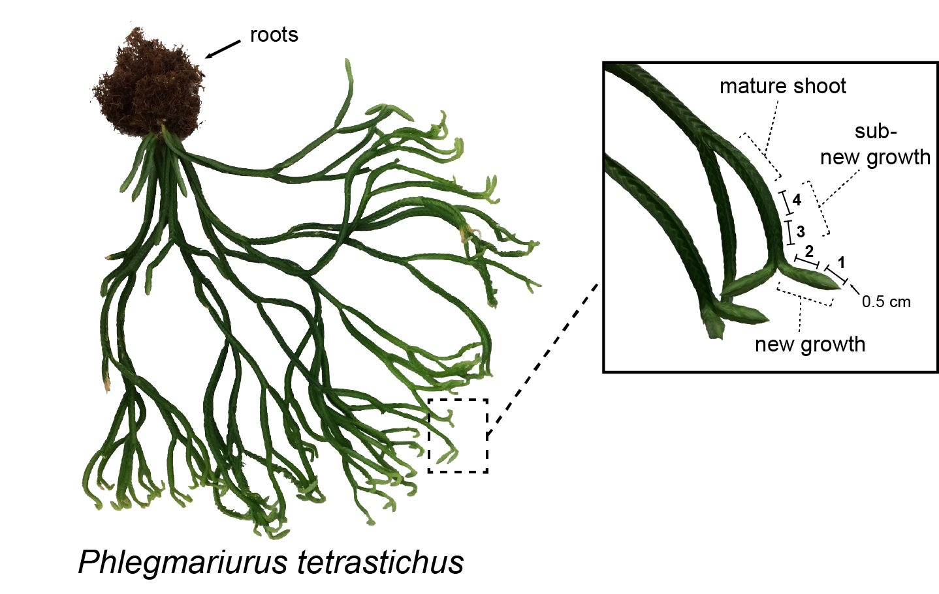
Metabolomic and transcriptomic profiling
Metabolomics identify new growth as the active site of biosynthesis
Nett*, Guan*, & Smith* et al. AIChE J. 2018.
Notes:
The first thing we did was explore where HupA was made in the plant. I don’t have time to go into details, but through multiple metabolomic strategies, we were able to show that the new growth of the shoots is really the only major site of active biosynthesis.

Slide 10
Determining sites of active biosynthesis
How do we identify the relevant pathway genes?
mRNA
(RNA-seq)
Nett*, Guan*, & Smith* et al. AIChE J. 2018.
Notes:
We could then perform RNA-sequencing of out plant, including biosynthetically active and inactive tissues in order to have a handle for differential expression analysis. However, RNA-seq results in many thousands of transcripts., which makes this a major bioinformatics challenge. How do we narrow down our list of candidates?

Slide 11
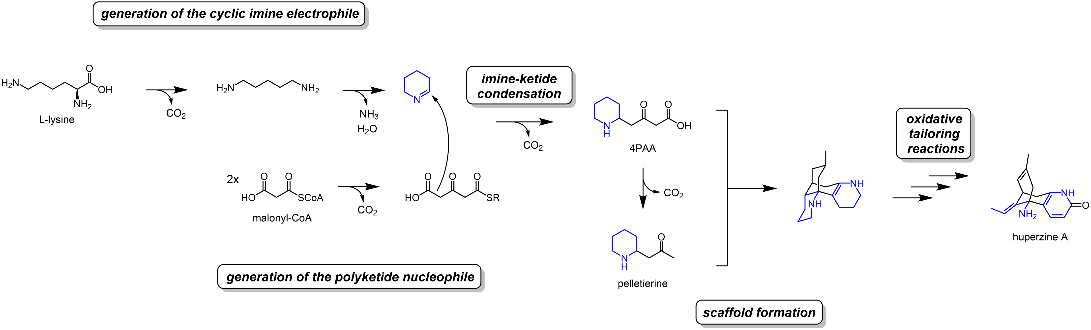
Biosynthetic logic guides candidate gene selection
Castillo et al. Can. J. Chem. 1970.
Castillo et al. Can. J. Bot. 1970.
Braekman et al. Can. J. Chem. 1972.
Hemscheidt et al. J. Am. Chem. Soc. 1996.
Ma and Gang. Nat. Prod. Rep. 2004.
Isotope tracer studies have guided a biosynthetic proposal
Notes:
We use chemical biosynthetic logic to guide our selection of candidate genes. If we have an idea of the chemical transformations, then we can make reasonable guesses about the types of enzymes involved. Isotope tracer studies have identified precursors to the Lycopodium alkaloids. Further, isolation of various alkaloids has allowed for the generation of a plausible biosynthetic route.

Slide 12
Biosynthetic logic guides candidate gene selection
Key enzymes can be hypothesized from this pathway – bait gene for co-expression analysis
lysine
decarboxylase
copper amine oxidase
cytochromes P450
2-oxoglutarate dependent dioxygenases
polyketide synthase
Bunsupa et al. Plant Physiol. 2016.
Xu et al. Phytochemistry 2017.
Sun et al. Bioorg. Med. Chem. Lett. 2012.
Notes:
An important aspect of enzymatic logic is gaining a foothold in the pathway. We can guess that lysine is processed by LDC and CAO enzymes – these can then serve as bait genes in co-expression analyses

Slide 13
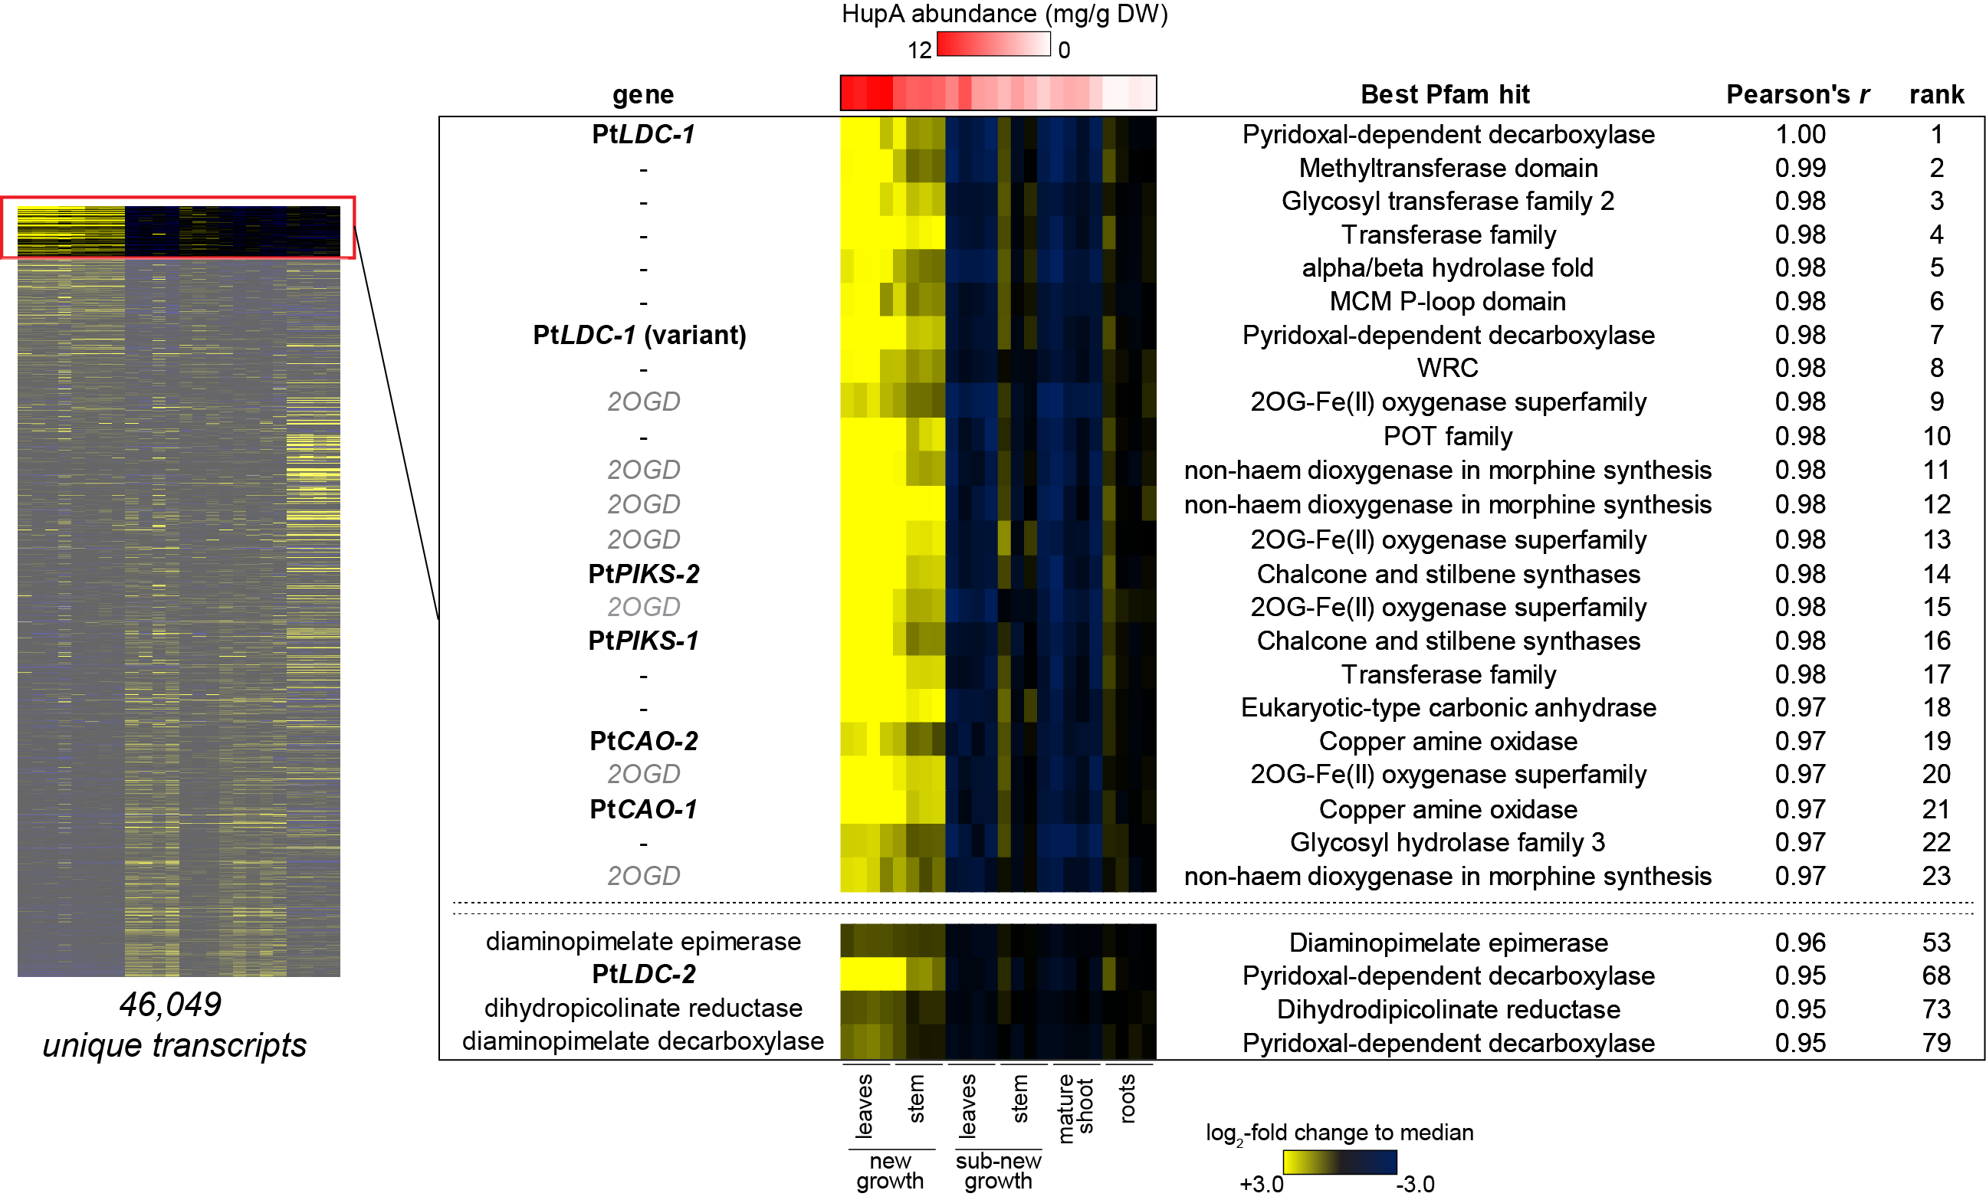
Identification of candidate genes via co-expression
Expression correlation with lysine decarboxylase (LDC)
CAO = copper amine oxidase
PIKS = piperidyl-ketide synthase (type III polyketide synthase)
Nett, Dho, Low, & Sattely. PNAS. 2021.
Notes:
Using lysine decarboxylase as a bait gene for correlation analysis, we identified both copper amine oxidase and polyketide synthase homologs within the top 25 co-expressing genes out of over 40,000!

Slide 14
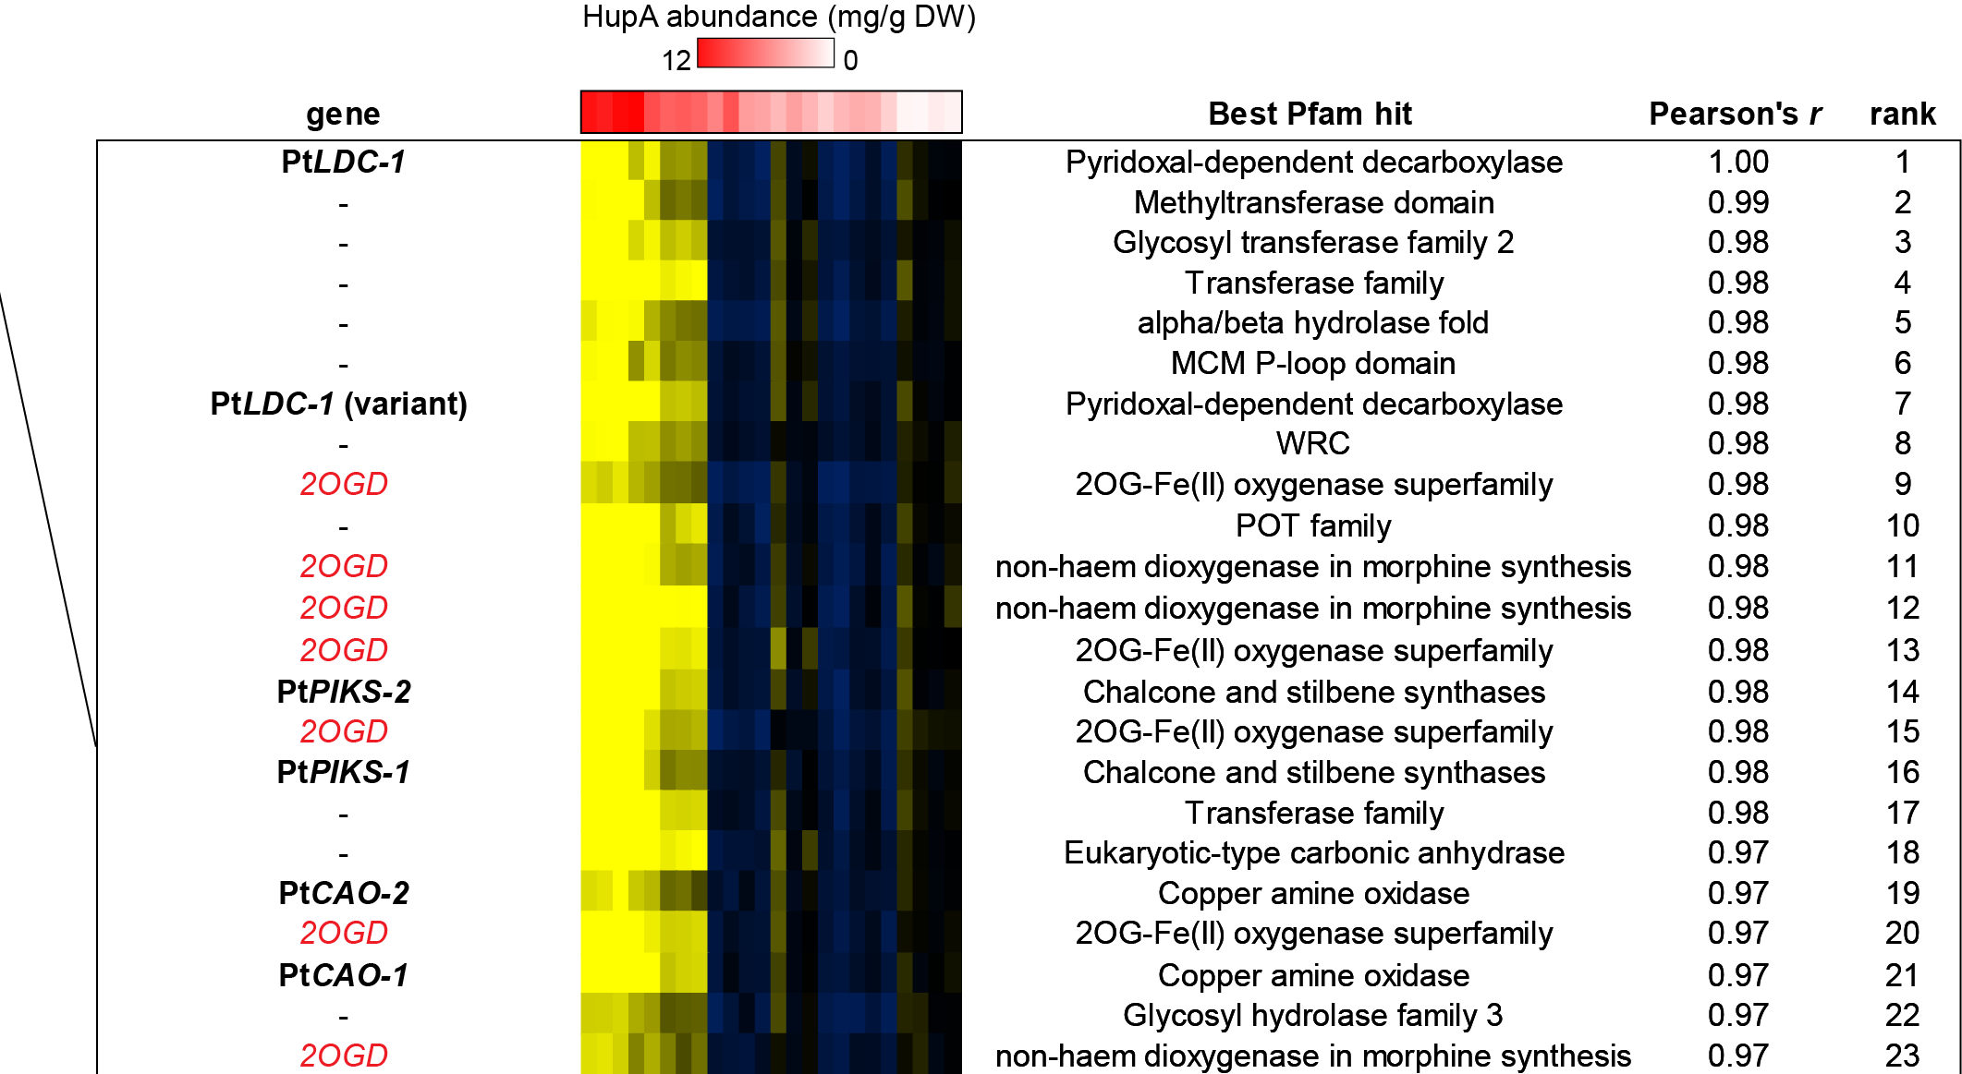
Identification of candidate genes via co-expression
Expression correlation with lysine decarboxylase (LDC)
2OGD = Fe(II)/2-oxoglutarate dependent dioxygenase
Nett, Dho, Low, & Sattely. PNAS. 2021.
Notes:
We also noted striking enrichment of 2OGD enzymes within this list, suggesting their involvement in the downstream oxidations.

Slide 15
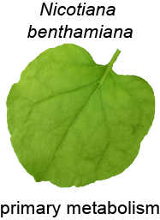
A rapid testing system
Agrobacterium-mediated transient expression
predict
candidate genes
Medicinal
Plant
Candidate
genes
Agrobacterium strain library
Nicotiana benthamiana
expression host
Notes:
Now that we have candidate genes, we can test them rapidly via Agrobacterium-mediated transient expression in Nicotiana benthamiana (tobacco).

Slide 16
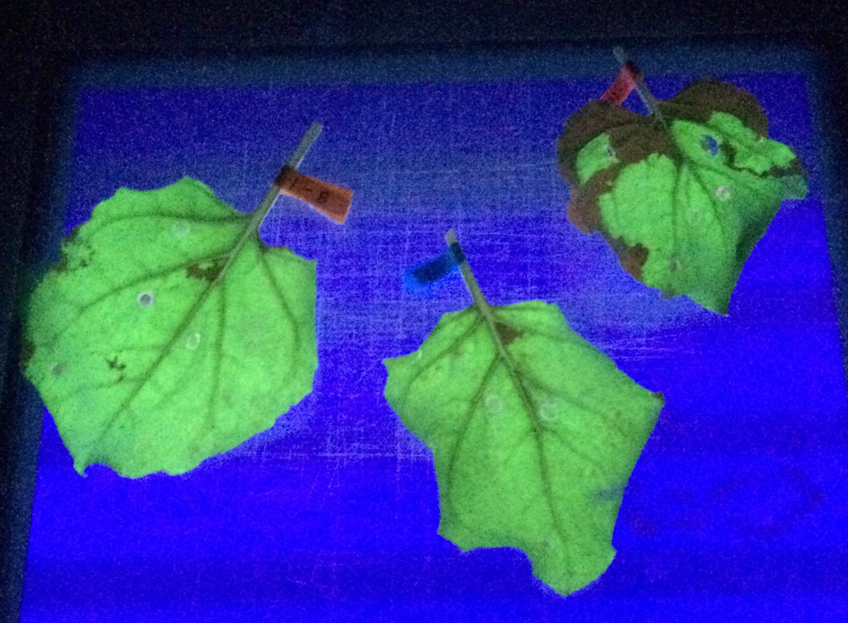
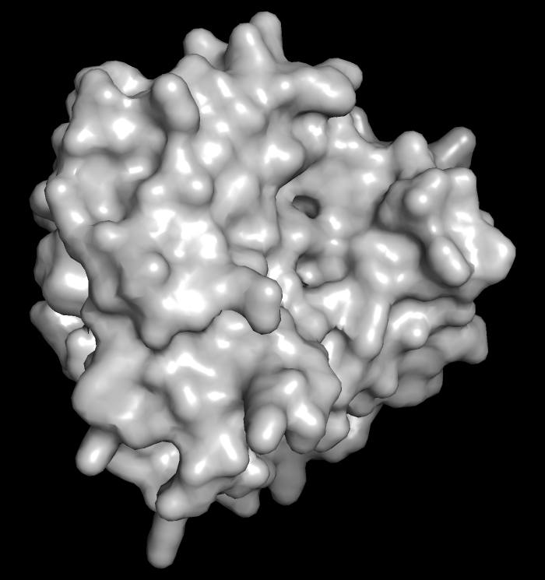
Harnessing a plant pathogen for protein production
Agrobacterium-mediated transient expression
gene
expression
Agrobacterium
protein
one strain,
one gene construct
transformation with a GFP construct
Notes:
In this system, we use a plant pathogen harboring our gene of interest to infect the plant. This bacterium transfers its T-DNA to the plant, and then the plant machinery transcribes and translates the gene to make our protein/enzyme candidate. Here is an example with GFP.

Slide 17
Harnessing a plant pathogen for protein production
Agrobacterium-mediated transient expression
Agrobacterium
Combinatorial batch testing
Building pathways in planta
candidate 1
candidate 2
A
B
C
in planta generation of substrate
Notes:
The beautiful thing about this system is that we can add in many strains/genes simultaneous, for co-production of multiple proteins. This allows for combinatorial batch testing, and building pathways in the plant leaf.

Slide 18
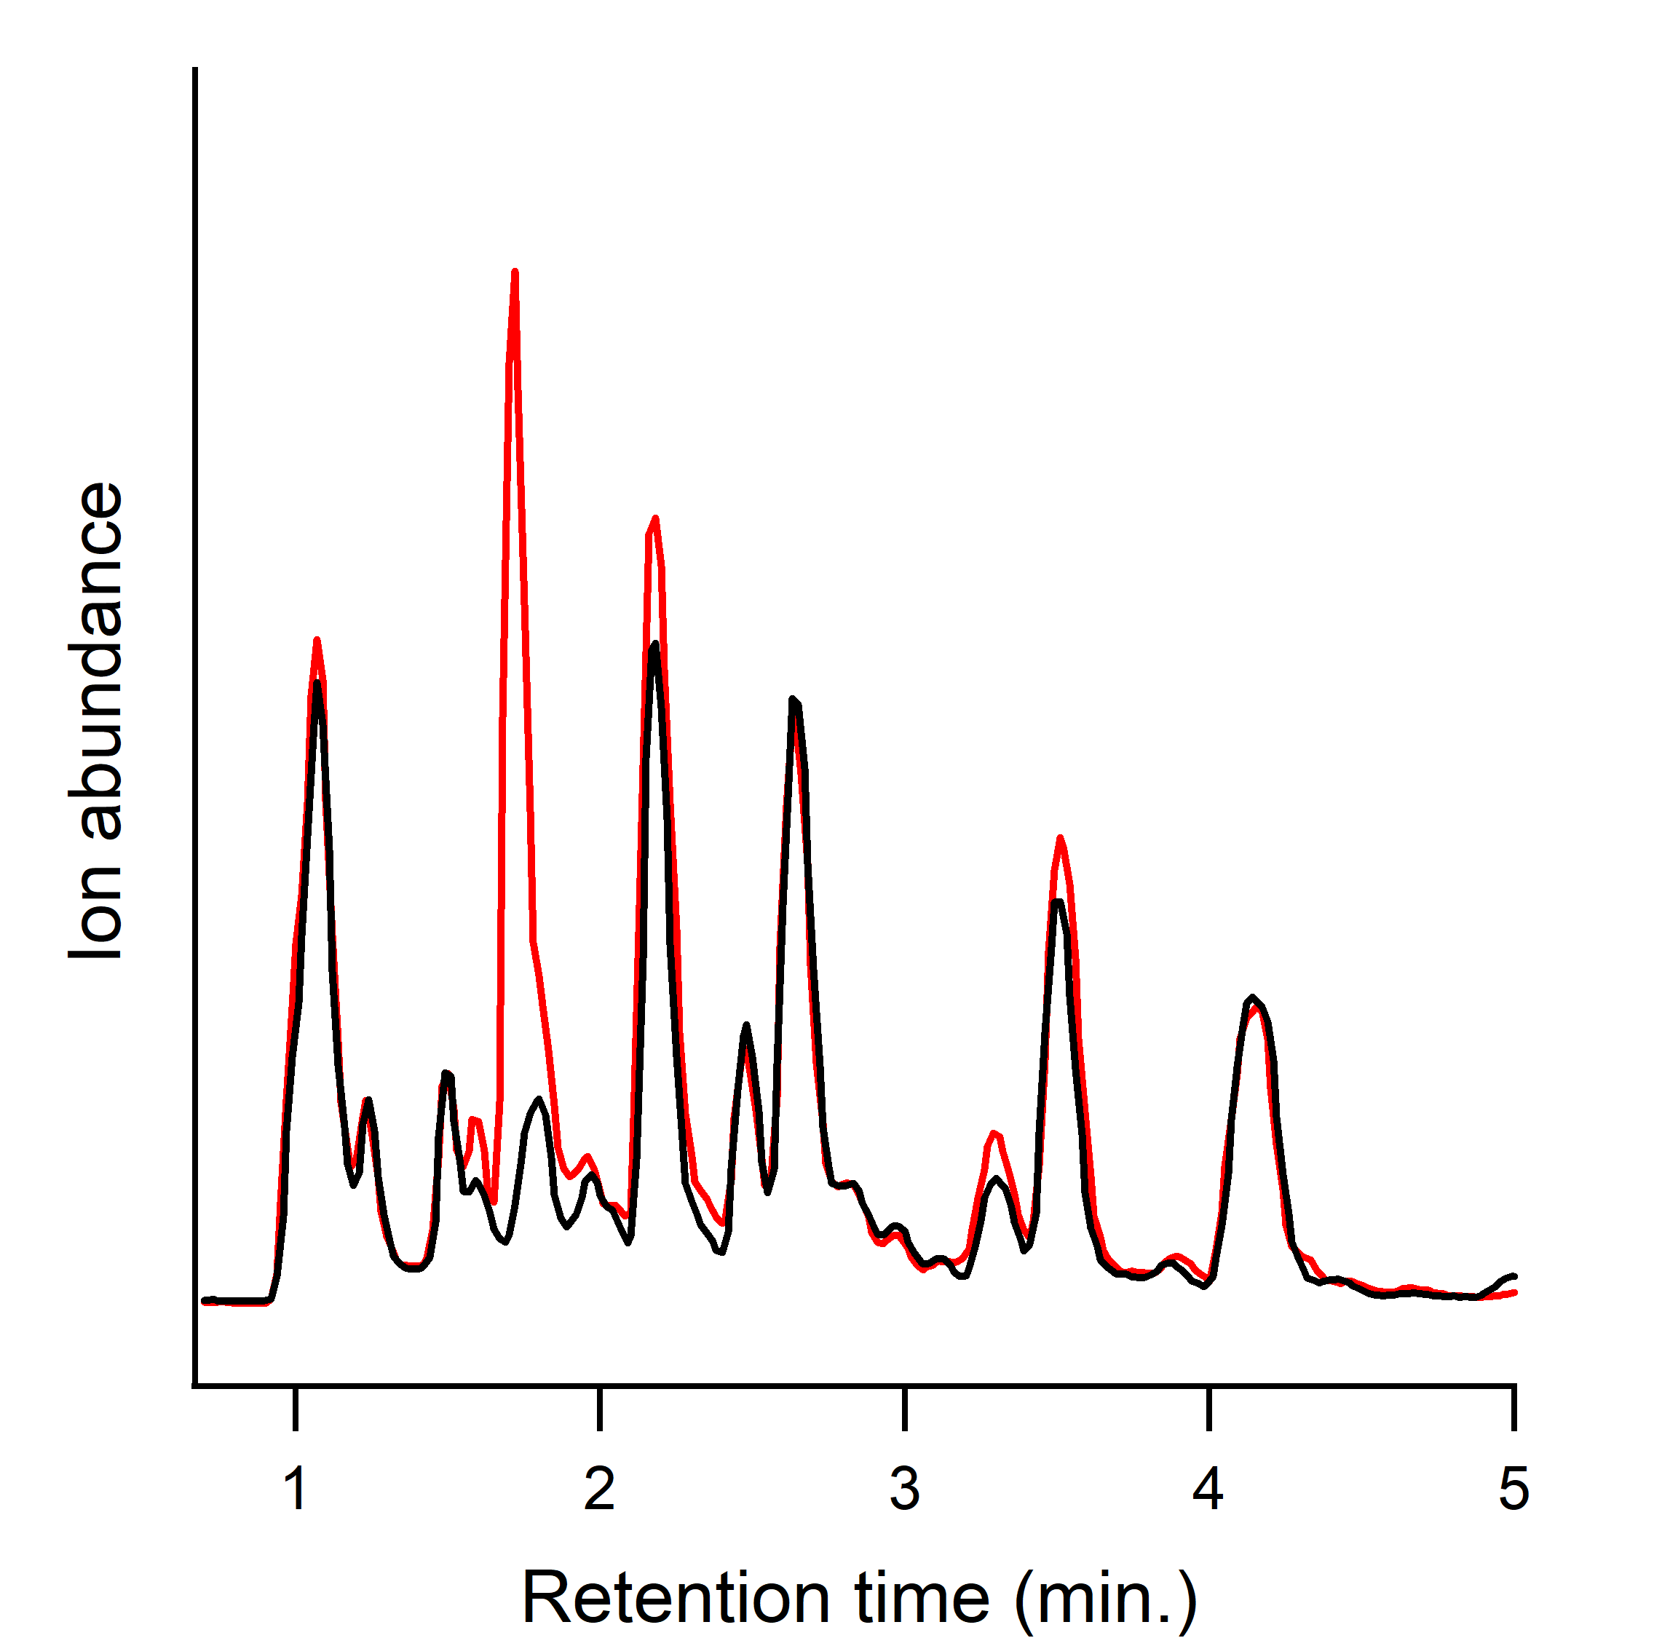
A rapid testing system
Agrobacterium-mediated transient expression
predict
candidate genes
combinatorial
testing
(un)targeted metabolomics
*
Medicinal
Plant
Candidate
genes
Agrobacterium strain library
Nicotiana benthamiana
expression host
LC-MS detection
substrate
Notes:
Just like a test tube reaction, we can also infiltrate substrate into the leaf if it is not provided by the plant. We then use untargeted metabolomics (predominantly by LC-MS detection) to look for the production of new molecules.

Slide 19
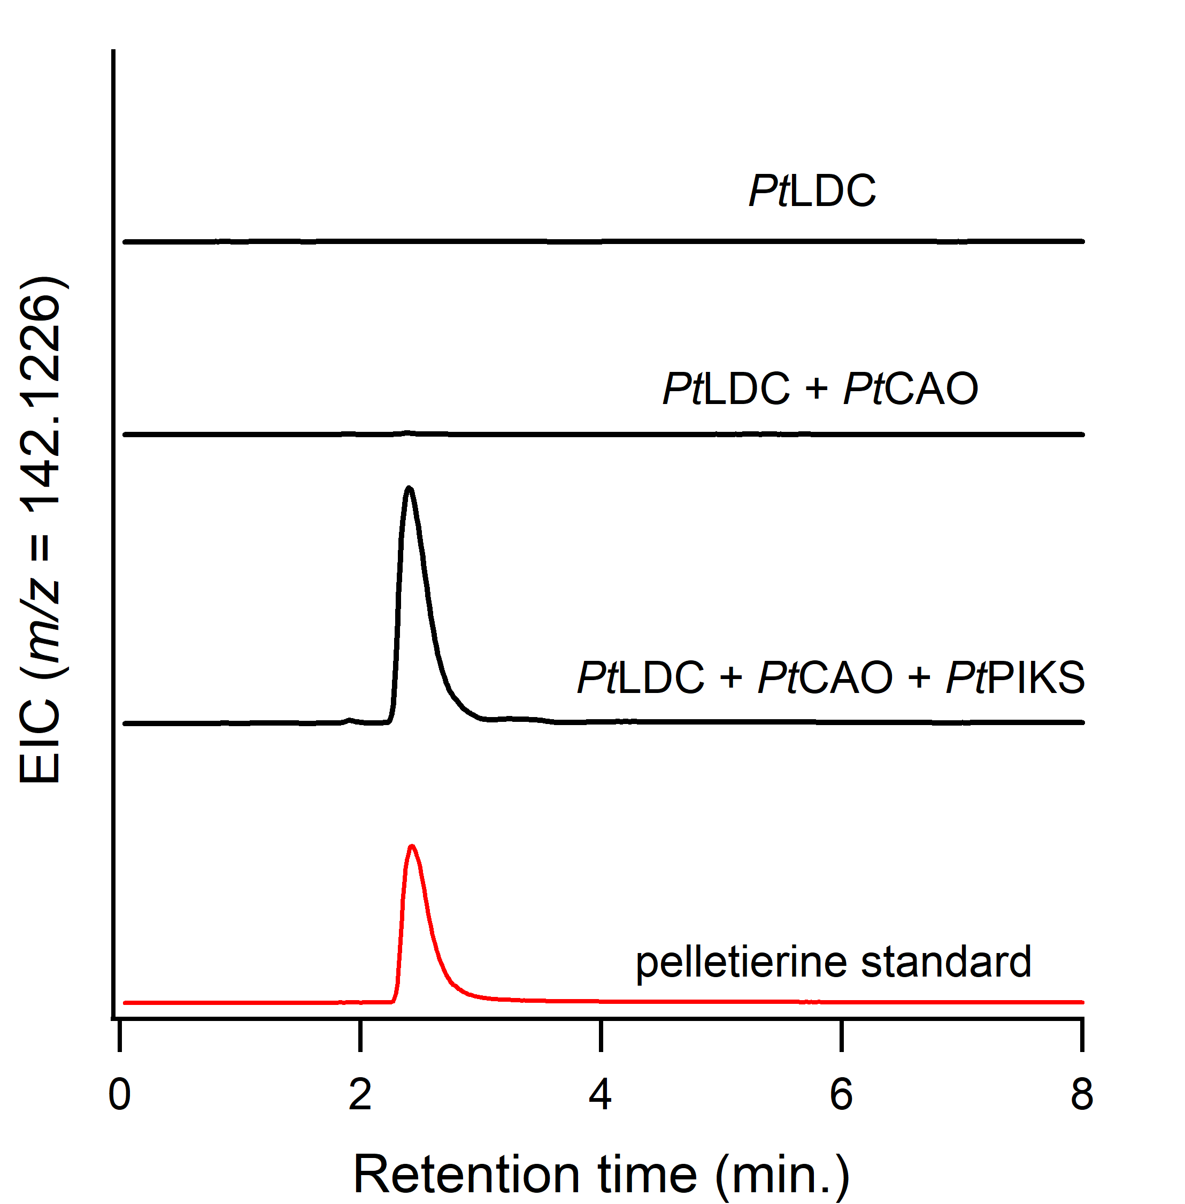
Identification of an early biosynthetic module
provided by
plant host
A unique polyketide synthase catalyzes the crucial imine-ketide condensation!
Wang et al. Org. Lett. 2020.
Nett, Dho, Low, & Sattely. PNAS. 2021.
Nett et al. Nature. 2023.
Notes:
Taken all together, this approach confirmed that we had identified functional LDC and CAO genes. Additionally, we found that a PKS performed the chain elongation and imine-ketide coupling reaction.

Slide 20

Access to key alkaloids
substrate
Dr. Yun Yee Low
University of Malaya
Nicotiana benthamiana
expression host
Ayer et al. Tetrahedron. 1962.
Liu et al. Can. J. Chem. 1986.
Ayer & Kasitu. Can. J. Chem. 1989.
Liu & Huang. Phytochemistry. 1994.
Yeap et al. J. Nat. Prod. 2019.
Jiang et al. Tetrahedron. 2022.
All can be found in HupA-producing species
Notes:
Many alkaloids have been isolated and characterized from HupA-producing plants, and these appear like they could be logical precursors. Luckily, a collaborator was able to provide us with many of this intermediates, which allowed us to test them through substrate infiltration with candidate co-expression.

Slide 21
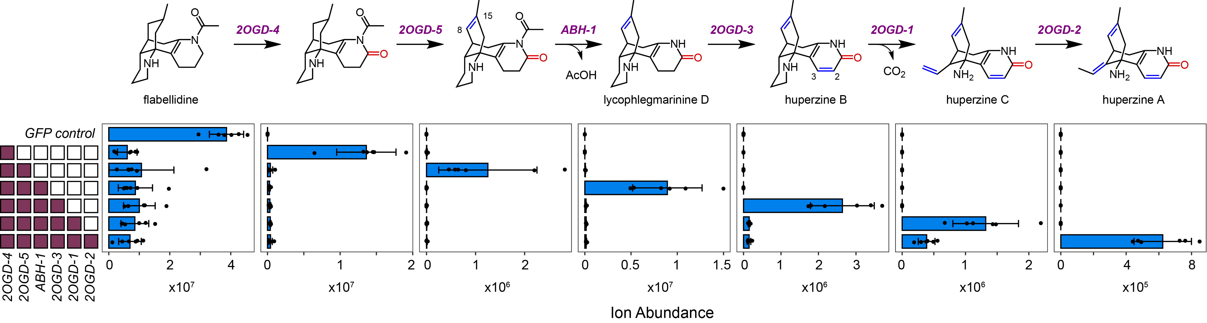
Identification of downstream transformations
Nett, Dho, Low, & Sattely. PNAS. 2021.
Nett et al. Nature. 2023.
Notes:
This allowed us to identify five 2OGDs and an alpha/beta hydrolase that can convert the precursor flabellidine into HupA itself, thereby providing us with insight into the downstream tailoring in this pathway.

Slide 22
Lycopodium alkaloid metabolic network
Biosynthetic modifications towards an optimized acetylcholine esterase inhibitor?
*
*
*
*
Access to 16 unique alkaloids!!!
Nett, Dho, Low, & Sattely. PNAS. 2021.
Nett et al. Nature. 2023.
*
*
*proposed structure
Notes:
We were further able to determine not just the pathway to HupA, but also an alternative set of pathways that all seem to co-exist to some extend within the native plants, allowing for a metabolic network of Lycopodium alkaloids. Interestingly, most of these have been tested for their ability to inhibit acetylcholine esterase, and there appears to be a clear trend in that each of the biosynthetic transformations leads to a more potent acetylcholine esterase. Perhaps this is capturing a snapshot of plant evolution towards a more potent toxin.

Slide 23
Rapid discovery of upstream and downstream modules
Nett et al. Nature. 2023.
unpublished
upstream module
Notes:
Taken together, this allowed us to quickly find both early and late biosynthetic modules for HupA biosynthesis.

Slide 24
Rapid discovery of upstream and downstream modules
Nett et al. Nature. 2023.
unpublished
upstream module
downstream module
Notes:
Taken together, this allowed us to quickly find both early and late biosynthetic modules for HupA biosynthesis.

Slide 25
Identification of a complete pathway to HupA
Nett et al. Nature. 2023.
unpublished
Notes:
Taken together, this allowed us to quickly find both early and late biosynthetic modules for HupA biosynthesis.

Slide 26
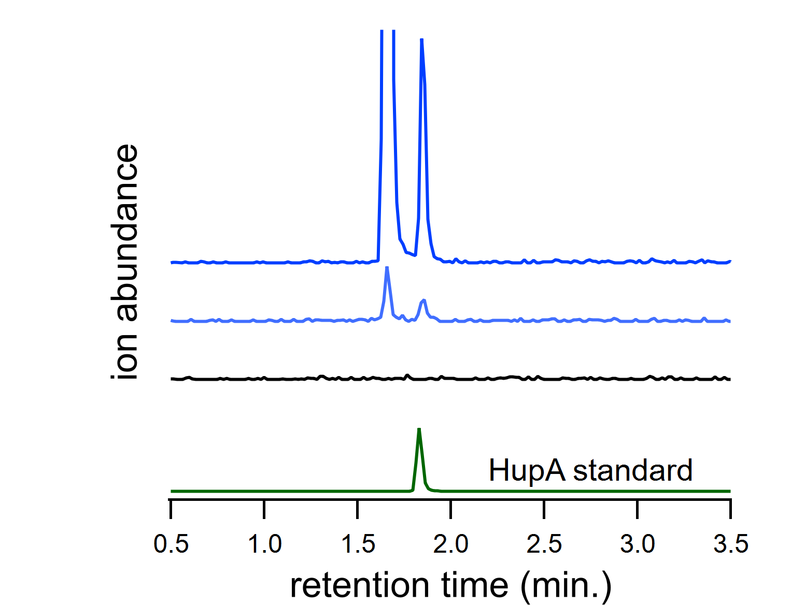

Engineering HupA biosynthesis
Nett, Dho, Low, & Sattely. PNAS. 2021.
Nett et al. Nature. 2023.
unpublished
co-expression of 20 genes
20 genes + 4 auxiliary proteins
HupC
HupA
20 genes
negative control
Eric Fields
Nicotiana benthamiana
Notes:
Taken together, this allowed us to quickly find both early and late biosynthetic modules for HupA biosynthesis.

Slide 27
Targets for pathway discovery
clubmosses
autumn crocus
kanna
Syrian rue
harmine
anti-depressant
huperzine A
dementia treatment
colchicine
anti-inflammation
mesembrine
anti-depressant
Notes:
Now that I’ve laid out a general strategy for finding these genes, I want to talk about how I have applied them to two specific molecules. Huperzine A, a potential treatment for dementia, and colchicine, an FDA-approved treatment for inflammation. First, I’ll talk about huperzine A.

Slide 28
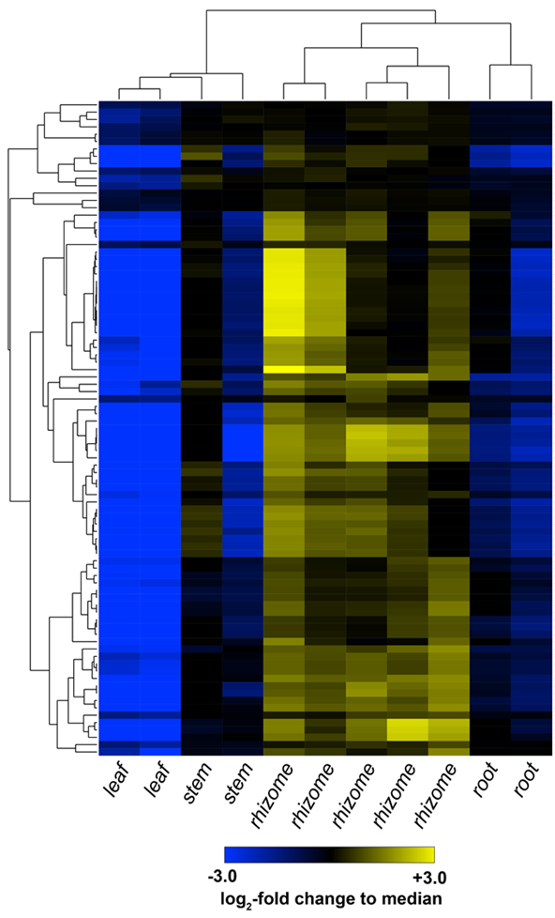
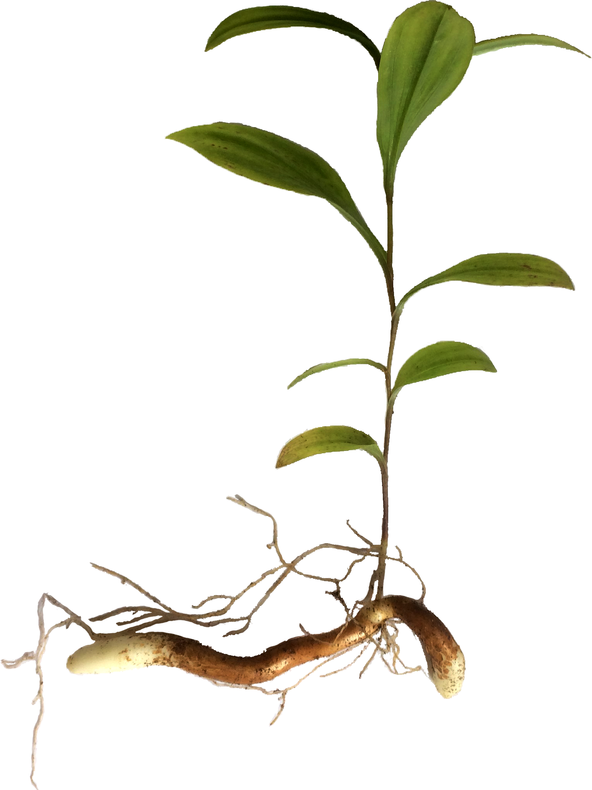
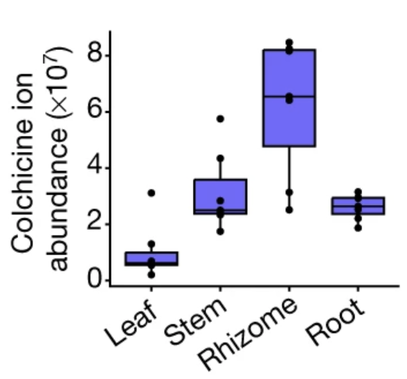
A powerful strategy for pathway discovery
Gloriosa superba
Paired analysis:
Metabolomics
Transcriptomics
active site of biosynthesis!
colchicine
mitotic poison, gout medicine
Notes:
I am going to spare you the details for the discovery process, as it is much the same as for HupA. Basically, we performed metabolomics to identify an active tissue of biosynthesis, which we found to be the rhizome. We then performed paired transcriptomic analysis of these tissues, performed correlation analysis and used biosynthetic logic.

Slide 29
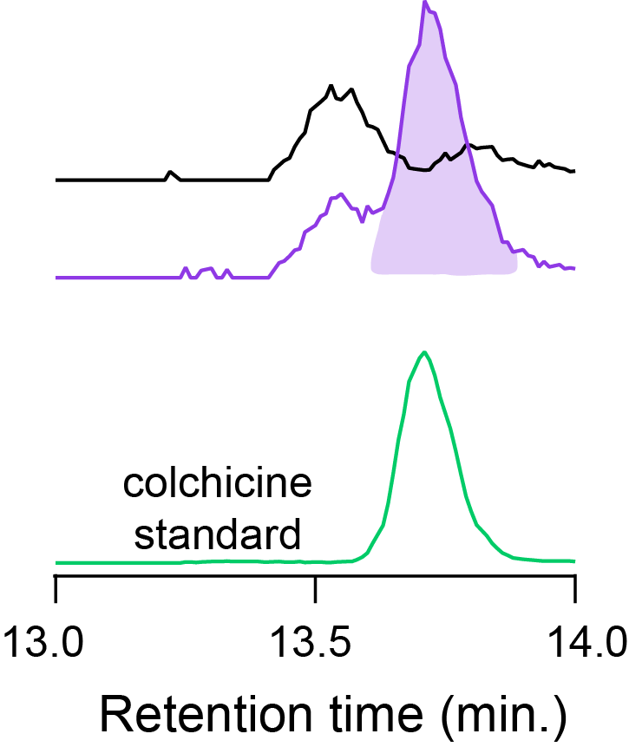
Total biosynthesis of colchicine
co-expression of 20 genes
9 genes
5 genes
2 genes
4 genes
yield: ~1 µg/g dry weight
(1000x lower than native plant)
control
20 gene pathway
Nicotiana benthamiana
Nett*, Lau*, & Sattely. Nature. 2020.
Nett & Sattely. JACS. 2021.
Notes:
I am going to spare you the details for the discovery process, as it is much the same as for HupA. Basically, we performed metabolomics to identify an active tissue of biosynthesis, which we found to be the rhizome. We then performed paired transcriptomic analysis of these tissues, performed correlation analysis and used biosynthetic logic.

Slide 30
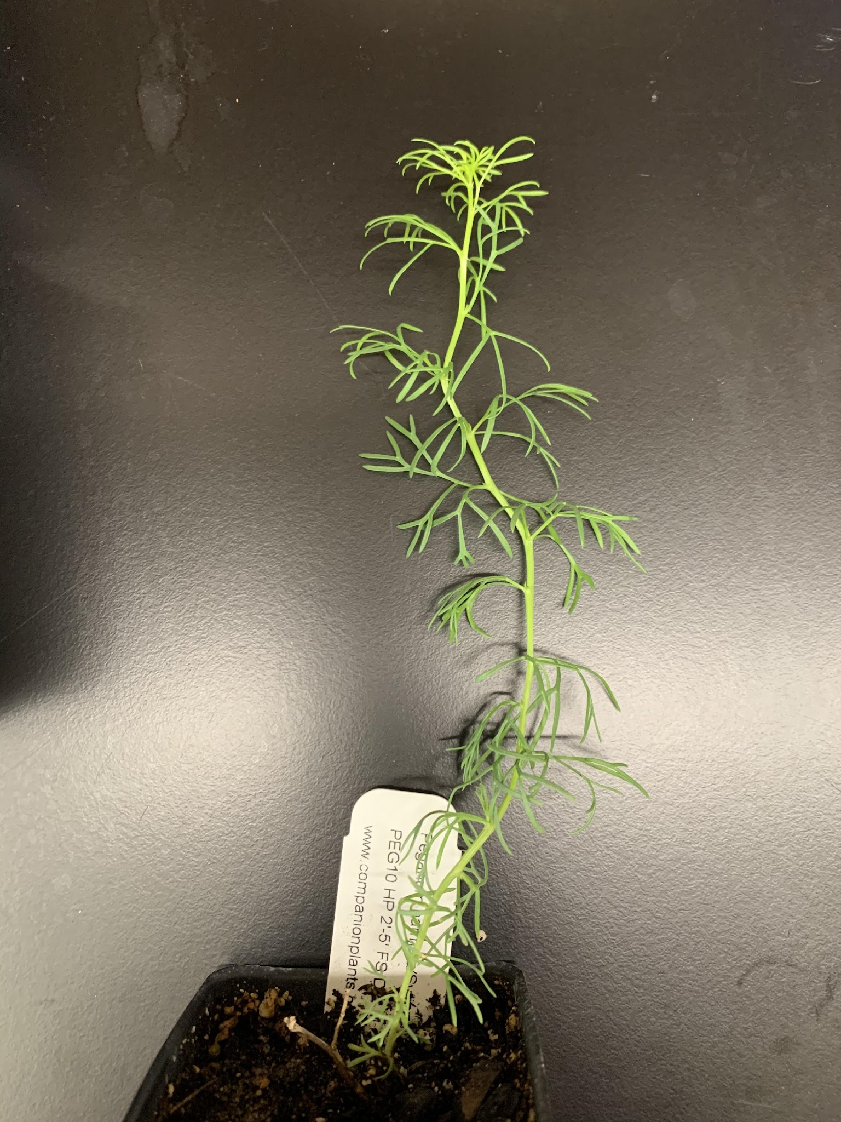
A powerful strategy for pathway discovery
Peganum harmala (Syrian rue)
harmine
monoamine oxidase inhibitor,
neuroactive
L-tryptophan
Notes:
I am going to spare you the details for the discovery process, as it is much the same as for HupA. Basically, we performed metabolomics to identify an active tissue of biosynthesis, which we found to be the rhizome. We then performed paired transcriptomic analysis of these tissues, performed correlation analysis and used biosynthetic logic.

Slide 31
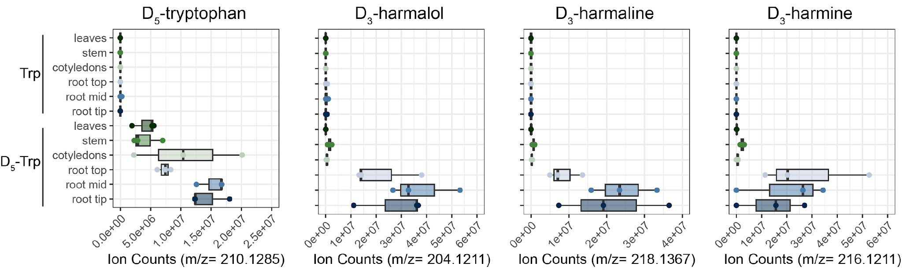
A powerful strategy for pathway discovery
Peganum harmala (Syrian rue)
harmine
[D₅]-L-tryptophan
root-specific biosynthesis!
transcriptomics
Notes:
I am going to spare you the details for the discovery process, as it is much the same as for HupA. Basically, we performed metabolomics to identify an active tissue of biosynthesis, which we found to be the rhizome. We then performed paired transcriptomic analysis of these tissues, performed correlation analysis and used biosynthetic logic.

Slide 32
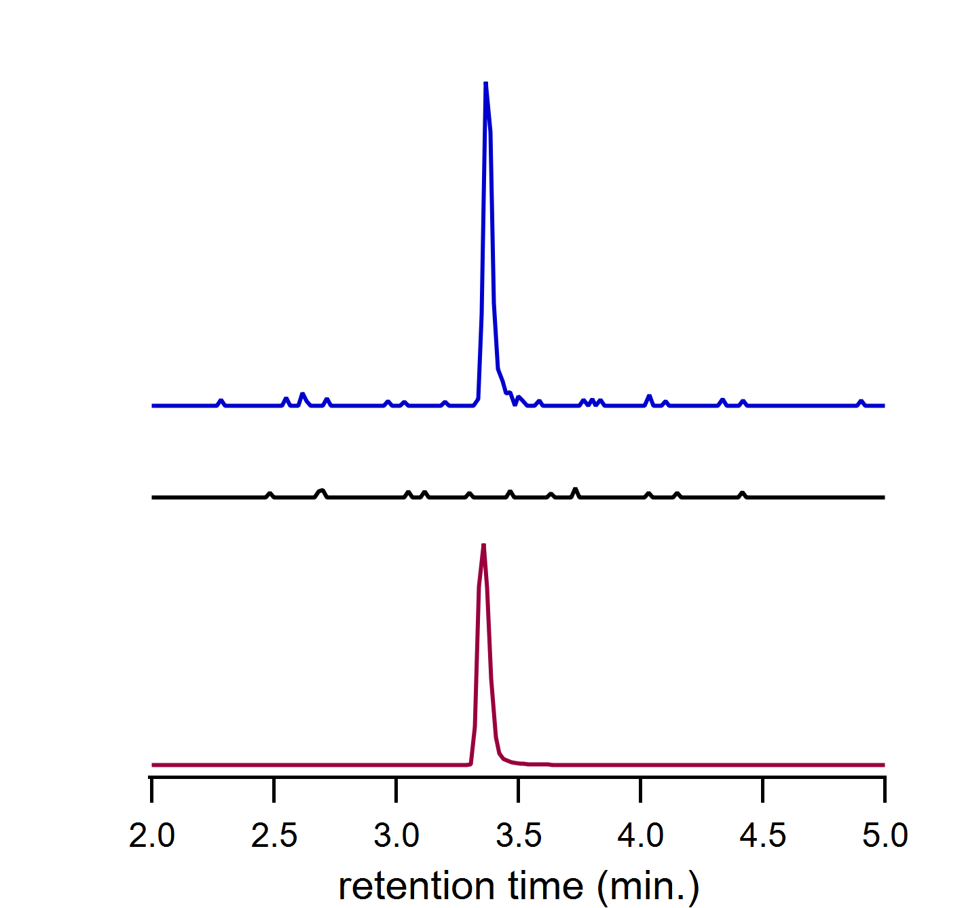

Near total biosynthesis of harmala alkaloids
co-expression of 6 genes
GLY-1
Need to optimize heterologous production to achieve harmine
6 genes
negative control
Fabiola Muro-Villanueva
harmaline
Nicotiana benthamiana
unpublished
Notes:
I am going to spare you the details for the discovery process, as it is much the same as for HupA. Basically, we performed metabolomics to identify an active tissue of biosynthesis, which we found to be the rhizome. We then performed paired transcriptomic analysis of these tissues, performed correlation analysis and used biosynthetic logic.

Slide 33
Major takeaways
We have a powerful strategy for the accelerated discovery of biosynthetic pathways in plants.
Complete pathways can be rapidly engineered in a model plant
Identification of the underlying biosynthetic genes allows us to access the broad metabolic diversity found in plants

Slide 34
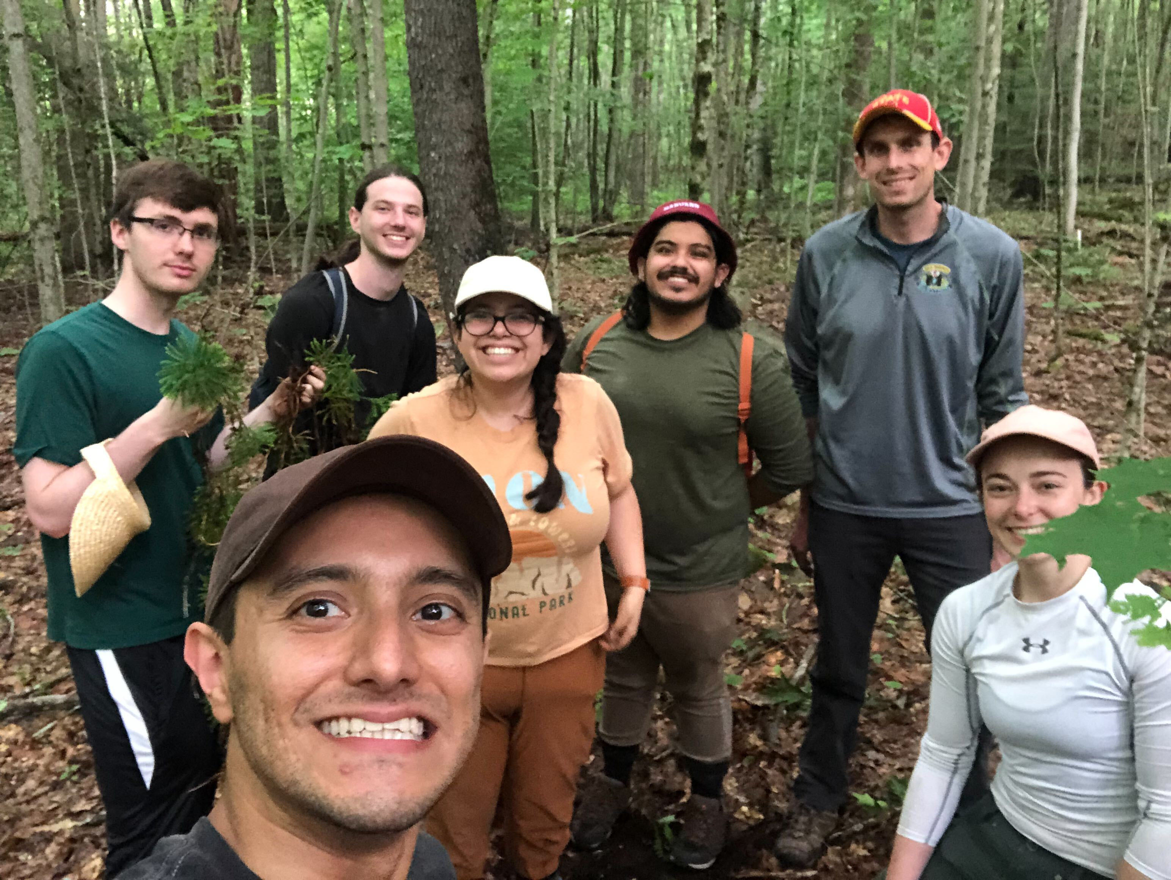
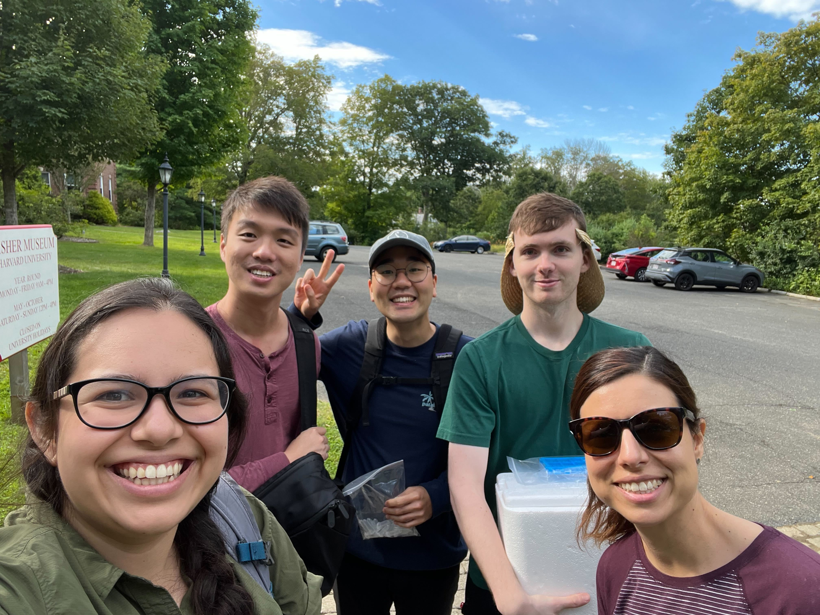




Acknowledgements
@rnett42
Sattely Lab (post-doc):
Beth Sattely
Chun Tsai
Yaereen Dho
Warren Lau
Dr. Yun Yee Low – University of Malaya
Nett lab members
Eric Fields
Colin Kim
Jaime Martinez Grundman
Fabiola Muro-Villanueva
Juan Orozco
Josh Park
Hisham Tadfie
Galen Tiong
Ye Won Ham
Jazmin Pearson
Caleb Jaffe
Former members
Andrea Loya Castillo
Sara Nelson
website: nett-lab.com
email: rnett@fas.harvard.edu

Slide 35
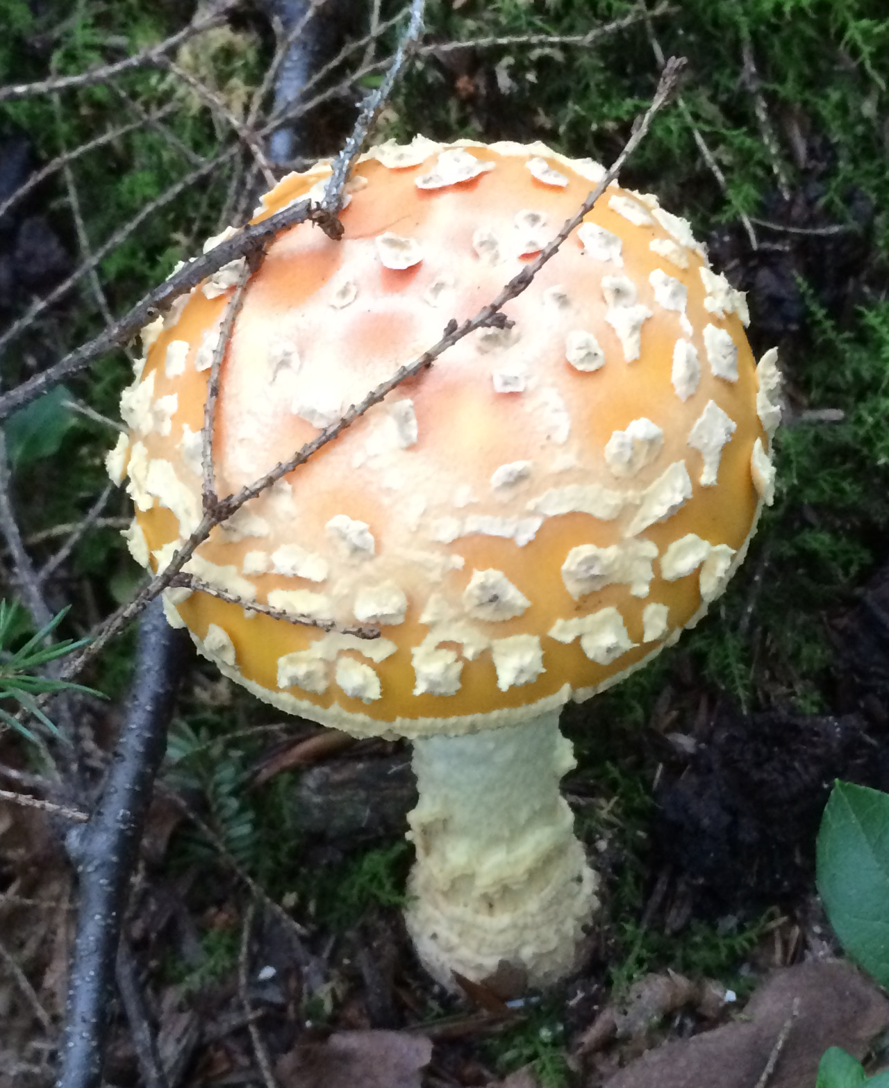
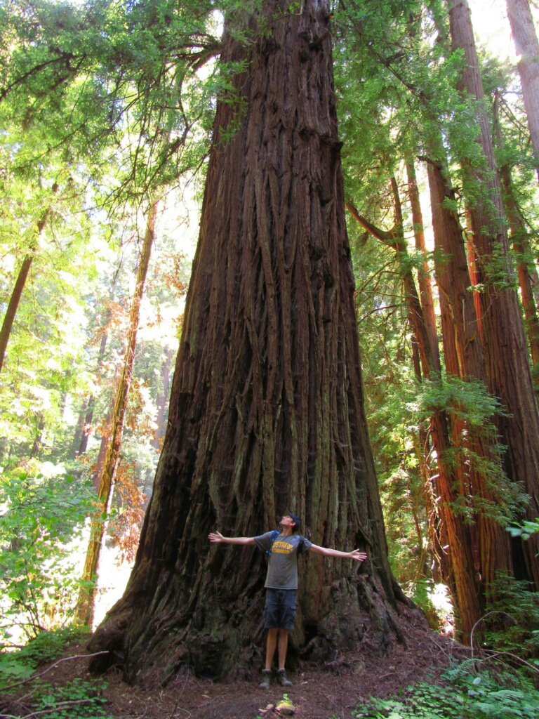

Challenges in plant pathway discovery
Difficulty in genome sequencing
  -genome size, complexity, polyploidy
coastal redwood
27 billion bp, hexaploid
fungi
~40 million bp
me (human)
3 billion bp, diploid
bacteria
~5 million bp
https://www.pacb.com/blog/tackling-a-giant-genome/
Gregory et al. Nucleic Acids Res. 2007.
Notes:
First, plant genomes are large and complex. Often much larger than a human genome, and certainly larger than those of other natural product-rich organisms (fungi and bacteria).

Slide 36
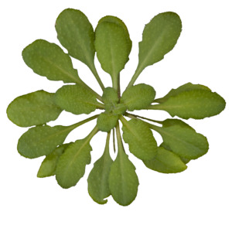
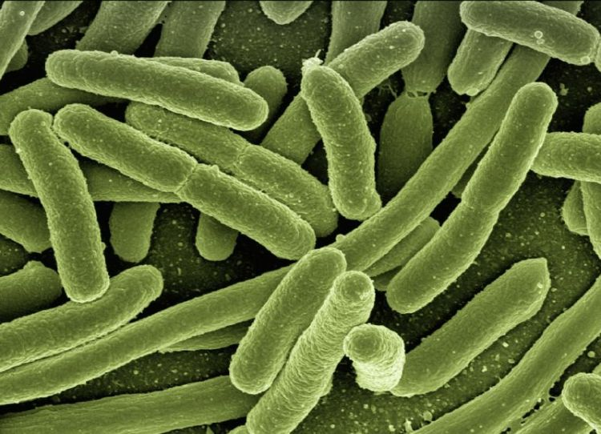
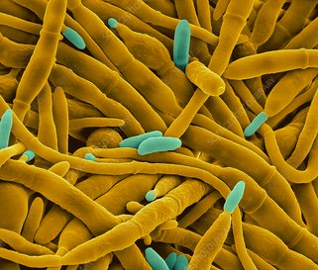
Challenges in plant pathway discovery
Difficulty in genome sequencing
  -genome size, complexity, polyploidy
Lack of biosynthetic gene clusters (usually)
Bacteria
Fungi
gibberellins
growth and developmental phytohormones
Notes:
Second, the biosynthetic genes are usually no clustered on the genomes (when it is available). This is highlighted by the biosynthesis of gibberellins in plants, fungi, and bacteria.

Slide 37
Challenges in plant pathway discovery
Difficulty in genome sequencing
  -genome size, complexity, polyploidy
Lack of biosynthetic gene clusters (usually)
Bacteria
Nett et al. Nat. Chem. Biol. 2017.
Nett et al. ACS Chem. Biol. 2017.
Fungi
Hedden et al. J. Plant Growth Regul. 2001.
Bömke & Tudzynski. Phytochemistry 2009.
Notes:
While bacteria and fungi have full biosynthetic gene clusters to make GA, the genes within plants are scattered across the genome.

Slide 38
Biosynthetic discovery in plants has been difficult
Pauli & Kutchan. Plant J. 1998.
Galanie et al. Science 2015.
Winzer et al. Science 2015.
Farrow et al. Nat. Chem. Biol. 2015.
opium poppy
Nearly 20 years from the first gene (1998) to the final gene (2015)
morphine
analgesic
Pacific yew tree
First gene identified in 1996 – minimal set of genes just identified (almost 30 years)
paclitaxel
chemotherapeutic
Wildung & Croteau. J. Biol. Chem. 1996.
Zhang et al. Mol Plant. 2023.
Li et al. Angewandte Chemie. 2023.
Jiang et al. Science. 2024.
Notes:
These challenges have made pathway discovery in plants difficult and slow. 20 years from the 1st to last gene in morphine biosynthesis. Still don’t know the pathway for paclitaxel!

Slide 39
Biosynthetic logic guides candidate gene selection
hydroxylase
acyl transferase
hypothetical biosynthetic pathway
Notes:
We use chemical biosynthetic logic to guide our selection of candidate genes. If we have an idea of the chemical transformations, then we can make reasonable guesses about the types of enzymes involved.

Slide 40

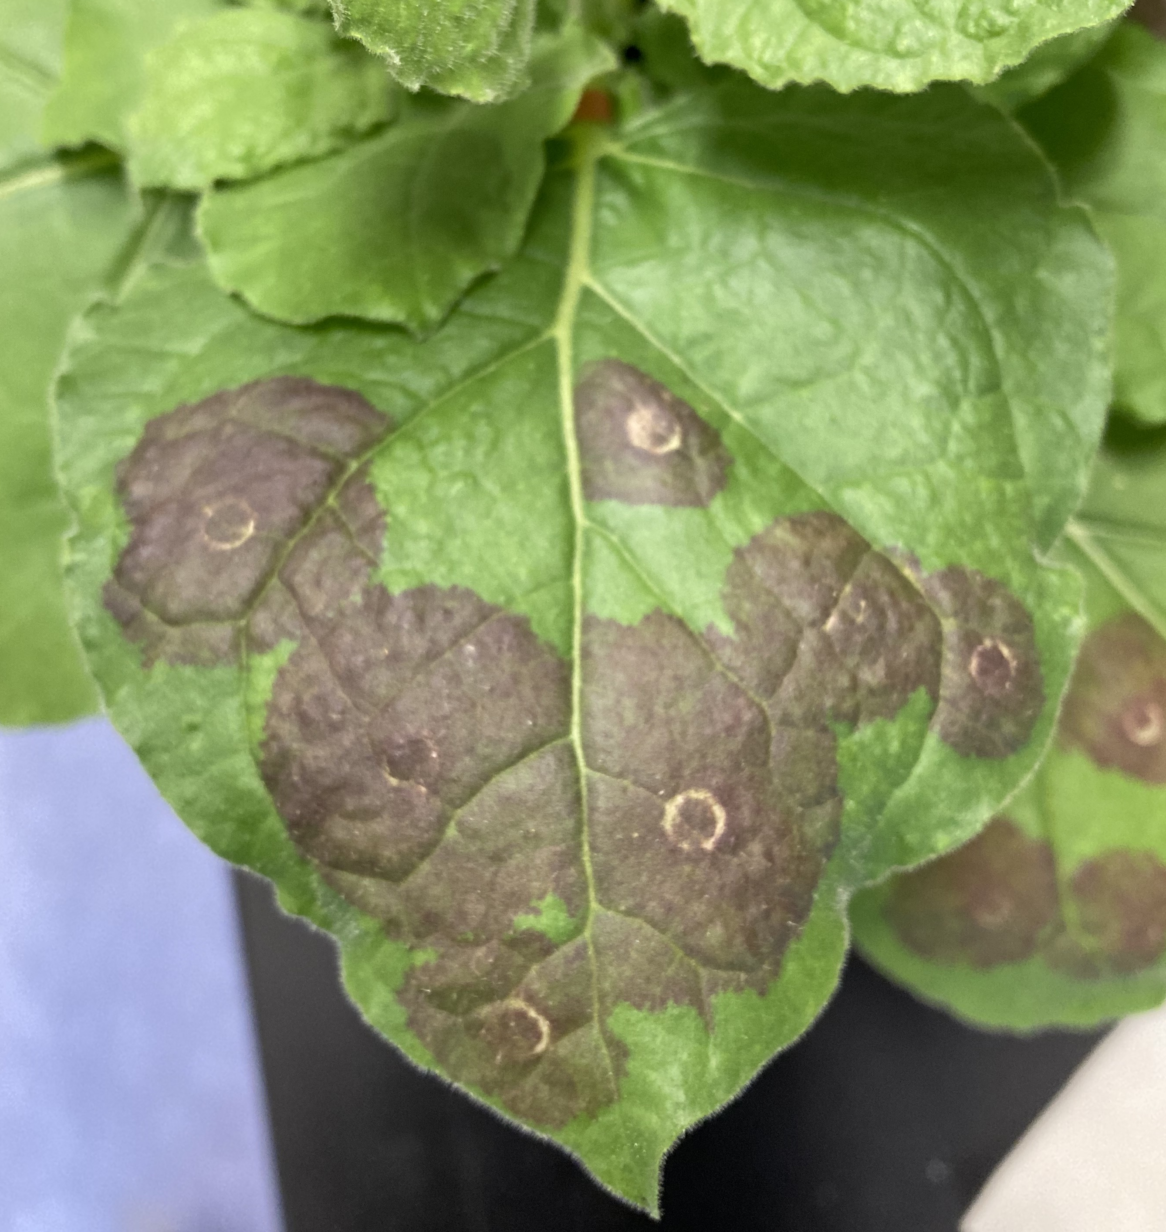
Harnessing a plant pathogen for protein production
supplied by tobacco metabolism
He et al. Horticulture Research. 2020
Notes:
The beautiful thing about this system is that we can add in many strains/genes simultaneous, for co-production of multiple proteins. This allows for combinatorial batch testing, and building pathways in the plant leaf.

