Slide 1
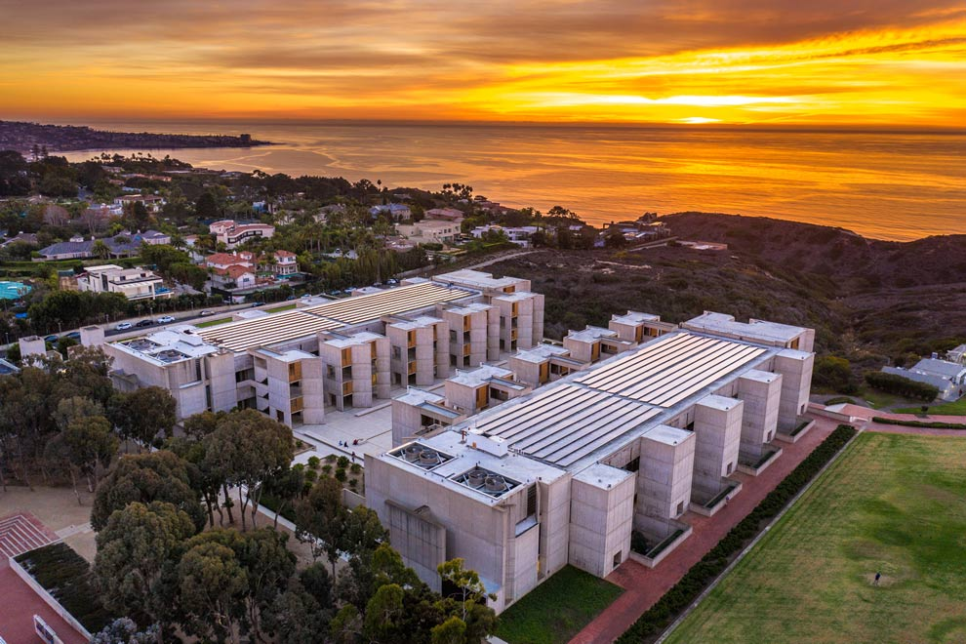

Identifying novel therapeutics for treating dementia
Global Health, Biodiversity, and Therapeutics Hybrid Seminar,
Harvard University Herbaria and University of Costa Rica
Costa Rica August 20, 2024
Antonio Currais, PhD
Cellular Neurobiology Department

Slide 2
Research at the CNB:
Fundamental knowledge
Drug Discovery

Slide 3
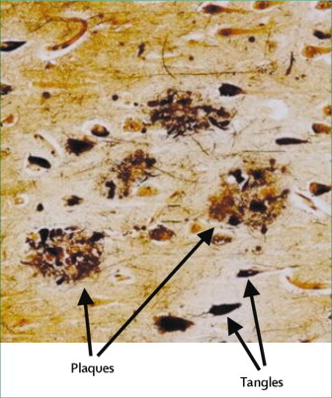
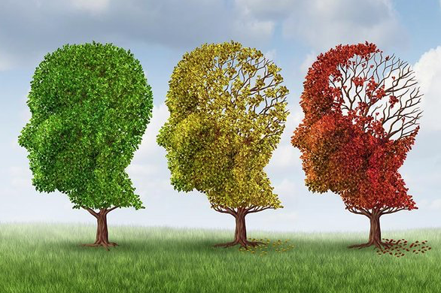
The Problem
The Amyloid cascade hypothesis
??
Aβ
deposits
Limitations…
NFTs
Neuronal cell death
Dementia
Hardy & Higgins, 1992. Science
Hardy & Selkoe, 2002. Science

Slide 4
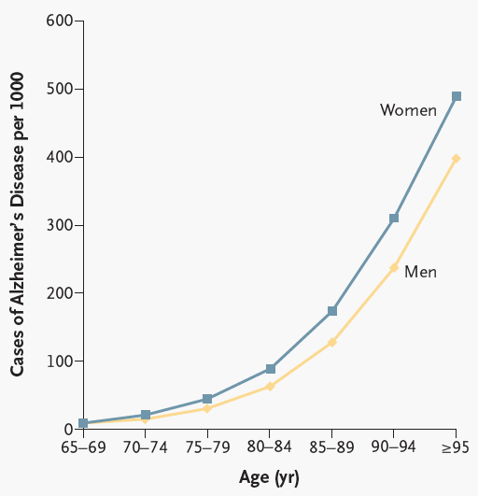
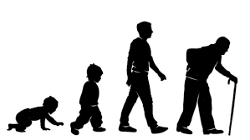
The aging brain and AD
Aging is the biggest risk factor for AD.
Guttmacher, 2003. NEJM

Slide 5

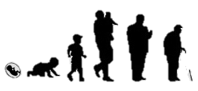
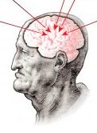
What is aging?
Altered intercellular communication
Genomic instability
Stem cell exhaustion
Telomere attrition
The Hallmarks of Aging
Cellular senescence
Epigenetic alterations
Mitochondrial dysfunction
Loss of proteostasis
Aging
Deregulated nutrient sensing
Hypothesis: Targeting aging processes to prevent early events in AD!
How??
Lopez-Otin, et al, 2013. Cell

Slide 6

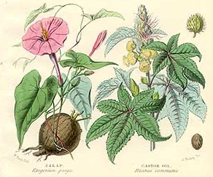
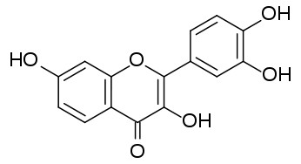
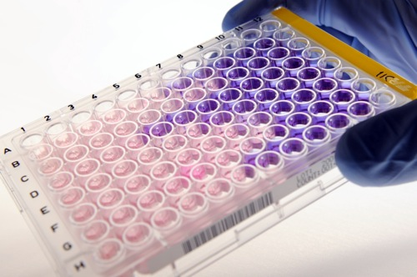
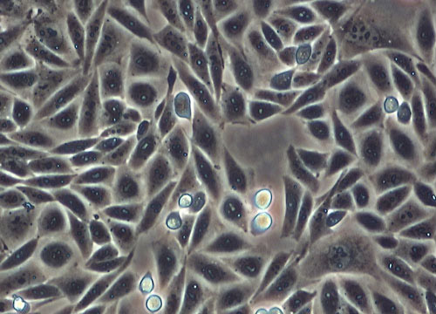
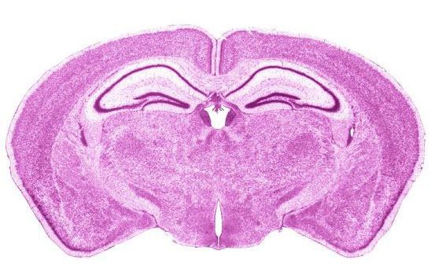
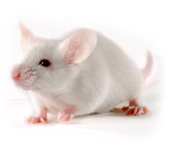
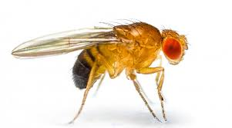
Workflow
Natural compounds/extracts
Cell-based phenotypic screening assays
Chemical optimization for CNS drugs
Neuroprotective compounds
Testing in animal models
(multi-omics)
Efficacy and mechanism of action
1
3
2
Drugs for treating Alzheimer’s disease
Fundamental understanding of the disease
Identification of novel therapeutic targets

Slide 7
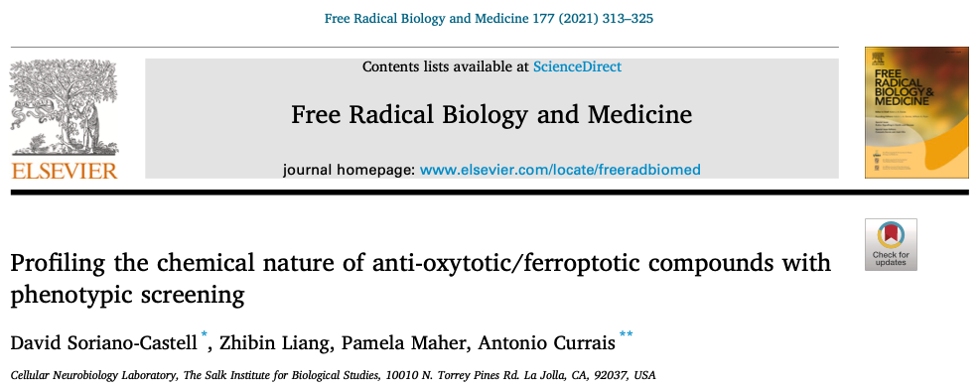
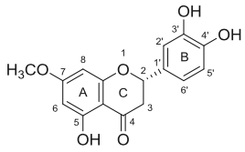
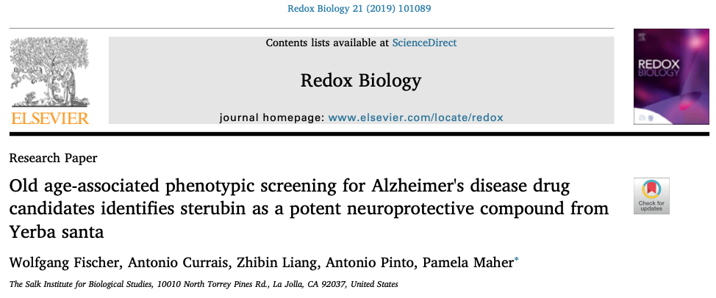
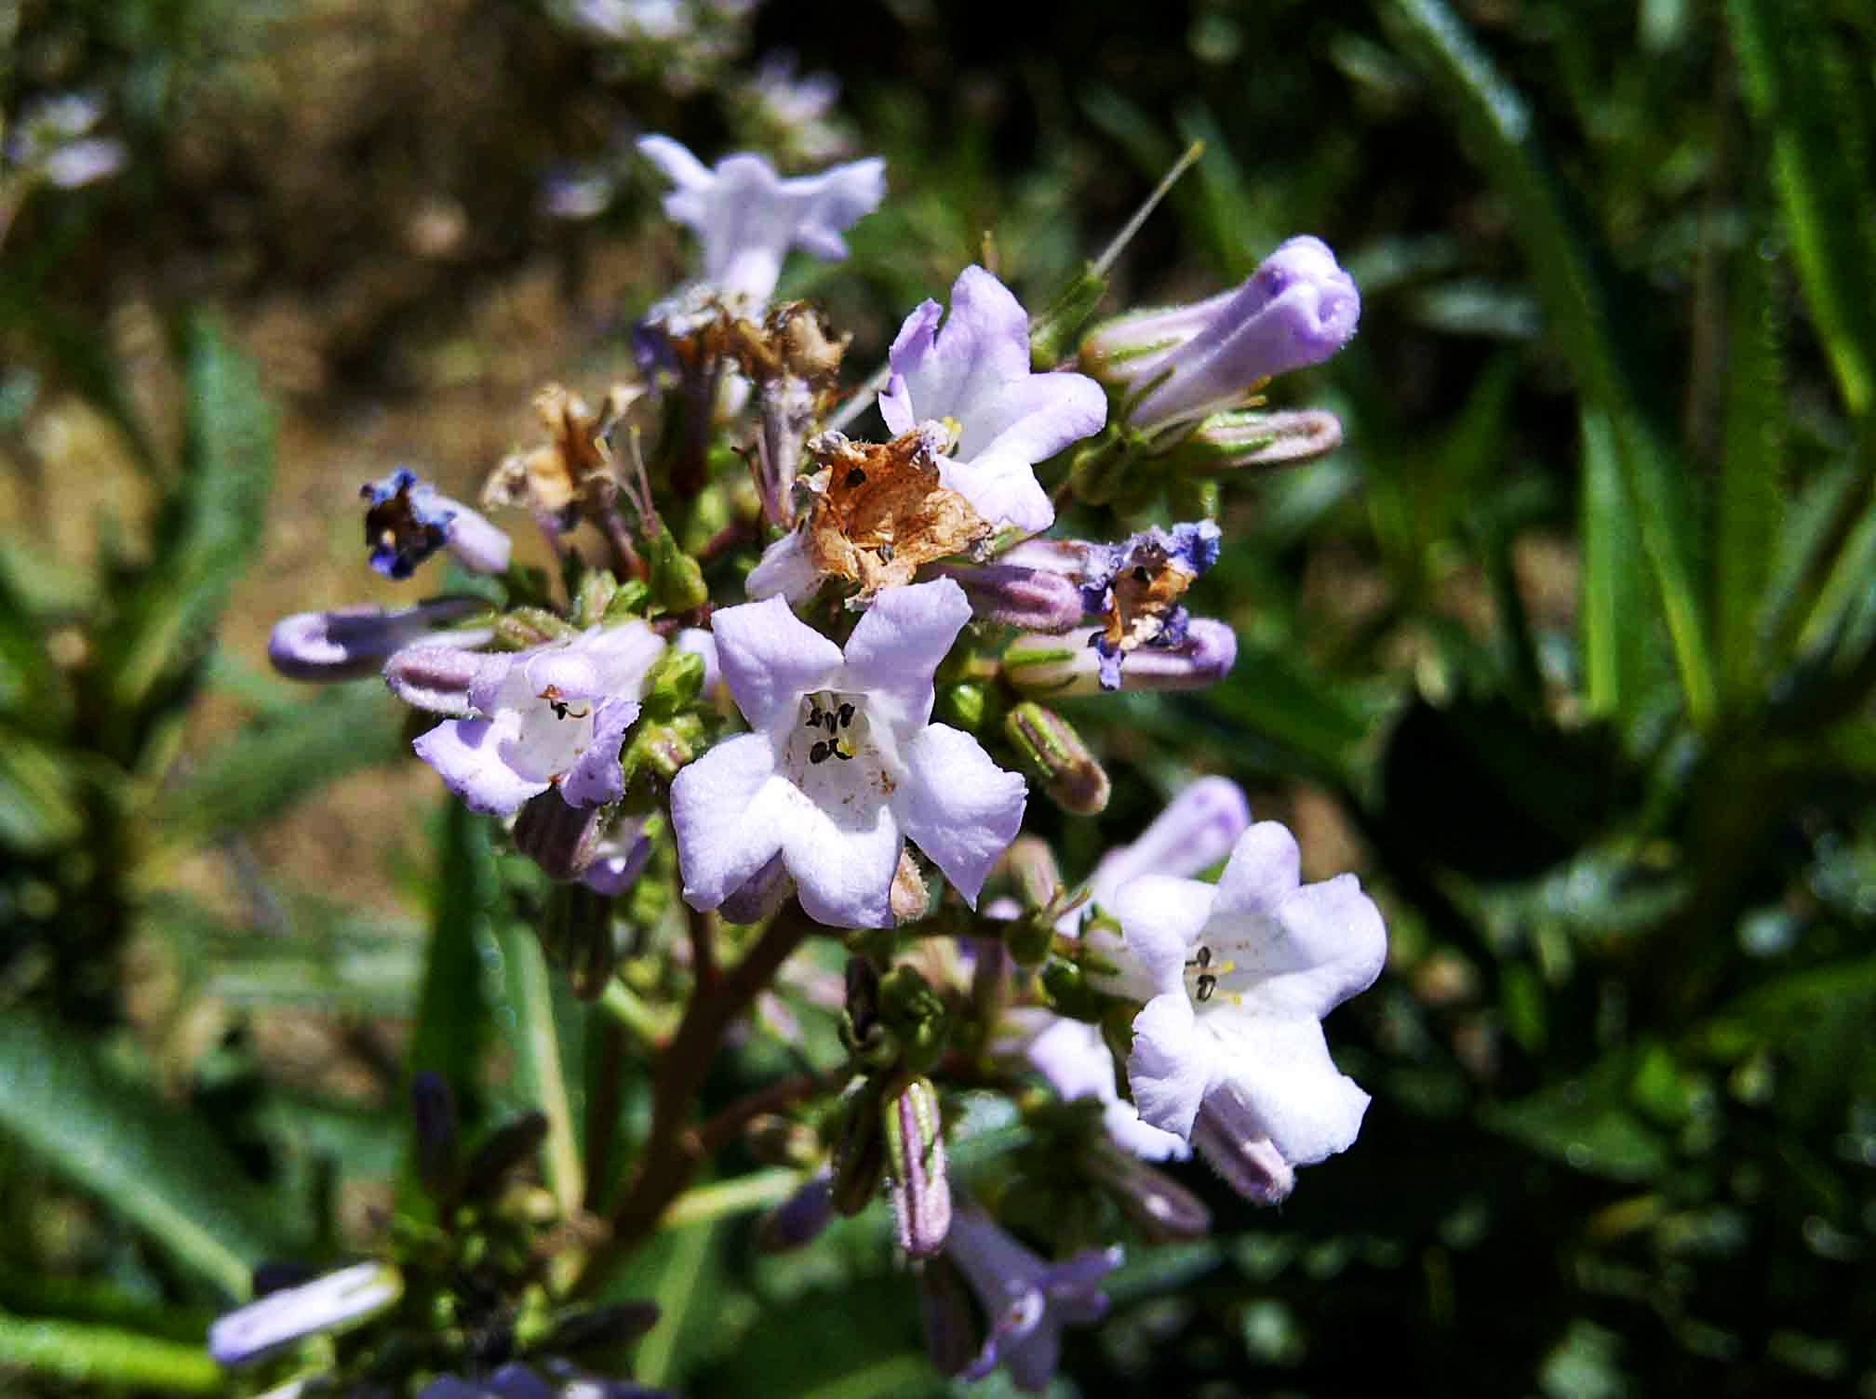

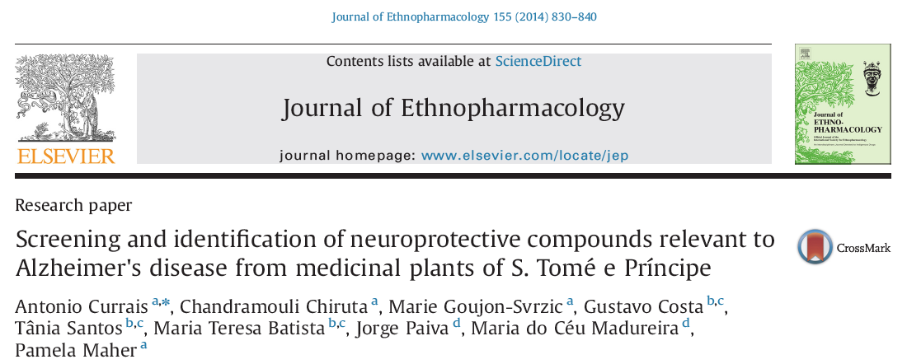


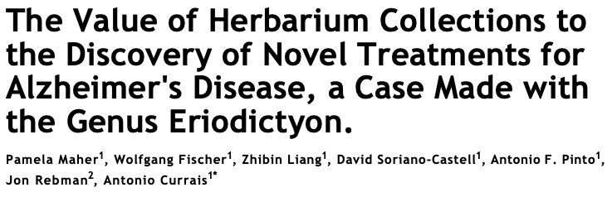
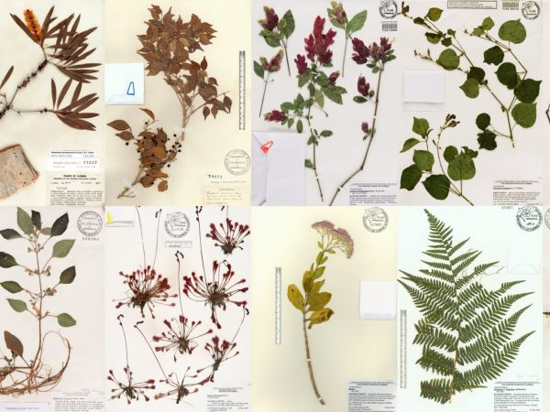
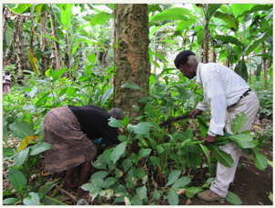
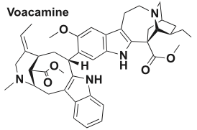
Sources of natural compounds
1) Libraries of natural compounds
(> 1000s compounds)
2) Libraries of plant extracts with pharmacological relevance
Sterubin
(> 100s plants)
Eriodictyon californicum
3) Collaborations with ethnopharmacological/plant groups
Voacamine

Slide 8

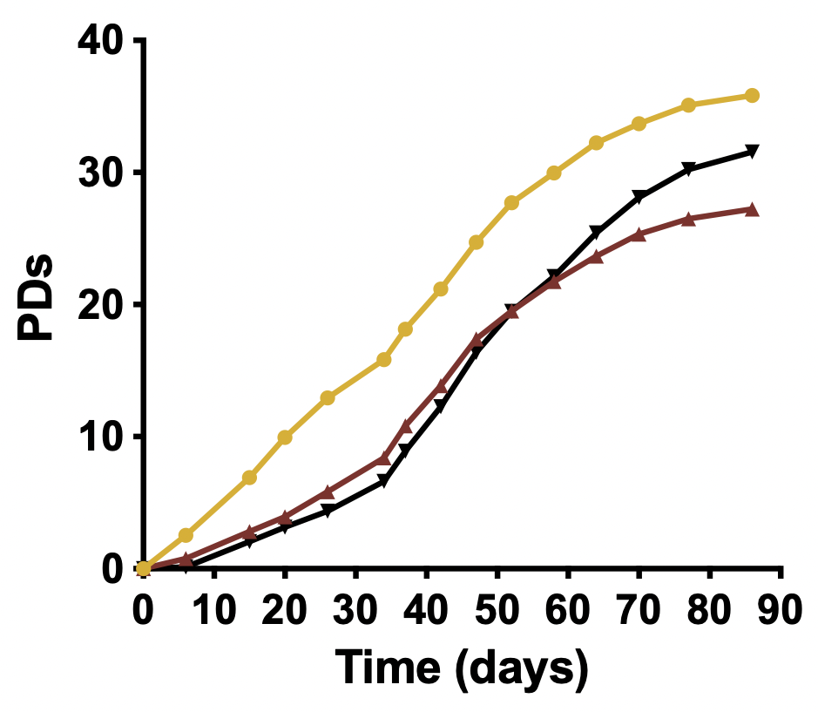
Phenotypic screening
Assays that mimic distinct neurotoxicity pathways associated with both aging and AD:
Growth factor loss (primary neurons)
Oxytosis/ferroptosis (HT22)
Energy loss (in vitro ischemia, HT22)
Aβ toxicity, extracellular (MC65) and intracellular (primary neurons)
Inflammation (microglia)
Nerve cell differentiation (PC12)
Others:
Replicative senescence/SASP (fibroblasts)
iNs from old human fibroblasts
Candidate compounds must show efficacy in assays before testing in animal models.

Slide 9
Workflow
Natural compounds/extracts
Cell-based phenotypic screening assays
Chemical optimization for CNS drugs
Neuroprotective compounds
Testing in animal models
(multi-omics)
Efficacy and mechanism of action
1
3
2
Drugs for treating Alzheimer’s disease
Fundamental understanding of the disease
Identification of novel therapeutic targets

Slide 10
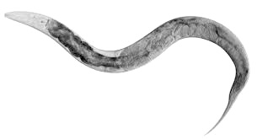
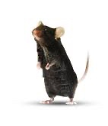
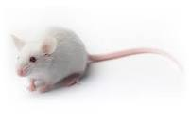
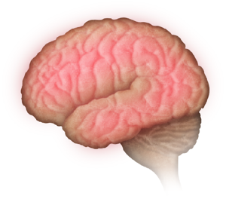
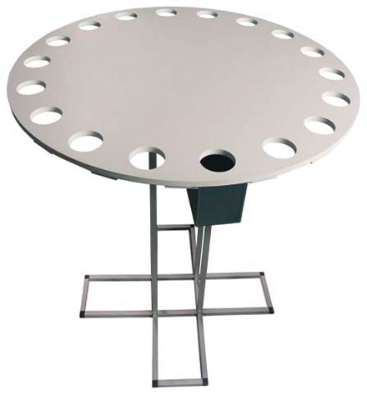
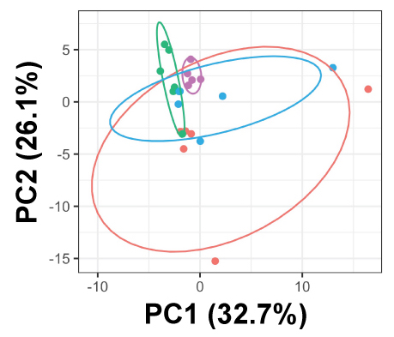
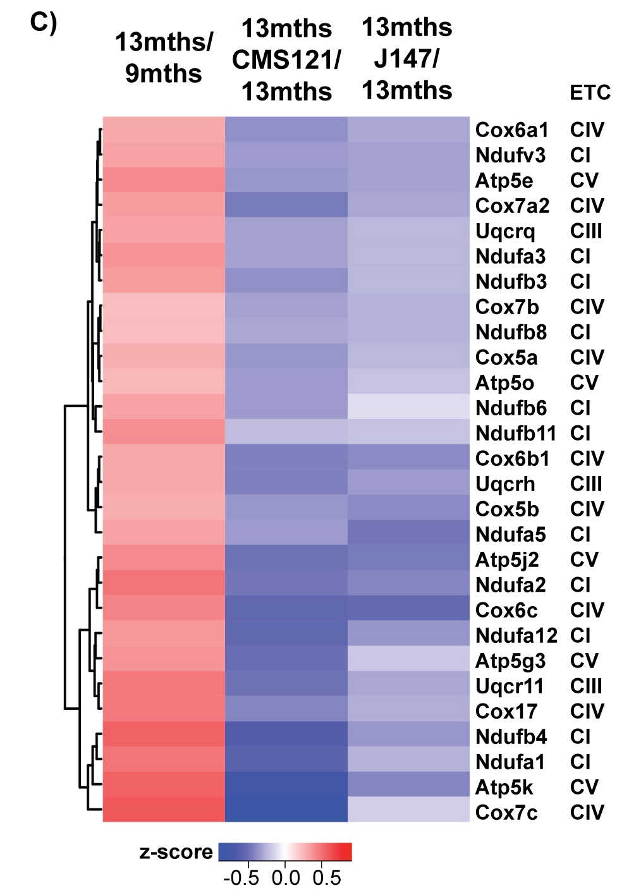
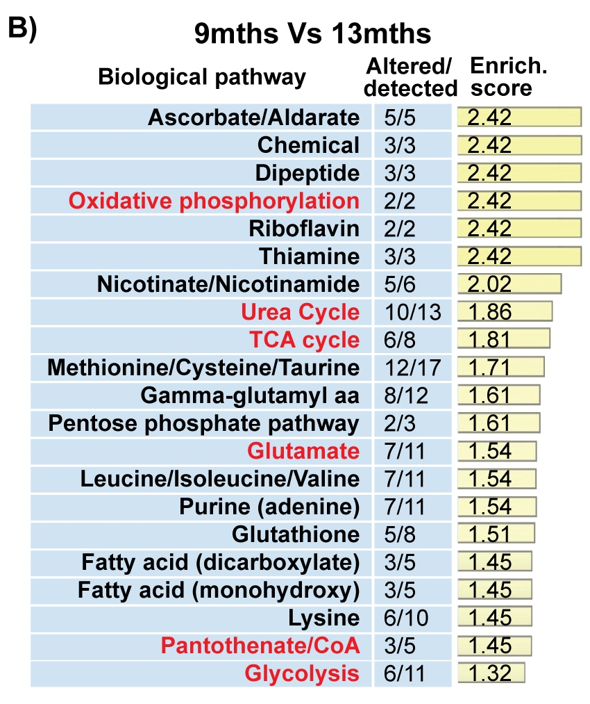
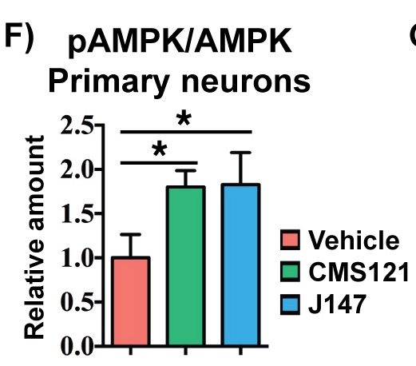
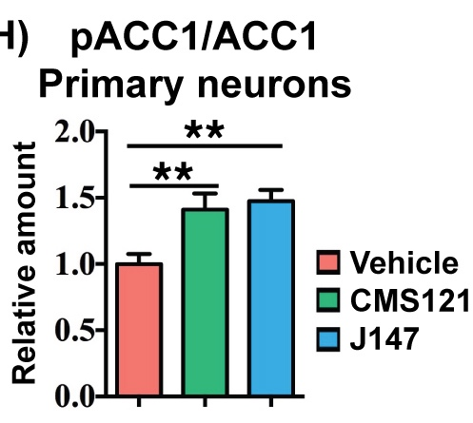

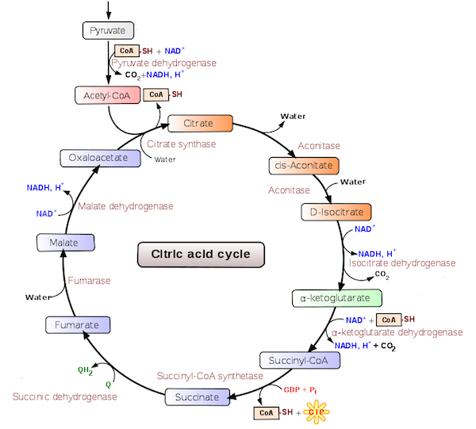
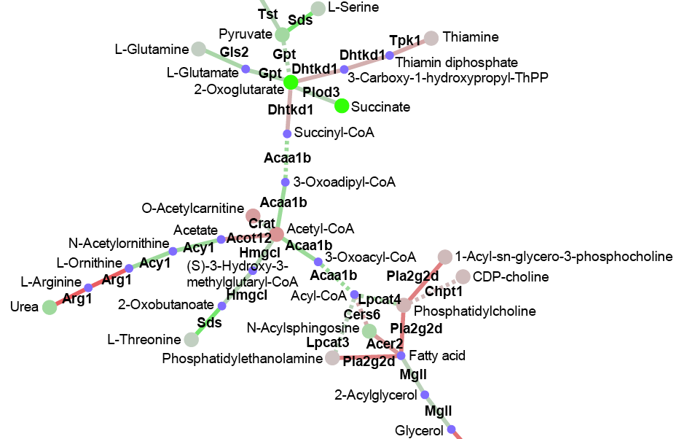
The animal models
C. elegans
AD transgenic (APPswe/PS1dE9,…)
D. melanogaster
SAMP8 (accelerated aging and dementia) -> Early events in AD
Cognition
Transcriptome
Metabolome
Proteome
Data integration
Molecular validation

Slide 11

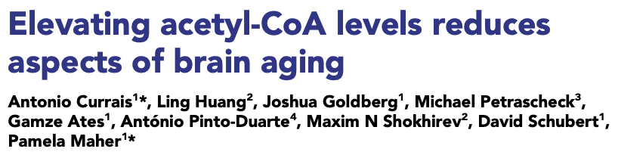
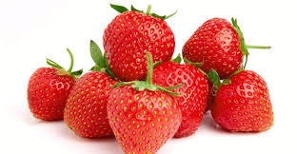
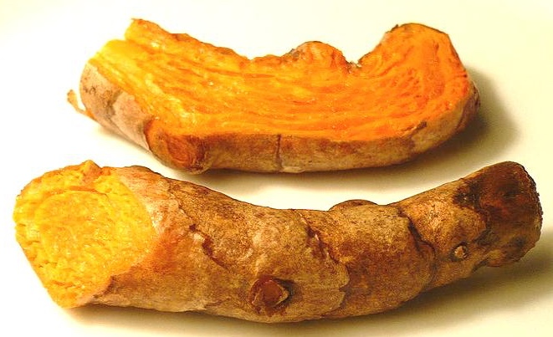
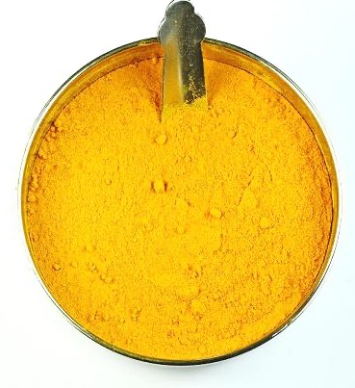
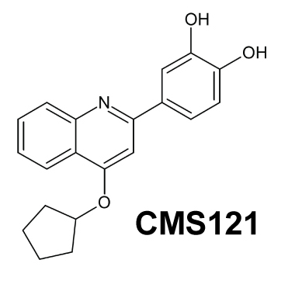
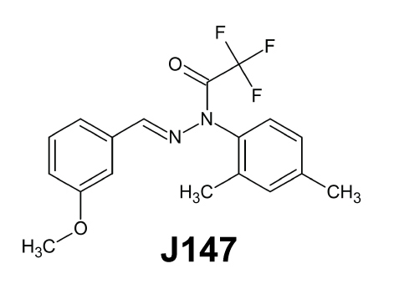
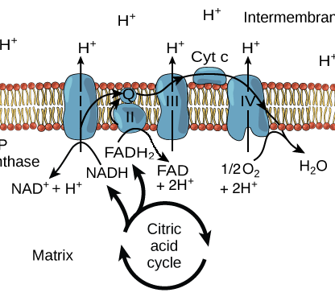
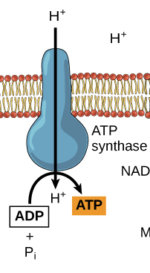
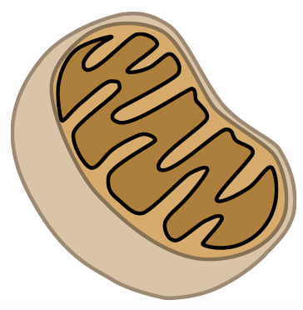
Fisetin
Curcumin
121
147
. Overlapping mechanism
. Energetic stress response
. Improved cognition
. Maintenance of mitochondria
. Prevention of aging markers
pAMPK
Acetyl-CoA
Healthy mitochondria
Aging

Slide 12
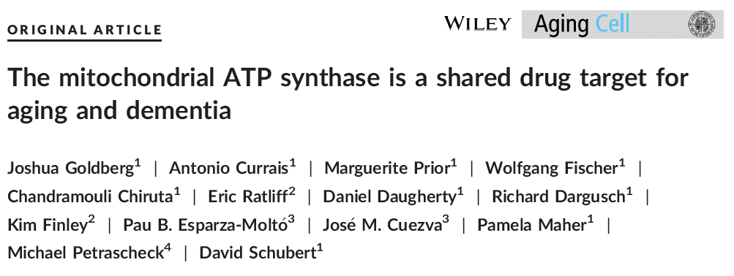
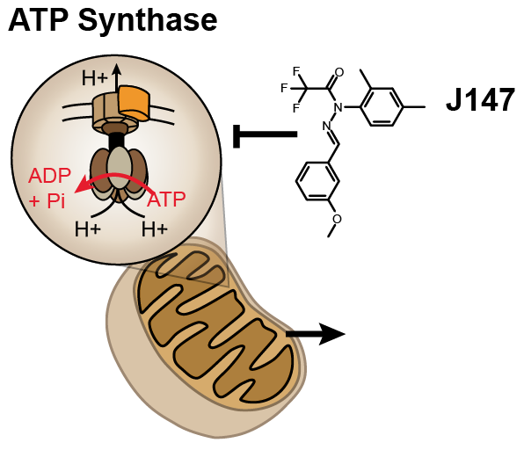
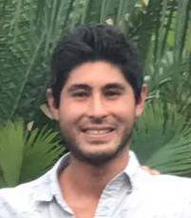
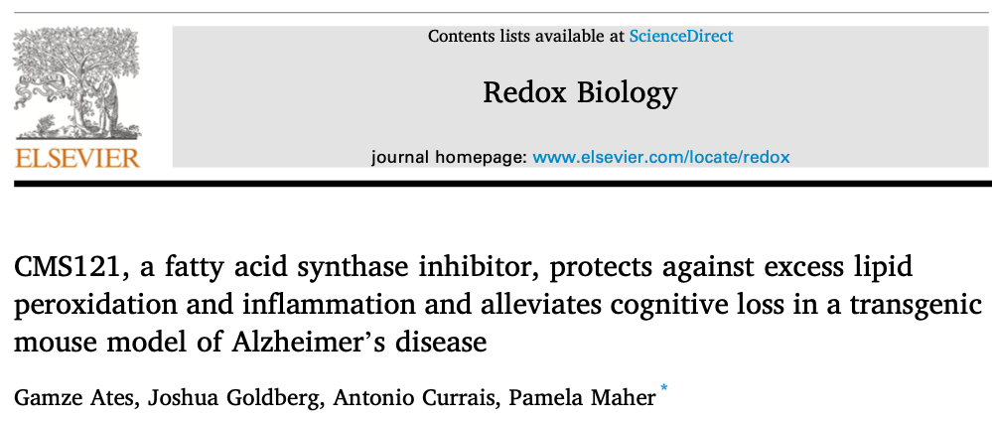
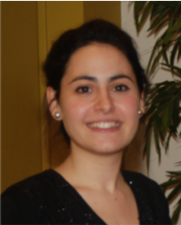

. Binds the α-F1-ATPsyn
. J147 delays markers of aging in mice
. Extends lifespan in D. melanogaster, C. elegans and M. musculus
147
J147
Joshua Goldberg
. Inhibits FAS
. Alleviates cognitive loss in mice
. Reduces lipid peroxidation and inflammation
121
Gamze Ates
Fatty acid synthase

Slide 13


The mechanism
?
. J147
. CMS121
. ↓ genetic/chemical ATPsyn
. ↓ genetic/chemical FAS
. ↓ genetic/chemical ACC1
Oxytosis/
Ferroptosis
Geroprotection!!
Aging
AD

Slide 14
Workflow
Natural compounds/extracts
Cell-based phenotypic screening assays
Chemical optimization for CNS drugs
Neuroprotective compounds
Testing in animal models
(multi-omics)
. J147 -> Phase I
. CMS121 -> Phase I
Efficacy and mechanism of action
Oxytosis/ferroptosis in AD
. ATP synthase
. FAS
1
3
2
Drugs for treating Alzheimer’s disease
Fundamental understanding of the disease
Identification of novel therapeutic targets

Slide 15


Thank you!
Cellular Neurobiology (Salk)
David Schubert (passed away)
Pamela Maher
Wolfgang Fischer
Joshua Goldberg
Richard Dargusch
Gamze Ates
Liang Zhibin
Devin Kepchia
Integrative Genomics and
Bioinformatics Core (Salk)
Ling Huang
Max Shokhirev
Jon Rebman
Michael Petraschek
  Funding
Salk Institute, Shiley-Marcos Alzheimer’s Disease Research Center at UCSD, Glenn Foundation for Medical Research, Alzheimer’s Association and NIH.

