Slide 1

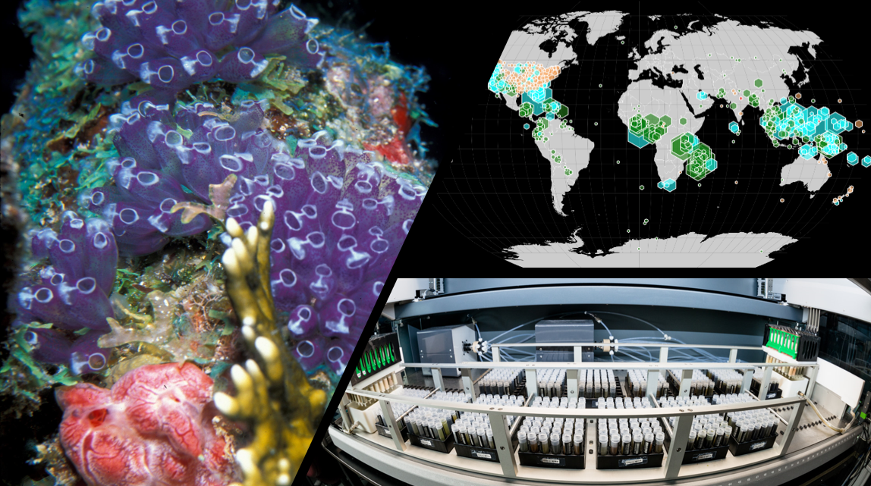
National Cancer Institute’s Program for Natural Product Discovery
Global Health, Biodiversity, and Therapeutics Hybrid Seminar
Costa Rica, 20th of August 2024
Tanja Grkovic
Natural Products Branch
Developmental Therapeutics Program
Division of Cancer Treatment and Diagnosis
Molecular Targets Program
Center for Cancer Research
National Cancer Institute

Slide 2
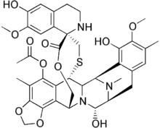
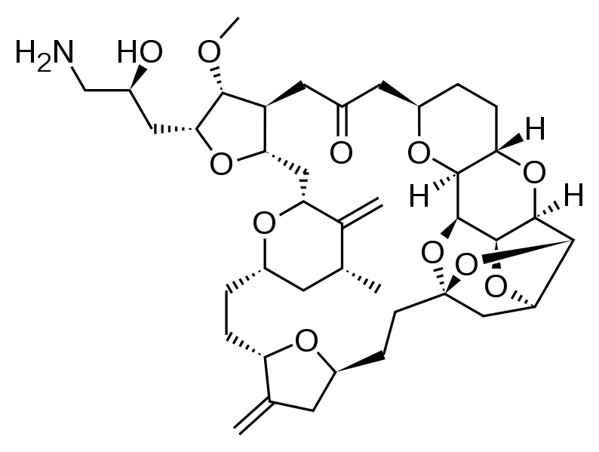
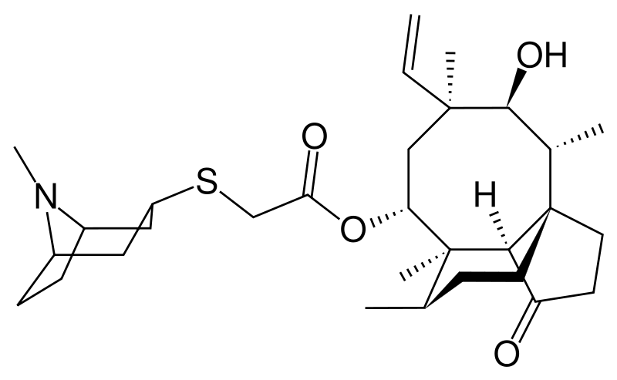
Natural Products as Sources of Drugs
30% of all small molecule drugs are natural product-derived
From 1981-2020 natural products and derivatives represented:
50% of antibacterial drugs
45% of antiparasitic drugs
40% of anticancer drugs
Artesunate
Malaria
Trabectedin
Ovarian, soft-tissue sarcoma
Retapamulin
Antibiotic
Eribulin
Metastatic breast cancer
PubMed Citations on High-Throughput Screening
Newman and Cragg J. Nat. Prod. 2020, 83, 770.;
Wilson et al. Nat Prod Rep. 2020, 37, 893.

Slide 3
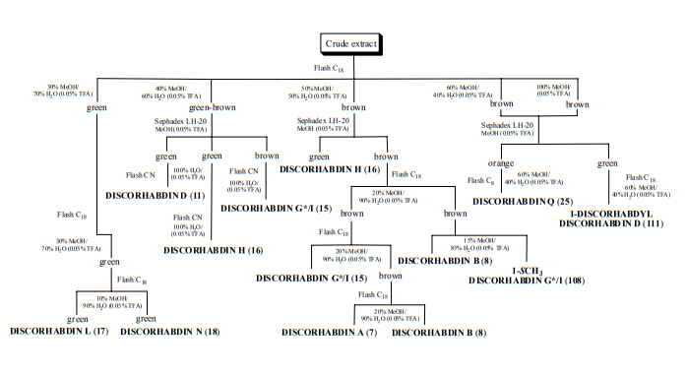
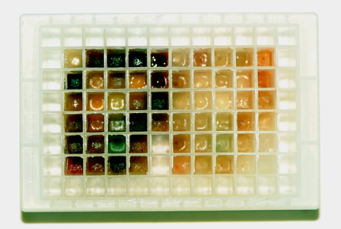
Challenges with Working on Natural Products
Complex mixtures of primary and secondary metabolites
Solubility
Lengthy isolation procedures
Cytotoxicity and off-target issues
HTS campaign over before the structure is determined…
Wilson et al. Nat Prod Rep. 2020, 37, 893.

Slide 4
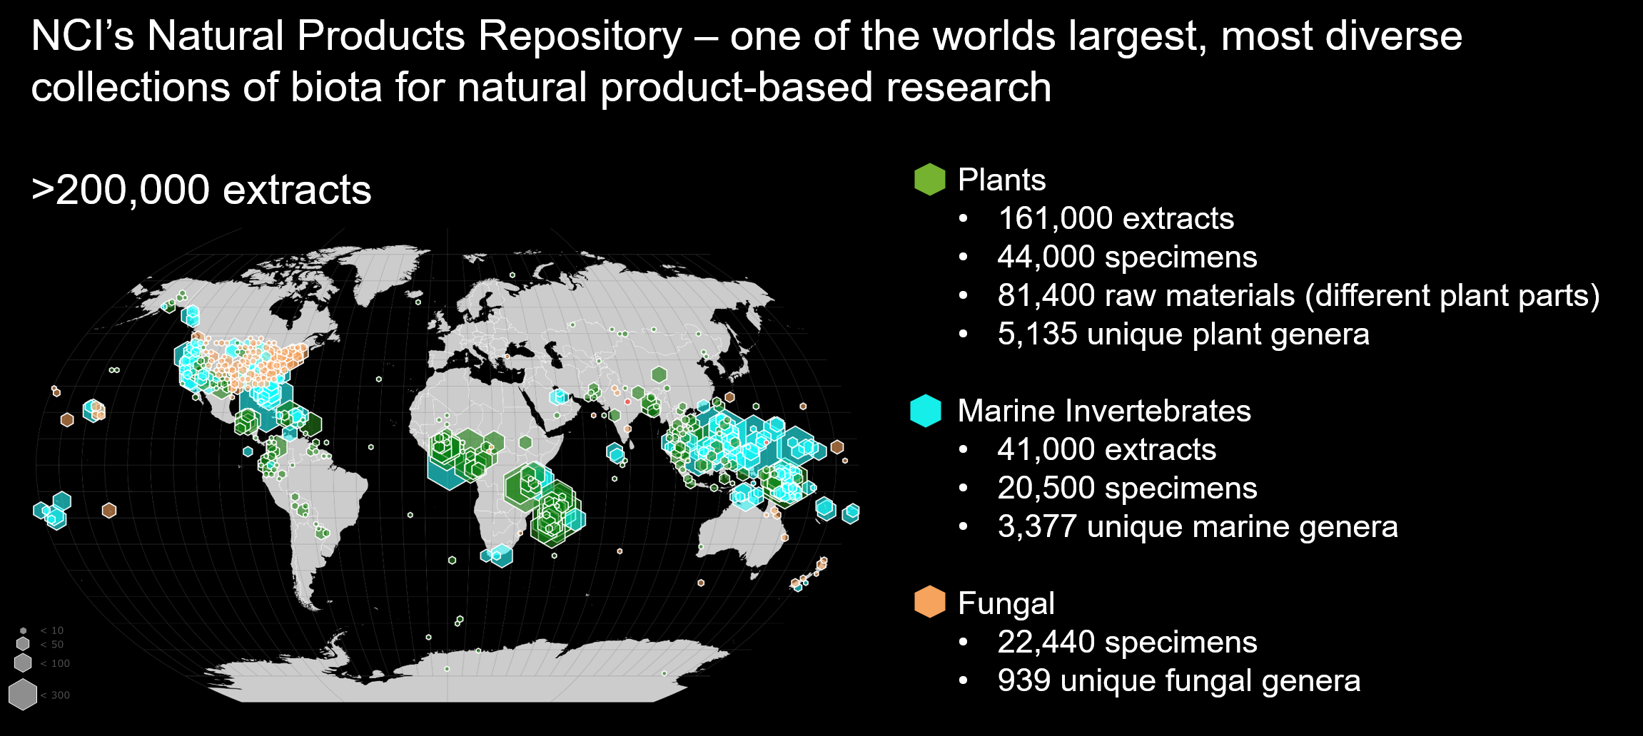
NCI’s Natural Product Repository

Slide 5
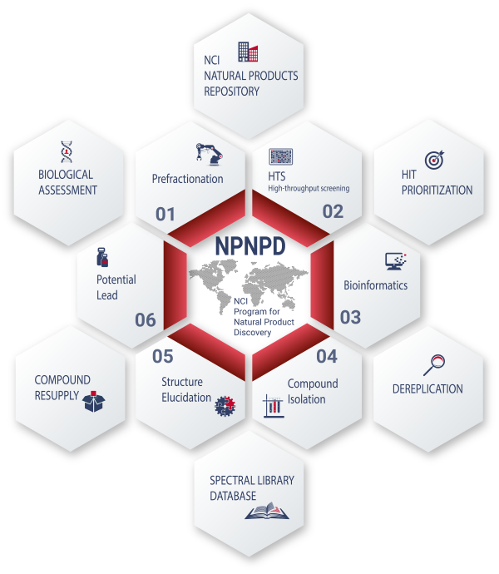
NCI’s Program for Natural Product Discovery
What are the aims of the NPNPD?
Prefractionate more than 125,000 crude extracts
Generate a library of 1,000,000 natural product fractions for modern high-throughput targeted screening technologies
What is the NPNPD prefractionated library?
Publicly accessible, free of charge, and open to screening against any disease target
Includes access to prefractionated natural product samples and analytical chemistry resources for screening support
https://dtp.cancer.gov/organization/npb/npnpd_prefractionated_library.htm

Slide 6
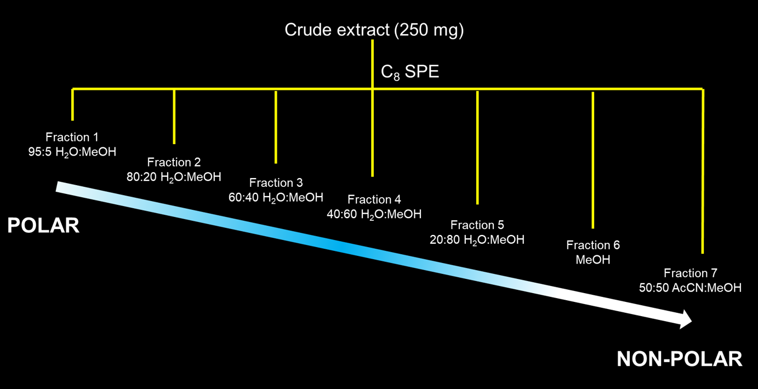
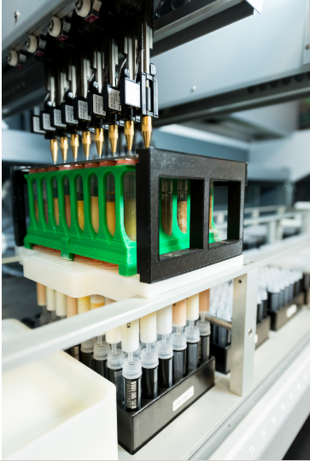

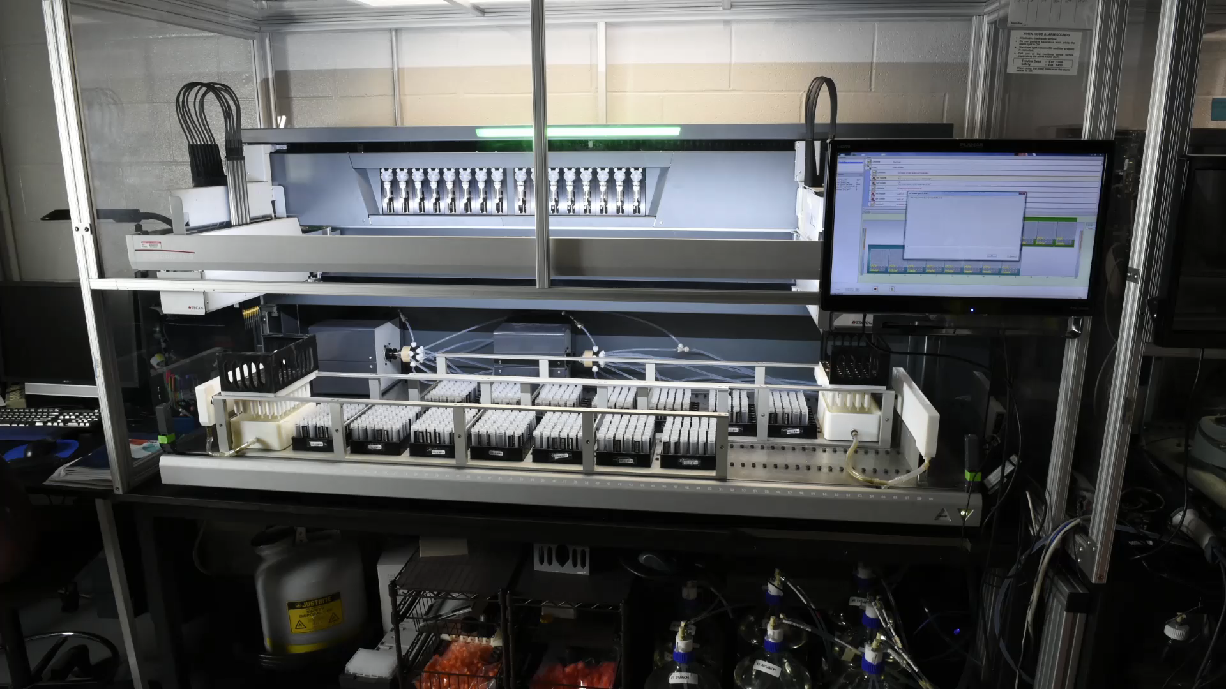

NPNPD Prefractionated Library
Fully automated methodology developed.
Extract separated into seven fractions of decreasing polarity
500,000 fractions available for HTS
TERRESTRIAL ENVIRONMENT
          416,176 Fractions
          4,282 Plant genera
          374 Fungal genera
MARINE ENVIRONMENT
          86,480 Fractions
          1,755 Invertebrate genera
          315 Algal genera
Thornburg et al., ACS Chemical Biology 2018, 13, 2484.

Slide 7
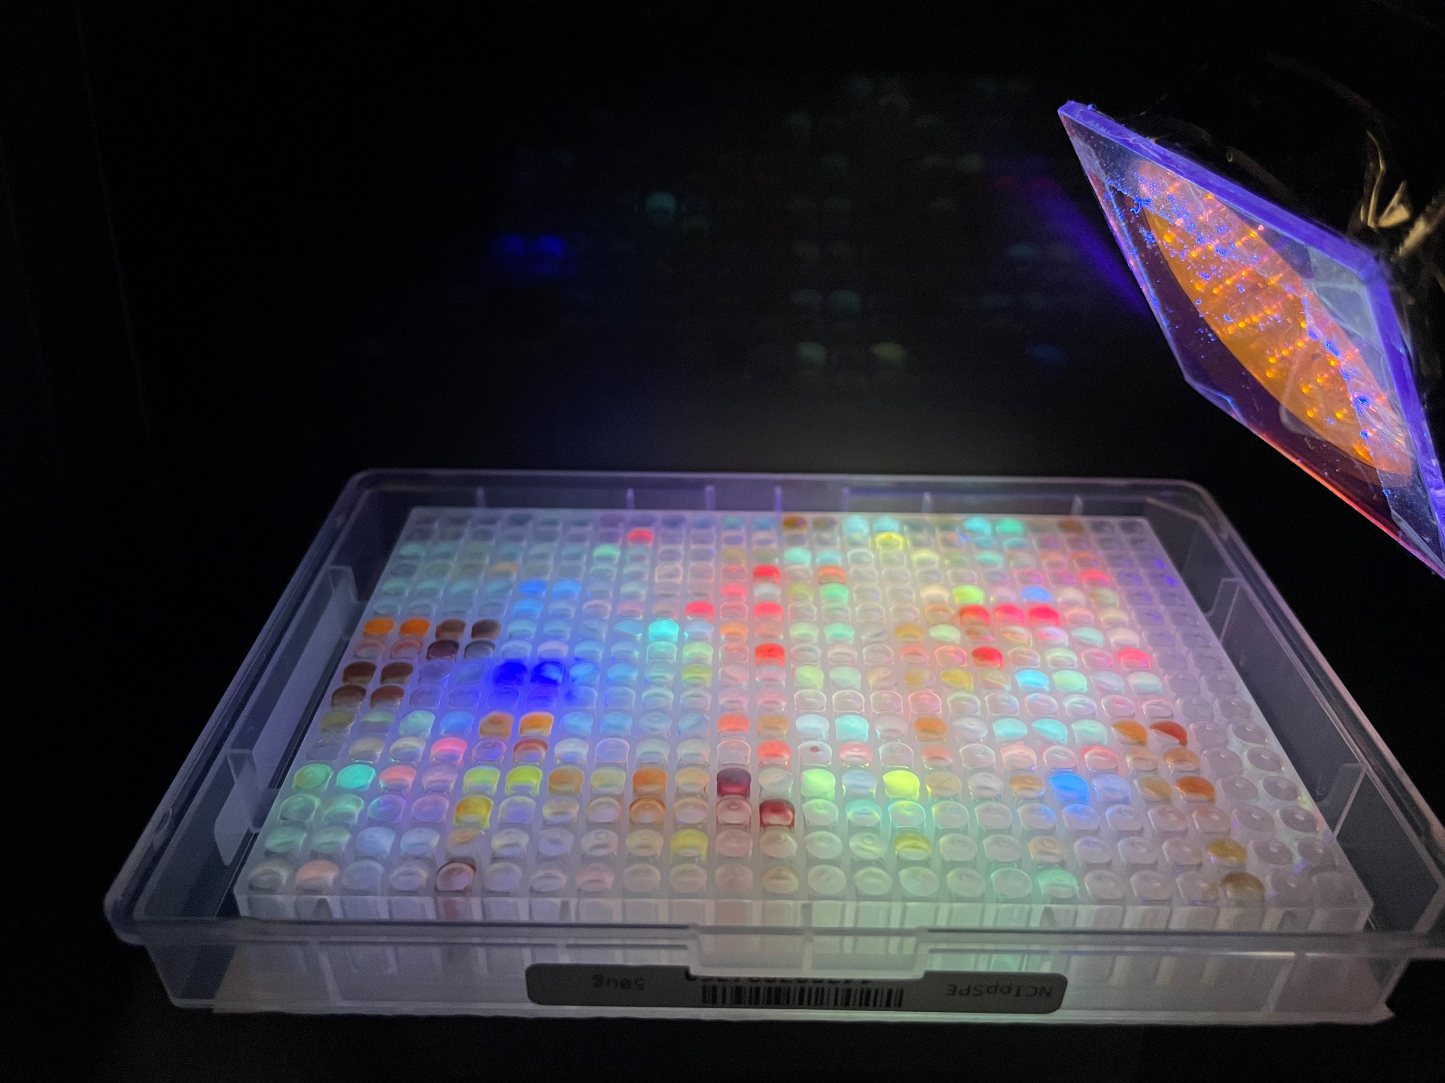
NPNPD Prefractionated Library
Natural product fractions are available in 384-well plates containing 10 µg/well of individual samples (fractions and crude extracts) dissolved in 2 µL of DMSO
For screening against any disease target.
Access to the library requires a signed MTA that acknowledges the intellectual property rights of the source country of the biota collection.
In multiple discovery campaigns,
70-80% of the time activity was identified in the fraction but not in the crude extract.
Thornburg et al., ACS Chemical Biology 2018, 13, 2484.

Slide 8
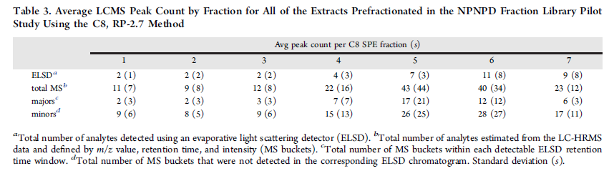
NPNPD Prefractionated Library – Screening Workflow
Primary screen on the NPNPD Library
Second stage HPLC - from simple mixtures to pure and semi-purified compounds
HPLC separation of 1 mg of fraction material
22 Subfractions collected and returned to the screening lab
Capable of processing 500 primary hit fractions in a period of two weeks
Thornburg et al., ACS Chemical Biology 2018, 13, 2484.

Slide 9
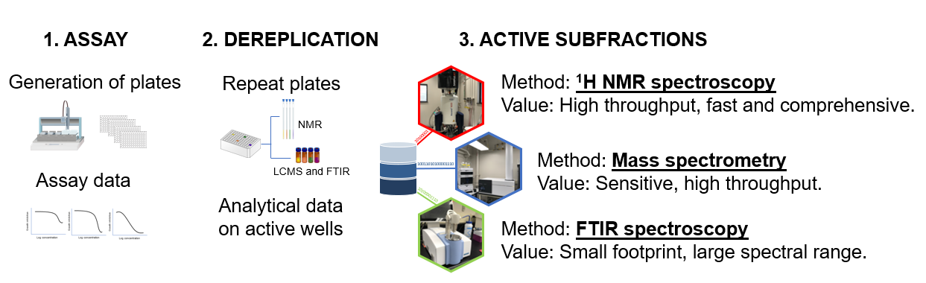
NPNPD Screening Support and Analytical Resources
Introduces knowledge of structure early in the isolation workflow.
Reduces the cost of natural product screening and creates timelines more amendable to high throughput screening programs
Grkovic et al., ACS Chemical Biology 2020, 15, 1104.

Slide 10
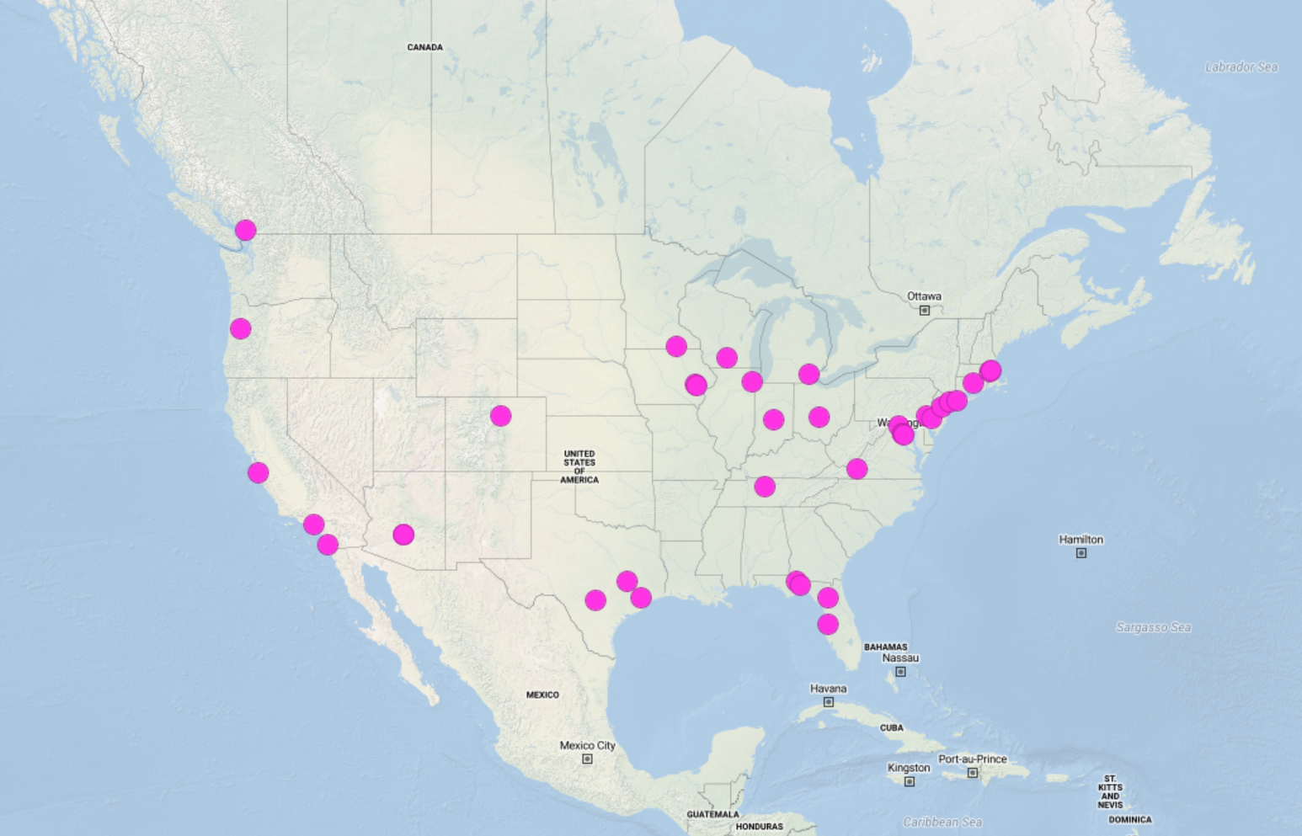
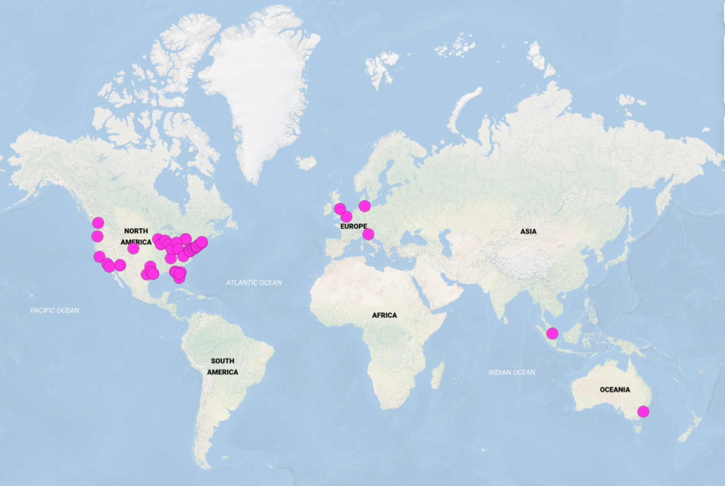
NPNPD Progress
Prefractionated library of 500,000 natural product samples publicly released.
Over 9,000,000 wells shipped to screening centers worldwide.
Technology transfer of methods and automated systems to groups worldwide.
Over 70 MTAs signed with industrial, government, and academic screening centers.
Shipping Locations North America
Executed MTAs Worldwide
https://dtp.cancer.gov/organization/npb/npnpd_prefractionated_library.htm

Slide 11
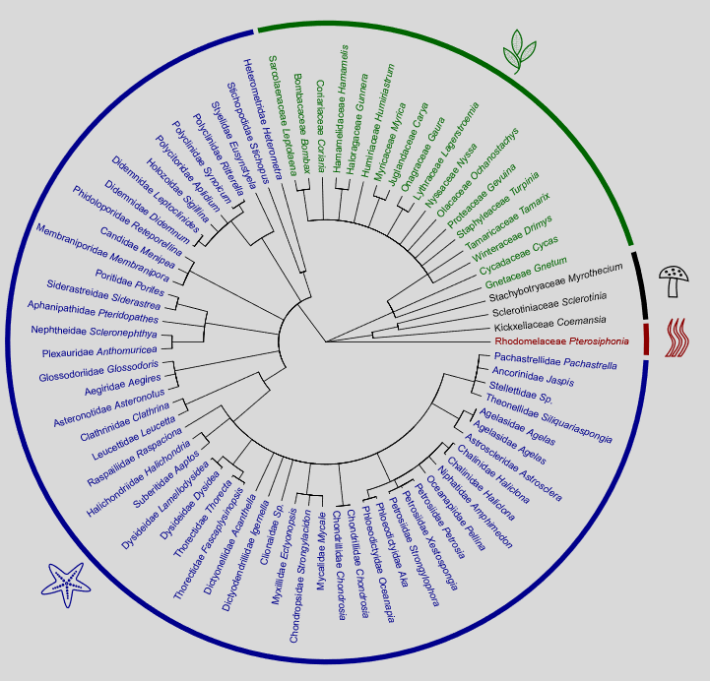
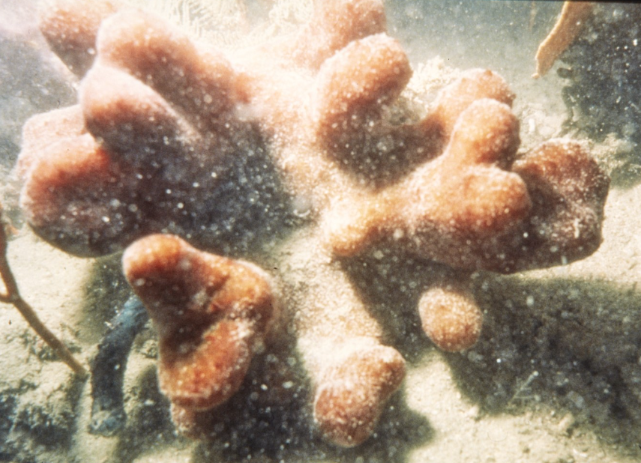
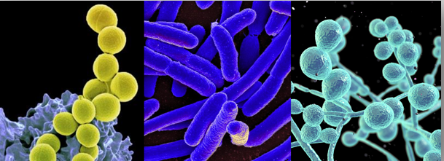
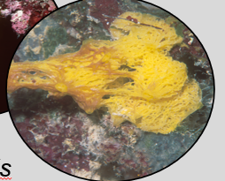
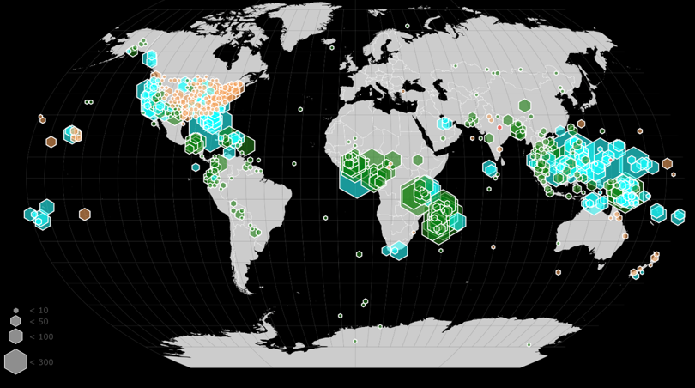
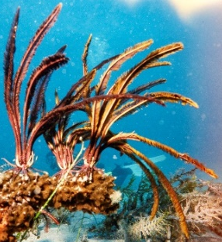
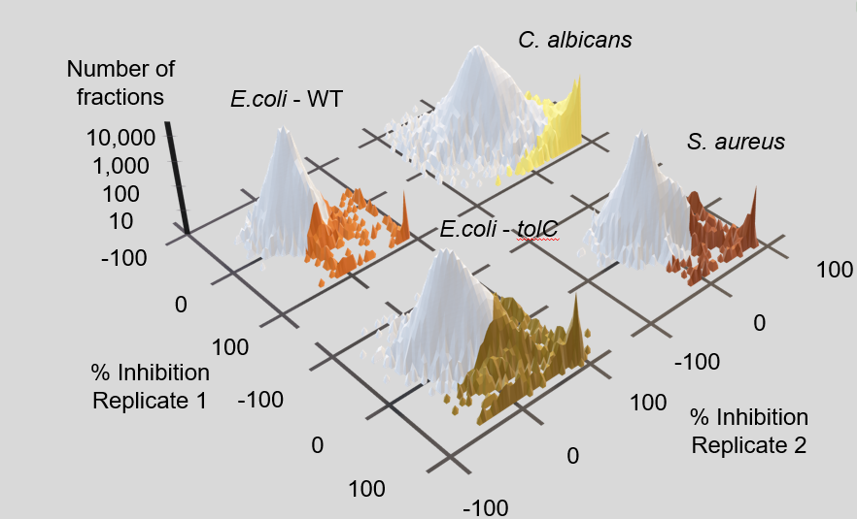
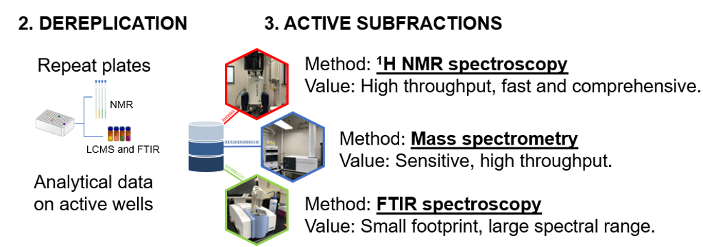
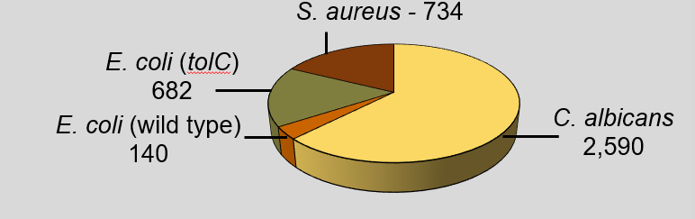
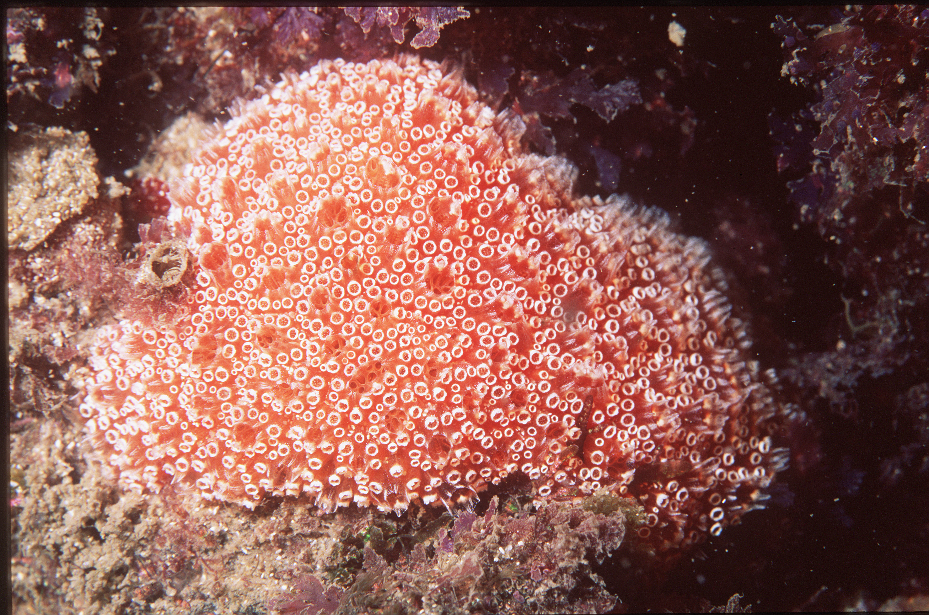
Antimicrobial HTS Discovery Campaign
Presentation Outline:
5. Antimicrobial Marine NPs
1. Targets and Library
3. Proof-of-Concept Study
2. HTS Results
4. High Throughput Compound ID

Slide 12
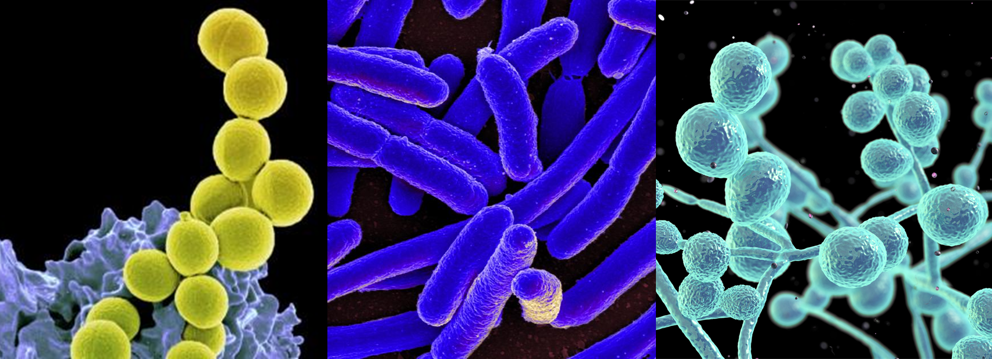
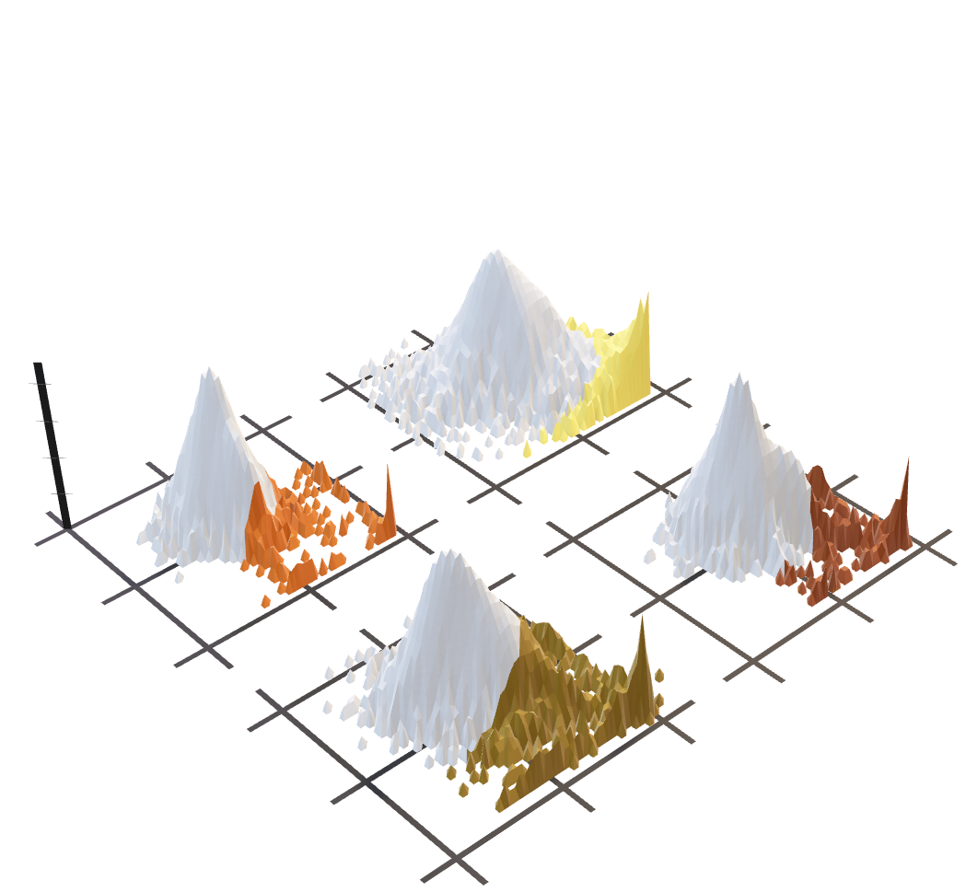
Antimicrobial HTS Discovery Campaign – Single Point Screen
Targets - NIAID
Staphylococcus aureus
Wild-type Escherichia coli
Efflux deficient Escherichia coli
Candida albicans
Screening concentration - 10 µg/mL in duplicates
Hit rate - 2.9%
C. albicans
Number of fractions
E.coli - WT
10,000
1,000
100
10
S. aureus
E.coli - tolC
-100
100
0
0
100
-100
% Inhibition
Replicate 1
Strains available from:
Coli Genetic Stock Center
American Type Culture Collection
-100
100
% Inhibition
Replicate 2
0
0
100
-100
Martínez-Fructuoso et al., ACS Infectious Diseases 2023, 9, 1245

Slide 13
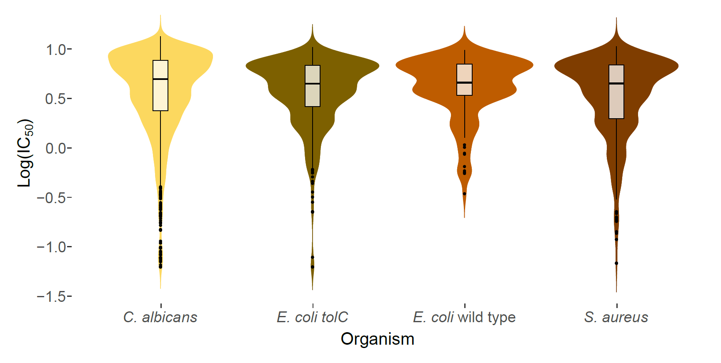
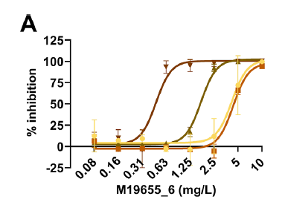
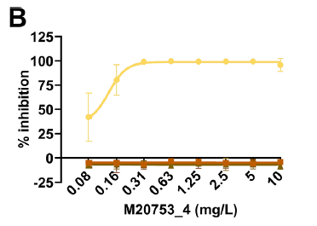
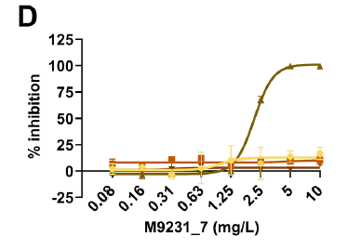
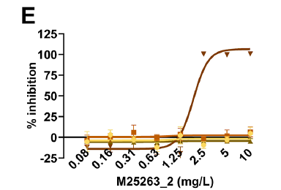
Antimicrobial HTS Discovery Campaign – Dose Response Screen
Screening concentration - 0.08 µg/mL to 10 µg/mL (8-dose)
Hit rate - 0.9%
S. aureus - 734
E. coli (tolC)
682
E. coli (wild type)
140
C. albicans
2,590
Eudistoma reginum
Clathrina darvinii
Petrosia sp.
Petrosia sp.
Martínez-Fructuoso et al., ACS Infectious Diseases 2023, 9, 1245

Slide 14
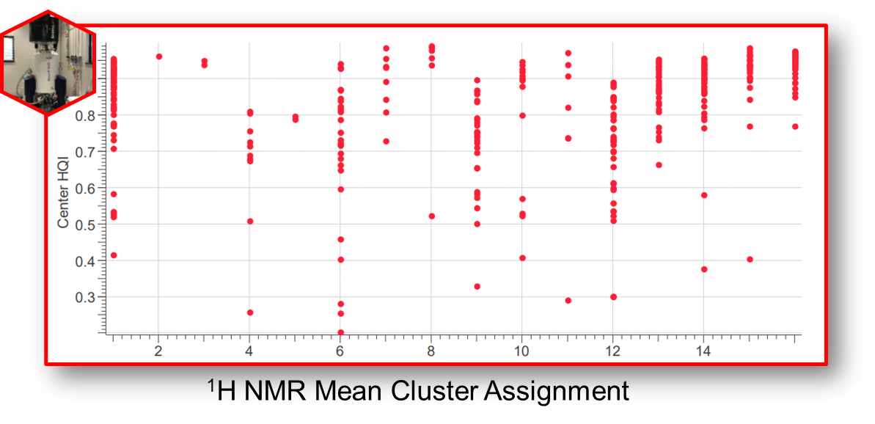
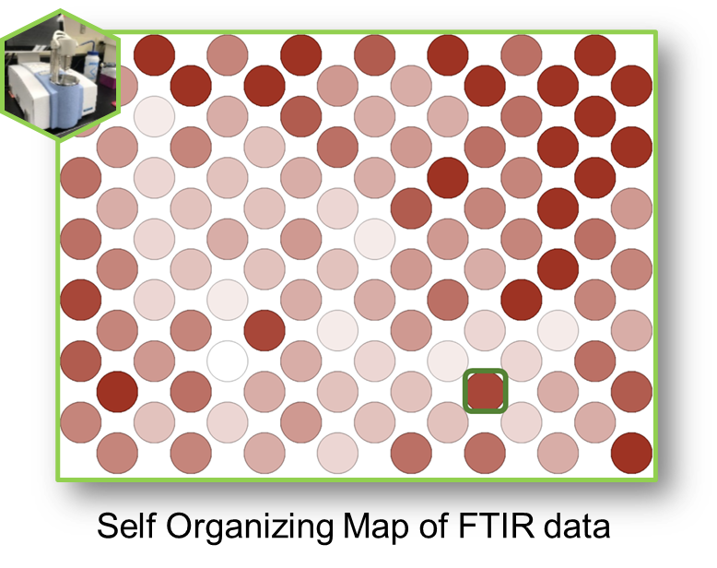
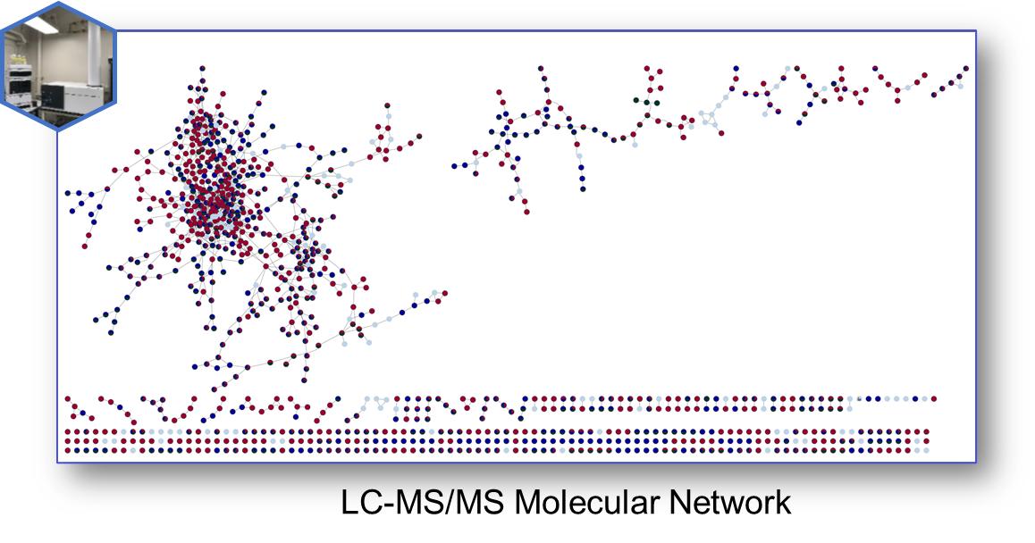
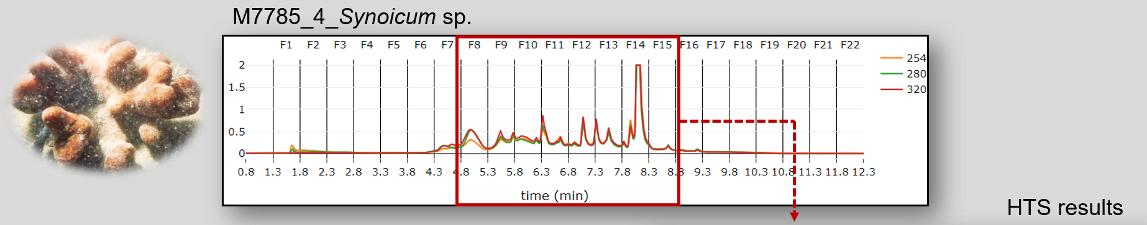
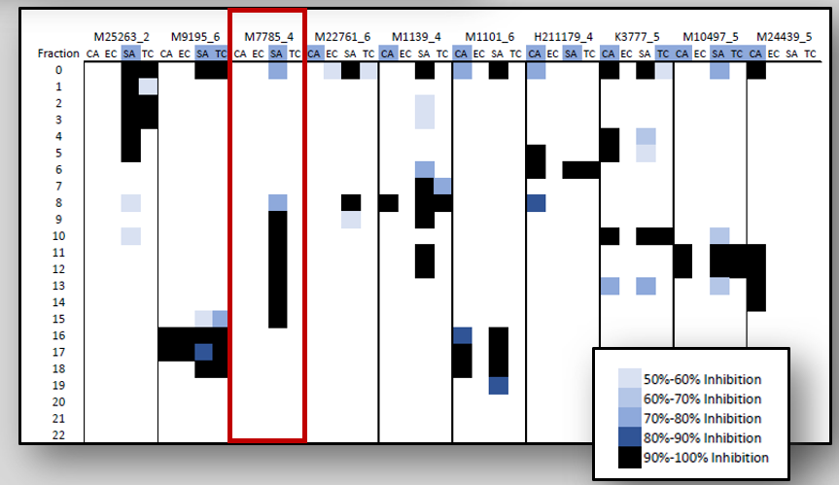
Proof-of-Concept Study
Selection of 75 hits based on:
Broad spectrum of potency
Lack of cytotoxicity
No activity in other NPNPD assays
Taxonomic redundancy
Analytical data acquisition
Second stage HPLC
Martínez-Fructuoso et al., ACS Infectious Diseases 2023, 9, 1245

Slide 15
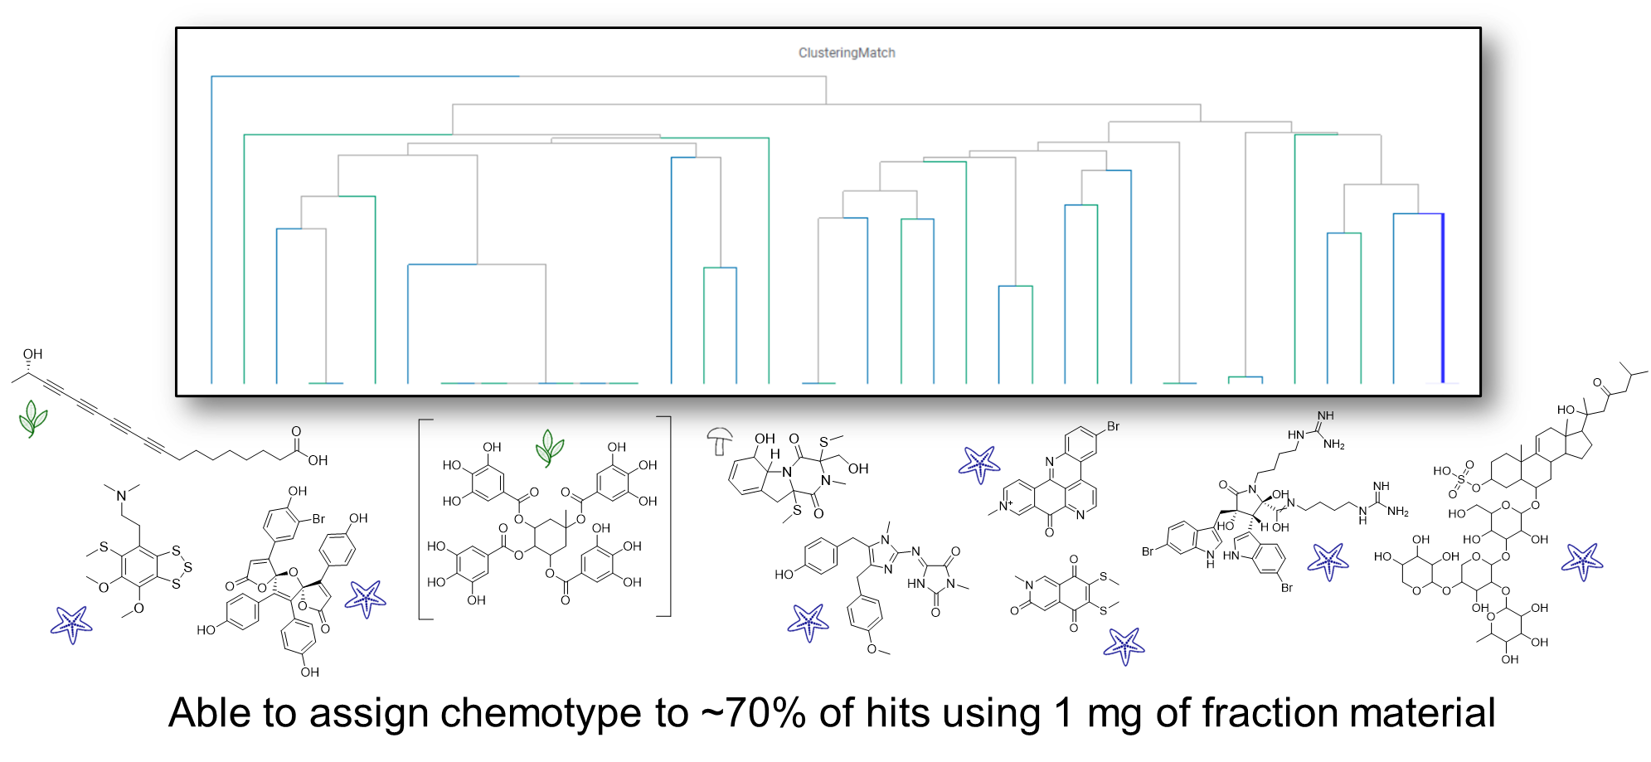
Proof-of-Concept Study
Martínez-Fructuoso et al., ACS Infectious Diseases 2023, 9, 1245

Slide 16
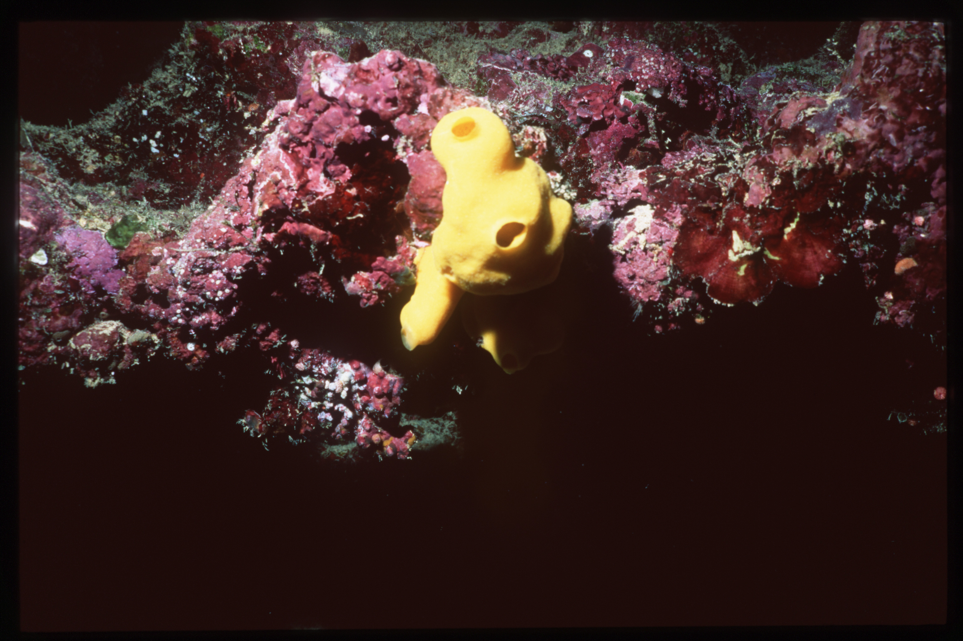
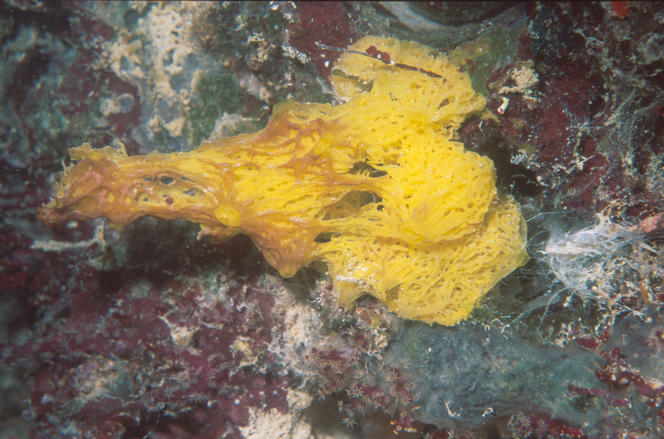
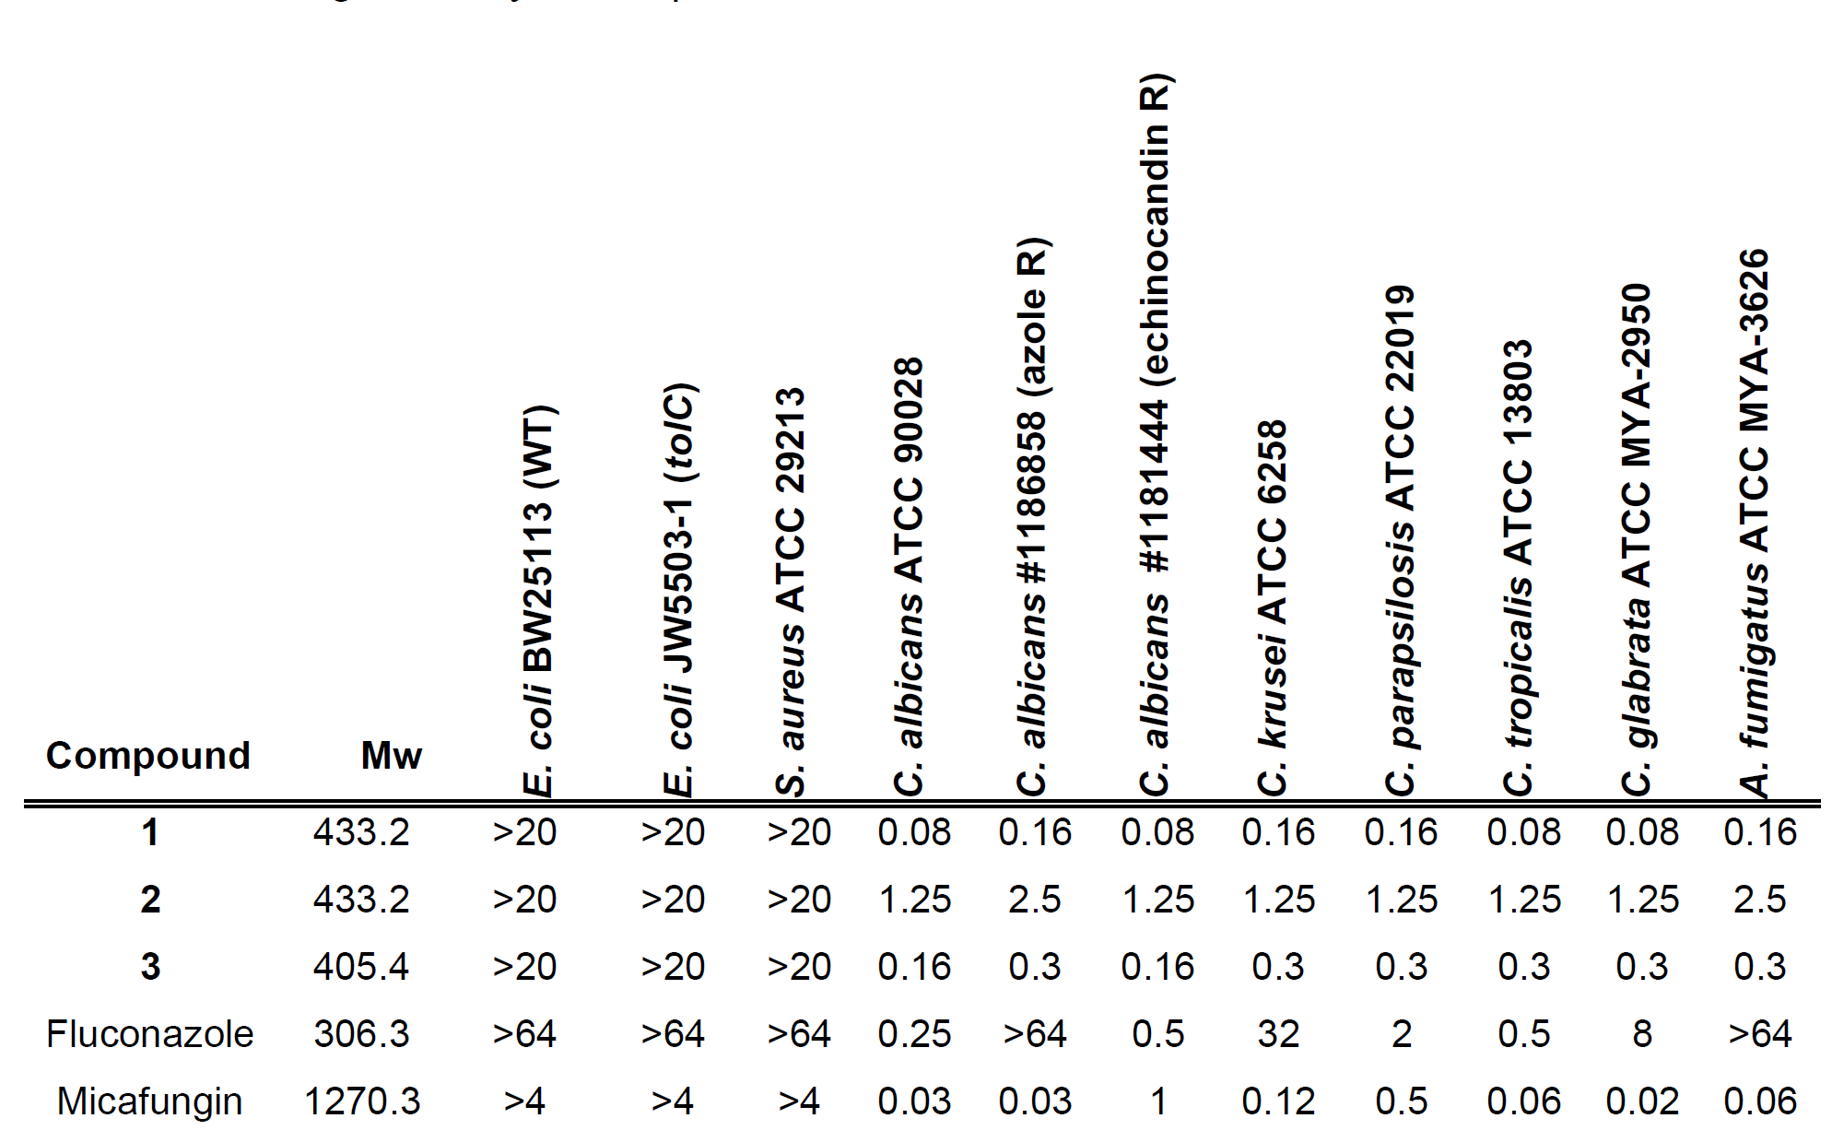
Active Principles – 2-Aminoimidazoles
Leucetta
chagosensis
Clathrina darwinii
Martínez-Fructuoso et al., ACS Infectious Diseases 2023, 9, 1245

Slide 17
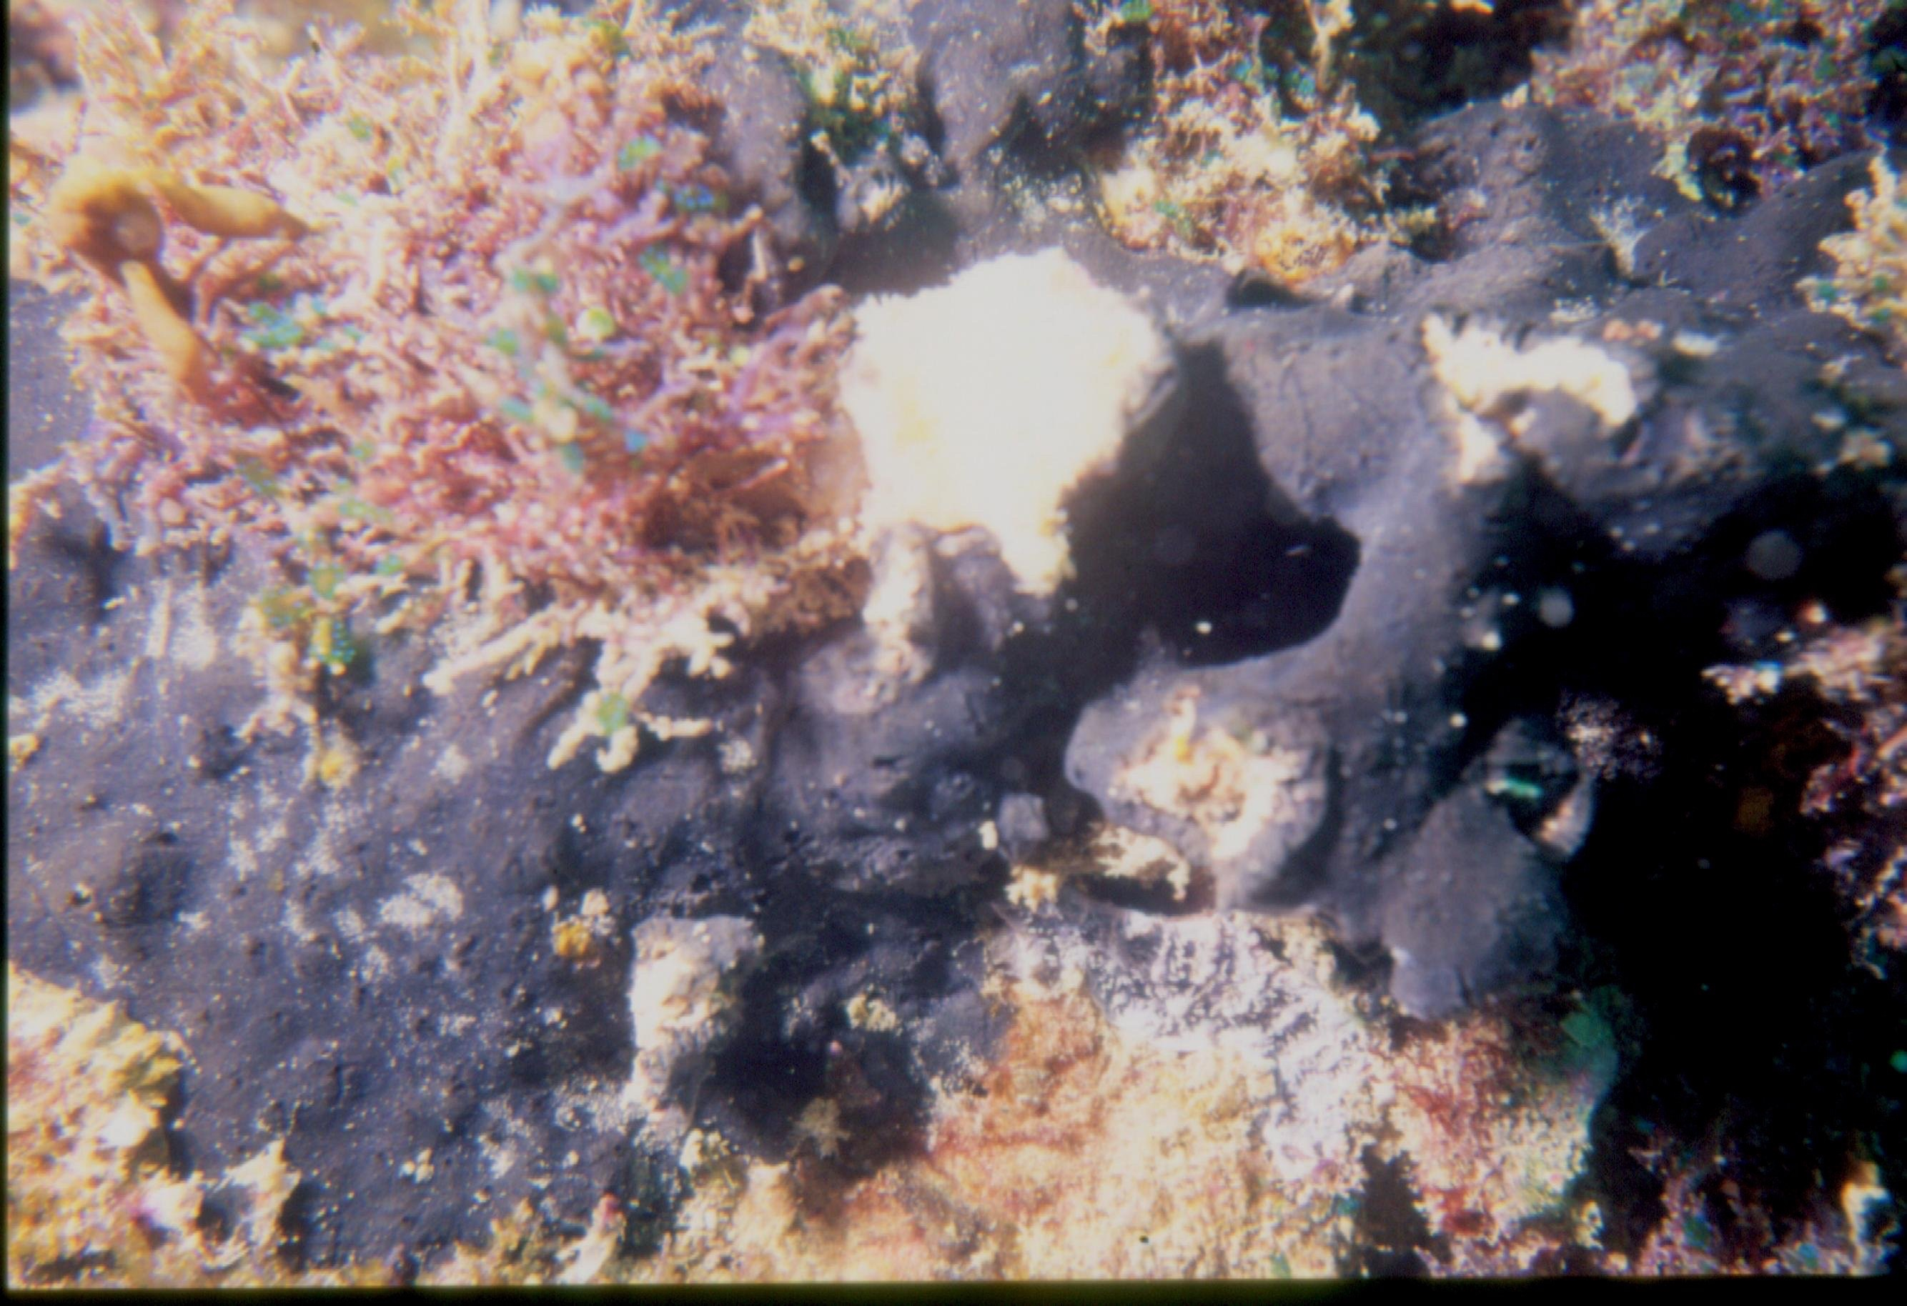
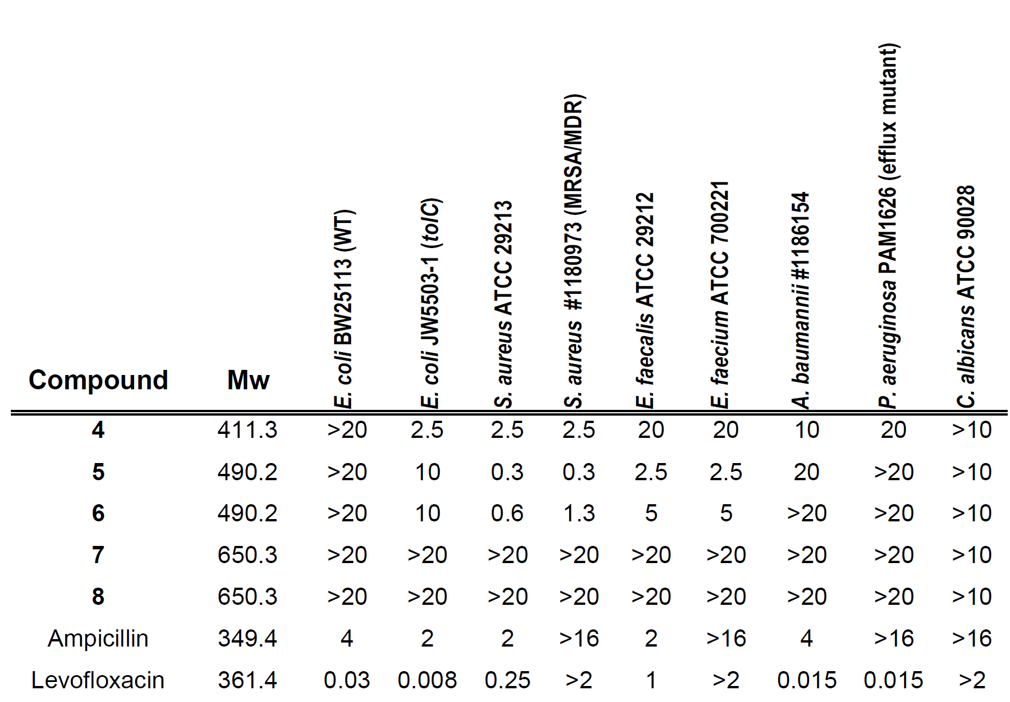
Active principles – Deoxyamphimedines
Petrosia sp.
Martínez-Fructuoso et al., ACS Infectious Diseases 2023, 9, 1245

Slide 18
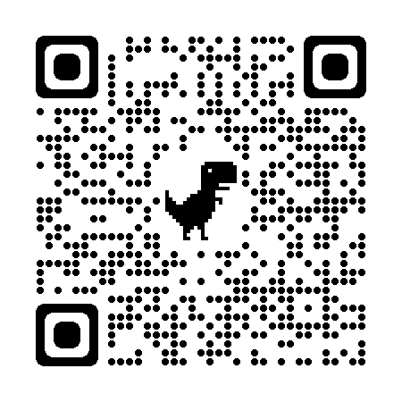
NPNPD Prefractionated Library – HTS Summary
Identified 3K fractions with antimicrobial activity.
Demonstrated fast and effective active principle isolation protocol.
Identified new natural products.
Results of the HTS made publicly available:
https://wiki.nci.nih.gov/display/NCIDTPdata/NPNPD+NIAID+Screen

Slide 19
Thank You
Natural Products Branch
NCINatProdRep@mail.nih.gov
Barry O’Keefe
Chief, NPB
okefeba@nih.gov
Tanja Grkovic
Staff Scientist, NPB
tanja.grkovic@nih.gov
NPNPD
https://dtp.cancer.gov/organization/npb/npnpd_prefractionated_library.htm

