Slide 1



Institute of Pharmaceutical Research (INIFAR)
University of Costa Rica
Global Health, Biodiversity, and Therapeutics Hybrid Seminar
Exploring Costa Rica's potential
for novel drug development
MSc. Gustavo Carazo Berrocal
Coordinator of Phytochemical Section and Quality Assurance LAFITEC
2024

Slide 2
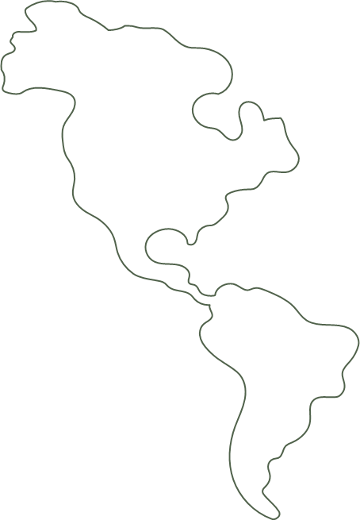

11500
500000
Plant species in the country
Species in Costa Rica
12%
Endemic species
6%
Of the world's biodiversity
Notes:
Costa Rica is recognized for being one of the 20 countries with the greatest diversity of species in the world and possibly the country with the highest density. It is estimated that some 500 000 species can be found in Costa Rica, representing 6% of the world's biodiversity, of which, until 2018, more than 121 000 are known, for an estimated 2.3 species per Km2 (MINAE et al., 2018).
The number of plant species in the country is estimated at more than 11 500 (Aguilar Sandí, 2018). Approximately 12% of these are endemic (Ministerio de Ambiente y Energía, 2018). Therefore, they are known only in Costa Rica and it is not possible to find them naturally in any other country. (Acebey et al., 2012). Some 500 species of medicinal plants are included from these. (Leitón, 2017)

Slide 3
  Overestimation of the possible effects of certain plants.
  Interest in medicinal plants is increasing globally.
  Increase in global consumption and trade in medicinal plants and herbal products.
Notes:
Plants have been used for medicinal purposes, in Costa Rica this tradition has had the contribution of knowledge of the indigenous, Spanish and Afro-Caribbean peopleThe usefulness of these plants has been transmitted from generation to generation orally or in a written manner (Nevertheless, popular knowledge about the use of medicinal plants has recently been lost substantially. (Contreras Arias & Campregher, 2010) In some cases, the effects of plants in the treatment of certain diseases have resulted in the overestimation of the possible effects of certain plants, attributing properties that they do not possess. Currently, interest in medicinal plants is increasing globally, and Costa Rica is not the exception, either because of the need to reduce drug use and the side effects they generate or because people do not have the economic resources to access health services or treatments

Slide 4




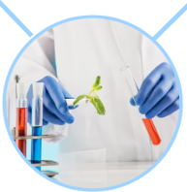
INIFAR
LAYAFA
Pharmaceutical Analysis
and Consulting Laboratory
LABIOFAR
Biopharmacy and
Pharmacokinetics Laboratory
LAPONABi
Polymers, Nanotechnology
and Pharmaceutical
Biotechnology Laboratory
CIMED
National Center for
Drug Information
LAFITEC
Phytopharmacology,
Pharmaceutical and Cosmetic
Technology Laboratory
Notes:
INIFAR Pharmacy Research Institute, it has 5 Units. LAYAFA Quality Control of all medicines to be register in the country. LABIOFAR, Laboratory of Biopharmacy and Pharmacokinetic, Therapeutic equivalence studies, bioequivalence studies. LAPONABI Polymers and nanotechnology. CIMED, our National information Center and LAFITEC Phytopharmacology and pharmaceutic technology, were we develop our investigation with natural products and plants

Slide 5
INIFAR/LAFITEC
Tours with biologists
around Costa Rica
Botany workshop for
plant identification
Extraction
Sample collection
Phytochemical
tests/ in vitro, ex vivo
and in vivo models
Results analysis
Notes:
In LAFITEC we have an interdisciplinary work, were we have pharmacist, microbiologist, chemist, biologist and other professionals who work together in or lines of research. We make for examples, tour all over the country with biologists looking for different types of medicinal plants, we make the plant identification, we collect the samples, then we make coms extracts of the organic material wich is use for the phytochemicals characterization, and they are tested in in vitro, ex vivo o in vivo models with animals

Slide 6
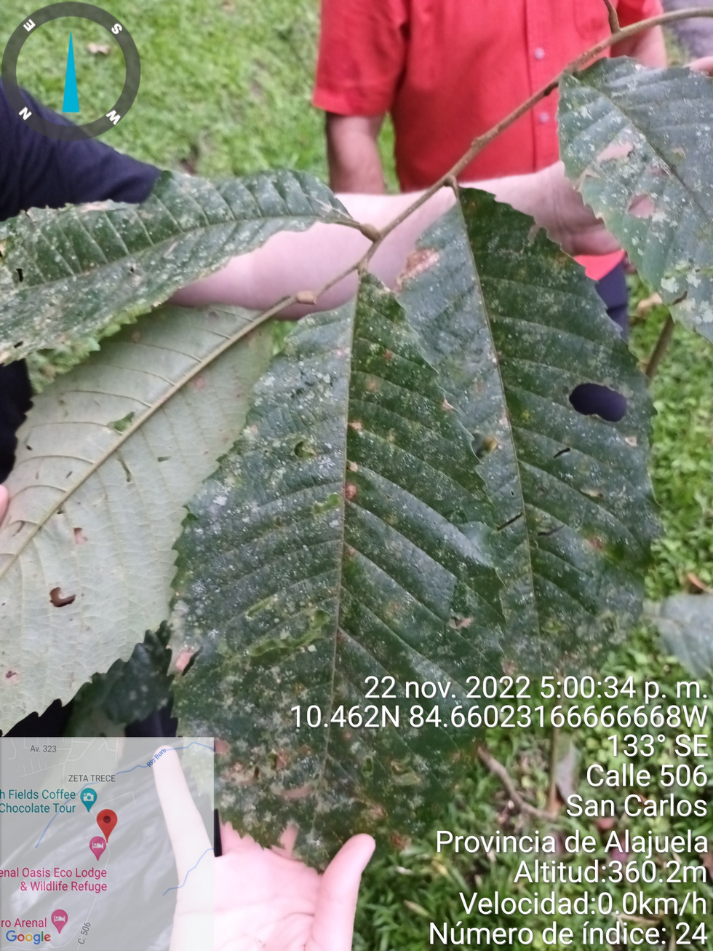
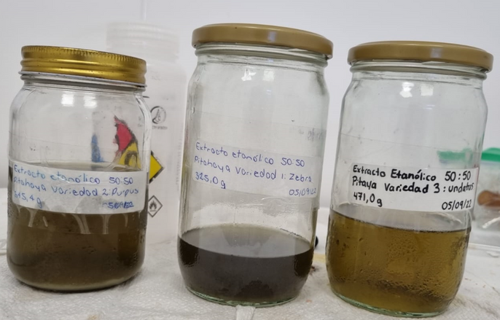
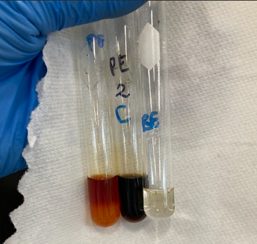
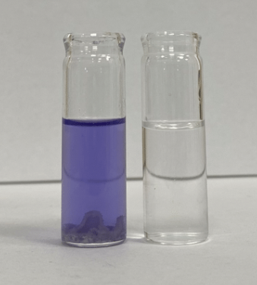
Notes:
Samples, extraction and test for the characterization

Slide 7
Myrtaceae | Myrtaceae | Myrtaceae
Specie | Location | Family usefulness
Calyptranthes guanacastensis | Northwest region of Guanacaste mountain range | Treat influenza and cough Treat abdominal pains Antiemetic Treat toothache Treat rheumatism Treat nerve crises Treat diarrhea Treat abuse of alcoholic beverages
Myrcia pauliijonesii | Surroundings of Chal bay in Osa peninsula | Treat influenza and cough Treat abdominal pains Antiemetic Treat toothache Treat rheumatism Treat nerve crises Treat diarrhea Treat abuse of alcoholic beverages
Myrcia riverae | Dulce gulf and Osa peninsula | Treat influenza and cough Treat abdominal pains Antiemetic Treat toothache Treat rheumatism Treat nerve crises Treat diarrhea Treat abuse of alcoholic beverages
Notes:
Looking for these medicinal plants, we make research of the plants that were discover between 2010 and 2020, looking for their possible usefulness
for medicinal purposes. This is an example of some of these plants. We were looking for Species from Costa Rica, endemic, recently discovered (between 2010 and 2020), that have few studies, that have ethnobotanical uses or that the family to which they belong report such medicinal uses

Slide 8
Passifloraceae | Passifloraceae | Passifloraceae
Specie | Location | Family usefulness
Passiflora soliana | Specie endemic to Costa Rica | Airways congestion Insomnia Skin conditions Treat helminths Treat cold Treat scurvy Treat tuberculosis Protects the stomach from gastric acids Aphrodisiac Calming and sedative Diuretic
Passiflora chimuensis | Humid forests of the Caribbean, in the foothills of the Central Volcanic range and Talamanca | Airways congestion Insomnia Skin conditions Treat helminths Treat cold Treat scurvy Treat tuberculosis Protects the stomach from gastric acids Aphrodisiac Calming and sedative Diuretic
Passiflora costarricensis | Specie endemic to Costa Rica | Airways congestion Insomnia Skin conditions Treat helminths Treat cold Treat scurvy Treat tuberculosis Protects the stomach from gastric acids Aphrodisiac Calming and sedative Diuretic

Slide 9
Polypodiaceae | Polypodiaceae | Polypodiaceae
Specie | Location | Family usefulness
Lellingeria vargasiana | Coco Island National Park | Treat skin tumors Anti-inflammatory Treat vitiligo, psoriasis, and atopic dermatitis
Stenogrammitis grammitoides | Coco Island National Park | Treat skin tumors Anti-inflammatory Treat vitiligo, psoriasis, and atopic dermatitis

Slide 10
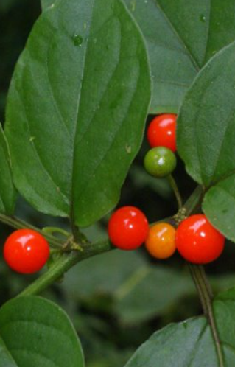
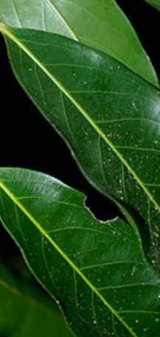
TEST IN PROGRESS
2023: 8 species are being studied
  Mucuna pruriens and Mucuna uriens
  Tynanthus croatianus and Tynanthus macranthus
  Plinia costarricensis
  Licania platypus
  Witheringea solanacea
  Hylocereus undatus
  Ilex aquifolium
  Gonolobus edulis and Gonolobus taylorianus
Witheringea solanacea
Licania platypus
Notes:
Test in progress. At this time we are developing studies in 8 species. Leer las 8.

Slide 11
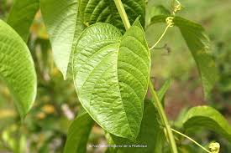
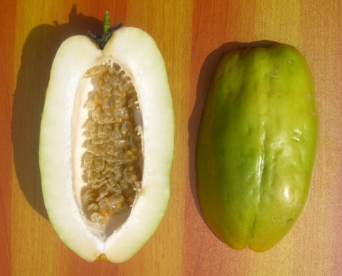
In relation to these plants, the anxiolytic effect will be studied
TEST IN PROGRESS
2024: 7 species are being studied
  Wigandia urens
  Salvia polistachia
  Banisteriopsis muricata
  Mollinedia viridiflora
  Plinea costarricensis
  Purpussi, Undatus (Pitahaya: Cebra/Orejona)
  Thynantus croatianus
  Passiflora: Passiflora miniata, Passiflora quadrangularis
  Passiflora quadrangularis
Notes:
In relation to these plants, the anxiolytic effect will be studied. Leer

Slide 12
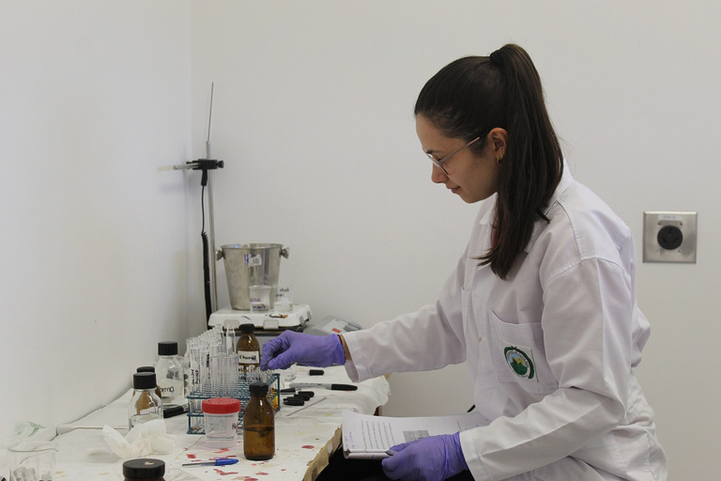
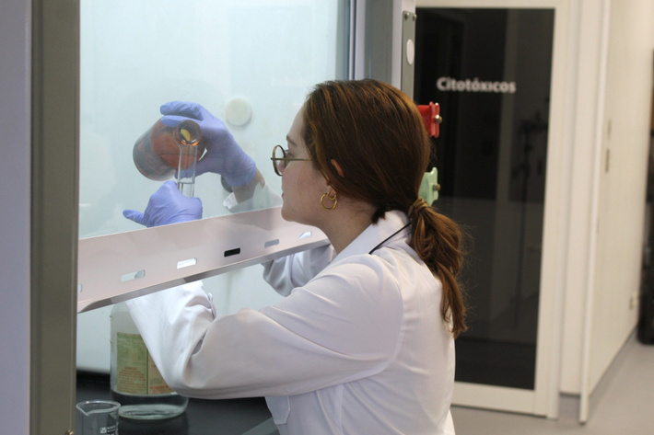
PHYTOCHEMICAL PROFILE
Dragendorff (alkaloids), Mayer (alkaloids), Wagner (alkaloids), Tollens (carbohydrates), Molish (carbohydrates), Fehling (reducing carbohydrates), Benedict (reducing carbohydrates), Shinoda (flavonoids), Pews (flavonoids), Carr-Price (carotenes), Perchloric Acid (terpenes), Ammonium Molybdate IV (terpenes), Tortelli-Jaffe (terpenes), Sudan (fats), Kedde (cardiotonic glycosides), Guignard (cyanogenic glycosides), Cooling (mucilages), Rosenthaler (saponins), Foam (saponins), Bornträger-Kraus (quinones), Nihydrin (amino acids), Formaldehyde-HCl (condensed tannins), Salkowski (terpenes), Gelatin-Salt (tannins), FeCl3 (gallic and catechinic tannins), Lieberman- Buchard (steroids), Rosenheim (anthocyanins), Ferric hydroxamate (sesquiterpene lactones).
Notes:
For the phytochemical profile and characterization, we make a lot of tests, leer algunas

Slide 13
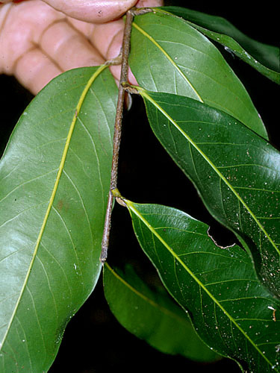
Study of the effect on intestinal motility of fractions of the ethanolic extract of Licania platypus leaves in an isolated organ model in HSD rats: Sprague Dawley for the identification of the extract with the highest activity.
Phytochemical profile results: Carbohydrates, reducing sugars, proteins, soluble phenols, saponins, coumarins, flavonoids, steroids, and triterpenes. The presence of tannins were found only in the extracts from Guanacaste and San Ramón.
Pharmacological activities:
  Inhibition of the cholinergic pathway, specifically due to a non-competitive muscarinic antagonist effect and the release of NO by the NO/cGMP system, are possible mechanisms of pharmacological action involved in the antispasmodic effect of the metabolites present in the ethanolic extract leaves.
  The metabolites present in the ethanolic extract of leaves do not seem to interfere with the serotonergic pathway that participates in the contraction of intestinal smooth muscle.
  Antibacterial activity was also found with a MIC of 5mg/mL.
Notes:
Two examples of results that we have of these plants that are being studying. Leer title de Licania (nombre común sonzapote). Minimal inhibitory concentration.

Slide 14
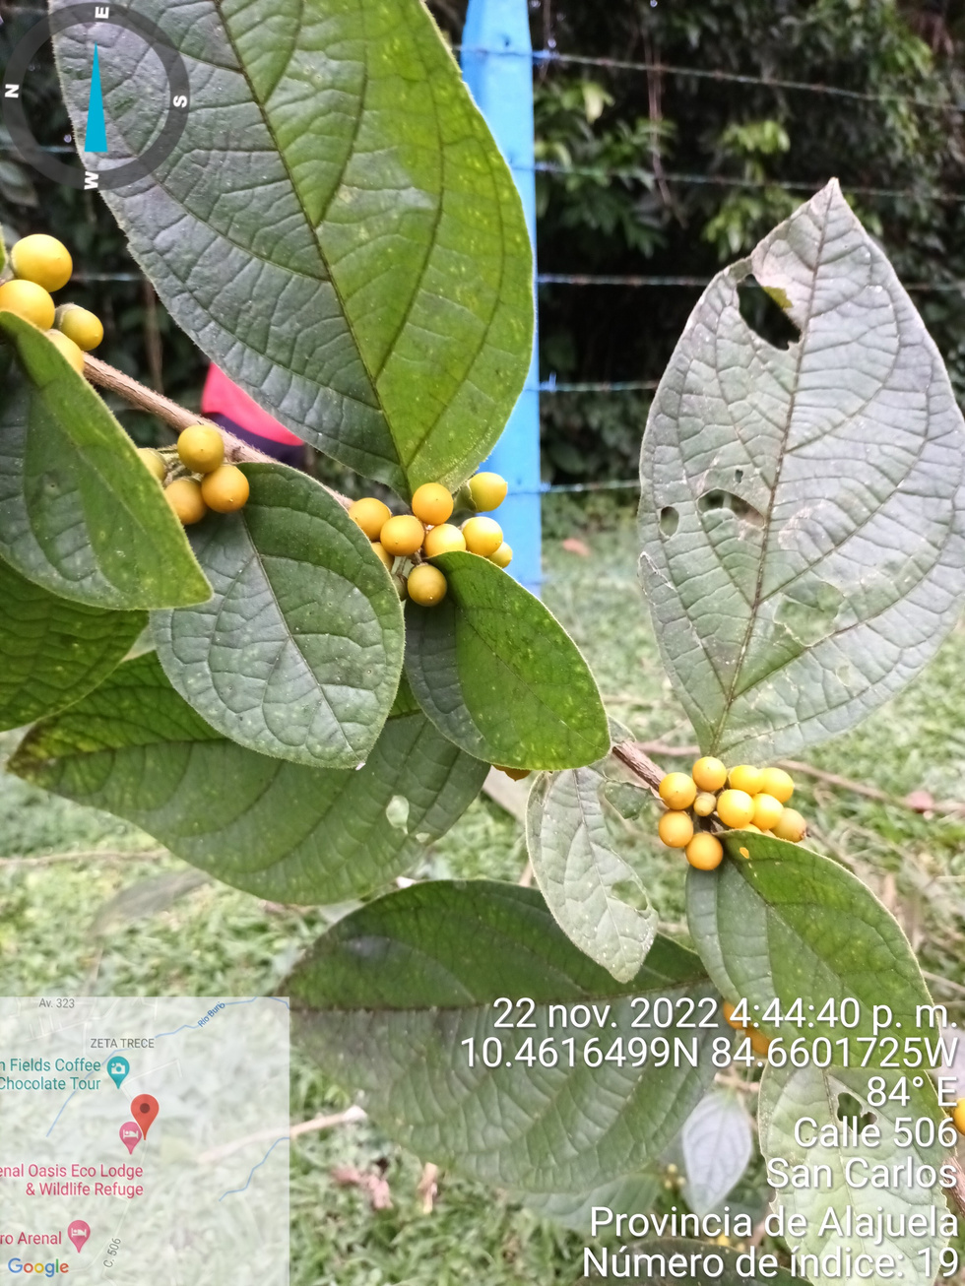
Pharmacological activities of hydroalcoholic extracts of the aerial part and fruit of the Witheringia solanacea plant
  Phytochemical screening: Phenolic compounds, flavonoids, coumarins, anthroquinones, cardiotonic glycosides, triterpenes and phytosterols. Only the fruit extract presented alkaloids.
  Fruit extract: Greater amount of phenolic compounds and total flavonoids, and a greater antioxidant capacity compared to the hydroalcoholic extracts from the aerial parts.
  The antioxidant activity of the plant is considered low.
Notes:
Leer witheigia (sulfatillo)

Slide 15
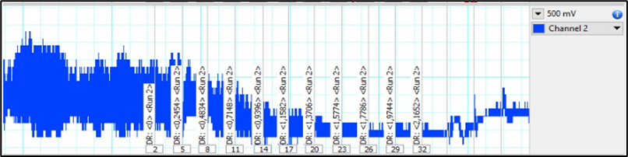
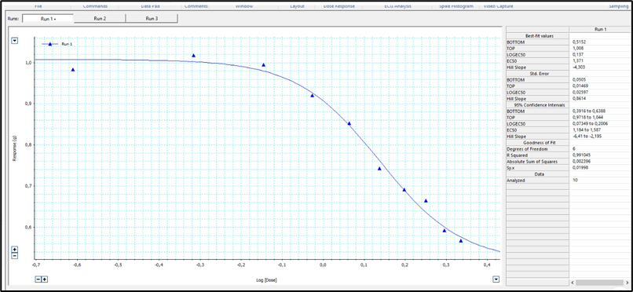
AERIAL PART EXTRACT
  Antimicrobial activity with a MIC of 5 mg/mL, without reaching a bactericidal effect = weak antibacterial effect of the extracts.
  Relaxing effect on the muscular contraction of the intestine isolated in an organ bath system.
  Anti-inflammatory activity in the paw edema model, but not in the ear edema model.
  Appears to have low toxicity according to OECD protocols.

Slide 16




SOCIAL MEDIA
inifar.ucr
Instituto de Investigaciones Farmacéuticas-inifar
INIFAR
INIFAR UCR

Slide 17
¡THANKS!
¿Questions and comments?
inifar@ucr.ac.cr
+506 2511 8349

Slide 18
REFERENCES
1.Acebey, A., Krömer, T., & Vázquez, M. (2012). ¿Qué es una especie endémica? Gaceta. Universidad Veracruzana, 121, 27–29.
2.Aguilar Fernández, R., Poveda Álvarez, L. J., & SANTAMARÍA-AGUILAR Shirley Tucker Herbarium, D. C. (2018). Hymenaea osanigraseminae: Un nuevo guapinol (Fabaceae) del Pacífico central y sur de Costa Rica. In Phytoneuron (Vol. 20).
3.Aguilar Sandí, D. (2018). Diversidad de plantas en Costa Rica: determinación y publicación de una nueva especie. Revista de Biología Tropical. BLOGRBT, Serie 1. https://revistas.ucr.ac.cr/index.php/rbt/issue/view/2701
4.Al.Rodr. & J.Sánchez-Gonz., 2017 in The International Plant Names Index Collaborators (2019). International Plant Names Index. Checklist dataset https://doi.org/10.15468/uhllmw
5.Blanco, P. (2018). Especie de Vanilla con valor comercial es descubierta en el país. https://www.ucr.ac.cr/noticias/2018/05/09/especie-de-vanilla-con-valor-comercial-es-descubierta-en-el-pais.html
6.Contreras Arias, A., & Campregher, C. (2010). Plantas medicinales en una plantación de cacao en Guápiles, Costa Rica. UNED Research Journal, 2(2), 231–237. https://doi.org/10.22458/urj.v2i2.159
7.Debouck, D. G., Araya, R., & Chaves, N. (2018). Phaseolus Angucianae (Leguminosae: Phaseoleae), A New Bean Species From Fila Cruces Of Southeastern Costa Rica. Journal of the Botanical Research Institute of Texas, 12(2), 507–520. https://www.jstor.org/stable/10.2307/26549480
8.Debouck, D. G., Chaves-Barrantes, N., & Araya-Villalobos, R. (2020). Phaseolus albicarminus (Leguminosae, Phaseoleae), a new wild bean species from the subhumid forests of southern central Costa Rica. Phytotaxa, 449(1), 1–14. https://doi.org/10.11646/phytotaxa.449.1.1
9.Dressler, R., & Pupulin, F. (2014). Two New White-Flowered Species of Sobralia (Orchidaceae) from Costa Rica. Harvard Papers in Botany, 19(1), 117–122. https://www.jstor.org/stable/10.2307/harpapbot.19.1.117
10.Epidendrum jorge-warneri Karremans & Hágsater in GBIF Secretariat (2019). GBIF Backbone Taxonomy. Checklist dataset

